Slide 1
PHASE: PRIMARY
World Refugee Day
THEME: Our Home

Slide 2
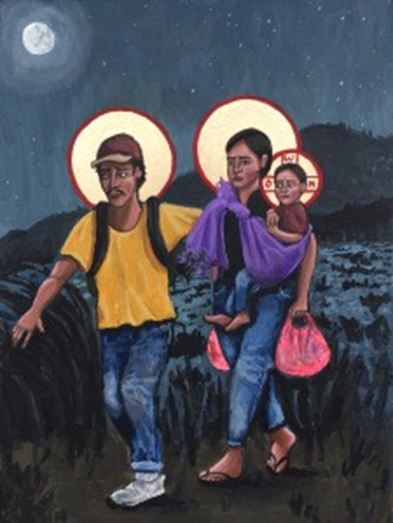
Gathering
Think >> Pair >> Share
Look closely at the image:
I wonder what you notice?
Who do you think these three people are?
What do you think they are doing?
How do you think they are feeling?
Refugees: La Sagrada Familia by Kelly Latimer.
https://kellylatimoreicons.com/gallery/img_2361/# main
Notes:
Find a place where you can be still, without interruptions. You might like to light a candle as you begin.

Slide 3
Stories of Refugees - Joseph, Mary and Jesus’ Story
Joseph, Mary and the baby Jesus had to leave Bethlehem to escape from a king who wanted to harm them. They went to Egypt to find safety. When they tried to go back, it was still not safe, so they went and lived in Nazareth.

Slide 4
Stories of Refugees - Joseph, Mary and Jesus’ Story
Joseph, Mary, and Jesus were refugees because they had to leave their home and go to a new place to be safe.
How do you think they felt on their journey?
Sad, scared, hopeful.
What can we learn from their story about helping others who need a safe place to live?

Slide 5
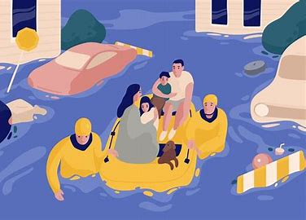
Why Do People Become Refugees?
War
Natural disasters
To be safe from danger

Slide 6
Response
If someone from another place comes to live with you, treat them as you would treat your own family. Love them as you love yourself because you were once new in a different place, too.
Leviticus 19: 33 -34
‘Everyone can make a difference. Every action counts.'
– The UN Refugee Agency.
What does it mean to 'love someone as you love yourself'?

Slide 7
World Refugee Day
Celebrated on June 20th
A day to remember and help refugees
How might we learn more about refugees and what we can do to make them feel welcome?

Slide 8
World Refugee Day – Great Big Live Assembly
On Thursday, June 20th, at 9:05 a.m., we will join the live broadcast for schools all across the country. The Great Big Live Assembly is hosted by Sanctuary Foundation , a charity advocating for the needs of refugees.
Great Big Live Assembly: World Refugee Day Tickets, Thu 20 Jun 2024 at 09:05 | Eventbrite

Slide 9
Response
Dear God,
We know that you understand what it is like to have to flee from danger.
Please help all the refugees in the world find safe homes, where they are no longer in danger.
Help us, in our own lives, to think about how we can make a difference and show welcome to those who have had to leave their homes.
Amen

