Slide 1
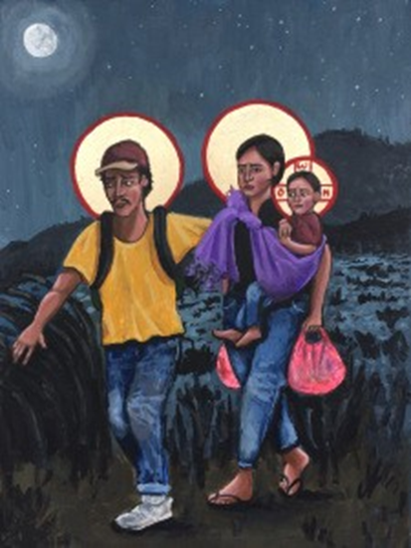
Welcome to Our Class Worship - World Refugee Day
Today, we're going to learn more about the story of when Joseph, Mary, and baby Jesus had to leave their home.

Slide 2
Let’s start with a short prayer.
Dear God,
Thank you for bringing us together today.
Help us understand and care for people who have to leave their homes.
Amen.

Slide 3
Revisiting the Bible Story of Joseph, Mary and Baby Jesus
A long time ago, Joseph and Mary had to travel to Bethlehem, where baby Jesus was born. But soon after Jesus was born, they were in danger because King Herod wanted to harm baby Jesus.
An angel came to Joseph in a dream and told him to take Mary and baby Jesus to a safe place called Egypt. They had to leave quickly and travel far away from home.
Can you imagine how scary that was for them? They were in a new place with new people and didn't know when they could go back home.

Slide 4
Stories of Refugees - Joseph, Mary and Jesus’s Story
Joseph, Mary, and Jesus were like refugees because they had to leave their home and go to a new place to be safe.
Let’s think about this. How do you think Joseph, Mary, and Jesus felt when they had to leave their home?
Yes, they probably felt scared and worried, just like many refugees today feel. But they also hoped things would get better.

Slide 5
Stories of Refugees - Joseph, Mary and Jesus’s Story
What three things would you take with you?
Draw a picture of the things you would bring.

Slide 6
Stories of Refugees - Joseph, Mary and Jesus’s Story
Think about how we can help others who are new to our community and need a safe place to live.

Slide 7
Reflection
I wonder how we could welcome a new family into our community?
What might they need? How might they feel?

Slide 8
Reflection Time
Let’s remember the stories we’ve talked about before, like Joseph, Mary, and Jesus. The story shows us that even a long time ago, people had to leave their homes to find safety. It’s important to be kind and welcoming!
Let’s make a "Helping Hands" poster.
Each of you will trace your hand on a piece of paper and write or draw one way you can help refugees or new people in your community. Then we’ll put all our hands together to make a big poster.
Notes:
(Allow students time to trace their hands and write or draw their ideas. Assemble the poster with all the hands.)

Slide 9
Look at all the wonderful ways we can help! This poster shows that even small acts of kindness can make a big difference. Let’s keep thinking about how we can help refugees and be welcoming to everyone.

Slide 10
Sending out
Dear God,
Thank you for all we can learn from the story of Joseph, Mary, and Jesus.
Help us to understand what it is like to need to leave your home. May we show kindness and welcome to those who are new to our community.
Amen.

