Slide 1
From Difference to Unity: Tolerance as a Path to Peace

Slide 2
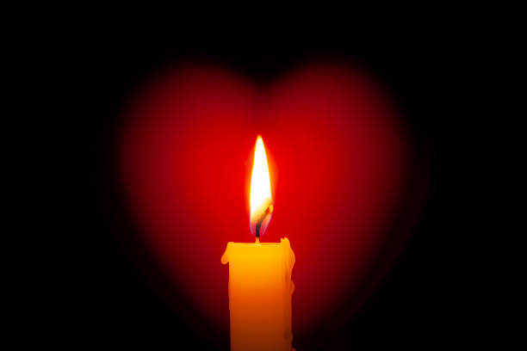
Gathering
Almighty God,
We thank You for the rich diversity You have created in our world.
As we gather on this International Day of Tolerance, help us to embrace our differences with open hearts and minds.
Grant us the wisdom to practise love, and the patience to understand one another.
May we become instruments of Your peace, fostering tolerance and respect in our community.
Through Jesus Christ, our Lord. Amen.

Slide 3
“In a world where you can be anything, be kind”
Jennifer Dukes Lee
“Our ability to reach unity in diversity will be the beauty and the blessing of the 21st century.”
Mahatma Gandhi
“It is not our differences that divide us. It is our inability to recognize, accept, and celebrate those differences.”
Audre Lorde
“I think tolerance is something everybody needs to understand. It doesn't mean accepting other people's viewpoints, but it does mean respecting them.”
Kelsey Grammer

Slide 4
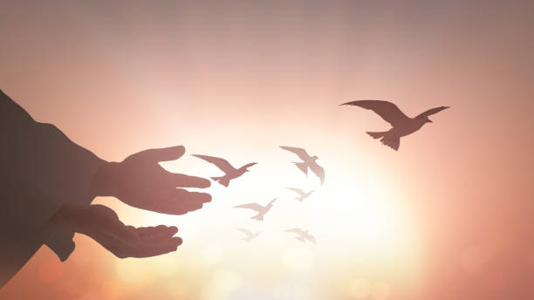
Unity and Maturity in the Body of Christ (Ephesians 4:2-3)
"Be completely humble and gentle; be patient, bearing with one another in love. Make every effort to keep the unity of the Spirit through the bond of peace."

Slide 5
Tolerance as Love in Action
Listening
Patience
Empathy
Forgiveness
How can we embody tolerance in our daily lives?
How can we reach out to those who may feel marginalized or misunderstood?
How can we practice active listening to better understand the perspectives of others?
In what ways can you show kindness to someone who holds different beliefs or opinions?
What role does patience play in resolving conflicts and fostering understanding?

Slide 6
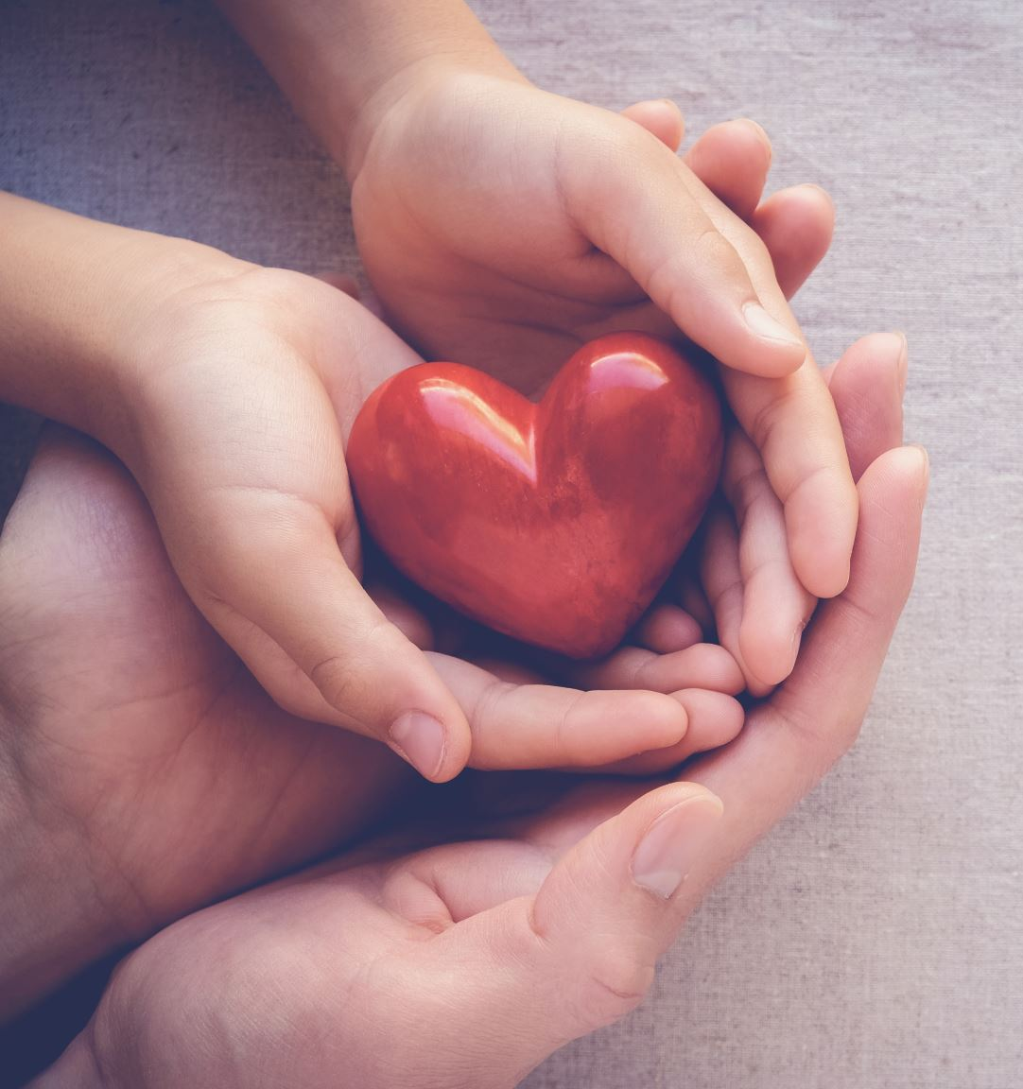
I can contribute to a more tolerant community by...
To better understand others, especially in challenging times, I could...
To help create a welcoming environment, I could...
I can make a positive impact, even when situations feel overwhelming, by...
To foster tolerance, even when faced with difficulties, I could...

Slide 7
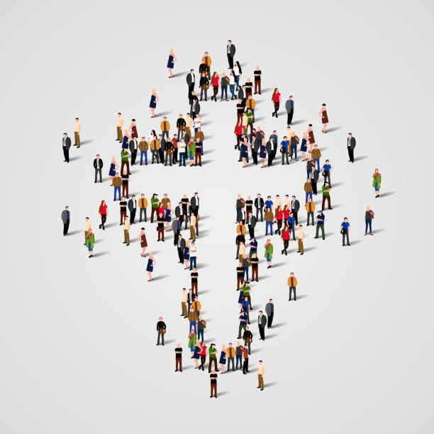
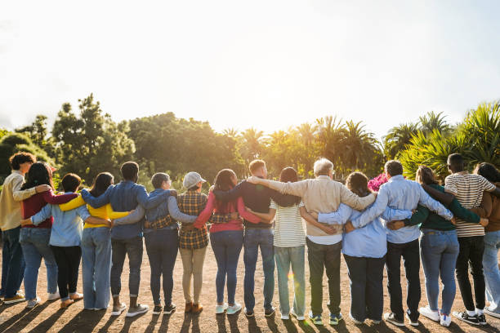

Slide 8
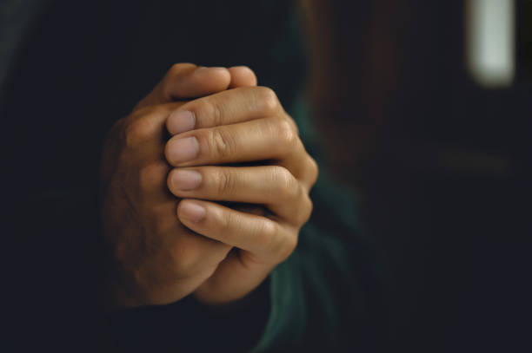
Our prayer
Loving God,
We come together in prayer, seeking your guidance in building a more just and inclusive world.
Open our hearts to see the dignity and worth of every person and teach us to stand against prejudice and division. Help us to be peacemakers in our school, our community, and beyond.
May we reflect your love in all we do, showing kindness, understanding, and respect to all. Strengthen our commitment to creating a society where everyone is valued and can thrive.
In Jesus' name, we pray.
Amen.

