Slide 1

Peer Support Network Session 1
Emily Norman, Head of Networks
Church of England Foundation for Educational Leadership

Slide 2
Introductions

Slide 3

Smartie Conversation Starters
Red = tell me about something you love
Yellow = tell me something you are proud of
Blue = tell me about something you find hard
Green = tell me about something you do to relax or have fun
Brown = tell me about a book, film, song or work of art which inspired you
Pink = tell me about something not many people know about you
Purple = tell me about something you hope to get out of today

Slide 4
Reflection

Slide 5

Driving
Improvement

Slide 6
‘Driving improvement is about recognising that each child has one shot, and thus pursuing the very best for each one as a result’.

Slide 7
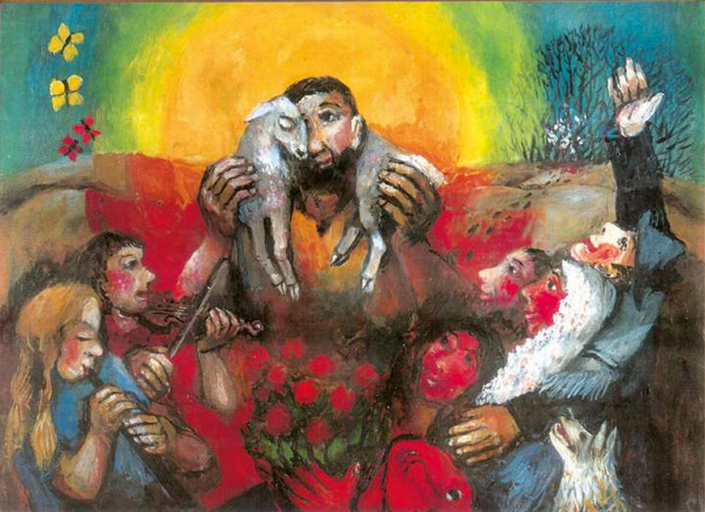
Notes:
Sieger Koder (1925-2015)

Slide 8
Introducing the Peer Support Network

Slide 9

‘Deeply Christian, Serving the Common Good’ – published Autumn 2016
Leadership, Pedagogy and Theology brought together
Clear vision for education for all schools, not just church schools
Educating for life in all its fullness

Slide 10
‘Life in all its fullness’
Educating for Wisdom, Knowledge and Skills
Educating for
Hope and Aspiration
Educating for Community and Living Well Together
Educating for Dignity and Respect

Slide 11
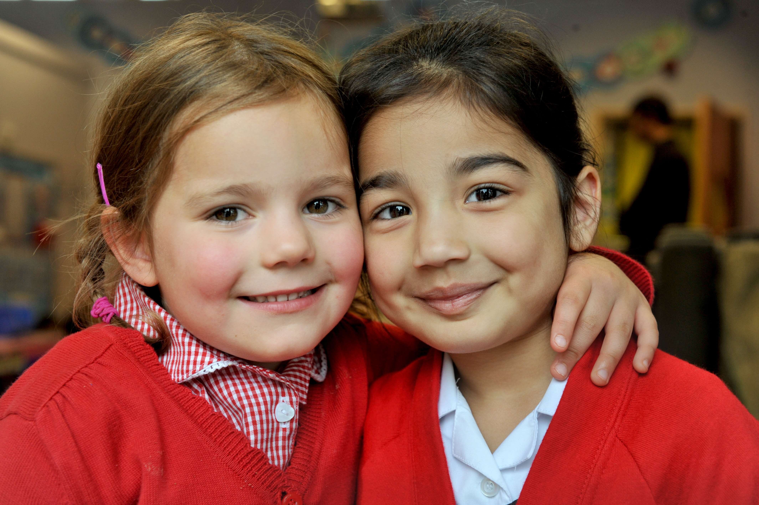
Educating for Wisdom, Knowledge and Skills:
Fostering discipline, confidence and delight in seeking wisdom and knowledge, and fully developing talents in all areas of life.

Slide 12
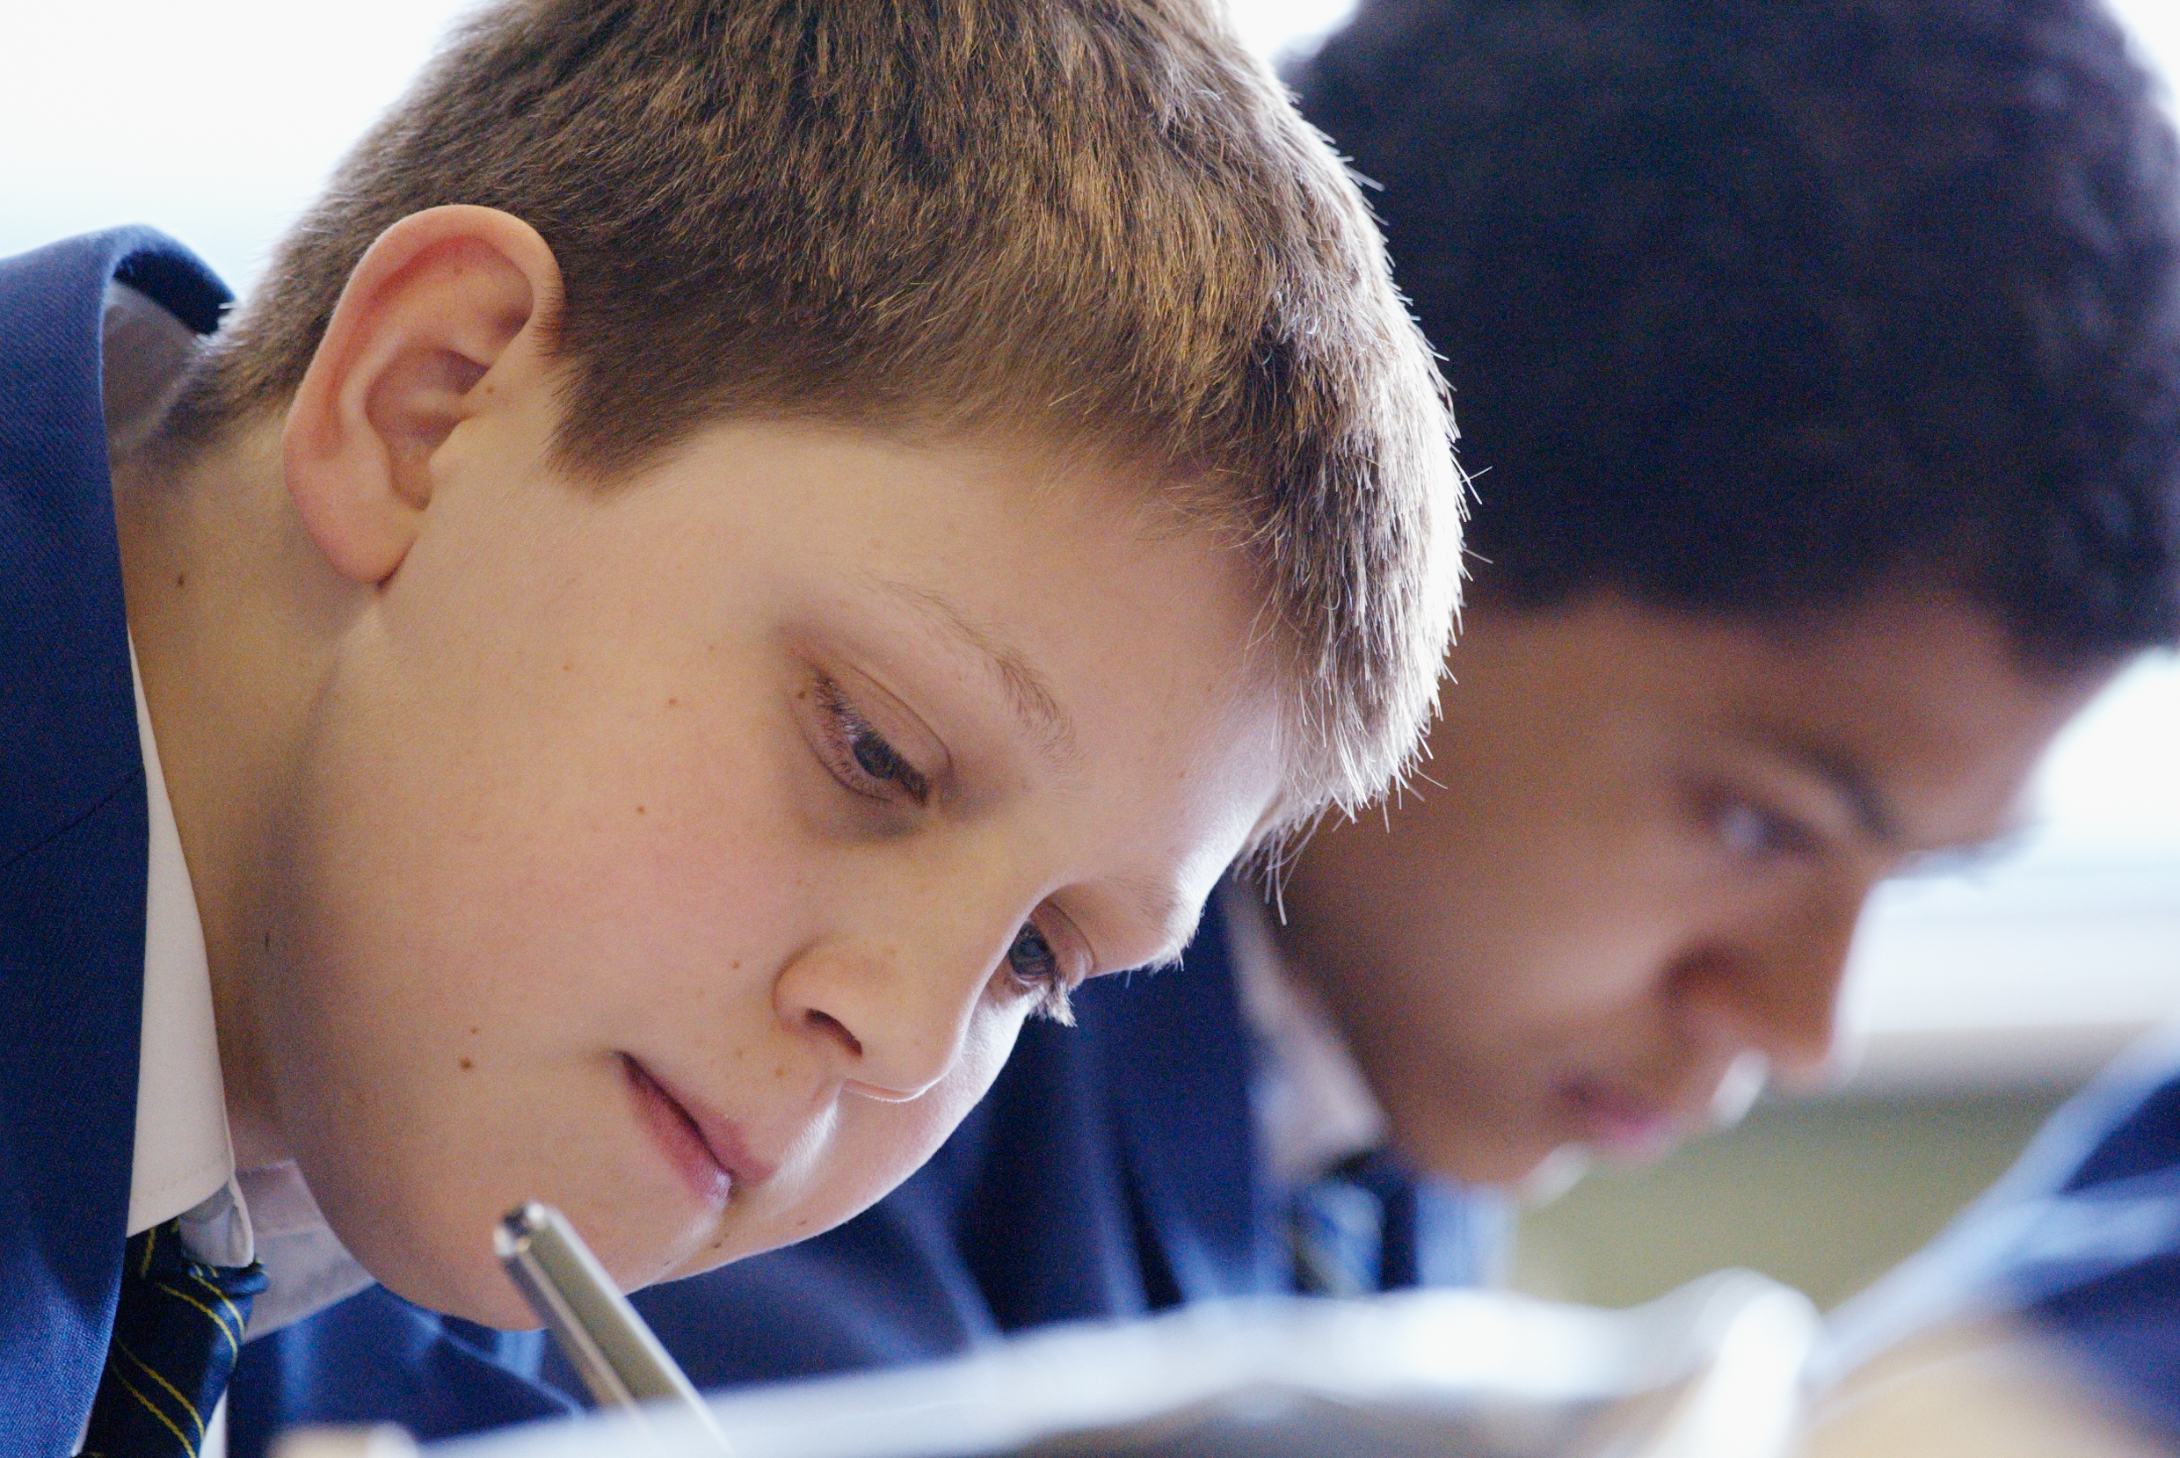
Educating for Hope and Aspiration:
Seeking healing, repair and renewal, coping wisely with things and people going wrong, opening horizons and guiding people into ways of fulfilling them.

Slide 13
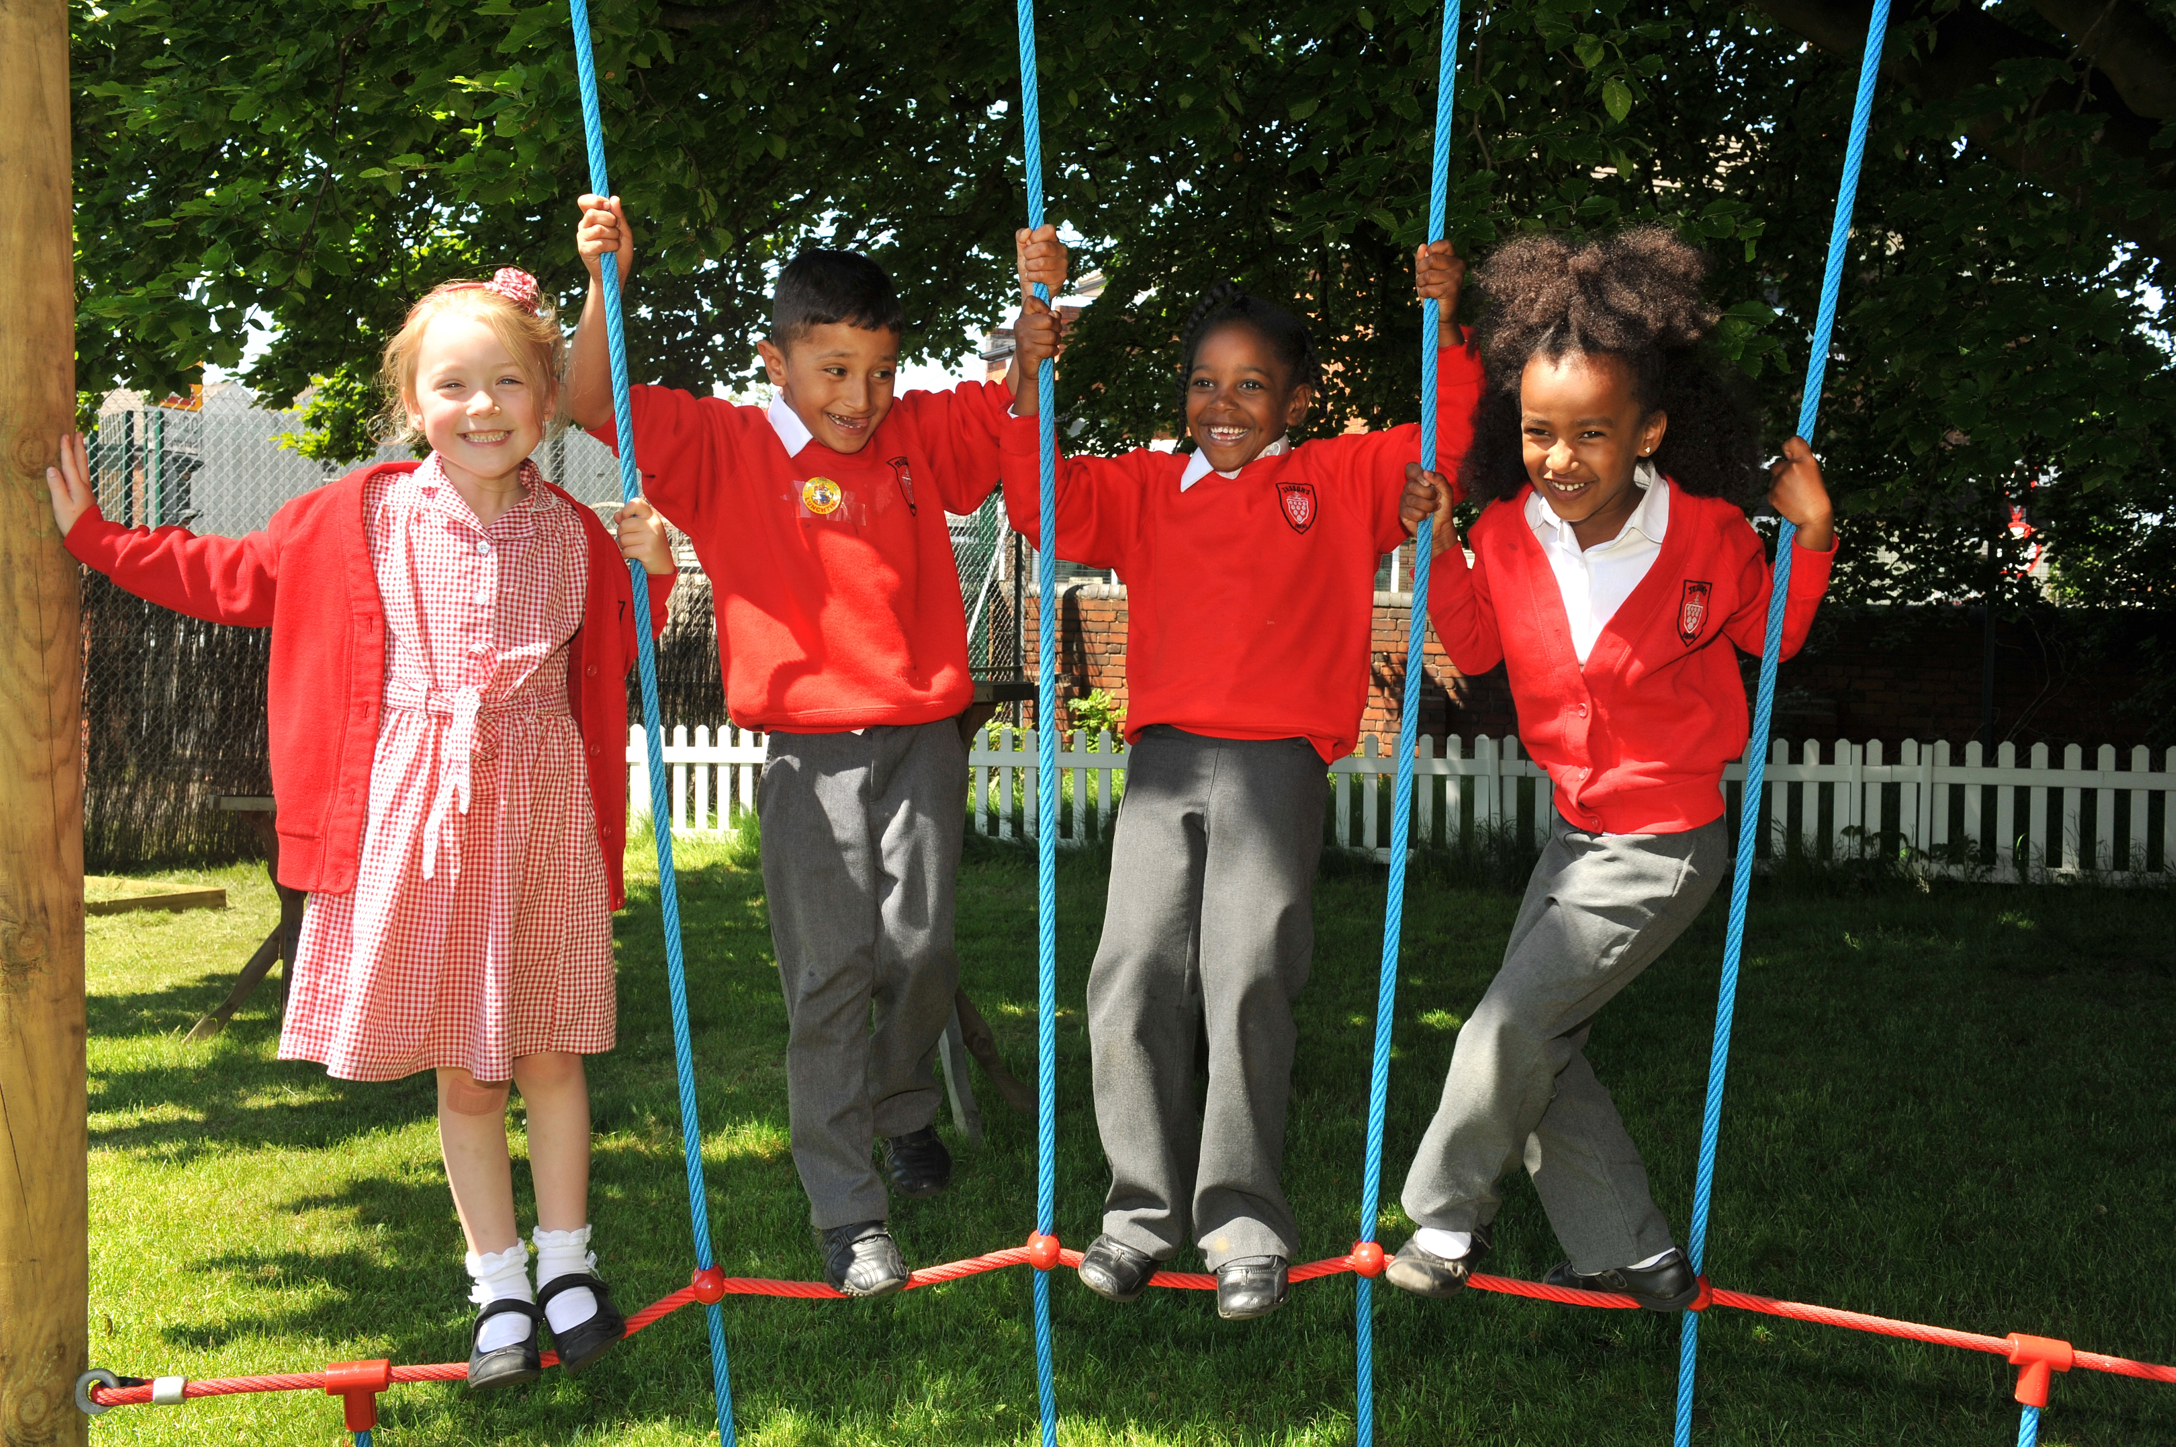
Educating for Community and Living Well Together:
Ensuring a core focus on relationships, participation in communities and the qualities of character that enable people to flourish together.

Slide 14
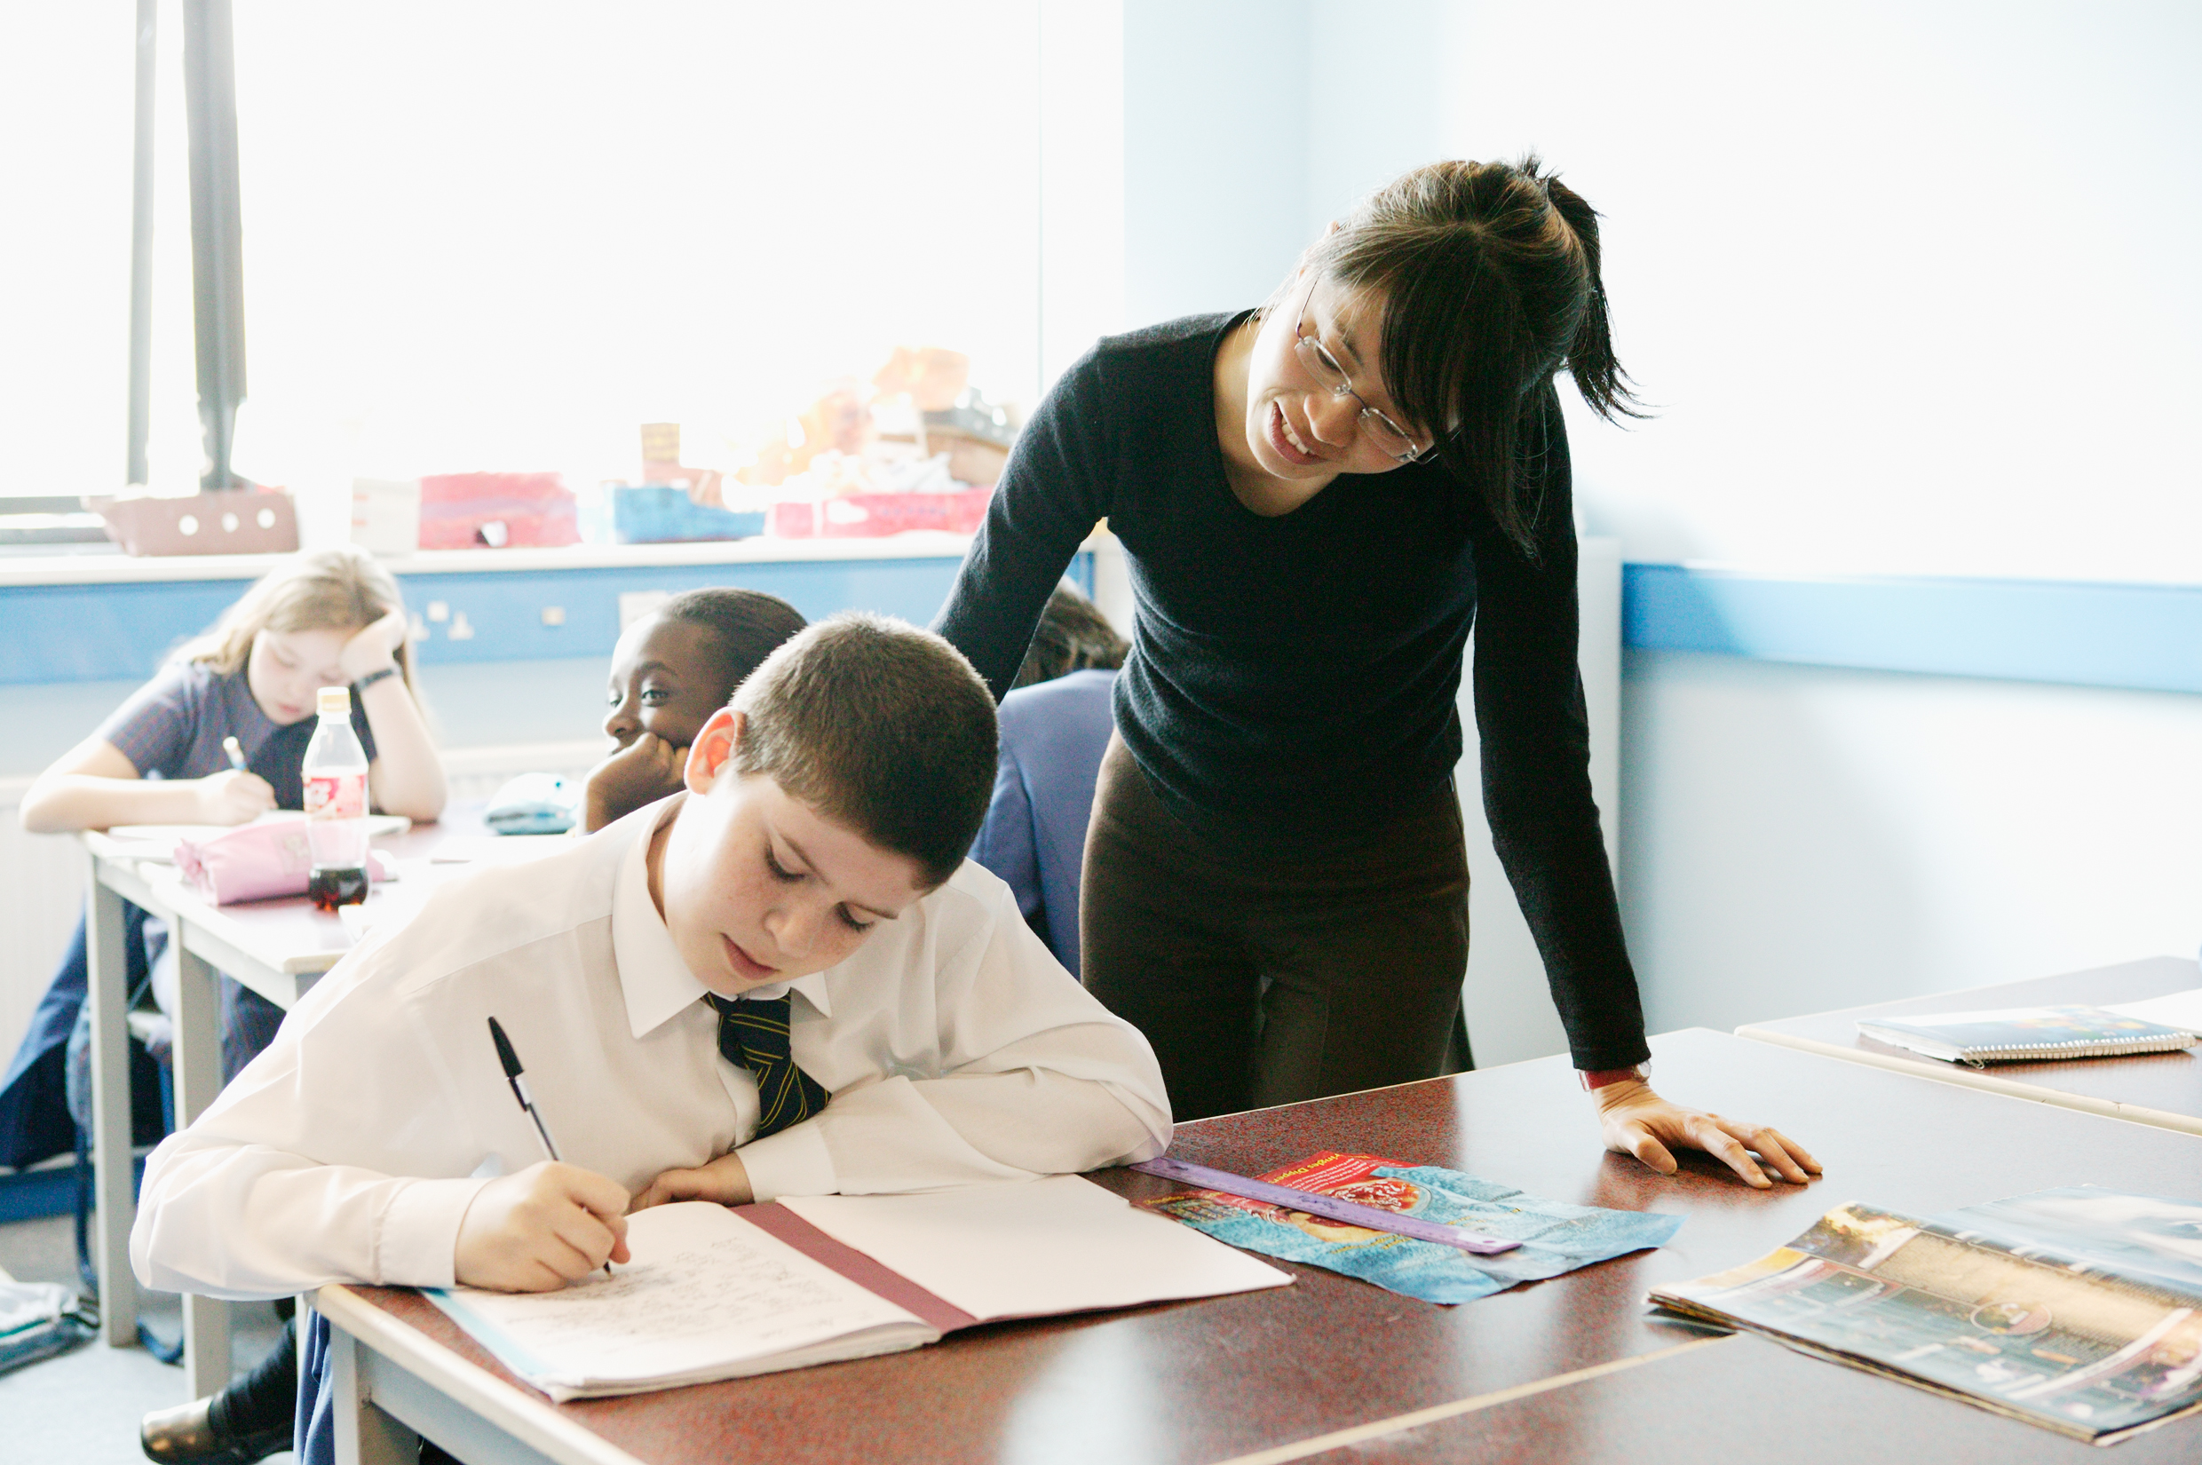
Educating for
Dignity and Respect:
Ensuring the basic principle of respect for the value and preciousness of each person, treating each person as a unique individual of inherent worth.

Slide 15
The Church of England Foundation
for Educational Leadership’s mission is:
“To develop inspirational leaders who are called, connected and committed to delivering the Church of England’s vision for education”

Slide 16
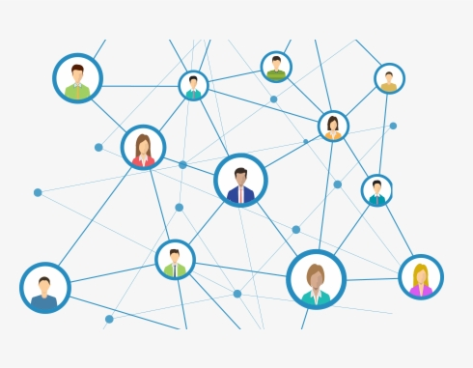
Benefits of a network:
Building relationships
Sharing good practice
Exploring enquiry questions
Evaluating what works
Long-term possibilities

Slide 17
‘Called’
Leadership

Slide 18
Called:
“Leaders who are called can articulate a strong sense of personal vocation to their role, and demonstrate this through their words, actions and decision making, exemplifying a strong moral purpose, confident vision, and ambitious trajectory of improvement. For some, this sense of vocation will be driven by an established or developing faith commitment. They show integrity, honesty and a deep sense of resilience, underpinned by their personal sense of vocation as a leader.”
Notes:
BEFORE GOING TO LUNCH, lets go back to our starting point.
Take a moment on your own to note down:
What has struck you during this morning’s session.
What actions will you take as a consequence
Share with a partner.

Slide 19


Slide 20
‘That which leaders choose to improve communicates much about their values.’
What kind of education?

Slide 21
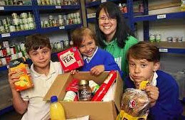
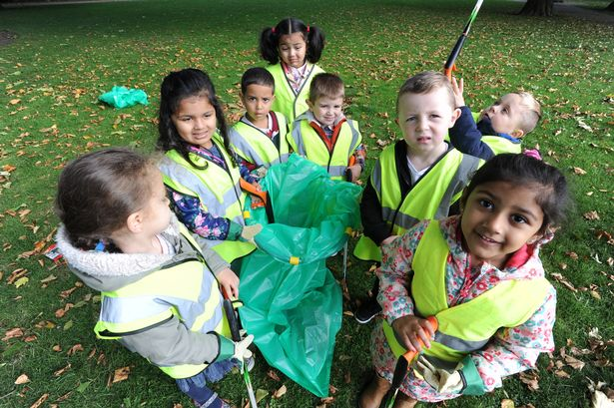
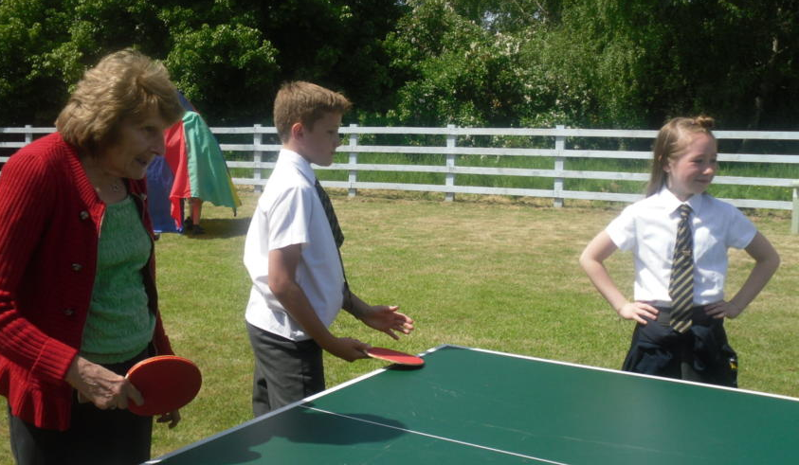


“Your vocation in life is where your greatest joy meets the world’s deepest need.”
Frederick Buechner

Slide 22
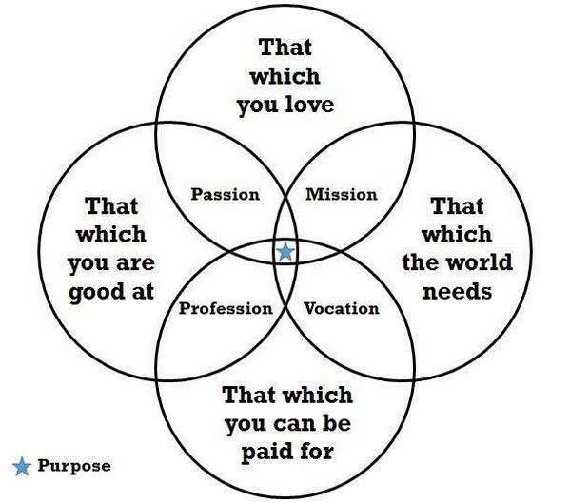
What do you consider your ‘calling’, ‘vocation’ or ‘purpose’ to be?
Is this something which has changed through your life?
What difference does this make to how you approach your role at school?

Slide 23
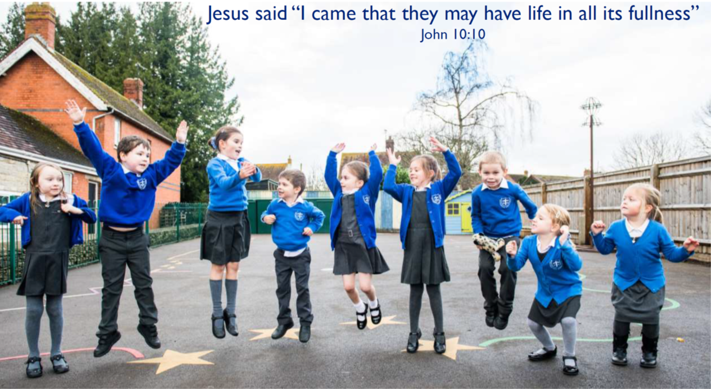

Slide 24
Children
‘Life in all its fullness’
Adults
Teams

Slide 25
What do we mean by ‘human flourishing’?

Slide 26
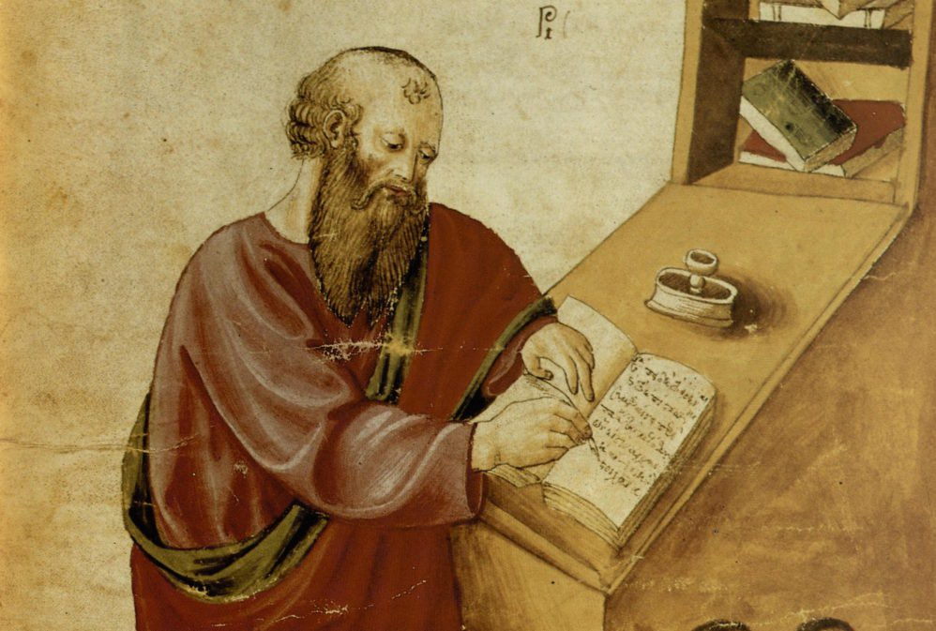
‘The notion of human flourishing set out in our thinking draws significantly on Aristotle, and especially on his conception of eudaimonia. The meaning of eudaimonia can be traced etymologically from its roots of ‘eu’ (good) and ‘daimon’ (spirit), refers to the notion of human flourishing and can…[refer to] physical flourishing, emotional flourishing, societal flourishing and fourthly, flourishing in terms of personal creativity, self-expression and knowledge seeking.’
Leadership of Character Education, 18

Slide 27
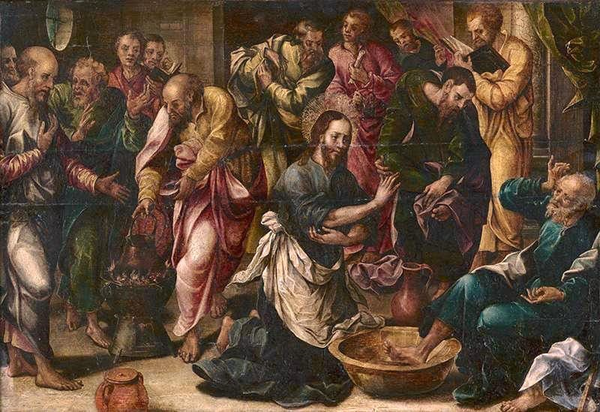
‘Love one another. As I have loved you, so you must love one another. By this, everyone will know that you are my disciples.’
John 13:34-5

Slide 28
We flourish because of our diversity and relationships
Flourishing Teams
Flourishing Adults
Flourishing Children

Slide 29

What does this mean for you as a leader?

Slide 30
We flourish because of our diversity and relationships
We flourish at different times and different speeds
Flourishing Teams
Flourishing Adults
Flourishing Children

Slide 31
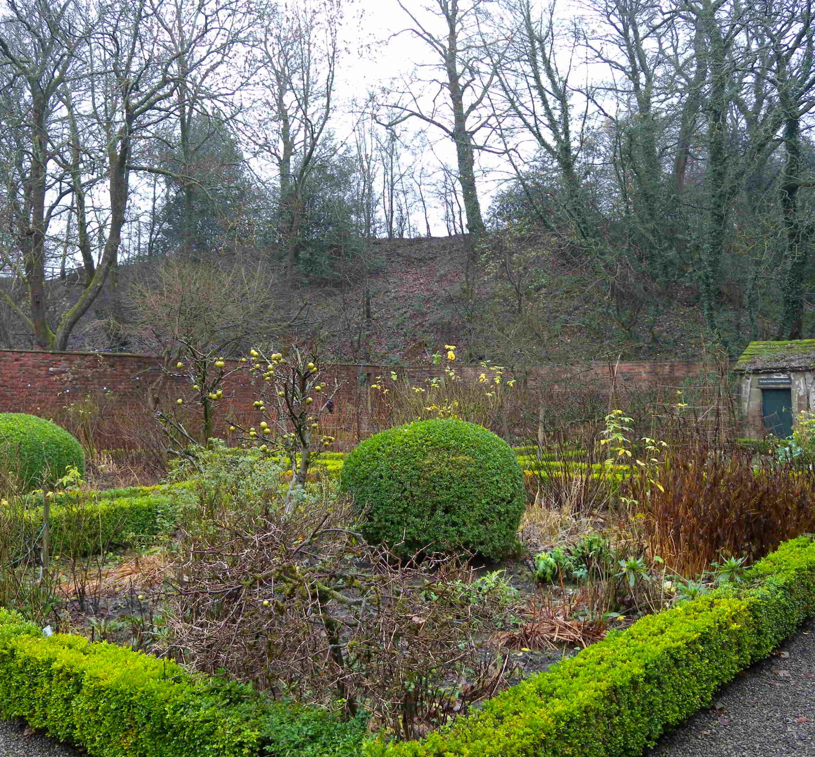

A garden that’s bursting into life…?

Slide 32
We flourish because of our diversity and relationships
We flourish at different times and different speeds
Flourishing Teams
Flourishing Adults
Flourishing Children
We flourish when we stop doing things

Slide 33
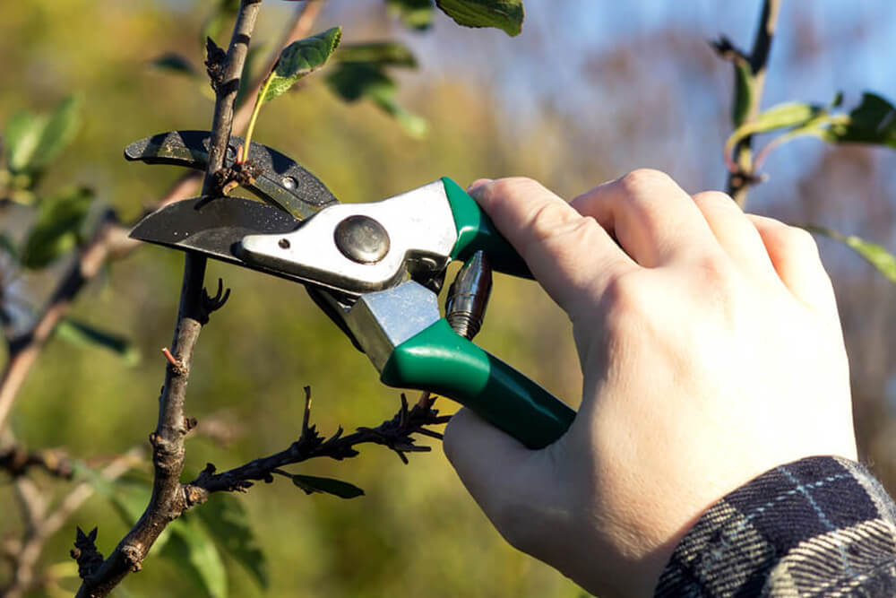
What should we stop doing?

Slide 34
We flourish because of our diversity and relationships
We flourish at different times and different speeds
Flourishing Teams
Flourishing Adults
We flourish so we can look outwards and give
Flourishing Children
We flourish when we stop doing things

Slide 35

“But since you excel in everything – in faith, in speech, in knowledge, in complete earnestness and in the love we have kindled in you – see that you also excel in this grace of giving.”
2 Corinthians 8:7

Slide 36
We flourish because of our diversity and relationships
We flourish at different times and different speeds
Flourishing Teams
Flourishing Adults
We flourish so we can look outwards and give
Flourishing Children
We flourish when we stop doing things

Slide 37


Transference of fear
MACRO
Ecology of blessing
OR
SCHOOL LEADERS
STAFF
PUPILS

Slide 38

What one thing could you do tomorrow that would increase your flourishing?
What difference would this make to those you lead, teach or meet?

Slide 39


Slide 40
Myself as a Leader

Slide 41
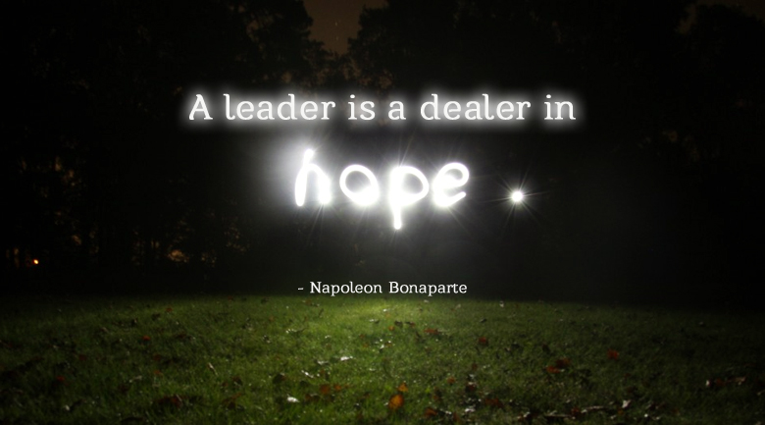

Slide 42
Sage/Guide/Expert/
Enthusiast
Resourced/Trusted/
Revered
Expectations for Middle & Senior Leadership
Storyteller/Evangelist/
Salesperson
Energy/Passion/Love/
Time

Slide 43



Slide 44
Daring leadership
Brené Brown
https://www.inc.com/dr-brene-brown/figure-out-what-makes-you-vulnerable.html

Slide 45
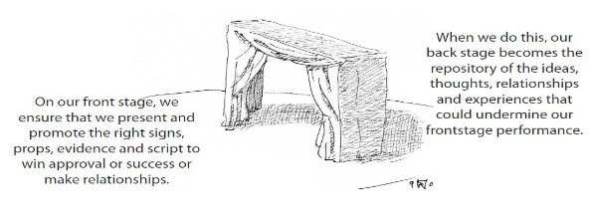
Simon P Walker Undefended Leadership
‘Front stage and back stage’
Is who you are on the ‘front stage’ the same as who you are ‘backstage’?

Slide 46
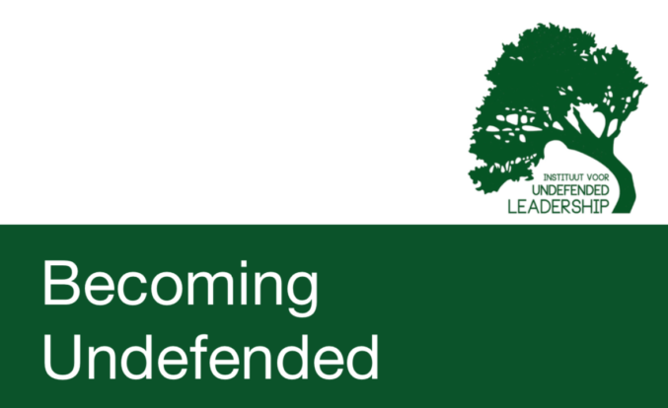
‘Leadership is an activity that leads other people into full humanity: which enables them to take hold of, and take responsibility for, the life that they, as a unique, particular person within the created human race, have been given to live.’
Simon P. Walker

Slide 47
Leadership Practices Matrix (2019)

Slide 48
 | Called | Connected | Committed
Educating for Wisdom, Knowledge and Skills | Leading Learning - Refining Judgement | Creating Confidence - Embracing Interdependence | Deepening Understanding - Driving Improvement
Educating for Hope and Aspiration | Developing Imagination - Nurturing Ambition | Healing Relationships - Pursuing Renewal | Sustaining Vision - Building Resilience
Educating for Community and Living Well Together | Removing Disadvantage - Seeking Reconciliation | Accepting Vulnerability - Demonstrating Generosity | Inspiring Faithfulness -Embodying Integrity
Educating for Dignity and Respect | Celebrating Diversity - Enabling Flourishing | Offering Encouragement - Encouraging Service | Practising Humility - Learning Love

Slide 49
Called:
“Leaders who are called can articulate a strong sense of personal vocation to their role, and demonstrate this through their words, actions and decision making, exemplifying a strong moral purpose, confident vision, and ambitious trajectory of improvement. For some, this sense of vocation will be driven by an established or developing faith commitment. They show integrity, honesty and a deep sense of resilience, underpinned by their personal sense of vocation as a leader.”
Notes:
BEFORE GOING TO LUNCH, lets go back to our starting point.
Take a moment on your own to note down:
What has struck you during this morning’s session.
What actions will you take as a consequence
Share with a partner.

Slide 50
 | Called | Connected | Committed
Educating for Wisdom, Knowledge and Skills | Leading Learning - Refining Judgement | Creating Confidence - Embracing Interdependence | Deepening Understanding - Driving Improvement
Educating for Hope and Aspiration | Developing Imagination - Nurturing Ambition | Healing Relationships - Pursuing Renewal | Sustaining Vision - Building Resilience
Educating for Community and Living Well Together | Removing Disadvantage - Seeking Reconciliation | Accepting Vulnerability - Demonstrating Generosity | Inspiring Faithfulness -Embodying Integrity
Educating for Dignity and Respect | Celebrating Diversity - Enabling Flourishing | Offering Encouragement - Encouraging Service | Practising Humility - Learning Love

Slide 51
Educating for
Dignity and Respect:
Ensuring the basic principle of respect for the value and preciousness of each person, treating each person as a unique individual of inherent worth.

Slide 52
 | Called | Connected | Committed
Educating for Wisdom, Knowledge and Skills | Leading Learning - Refining Judgement | Creating Confidence - Embracing Interdependence | Deepening Understanding - Driving Improvement
Educating for Hope and Aspiration | Developing Imagination - Nurturing Ambition | Healing Relationships - Pursuing Renewal | Sustaining Vision - Building Resilience
Educating for Community and Living Well Together | Removing Disadvantage - Seeking Reconciliation | Accepting Vulnerability - Demonstrating Generosity | Inspiring Faithfulness -Embodying Integrity
Educating for Dignity and Respect | Celebrating Diversity - Enabling Flourishing | Offering Encouragement - Encouraging Service | Practising Humility - Learning Love

Slide 53

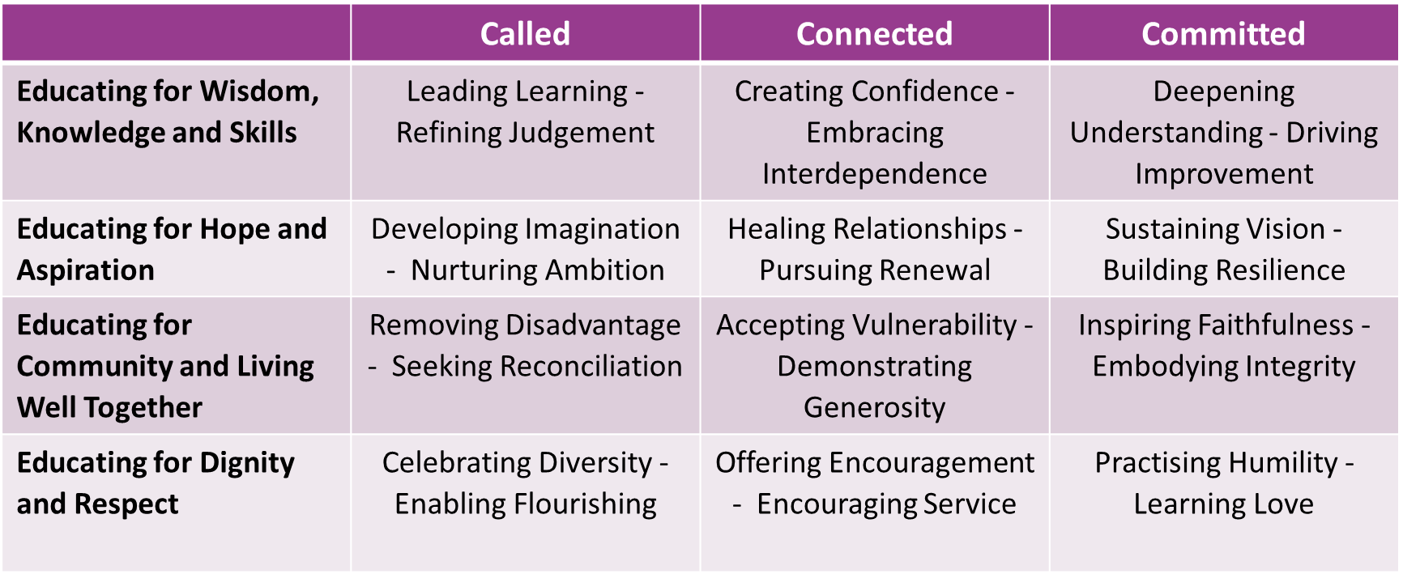

Slide 54
Lunch

Slide 55
Evaluating Prevailing Narratives

Slide 56
Thin Narratives | Thick Narratives
Utilitarian/ Instrumentalist | Wisdom, Knowledge and Skills (for living well)
Competitive | Hope and Aspiration (through forgiveness and grace)
Individualistic | Community and Living Well Together (created for life together)
Reductionist | Dignity and Respect (of every person)

Slide 57
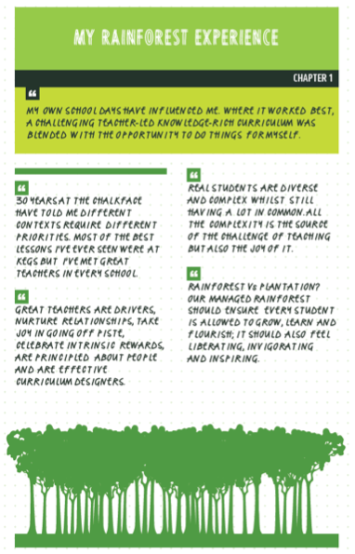


Slide 58
Learning Plantation | Learning Rainforest
‘A right way to do things’ – set routines – e.g. L.O. on the board every lesson | Nourishing individual talents - high trust/high challenge
Leaders driven by compliance to external voices | Great variety in pedagogy and OK to try new things all the time
T+L focused on what can be examined | If creative approaches deliver, there is high level of autonomy
Data has very high status | Data is part of the picture of learning
Interventions heavily focused on short-term gains | T+L structures are dynamic/organic, aligning T+L to stated school values
Creativity becomes rules – e.g. standardised homework format etc. | Highly personalised CPD

Slide 59
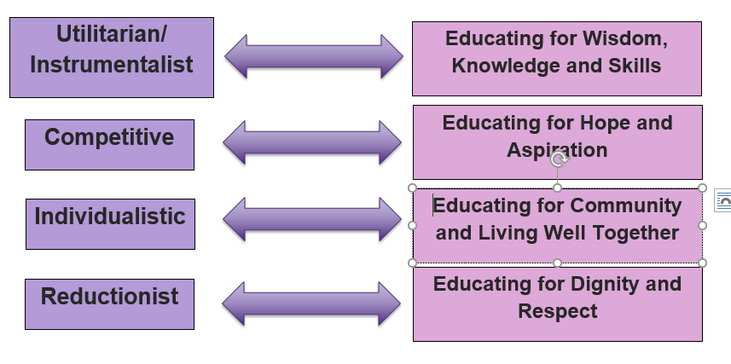
Activity: Evaluating Prevailing Narratives

Slide 60
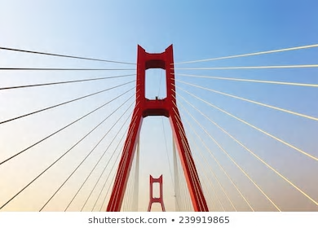
Are there any tensions between how I see my ‘calling’ and the educational landscape today?

Slide 61

How far do the challenges we face provide opportunities for us to demonstrate our values?

Slide 62
Ethos Enhancing Outcomes

Slide 63

“If the Vision for Education fails to make and sustain meaningful connections between a school’s ethos and its outcomes, it will become nothing more than a deeply eloquent and well-meaning piece of writing…”

Slide 64
“..It must come off the shelf and be brought to life through leaders evaluating its potential impact on every area of day-to-day school life…”

Slide 65
“…This dynamic and enhancing connection between ethos and outcomes is what we mean by ‘Bringing the Vision Alive.’”

Slide 66
My hope is that the lessons of the Foundation will resonate not just within Anglican schools, but also beyond, supporting improvement right across the system.
One of those lessons, that I certainly hope echoes in schools of all faiths and none, is the Foundation’s affirmation that there should not, indeed cannot, be a trade-off between school ethos and school outcomes.
Amanda Spielman, HMCI, Feb 2018

Slide 67
What outcomes are you trying to improve?
What are the pressures and challenges?
Who defines this journey?
What help could the Vision offer you?
ethos
enhancing
outcomes
How do you define this for your school?
(in a sentence…)
Where does your ethos come from?
What are the commonalities and differences between us?
What difference does it make to your lived reality?

Slide 68
Activity: Ethos Enhancing Outcomes

Slide 69
Group activity:
Choose a question which resonates with you as a group
How might you go about answering this?
How might you use this resource in school?
Be ready to share your ideas with another group

Slide 70


Slide 71

Activity: LPT questions

Slide 72


Slide 73
Wisdom is…
Wisdom is a shared conversation not a one-way transaction
Wisdom is reliant on one expert, but seeks other views
Wisdom is reading slowly and widely
Wisdom is connecting and synthesising, re-using and rejecting
Wisdom loves detail, not just superficiality
Wisdom unleashes imagination
Wisdom needs diversity, not just because it’s right but because it’s inherently better
Wisdom is making choices, sometimes between two seemingly good things
Wisdom is inherited from those in community & family around us
Wisdom always permits good questions, but has the confidence to articulate clear answers
Wisdom views mistakes with perspective

Slide 74

Formulating research questions
What would you like to explore around driving improvement in your school enables the flourishing of pupils, adults and teams?
How will you go about finding this out?
Who will you need to involve?

Slide 75


