Slide 1
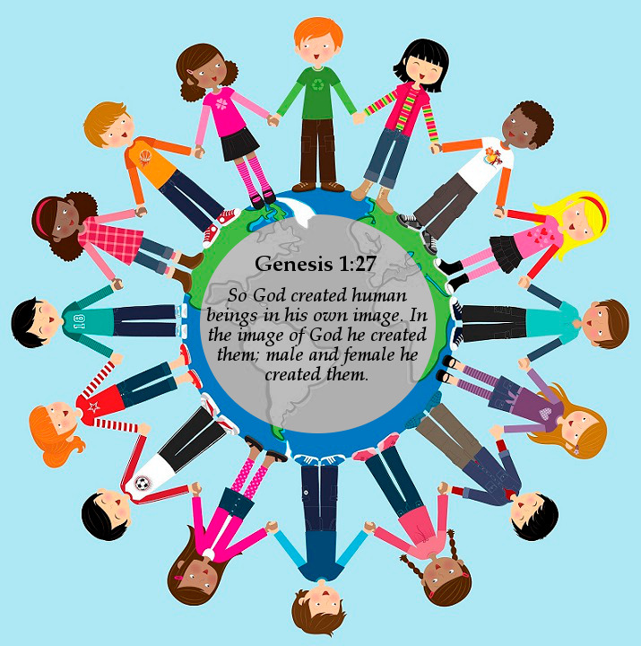
Made In God’s Image
Reflecting God's Love: Celebrating Diversity and Seeking Justice

Slide 2
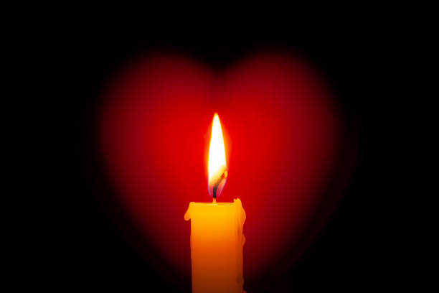
Gathering
Dear God,
Thank You for making each one of us unique and special.
Help us to love one another as You love us.
Teach us to see the beauty in all people and to treat everyone with kindness and fairness.
In Jesus’ name, we pray,
Amen.

Slide 3
Race Equality Week helps us think about why it is important to treat everyone fairly.
Notes:
Notes: Today, we gather to reflect on Race Equality Week, a time dedicated to raising awareness of racial inequality, celebrating diversity in nationalities and ethnicities and seeking justice for the racially marginalised in our world. Race equality is not just about fairness; it’s about creating a society where everyone is treated with dignity, respect, and justice, honouring their unique heritage, background and ethnicity. We recognise that there has been a history of marginalisation based on perceived race. While race is a social construct, racism is real and has a negative impact on those who are racially marginalised.
Race Equality Week is an opportunity to go beyond mere tolerance. It challenges us to actively understand and embrace the richness of different cultures, experiences, and perspectives. In a world where racial prejudice and discrimination continue to affect many lives, the need for equality and inclusion is more urgent than ever. This week encourages us to reflect on our progress in the field of equity, diversity, inclusion and justice while acknowledging the work still to be done. Let us be inspired to act with empathy, kindness, and a commitment to justice and equity for the marginalised to achieve equality. Together, we can create a world where everyone, embracing their diverse backgrounds and identities, is treated with the respect and dignity they deserve, experiencing life in all its fullness as Jesus promised in John 10:10: "I have come that they may have life, and have it to the full."

Slide 4
We can all learn how to love, care, and treat people with kindness.
Did you know that no one is born with unkind thoughts about others?

Slide 5
God made everyone in His image
I wonder why it’s important to understand that God loves everyone the same
I wonder how this helps us to treat everyone fairly

Slide 6
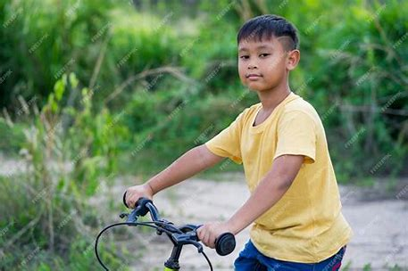
Learning and Unlearning
I wonder if you made some New Year resolutions to learn something new this year?

Slide 7
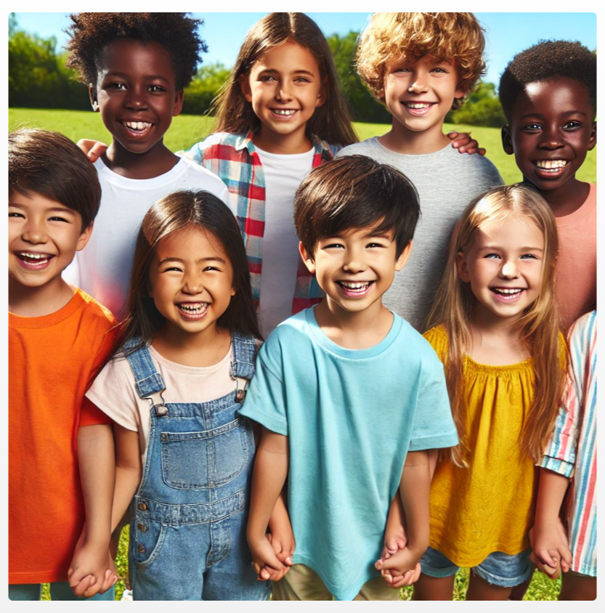
Learning to treat everyone fairly, all the time
How you could show fairness to someone who isn't always treated fairly?

Slide 8
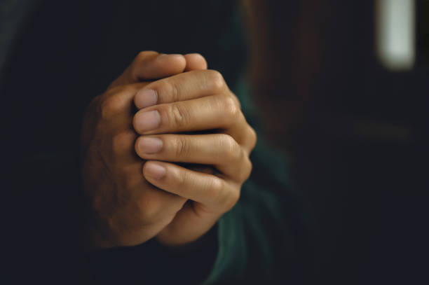
Our prayer
Lord, we thank You for this time together to learn about treating one another fairly.
Help us to celebrate our differences and work together for peace and fairness in our world.
Amen.

