Slide 1
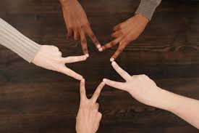
Reflecting God's Love: Embracing Race Equality in Our Community

Slide 2
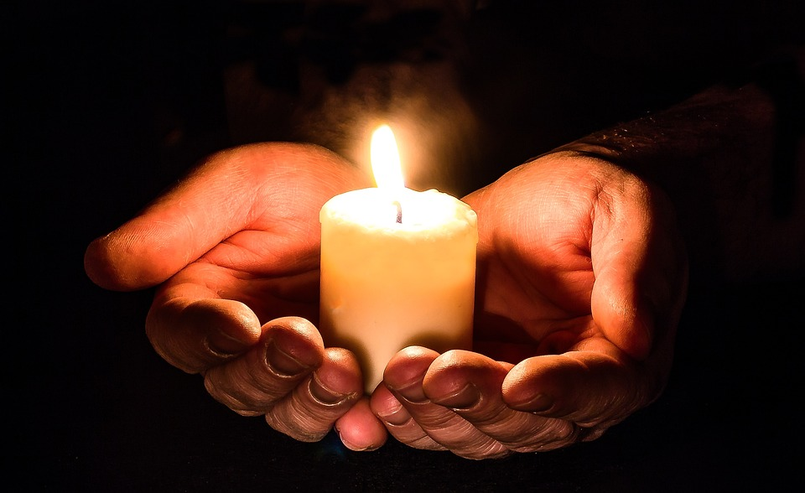
Gathering
Almighty God,
We thank You for creating every person in Your image and for the beautiful diversity you have woven into our world.
As we come together this week to reflect on race equality, help us to see Your likeness in every face we meet.
Grant us the courage to stand against injustice, and the humility to listen, learn, and grow.
May we recognise the dignity of all people and treat each other with the respect and love You show us.
Through Jesus Christ, our Lord who taught us to love one another as You have loved us. Amen.

Slide 3
“No matter who you are, where you come from, or the colour of your skin, we are all equal."
Stormzy
“We need to build a society where race doesn’t limit your opportunities and doesn’t define your worth.”
Akala
"It’s a failure of imagination to think that people are defined by the colour of their skin, when we are all living complex lives, with complex histories."
Zadie Smith

Slide 4
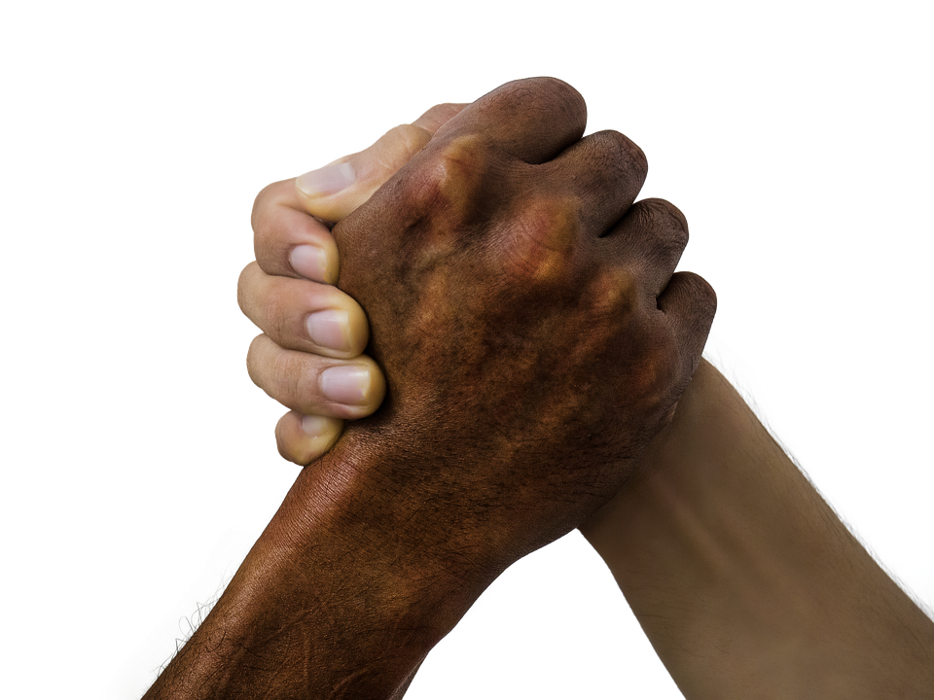
What can we learn from the experiences and wisdom of those who have fought for racial equality before us?
What actions can we take as individuals to promote racial equality and respect within our school community?
How can we learn from the stories and experiences of others to create a more inclusive and understanding environment at school?
How can we support one another in celebrating our racial and cultural differences while also finding common ground?
In what ways can small acts of kindness and solidarity help create a ripple effect of racial equality and unity in our community?

Slide 5
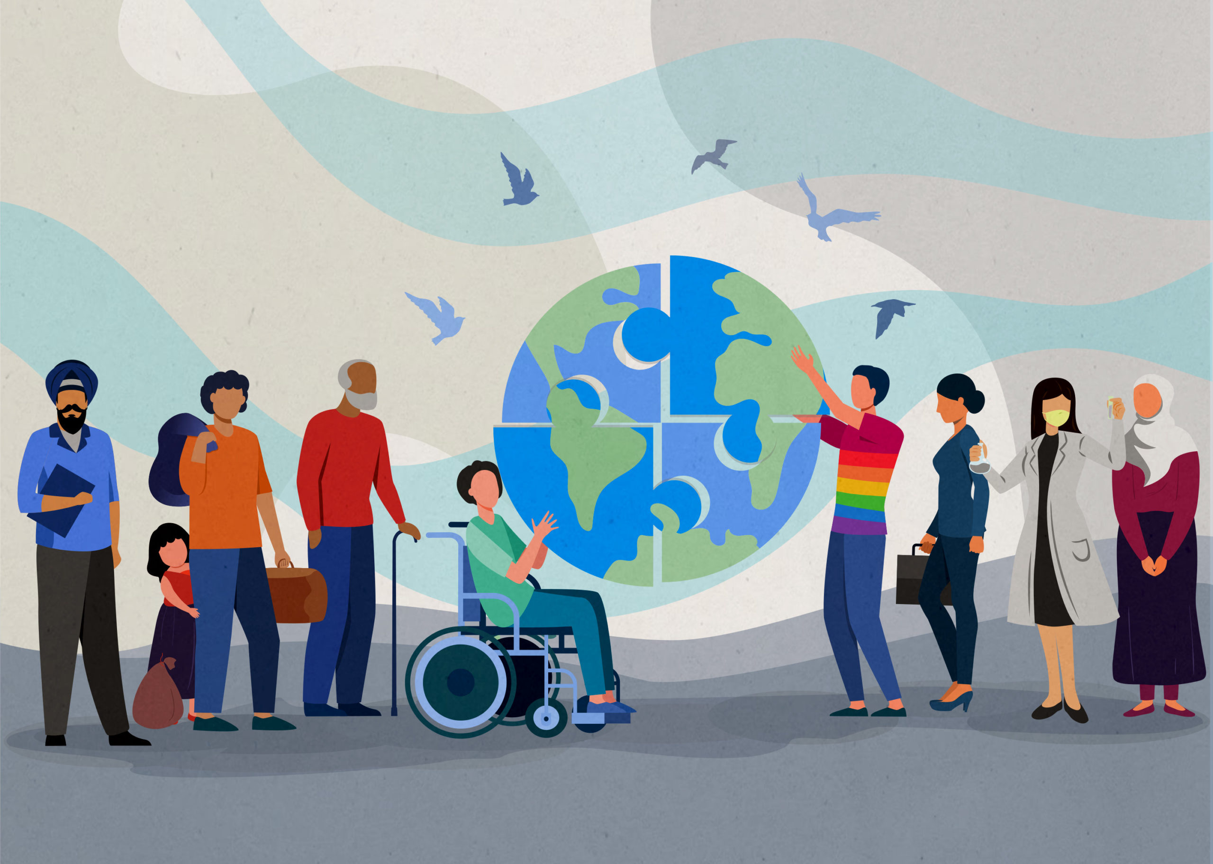
Imago Dei
(Genesis 1:26-27)
“Then God said, ‘Let us make mankind in our image, in our likeness, so that they may rule over the fish in the sea and the birds in the sky, over the livestock and all the wild animals, and over all the creatures that move along the ground.’ So God created mankind in his own image, in the image of God he created them; male and female he created them.

Slide 6
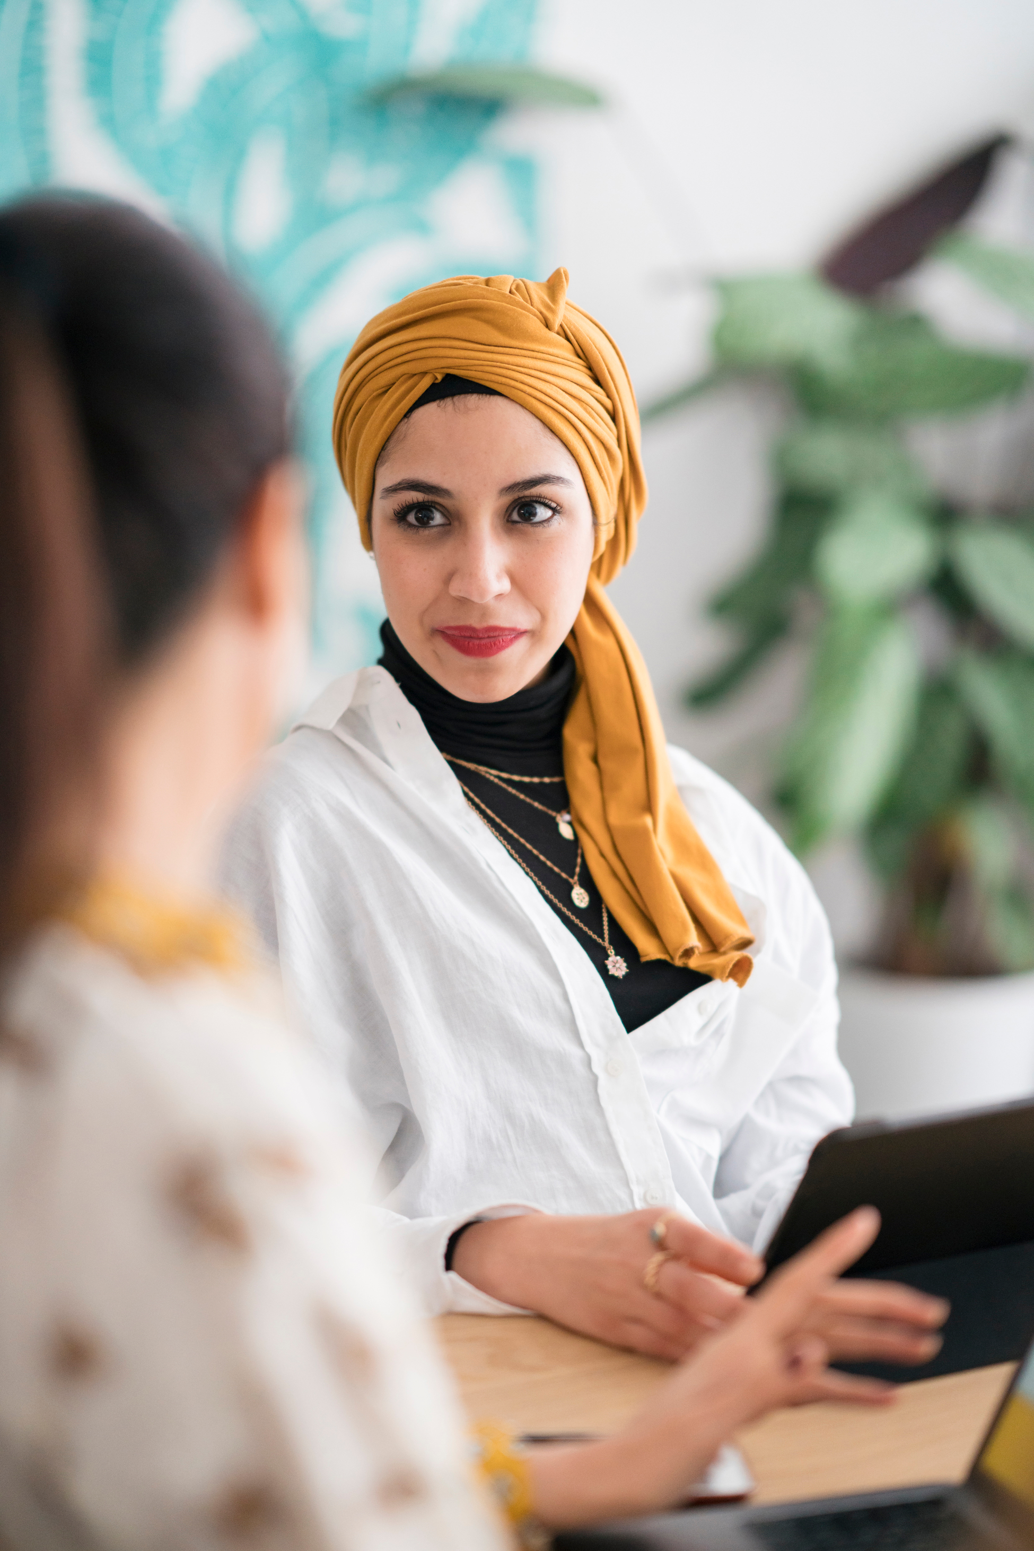
Listening
Patience
Empathy

Slide 7
I can contribute to a more racially equal community by...
To better understand others, especially those from different racial backgrounds, I could...
To help create a more inclusive and welcoming environment for all races, I could...
I can make a positive impact on racial equality, even when situations feel challenging, by...
To foster racial equality and understanding, even when faced with prejudice or discrimination, I could...

Slide 8
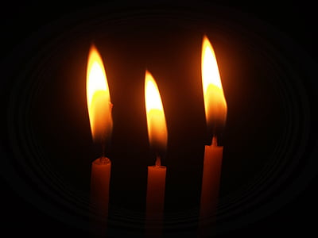
Our prayer
Loving God,
As we conclude our time of reflection, we ask for Your guidance in building a world where equality, justice, and love abound.
Open our eyes to see the beauty in every person, and help us to recognise Your image in all who we meet. Teach us to stand firm against division, prejudice, and injustice, and empower us to be agents of reconciliation and peace.
May Your love inspire us to treat each person with kindness, respect, and compassion, both in our school and in the wider world. Strengthen our resolve to create a community where everyone is valued, cherished, and given the opportunity to thrive.
In Jesus' name, we pray. Amen.

