Slide 1
Together is Better!
We’re All Different, We’re All Special!
Be Kind,
Be Friendly,
Be You!

Slide 2
Gathering
Dear God,
Thank you for making our world so special and full of different people.
As we come together today, help us to be kind and open to everyone.
Teach us to show love and understanding, and to be patient with each other.
Help us bring peace, respect, and friendship to our community.
In Jesus’ name, we pray, Amen.

Slide 3
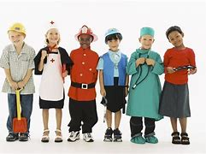
“In a world where you can be anything, be kind”
Jennifer Dukes Lee
I wonder… What would you like to be when you grow up?

Slide 4
Don't be proud at all.
Be completely gentle.
Be patient.
Put up with one another in love.
The Holy Spirit makes you one in every way.
So try your best to remain as one.
Let peace keep you together.
Ephesians 4:2-3, NIrV
I wonder what it feels like when people work together peacefully.

Slide 5
Don't be proud at all.
Be completely gentle.
Be patient.
Put up with one another in love.
The Holy Spirit makes you one in every way.
So try your best to remain as one.
Let peace keep you together.
Ephesians 4:2-3, NIrV
I wonder how we can bring peace to our school, family and communities.

Slide 6
Tolerance is an important Christian value, showing Christ’s love for everyone.
Just like early Christians welcomed people from different places, we are called to create a world where kindness and understanding bring people together
I wonder what tolerance means and how we can show it to others

Slide 7
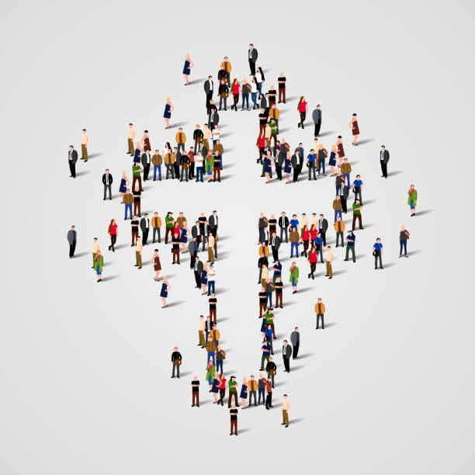
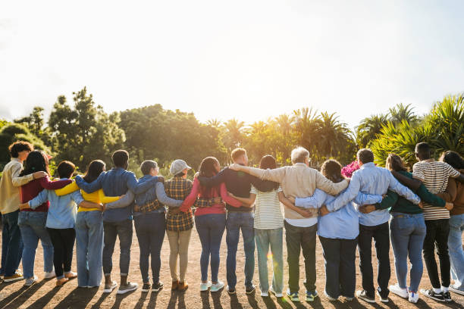
The Holy Spirit makes you one in every way
Ephesians 4:3
Many leaves, one tree—united in love through the Holy Spirit.

Slide 8
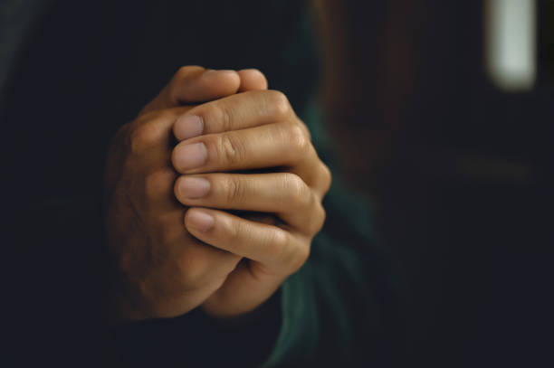
Our prayer
Dear God,
Thank you for making each of us special.
Help us to remember that, just like the leaves on a tree, we are all important parts of Your family.
Help us to live in peace and unity, and to show love and kindness to everyone.
Amen.

