Slide 1
Peer Support Network
Peterborough
14th November

Slide 2
Ethos Enhancing Outcomes

Slide 3

“If the Vision for Education fails to make and sustain meaningful connections between a school’s ethos and its outcomes, it will become nothing more than a deeply eloquent and well-meaning piece of writing…”

Slide 4
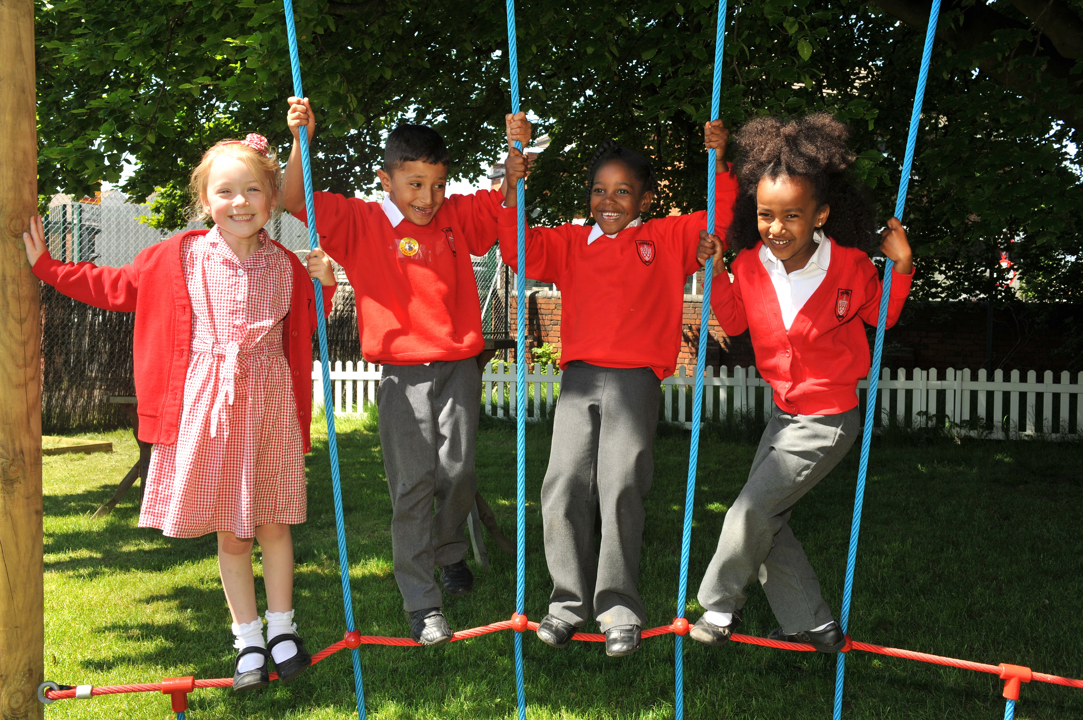
“..It must come off the shelf and be brought to life through leaders evaluating its potential impact on every area of day-to-day school life…”

Slide 5
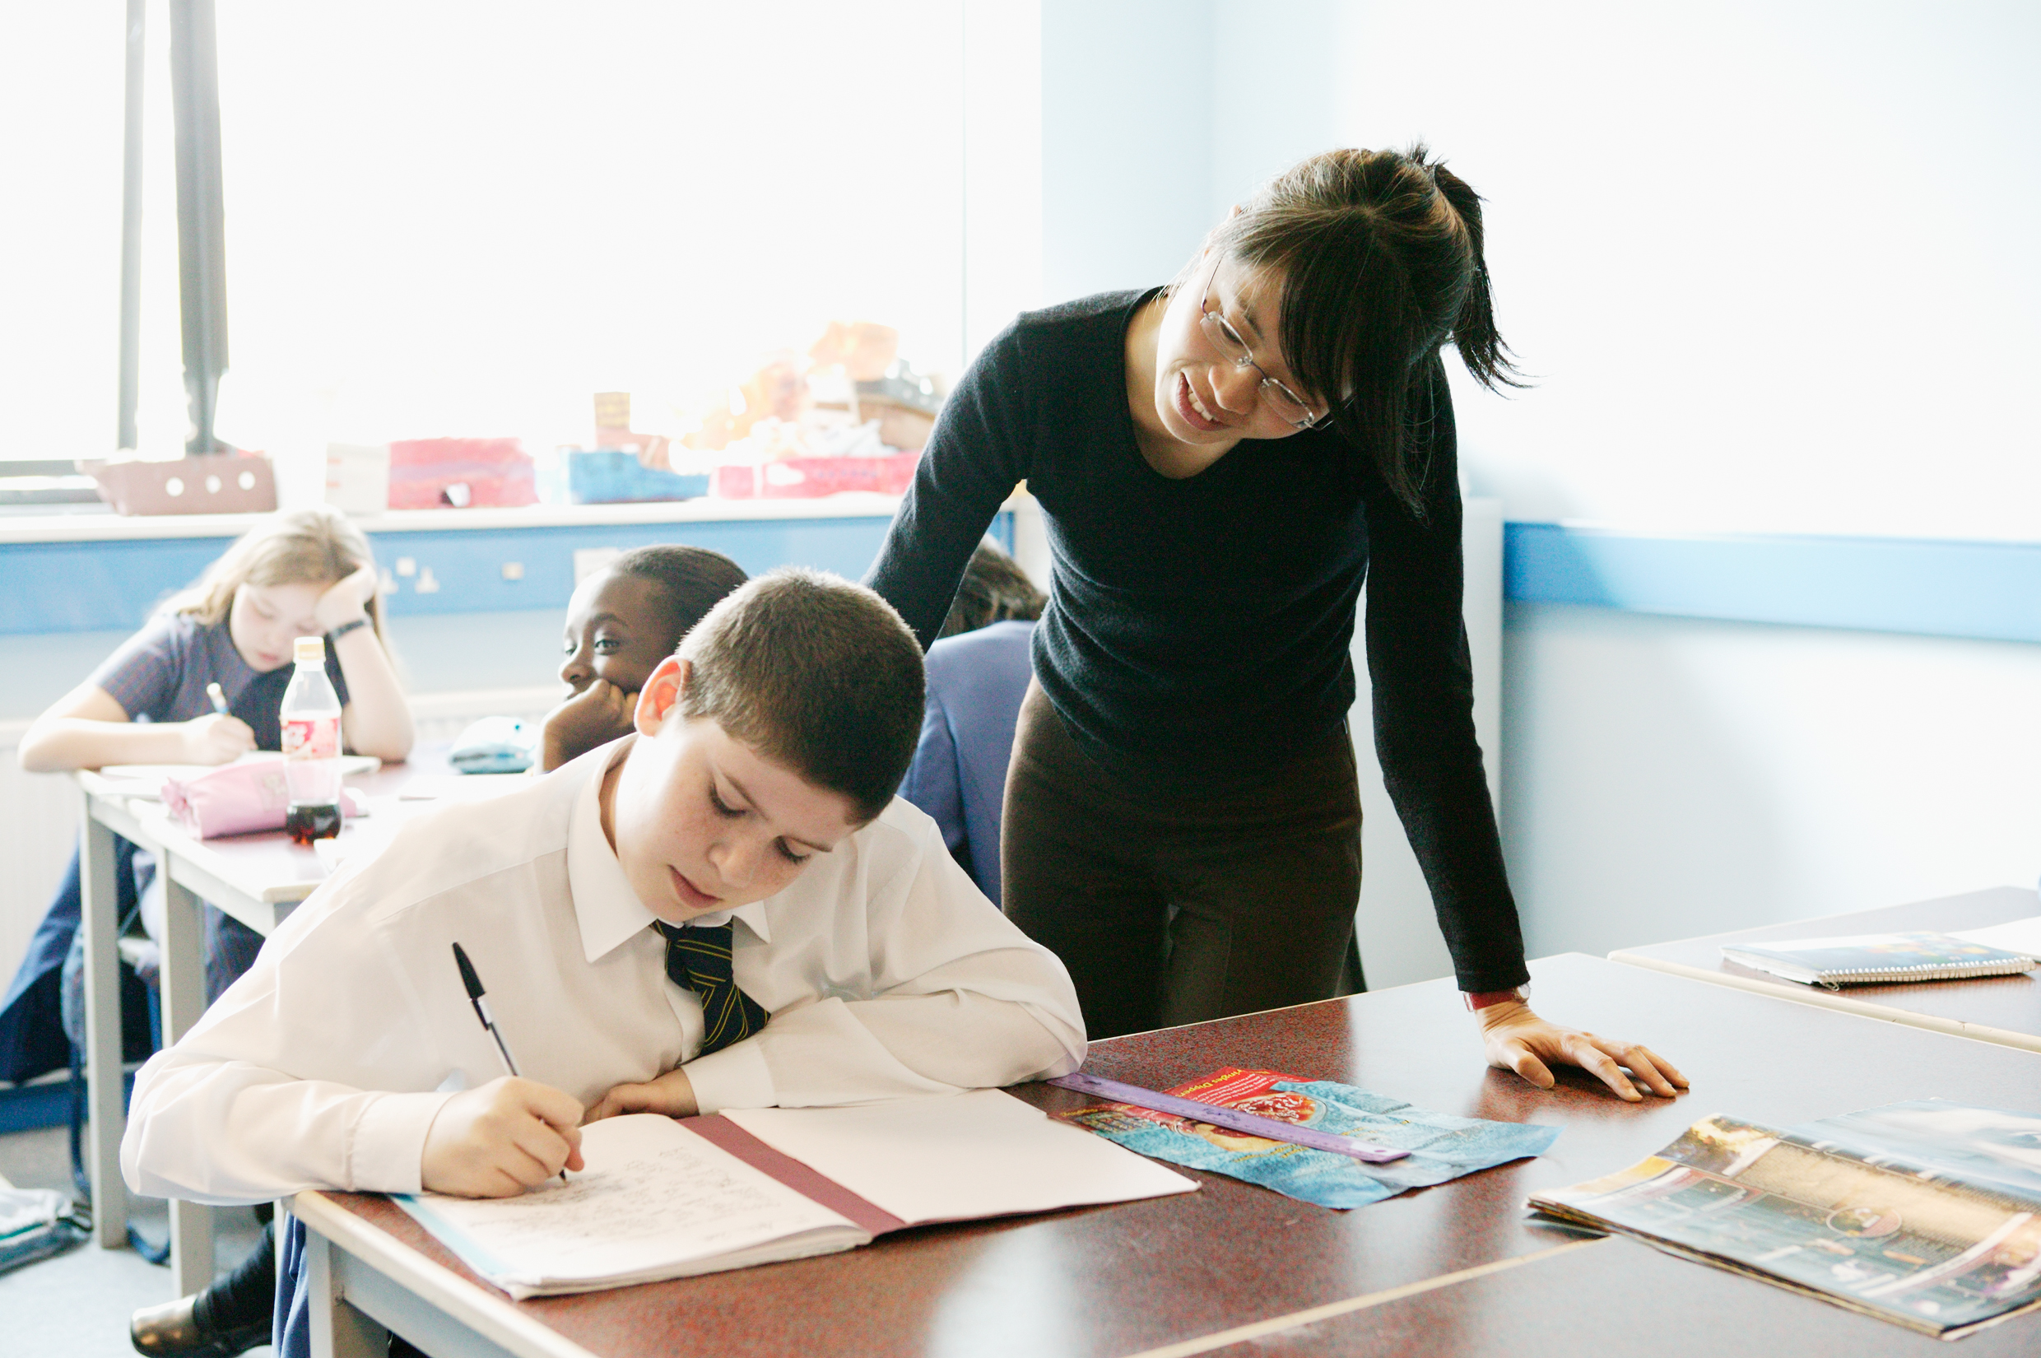
“…This dynamic and enhancing connection between ethos and outcomes is what we mean by ‘Bringing the Vision Alive.’”

Slide 7
What outcomes are you trying to improve?
What are the pressures and challenges?
Who defines this journey?
What help could the Vision offer you?
ethos
enhancing
outcomes
How do you define this for your school?
(in a sentence…)
Where does your ethos come from?
What are the commonalities and differences between us?
What difference does it make to your lived reality?

Slide 8
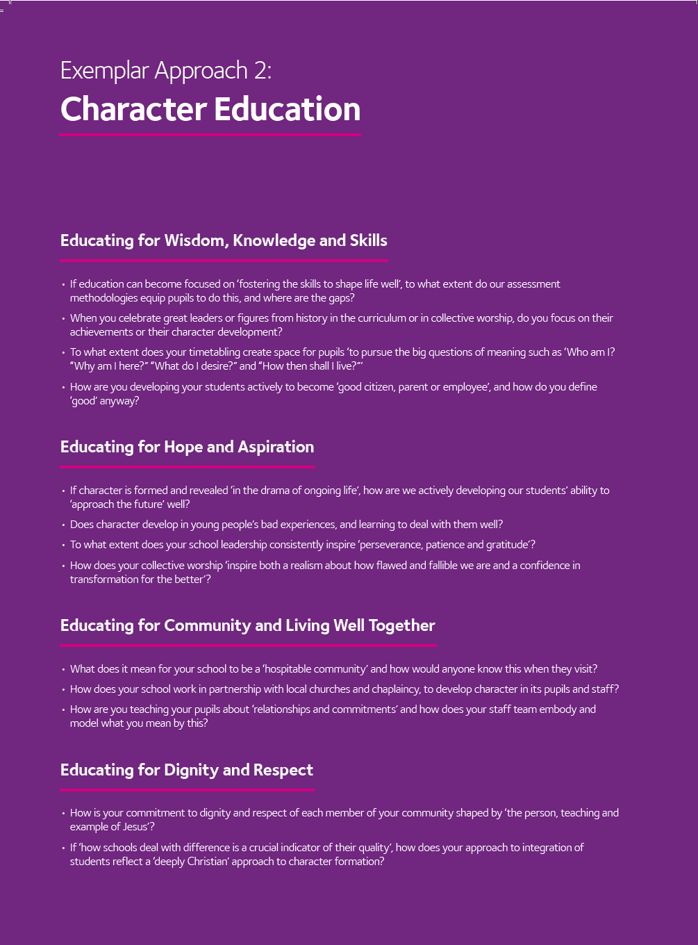
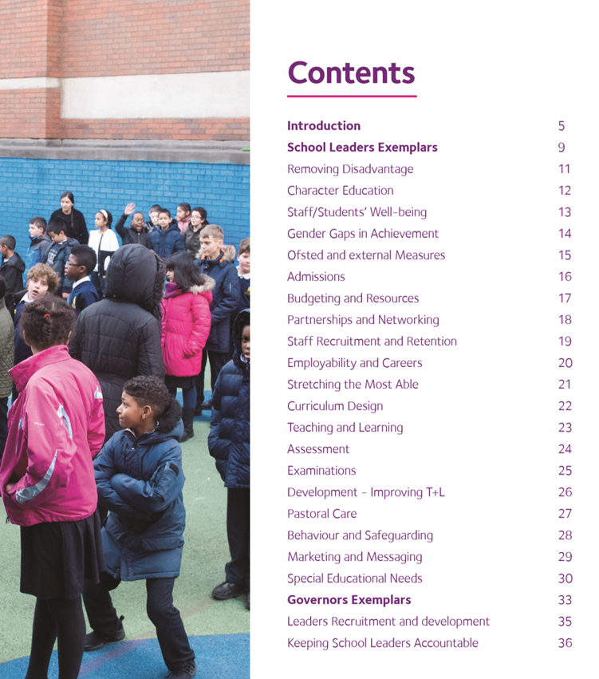
Notes:
Look together at Removing Disadvantage (as an example) – one group to take each strand… what resonated for you?

Slide 10
Theology of Educational Leadership Practices Matrix (2019)

Slide 11
 | Called | Connected | Committed
Educating for Wisdom, Knowledge and Skills | Leading Learning - Refining Judgement | Creating Confidence - Embracing Interdependence | Deepening Understanding - Driving Improvement
Educating for Hope and Aspiration | Developing Imagination - Nurturing Ambition | Healing Relationships - Pursuing Renewal | Sustaining Vision - Building Resilience
Educating for Community and Living Well Together | Removing Disadvantage - Seeking Reconciliation | Accepting Vulnerability - Demonstrating Generosity | Inspiring Faithfulness -Embodying Integrity
Educating for Dignity and Respect | Celebrating Diversity - Enabling Flourishing | Offering Encouragement - Encouraging Service | Practising Humility - Learning Love

Slide 12
Connected:
“Leaders who are connected operate deliberately within communities of practice, positioning themselves within positive relationships that sustain and encourage all parties. They embrace interdependence, demonstrate compassion and embody service to others humbly. They create shared identity within their teams and draw colleagues around a common purpose.”
Notes:
5 minutes
BEFORE GOING TO LUNCH, lets go back to our starting point.
Take a moment on your own to note down:
What has struck you during this morning’s session.
What actions will you take as a consequence
Share with a partner.

Slide 13
 | Called | Connected | Committed
Educating for Wisdom, Knowledge and Skills | Leading Learning - Refining Judgement | Creating Confidence - Embracing Interdependence | Deepening Understanding - Driving Improvement
Educating for Hope and Aspiration | Developing Imagination - Nurturing Ambition | Healing Relationships - Pursuing Renewal | Sustaining Vision - Building Resilience
Educating for Community and Living Well Together | Removing Disadvantage - Seeking Reconciliation | Accepting Vulnerability - Demonstrating Generosity | Inspiring Faithfulness -Embodying Integrity
Educating for Dignity and Respect | Celebrating Diversity - Enabling Flourishing | Offering Encouragement - Encouraging Service | Practising Humility - Learning Love

Slide 14
Educating for
Dignity and Respect:
Ensuring the basic principle of respect for the value and preciousness of each person, treating each person as a unique individual of inherent worth.

Slide 15
 | Called | Connected | Committed
Educating for Wisdom, Knowledge and Skills | Leading Learning - Refining Judgement | Creating Confidence - Embracing Interdependence | Deepening Understanding - Driving Improvement
Educating for Hope and Aspiration | Developing Imagination - Nurturing Ambition | Healing Relationships - Pursuing Renewal | Sustaining Vision - Building Resilience
Educating for Community and Living Well Together | Removing Disadvantage - Seeking Reconciliation | Accepting Vulnerability - Demonstrating Generosity | Inspiring Faithfulness -Embodying Integrity
Educating for Dignity and Respect | Celebrating Diversity - Enabling Flourishing | Offering Encouragement - Encouraging Service | Practising Humility - Learning Love

Slide 16


Slide 17

Offering Encouragement –
Encouraging Service
To lead in education is to give courage to teachers and children, rooted in energising memories and summoned by radical hopes. Leaders advocate for their people, noticing things going well, cheering on and never missing an opportunity to praise. Their encouragement and coaching nurtures leaders who go on to achieve even greater things than the leader themselves. They encourage generous acts of kindness, inspiring children to respect and serve others first.

Slide 18

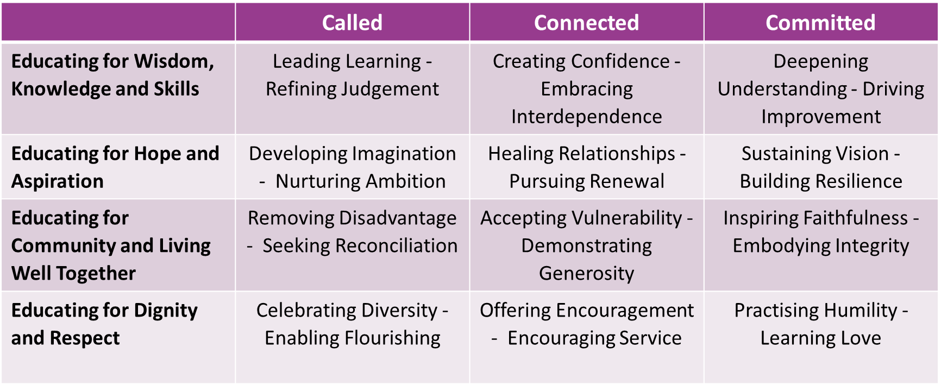
Notes:
Use the Leadership Matrix cards to self-evaluate – choose 2 strengths and 1 area for development to focus on for the year. Record (self-evaluation sheet??)

Slide 20

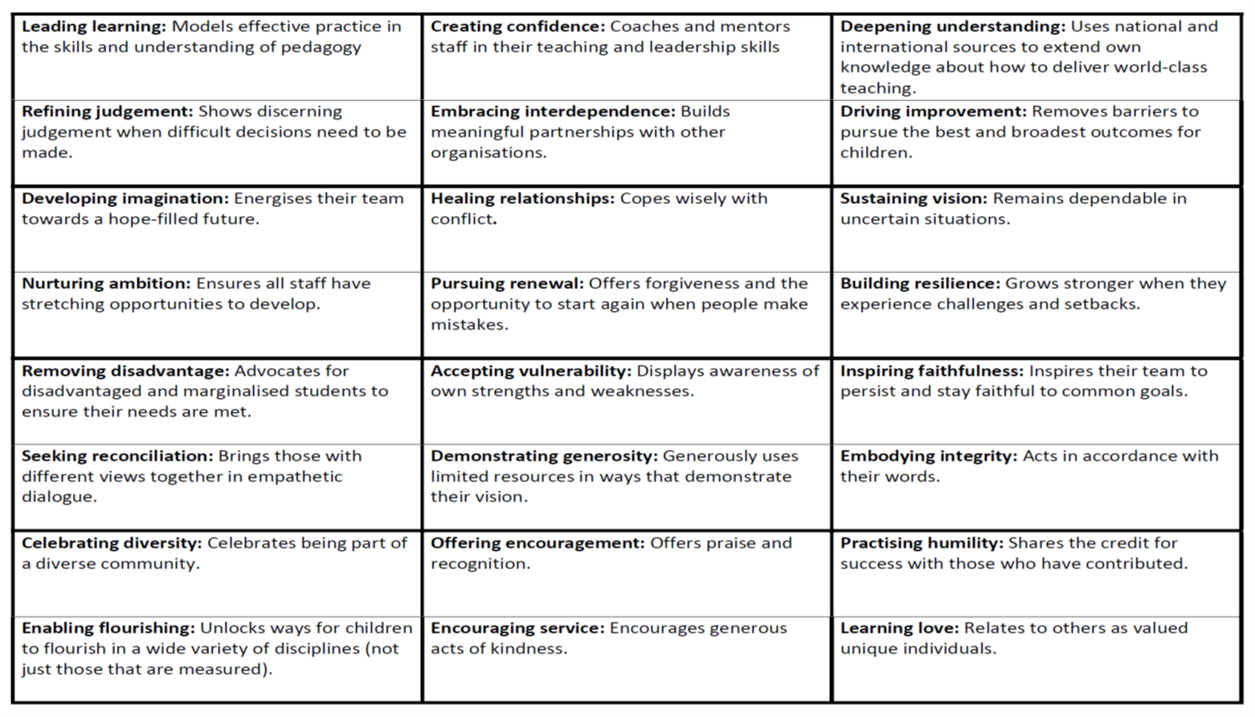
Offering Encouragement –
Encouraging Service

Slide 21
 | Called | Connected | Committed
Educating for Wisdom, Knowledge and Skills | Leading Learning - Refining Judgement | Creating Confidence - Embracing Interdependence | Deepening Understanding - Driving Improvement
Educating for Hope and Aspiration | Developing Imagination - Nurturing Ambition | Healing Relationships - Pursuing Renewal | Sustaining Vision - Building Resilience
Educating for Community and Living Well Together | Removing Disadvantage - Seeking Reconciliation | Accepting Vulnerability - Demonstrating Generosity | Inspiring Faithfulness -Embodying Integrity
Educating for Dignity and Respect | Celebrating Diversity - Enabling Flourishing | Offering Encouragement - Encouraging Service | Practising Humility - Learning Love

Slide 23
National Conference 6th February
Visionary Curriculum Leadership

