Slide 1
Norwich Headteachers
Peer Support Network
21st January

Slide 2
Leading the preparation for inspection across more than one school

Slide 3
Reflection

Slide 4
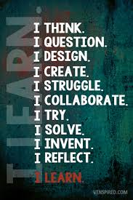
What kind of education?

Slide 5

‘That which leaders choose to improve communicates much about their values.’

Slide 6

‘The imagination must come before the implementation…
…Leaders who develop this imagination in their teams, like teachers who do the same with their children, build resilience for challenging moments or when things change.’

Slide 7
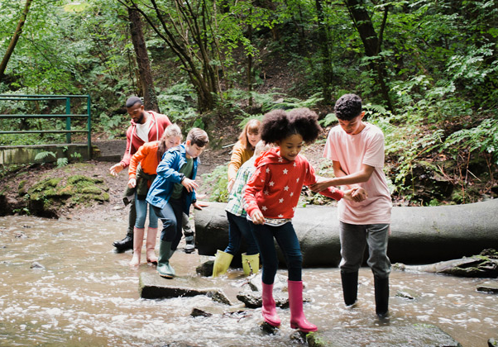
‘Leaders understand that wisdom, knowledge and skills liberate children, giving freedom to create, grow, earn, flourish and relate.’

Slide 8

‘Encouraging leaders… take challenge seriously, and they define reality accurately, even when it presents uncomfortable truth.’

Slide 9
Peer Support Network

Slide 10
The Church of England Foundation
for Educational Leadership’s mission is:
“To develop inspirational leaders who are called, connected and committed to delivering the Church of England’s vision for education”

Slide 11

Benefits of the Peer Support Network:
Building relationships
Long-term commitment with possibilities for ongoing peer to peer support
Sharing good practice & owning the focus
Exploring enquiry questions through high quality resources & expert facilitation
Evaluating what works
Utilising a proven methodology

Slide 12
Defining our Current Reality

Slide 13
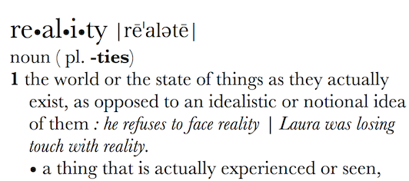
Can Vision be too idealistic? Rose-tinted? Inspirational? Transformational?
What is your actual lived experience? Is the first step of great leadership defining reality accurately?

Slide 14
How might we define our current lived reality?
Which CofE reports/ key policy statements/White Papers have affected us the most? (how and why?)
How do we articulate our current vision for our school – how embedded is this vision in the lived experience of our community?
How does the changing educational landscape affect the way we think and plan? What are the key challenges and opportunities?

Slide 15
How can we evaluate the prevailing educational narratives?
The importance of teaching (2010)
Schools that work for everyone (2016)
Every Child Matters (2003)
Educational Excellence Everywhere (2016)
Your child, your schools, our future (2009)

Slide 16
How can we evaluate the prevailing educational narratives?
‘A building with 4 walls and tomorrow inside’
‘Building a better world, one student at a time’
Learners Today. Leaders Tomorrow.
Imagine greatness. Knowledge is Power
‘Be safe. Be Kind. Be smart’

Slide 17
How can we evaluate the prevailing educational narratives?
Narrowing the horizons of learning – keeping it tight until May in Year 6
Every percentage point counts
Your child? Our unit of economic capital
Their results? My job.
Most children matter, some matter more than others

Slide 18
Thin Narratives | Thick Narratives
Utilitarian/ Instrumentalist | Wisdom, Knowledge and Skills (for living well)
Competitive | Hope and Aspiration (through forgiveness and grace)
Individualistic | Community and Living Well Together (created for life together)
Reductionist | Dignity and Respect (of every person)

Slide 19
Children
‘Life in all its fullness’
Adults
Teams

Slide 20
To which leaders do these apply? How ready are leaders at all levels for these expectations?
How many of these are reasonable? How many are external, and how many are internal?
Sage/Guide/Expert/
Enthusiast
Resourced/Trusted/
Revered
Expectations for Leadership
Storyteller/Evangelist/
Salesperson
Energy/Passion/Love/
Time

Slide 21
Leading with vision across more than one school

Slide 22
A Vision for Education
  Not a blueprint to be imposed but compelling principles to shape our narrative

Slide 23
A Vision for Education
  The principles of a movement rather than the policy of an organisation

Slide 24


Slide 25
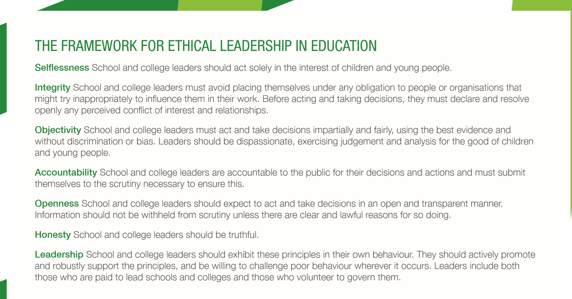

Slide 26
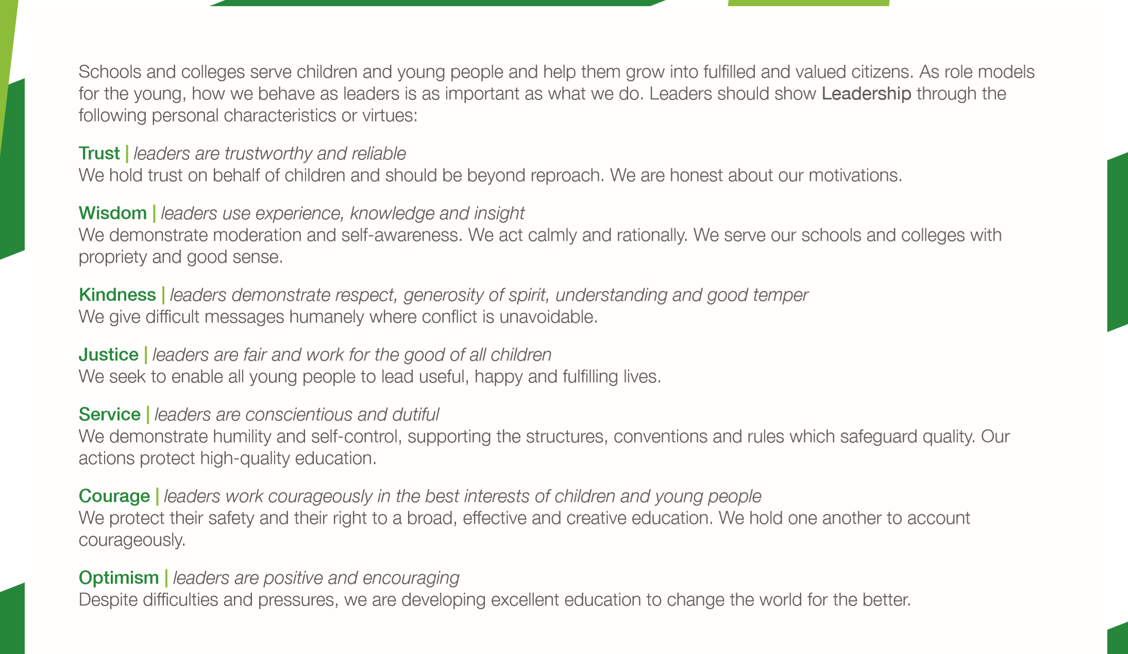

Slide 27
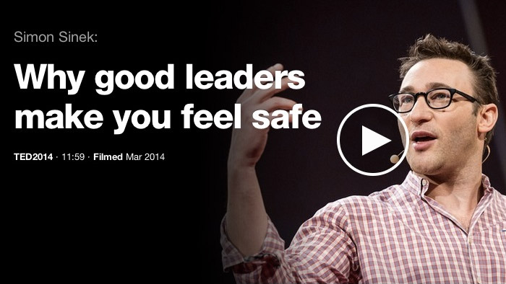
Given the elevated role for middle leaders in the new inspection framework, how can you ensure they feel safe and secure?
https://www.ted.com/talks/simon_sinek_why_good_leaders_make_you_feel_safe#t-597897

Slide 28
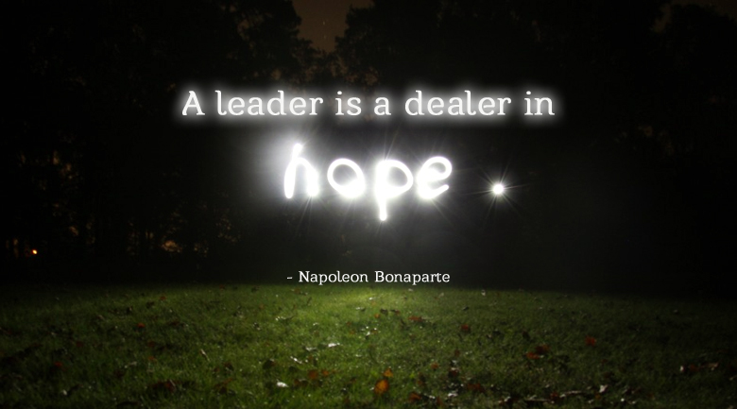
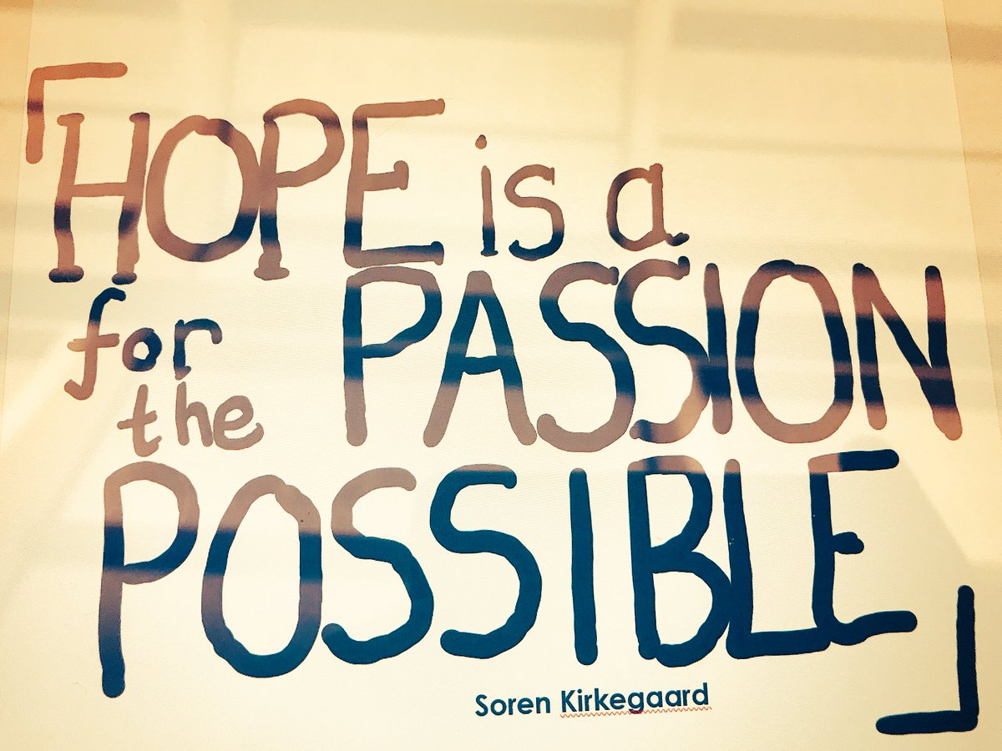
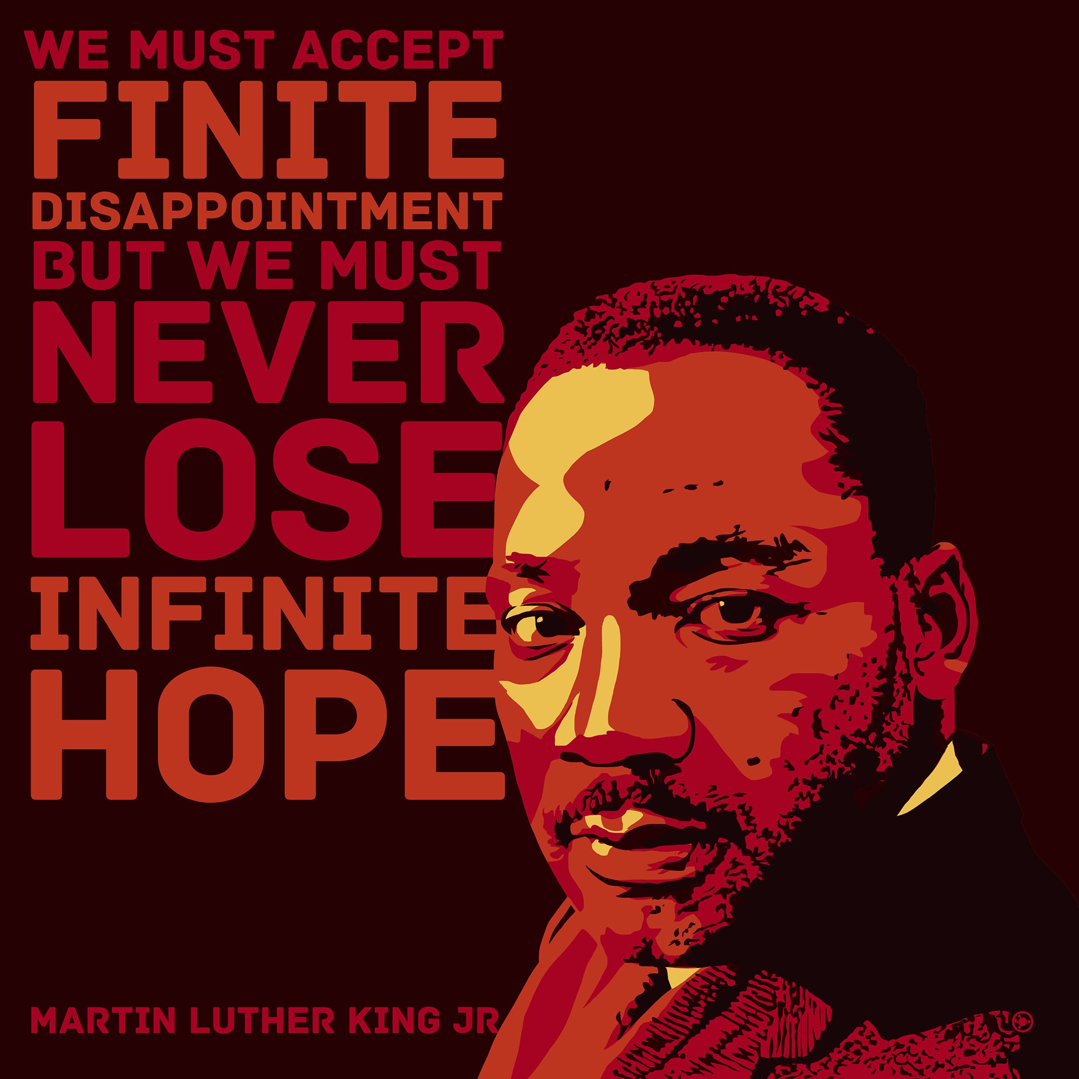
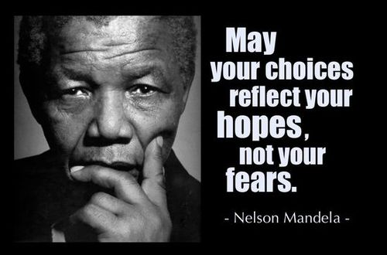

Slide 29


Slide 30
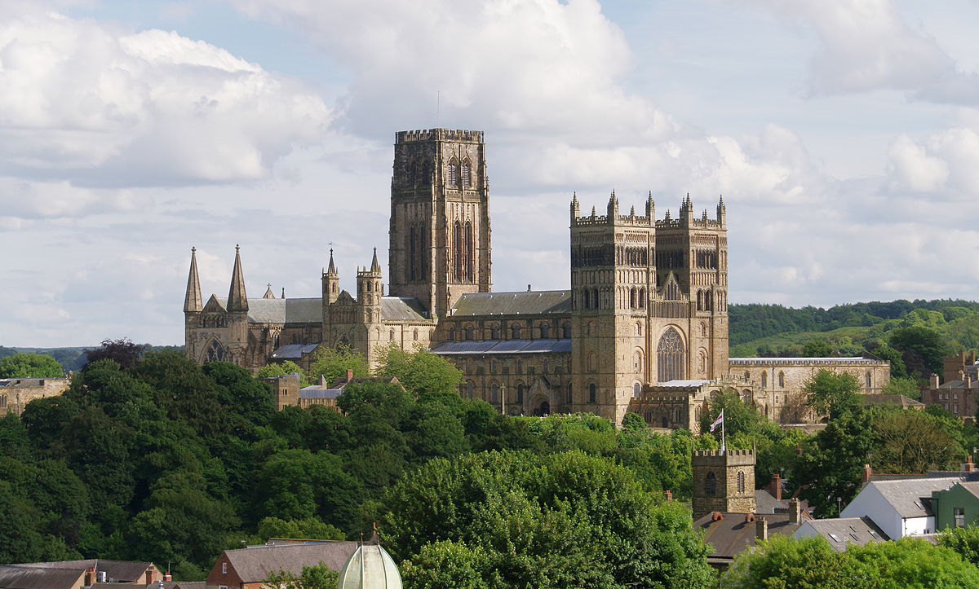
Building cathedrals…?

Slide 31
‘It is not the beauty of a building you should look at; it’s the construction of the foundation that will stand the test of time.’
David Allen Coe

Slide 32
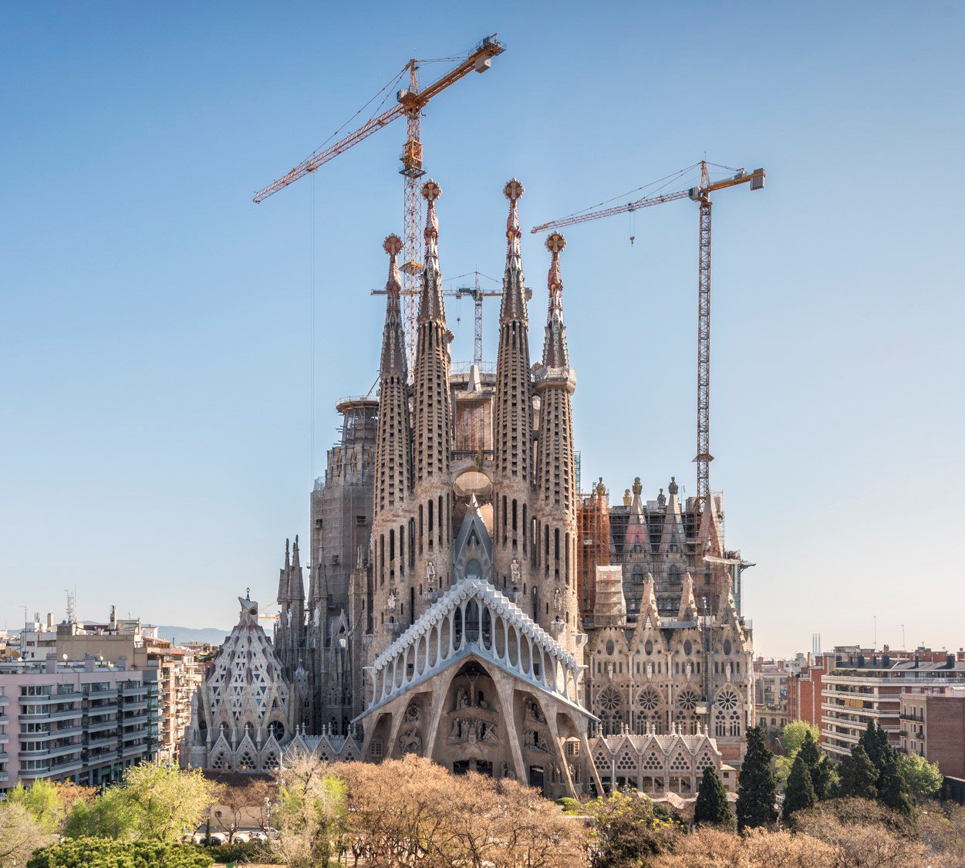
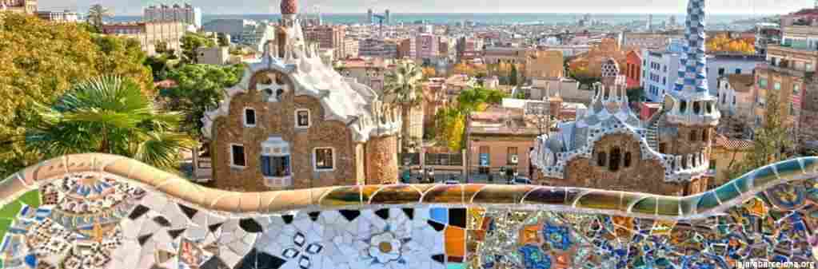
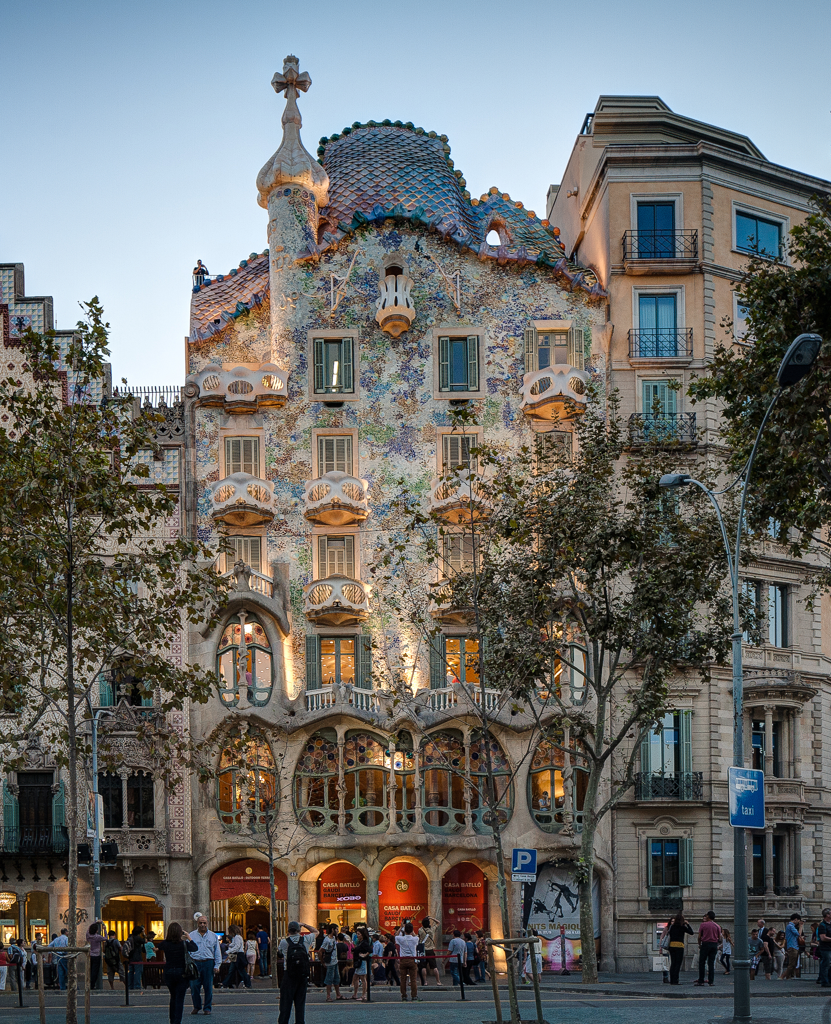


Slide 33
Leading with vision: curriculum intent

Slide 34


Slide 35
Why?
How?
What?
Do staff know WHY they are teaching what they are teaching?
Do pupils know WHY they are learning what they are learning?

Slide 36
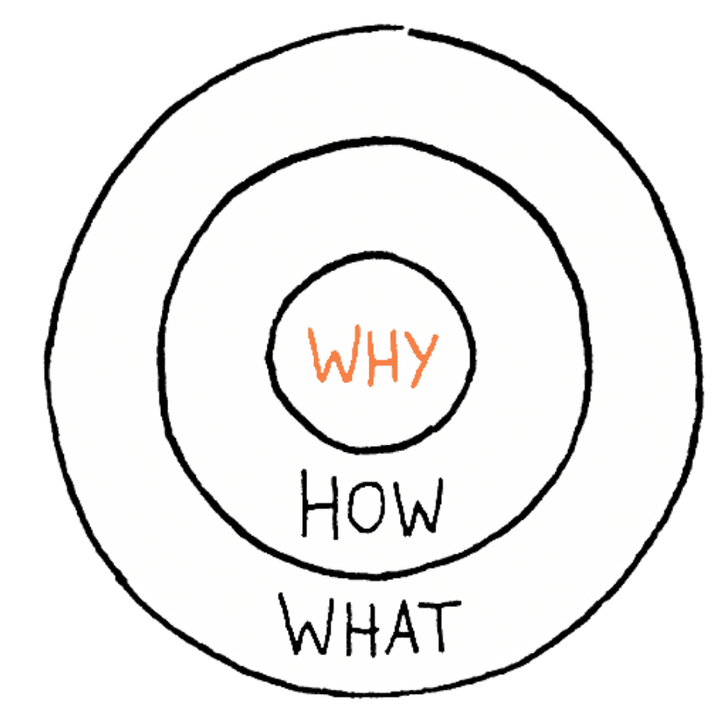
How far are your subject leaders able to articulate their ‘why’?

Slide 37
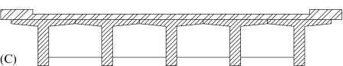
PSHE/ RSHE
English
Maths
RE
Science
PE
History
Geography
Music
Art
DT
Which subjects are ‘earthquake-proof’?
Which are not…yet…?

Slide 38
Vision into practice: Ethos Enhancing Outcomes

Slide 39

“If the Vision for Education fails to make and sustain meaningful connections between a school’s ethos and its outcomes, it will become nothing more than a deeply eloquent and well-meaning piece of writing…”

Slide 40
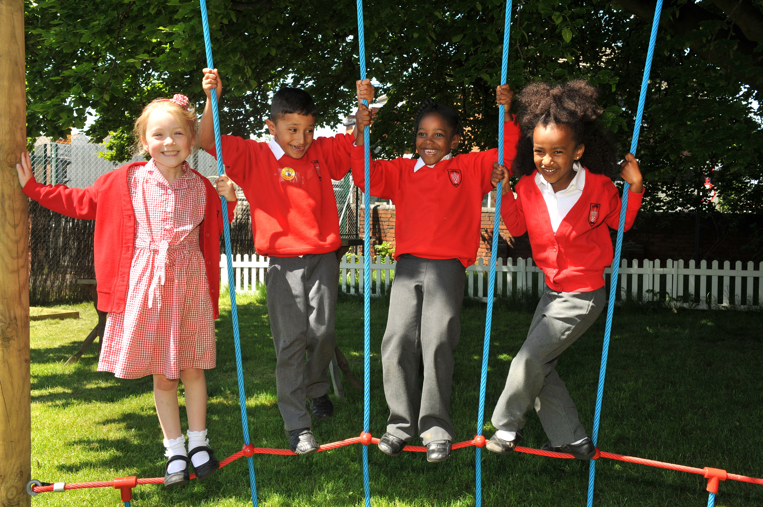
“..It must come off the shelf and be brought to life through leaders evaluating its potential impact on every area of day-to-day school life…”

Slide 41
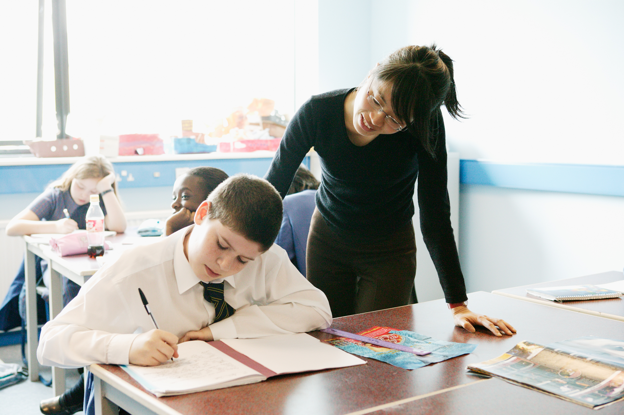
“…This dynamic and enhancing connection between ethos and outcomes is what we mean by ‘Bringing the Vision Alive.’”

Slide 43
What outcomes are you trying to improve?
What are the pressures and challenges?
Who defines this journey?
What help could the Vision offer you?
ethos
enhancing
outcomes
How do you define this for your school?
(in a sentence…)
Where does your ethos come from?
What are the commonalities and differences between us?
What difference does it make to your lived reality?

Slide 44
To what extent does your vision and ethos actually ‘foster confidence’ in driving school improvement and results?
How can you identify and ‘nurture (the best) academic habits and skills’ in staff and pupils to develop a strong ethos and love of learning across all your schools?
Good staff and pupil relationships are key to the success of any school. How do you develop and sustain a genuine partnership between staff and pupils?
If your school was known for being a ‘community centred institution’, how would this be reflected in your vision, values and the way you operate?

Slide 45
How much do we focus on short-term accountability measures, compared to the longer-term ambition of educating for hope and aspiration?
Do our young people articulate hope and aspiration and speak about ‘what it means to live life in all its fullness’ when talking to governors, senior leaders, inspectors and others?
Can we demonstrate to external bodies across all our schools that we are always willing to learn from others as we seek to grow stronger?
Can we demonstrate that staff across all our schools feel that they are treated with dignity and respect, and that we are ‘allowing for healthily diverse debate, agreement and disagreement’?

Slide 46
Called, Connected, Committed: Leadership Practices Matrix (2020)

Slide 47
 | Called | Connected | Committed
Educating for Wisdom, Knowledge and Skills | Leading Learning - Refining Judgement | Creating Confidence - Embracing Interdependence | Deepening Understanding - Driving Improvement
Educating for Hope and Aspiration | Developing Imagination - Nurturing Ambition | Healing Relationships - Pursuing Renewal | Sustaining Vision - Building Resilience
Educating for Community and Living Well Together | Removing Disadvantage - Seeking Reconciliation | Accepting Vulnerability - Demonstrating Generosity | Inspiring Faithfulness -Embodying Integrity
Educating for Dignity and Respect | Celebrating Diversity - Enabling Flourishing | Offering Encouragement - Encouraging Service | Practising Humility - Learning Love

Slide 48
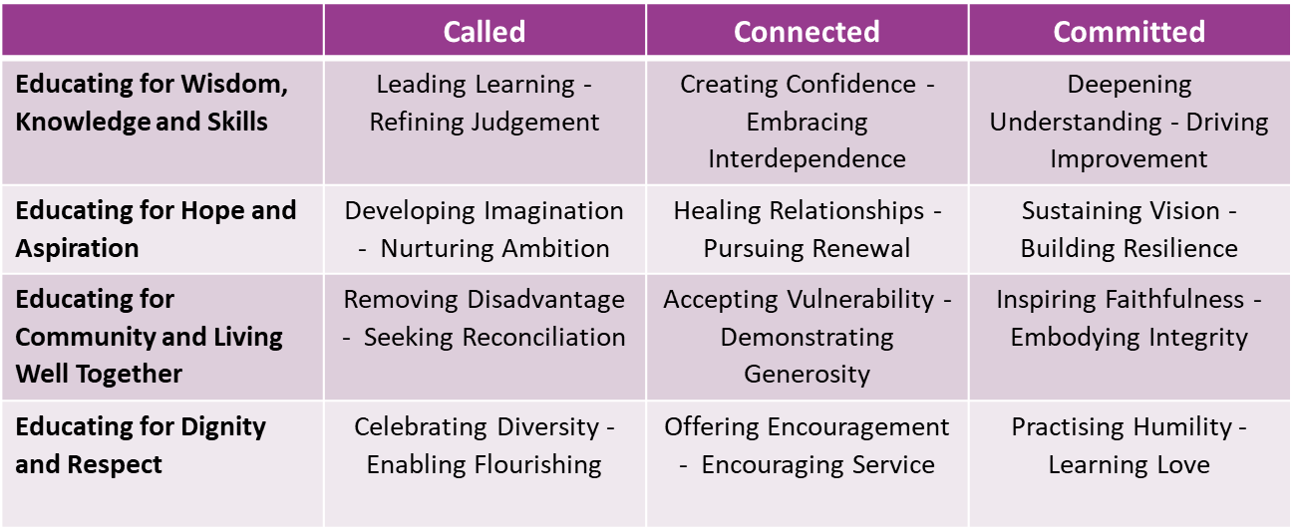
The Leadership Practice Gap Analysis
For each leadership practice, think about where the strengths in your schools are. Can you think of a person (or people) who particularly demonstrate that practice?
Use a different colour for each of your schools.
Now look where the gaps are. What could you do to encourage this practice across your schools?
Which practices are most essential for preparing for inspection? How confident are your leaders in these?

Slide 49


The Leadership Practice ‘deep dive’
Sustaining Vision
Building Resilience

Slide 50
Committed:
“Leaders who are committed exude energy and passion in all they do, inspiring confidence and faithfulness in their teams. They are clear about their purpose and resilient in the face of challenge. They take long-term decisions and not easily swayed by short-term changes of policy or procedure. They articulate a sense of mission in their approach to education to which they draw others, and are committed to the flourishing of their pupils and colleagues.”
Notes:
5 minutes
BEFORE GOING TO LUNCH, lets go back to our starting point.
Take a moment on your own to note down:
What has struck you during this morning’s session.
What actions will you take as a consequence
Share with a partner.

Slide 51
 | Called | Connected | Committed
Educating for Wisdom, Knowledge and Skills | Leading Learning - Refining Judgement | Creating Confidence - Embracing Interdependence | Deepening Understanding - Driving Improvement
Educating for Hope and Aspiration | Developing Imagination - Nurturing Ambition | Healing Relationships - Pursuing Renewal | Sustaining Vision - Building Resilience
Educating for Community and Living Well Together | Removing Disadvantage - Seeking Reconciliation | Accepting Vulnerability - Demonstrating Generosity | Inspiring Faithfulness -Embodying Integrity
Educating for Dignity and Respect | Celebrating Diversity - Enabling Flourishing | Offering Encouragement - Encouraging Service | Practising Humility - Learning Love

Slide 52
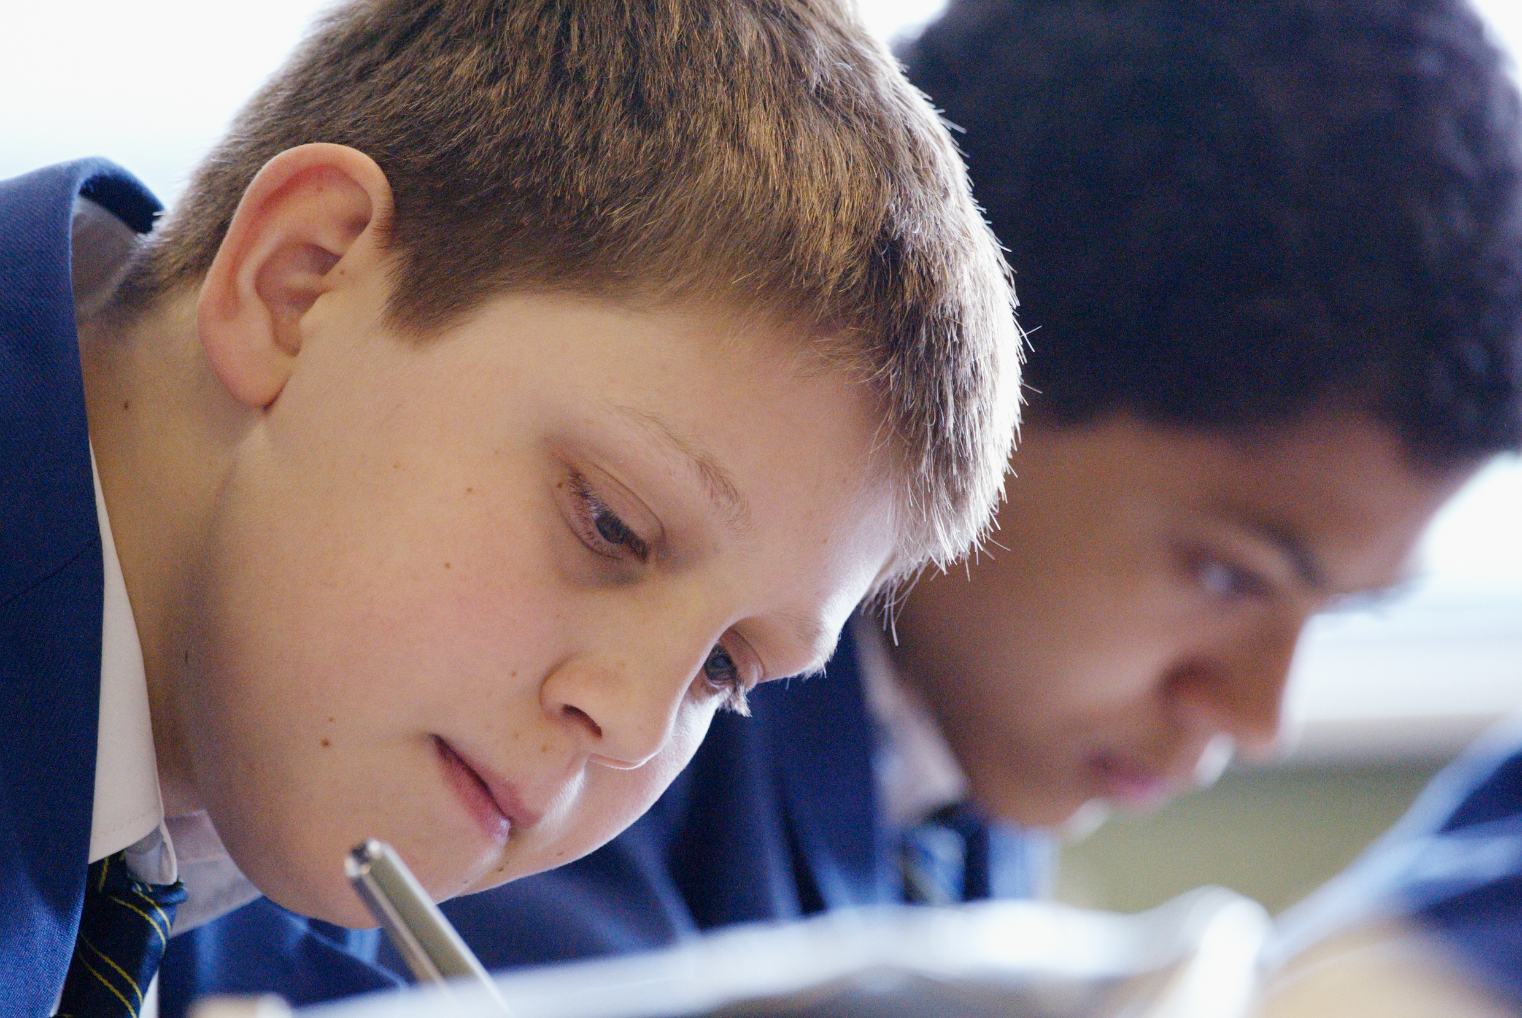
Educating for Hope and Aspiration:
Seeking healing, repair and renewal, coping wisely with things and people going wrong, opening horizons and guiding people into ways of fulfilling them.

Slide 53
 | Called | Connected | Committed
Educating for Wisdom, Knowledge and Skills | Leading Learning - Refining Judgement | Creating Confidence - Embracing Interdependence | Deepening Understanding - Driving Improvement
Educating for Hope and Aspiration | Developing Imagination - Nurturing Ambition | Healing Relationships - Pursuing Renewal | Sustaining Vision - Building Resilience
Educating for Community and Living Well Together | Removing Disadvantage - Seeking Reconciliation | Accepting Vulnerability - Demonstrating Generosity | Inspiring Faithfulness -Embodying Integrity
Educating for Dignity and Respect | Celebrating Diversity - Enabling Flourishing | Offering Encouragement - Encouraging Service | Practising Humility - Learning Love

Slide 55
Sustaining Vision
How important are consistency, dependability and ‘sticking around’ in leadership?
What resources does your team need to draw on in order to sustain a vision, as oppose to merely create it?
To what extent do you agree that ‘Vision is sustainable even if circumstances and situations are against you’? How could this be reflected in your actions and decision making?
Building Resilience
Where do you get your resilience from as a leader?
How might you define resilience in your organisation? What practical strategies or experiences do you think help to build resilience in teams? Is it the same for adults and children?
Are there circumstances where you have experienced the need to rely on God and/ or others? How has this affected your leadership journey?

Slide 56

Formulating research questions
What would you like to explore around how to prepare for inspection across more than one school?
How will you go about finding this out?
Who will you need to involve?

Slide 57


