Slide 1
Peer Support Network: Visionary Curriculum Leadership in Small Schools – Norwich 21st January

Slide 2
Reflection

Slide 3

Developing Imagination

Slide 4
‘The imagination must come before the implementation. Our culture is competent to implement almost anything and imagine almost nothing. It is our vocation to keep alive the ministry of imagination.’
Walter Brueggemann The Prophetic Imagination

Slide 5
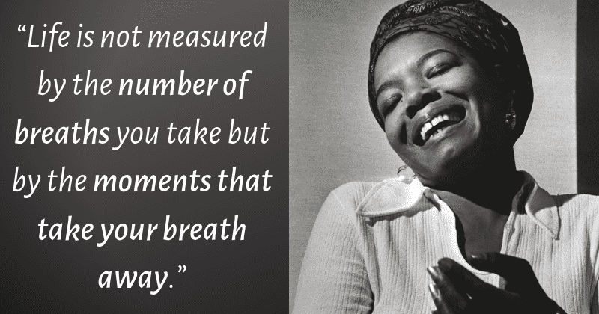
Notes:
Maya Angelou

Slide 6
Defining our Current Reality

Slide 7
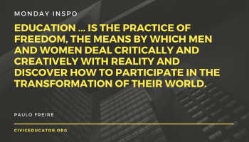

Slide 8
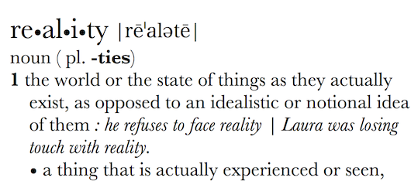
Can Vision be too idealistic? Rose-tinted? Inspirational? Transformational?
What is your actual lived experience? Is the first step of great leadership defining reality accurately?

Slide 9
How can we evaluate the prevailing educational narratives?
Narrowing the horizons of learning – keeping it tight until May in Year 6
Every percentage point counts
Your child? Our unit of economic capital
Their results? My job.
Most children matter, some matter more than others

Slide 10
Thin Narratives | Thick Narratives
Utilitarian/ Instrumentalist | Wisdom, Knowledge and Skills (for living well)
Competitive | Hope and Aspiration (through forgiveness and grace)
Individualistic | Community and Living Well Together (created for life together)
Reductionist | Dignity and Respect (of every person)

Slide 11
Children
‘Life in all its fullness’
Adults
Teams

Slide 12
What do we mean by ‘human flourishing’?

Slide 13
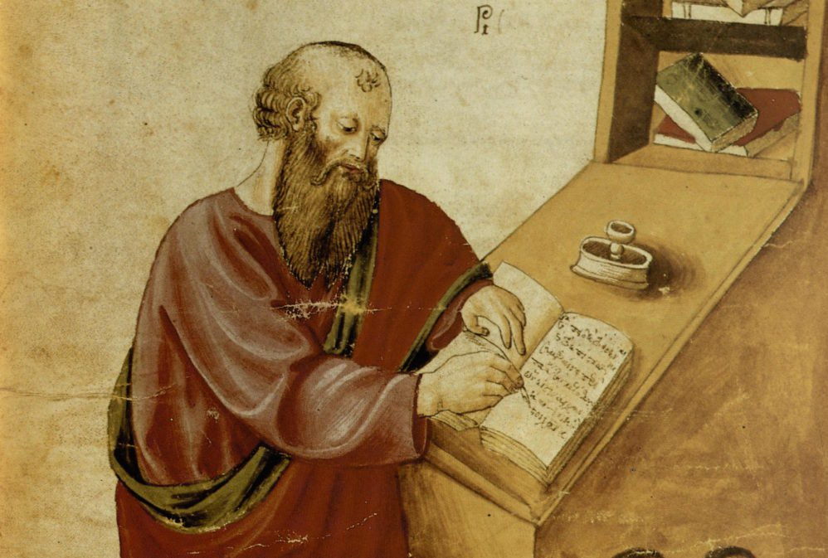
‘The notion of human flourishing set out in our thinking draws significantly on Aristotle, and especially on his conception of eudaimonia. The meaning of eudaimonia can be traced etymologically from its roots of ‘eu’ (good) and ‘daimon’ (spirit), refers to the notion of human flourishing and can…[refer to] physical flourishing, emotional flourishing, societal flourishing and fourthly, flourishing in terms of personal creativity, self-expression and knowledge seeking.’
Leadership of Character Education, 18

Slide 14
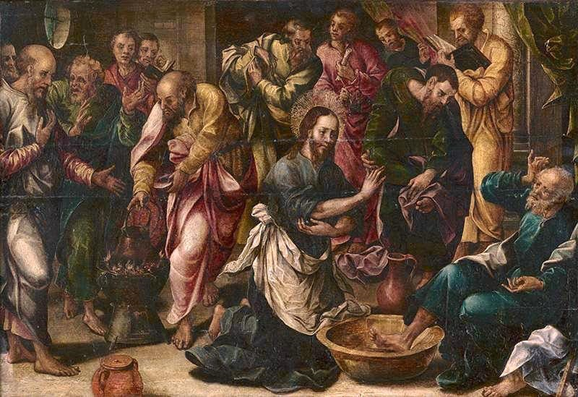
‘Love one another. As I have loved you, so you must love one another. By this, everyone will know that you are my disciples.’
John 13:34-5

Slide 15

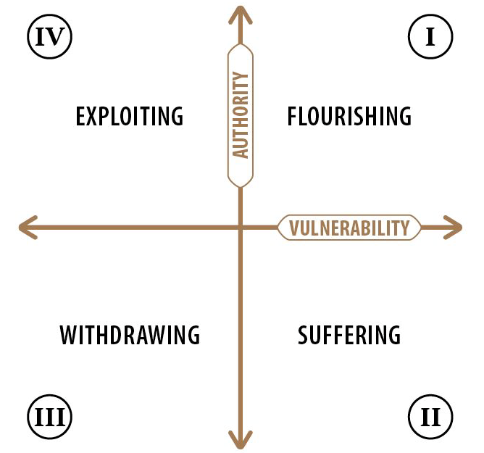
https://www.youtube.com/watch?v=GJ8ry2MyyVA

Slide 16

How can we enable flourishing of pupils (and adults!) through our curriculum?
Where are the opportunities for risk?
Where are the opportunities to take the lead?
Where might children withdraw – is this more likely in some subjects than others? What could we do to mitigate this?

Slide 17
What is the Curriculum for?

Slide 18
Children
‘Life in all its fullness’
Adults
Teams

Slide 19
We flourish because of our diversity and relationships
We flourish at different times and different speeds
Flourishing Teams
Flourishing Adults
We flourish so we can look outwards and give
Flourishing Children
We flourish when we stop doing things

Slide 20

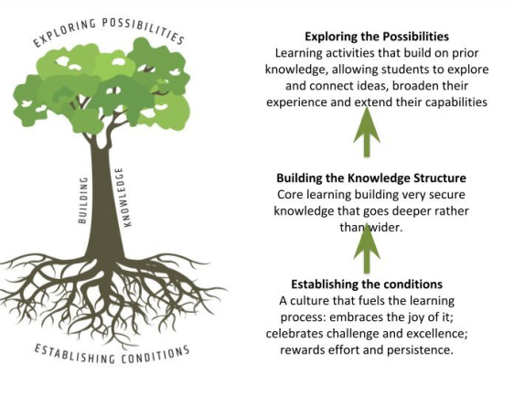

Slide 21
Learning Plantation | Learning Rainforest
‘A right way to do things’ – set routines – e.g. L.O. on the board every lesson | Nourishing individual talents - high trust/high challenge
Leaders driven by compliance to external voices | Great variety in pedagogy and OK to try new things all the time
T+L focused on what can be examined | If creative approaches deliver, there is high level of autonomy
Data has very high status | Data is part of the picture of learning
Interventions heavily focused on short-term gains | T+L structures are dynamic/organic, aligning T+L to stated school values
Creativity becomes rules – e.g. standardised homework format etc. | Highly personalised CPD

Slide 22

‘The job of a good curriculum is to inspire teachers, not instruct them’
Russell Hobby
‘Knowledge is power. Information is liberating’
Kofi Annan
‘It is not the beauty of a building you should look at; it’s the construction of the foundation that will stand the test of time.’
David Allen Coe
‘Question everything. Learn something’
Euripides

Slide 23

Read ‘Curriculum Purpose’
What stands out to you?
Is there anything here you might not have considered?
How far would children in your classes be able to say ‘we are learning this so that…’

Slide 24
Designing a Curriculum for Wisdom

Slide 25
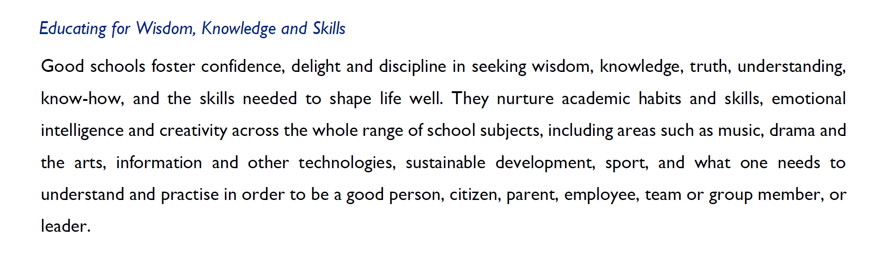

Slide 26
Wisdom is…
Wisdom is a shared conversation not a one-way transaction
Wisdom is reliant on one expert, but seeks other views
Wisdom is reading slowly and widely
Wisdom is connecting and synthesising, re-using and rejecting
Wisdom loves detail, not just superficiality
Wisdom unleashes imagination
Wisdom needs diversity, not just because it’s right but because it’s inherently better
Wisdom is making choices, sometimes between two seemingly good things
Wisdom is inherited from those in community & family around us
Wisdom always permits good questions, but has the confidence to articulate clear answers
Wisdom views mistakes with perspective

Slide 29
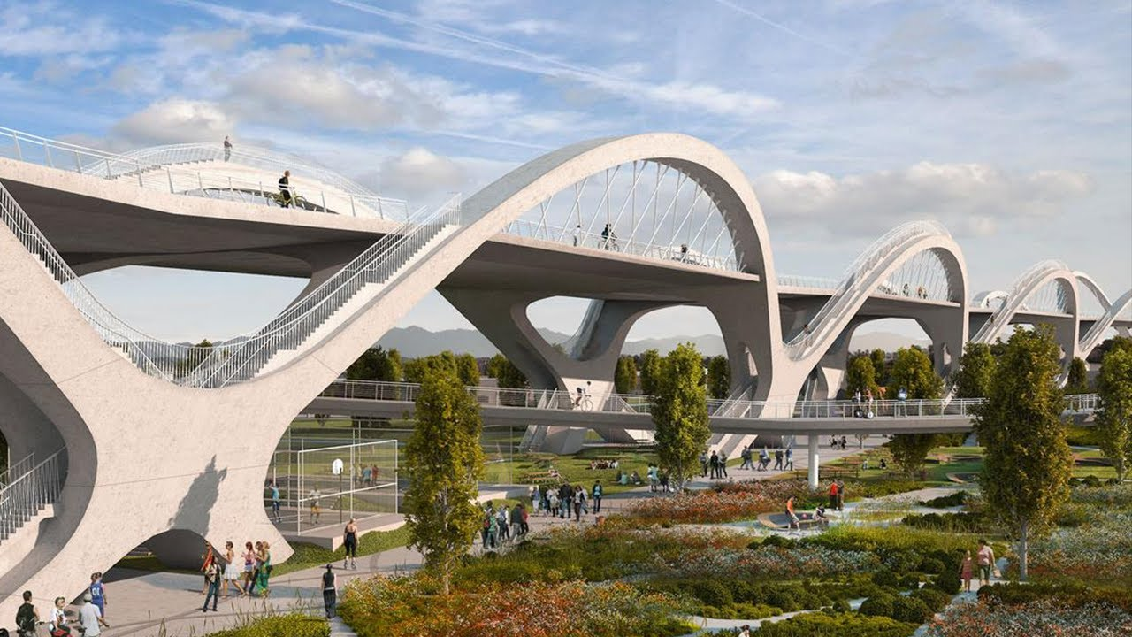
Designing bridges to withstand earthquakes: whole bridge vs individual piers

Slide 30
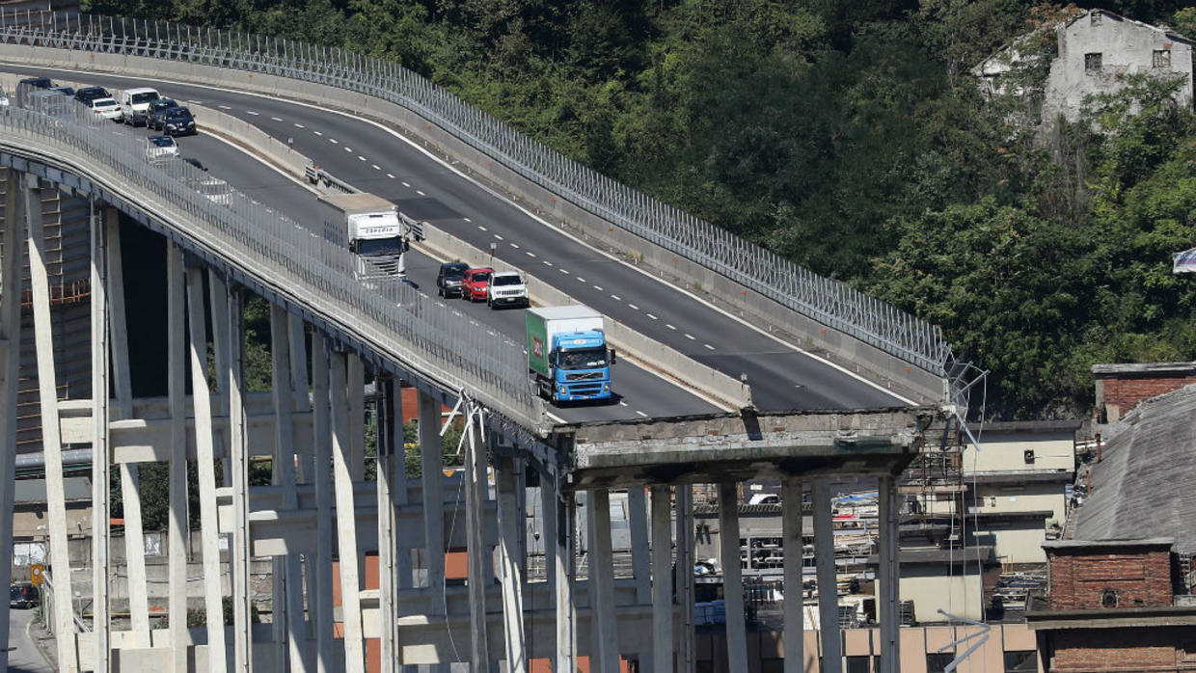
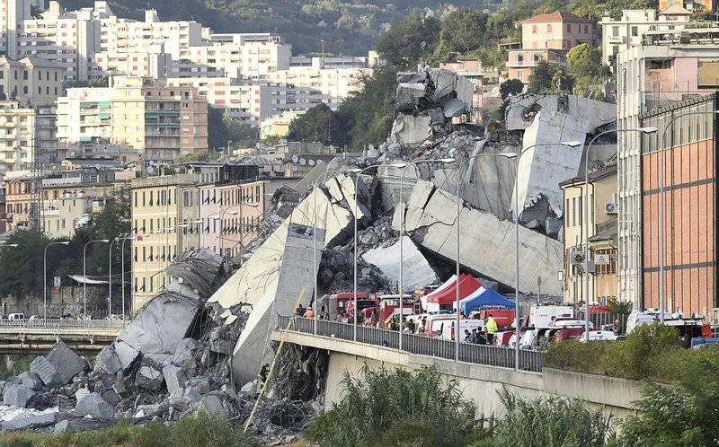
Localised collapse: if a small section of the bridge collapses, it becomes completely unusable
Engineers design bridges so that they are interdependent in order to compensate for any failures. This means that even if one component fails, the bridge will remain safe and functional.
Disproportionate collapse: a tiny failure in the bridge can cause the entire bridge to collapse

Slide 31
Connection, interconnection and disconnection: Ofsted Framework (2019)
‘Interconnection’ of evidence: inspectors will connect evidence from lessons and work scrutiny to other sources of evidence available to build a picture of the quality of education.
An appropriate curriculum for Maths ‘draws connections’ and books chosen for reading should be ‘connected’ to pupils’ phonics knowledge.
Words with the root ‘connect’ occur 18 times
Inspectors will look at the ‘connectedness’ of the curriculum, teaching, assessment and standards.
Pupils should connect their new learning with their prior learning, not learn ‘disconnected facts’.

Slide 32
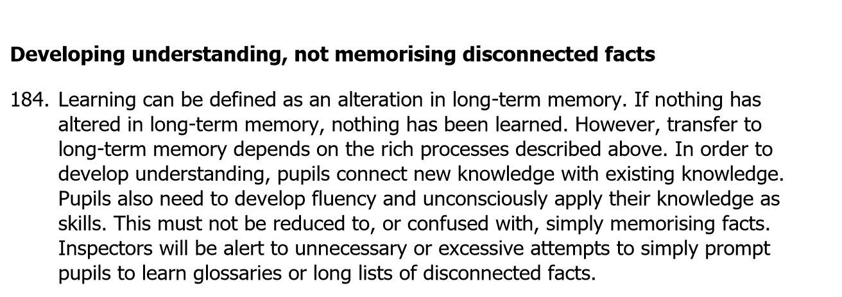

Slide 33
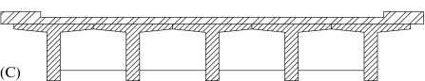
Where can you design for connection and interdependence?
PSHE/ RSHE
English
Maths
RE
Science
PE
History
Geography
Music
Art
DT
Which subjects are ‘earthquake-proof’?
Which are not…yet…?

Slide 34
Ethos Enhancing Outcomes

Slide 35

“If the Vision for Education fails to make and sustain meaningful connections between a school’s ethos and its outcomes, it will become nothing more than a deeply eloquent and well-meaning piece of writing…”

Slide 36
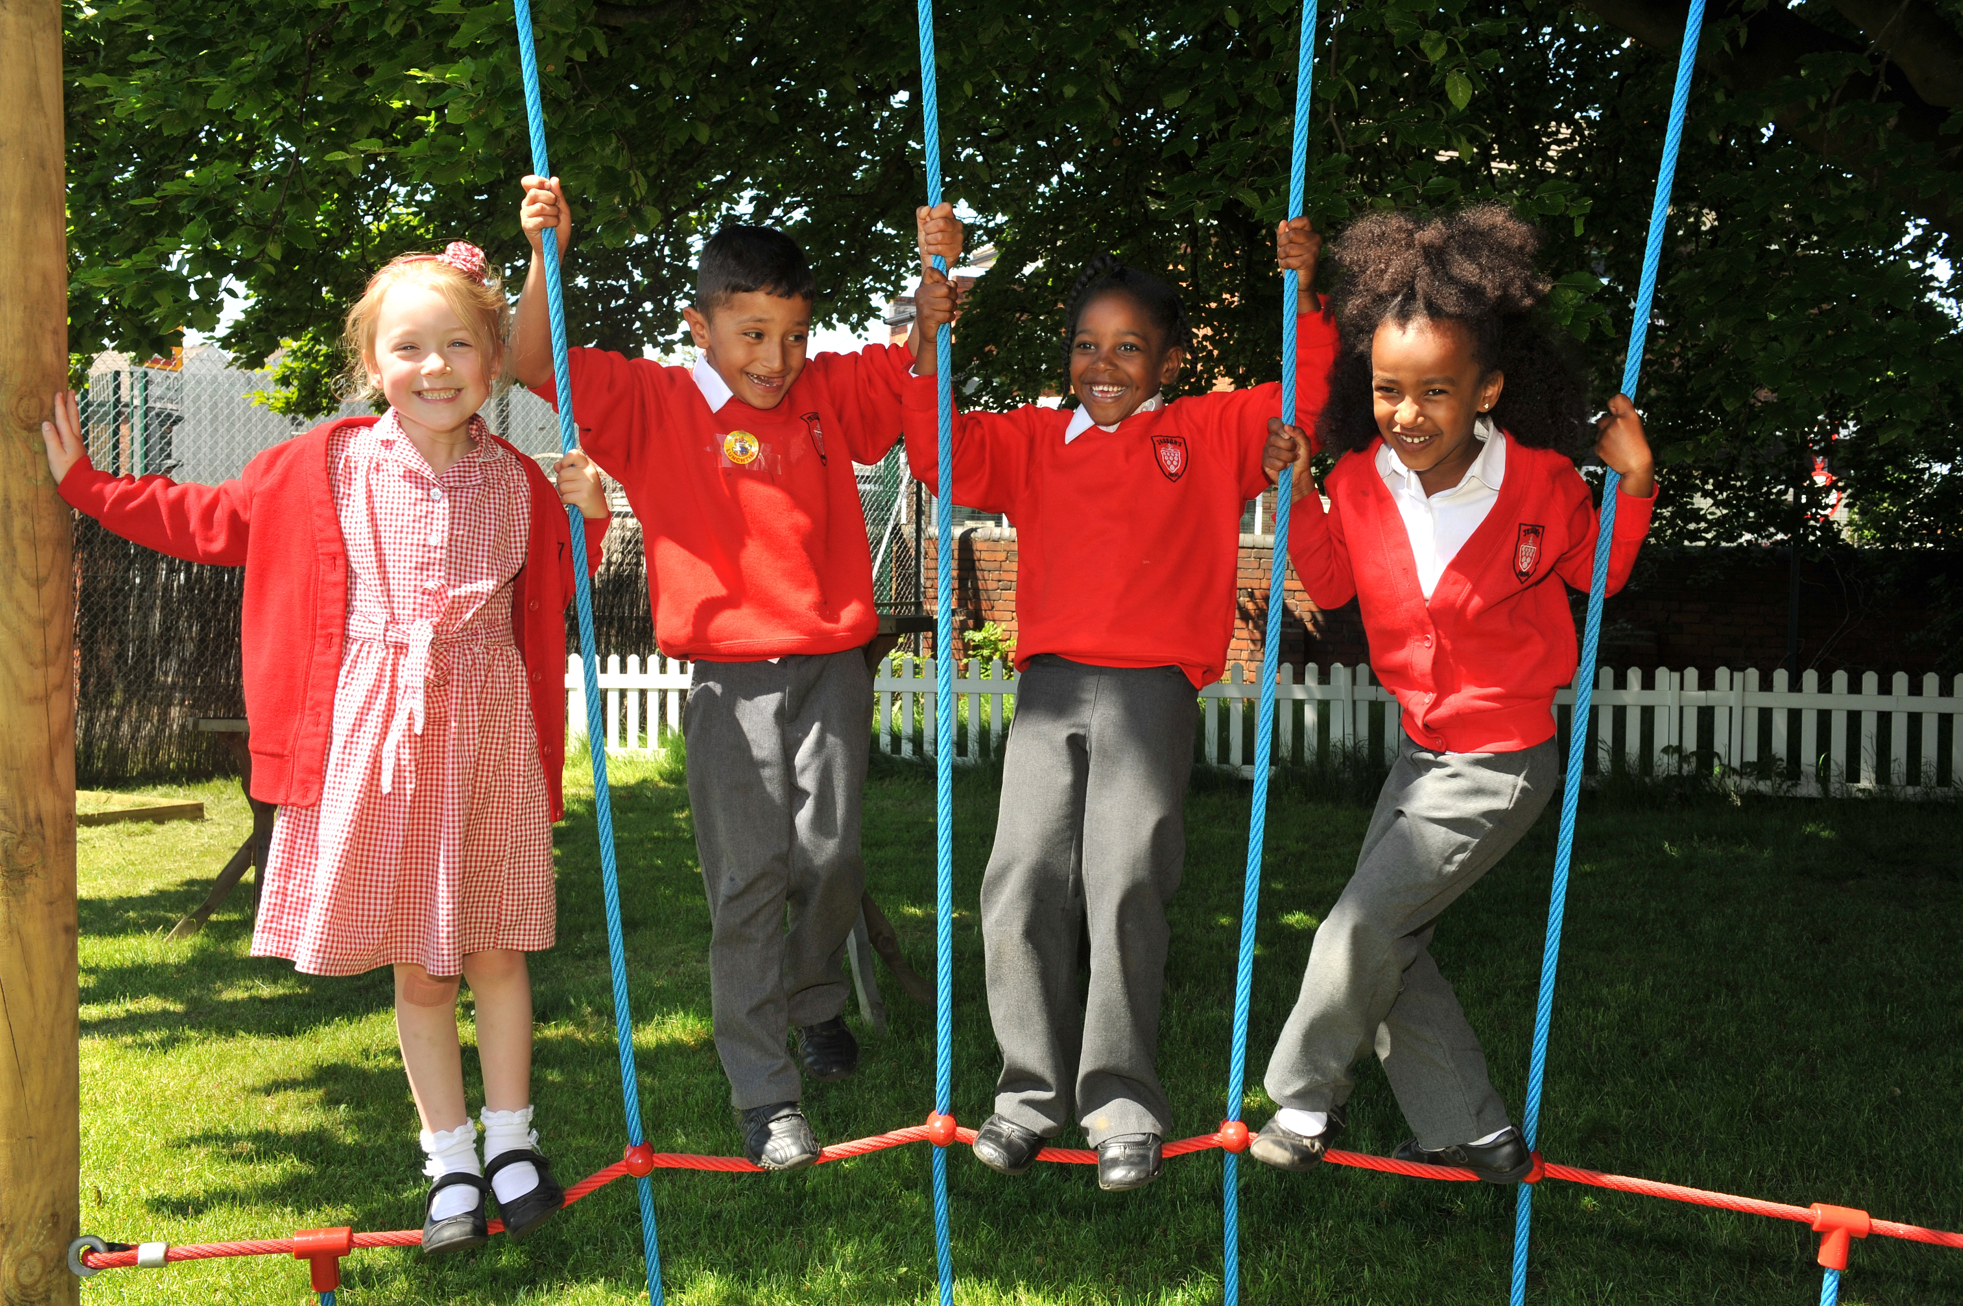
“..It must come off the shelf and be brought to life through leaders evaluating its potential impact on every area of day-to-day school life…”

Slide 37
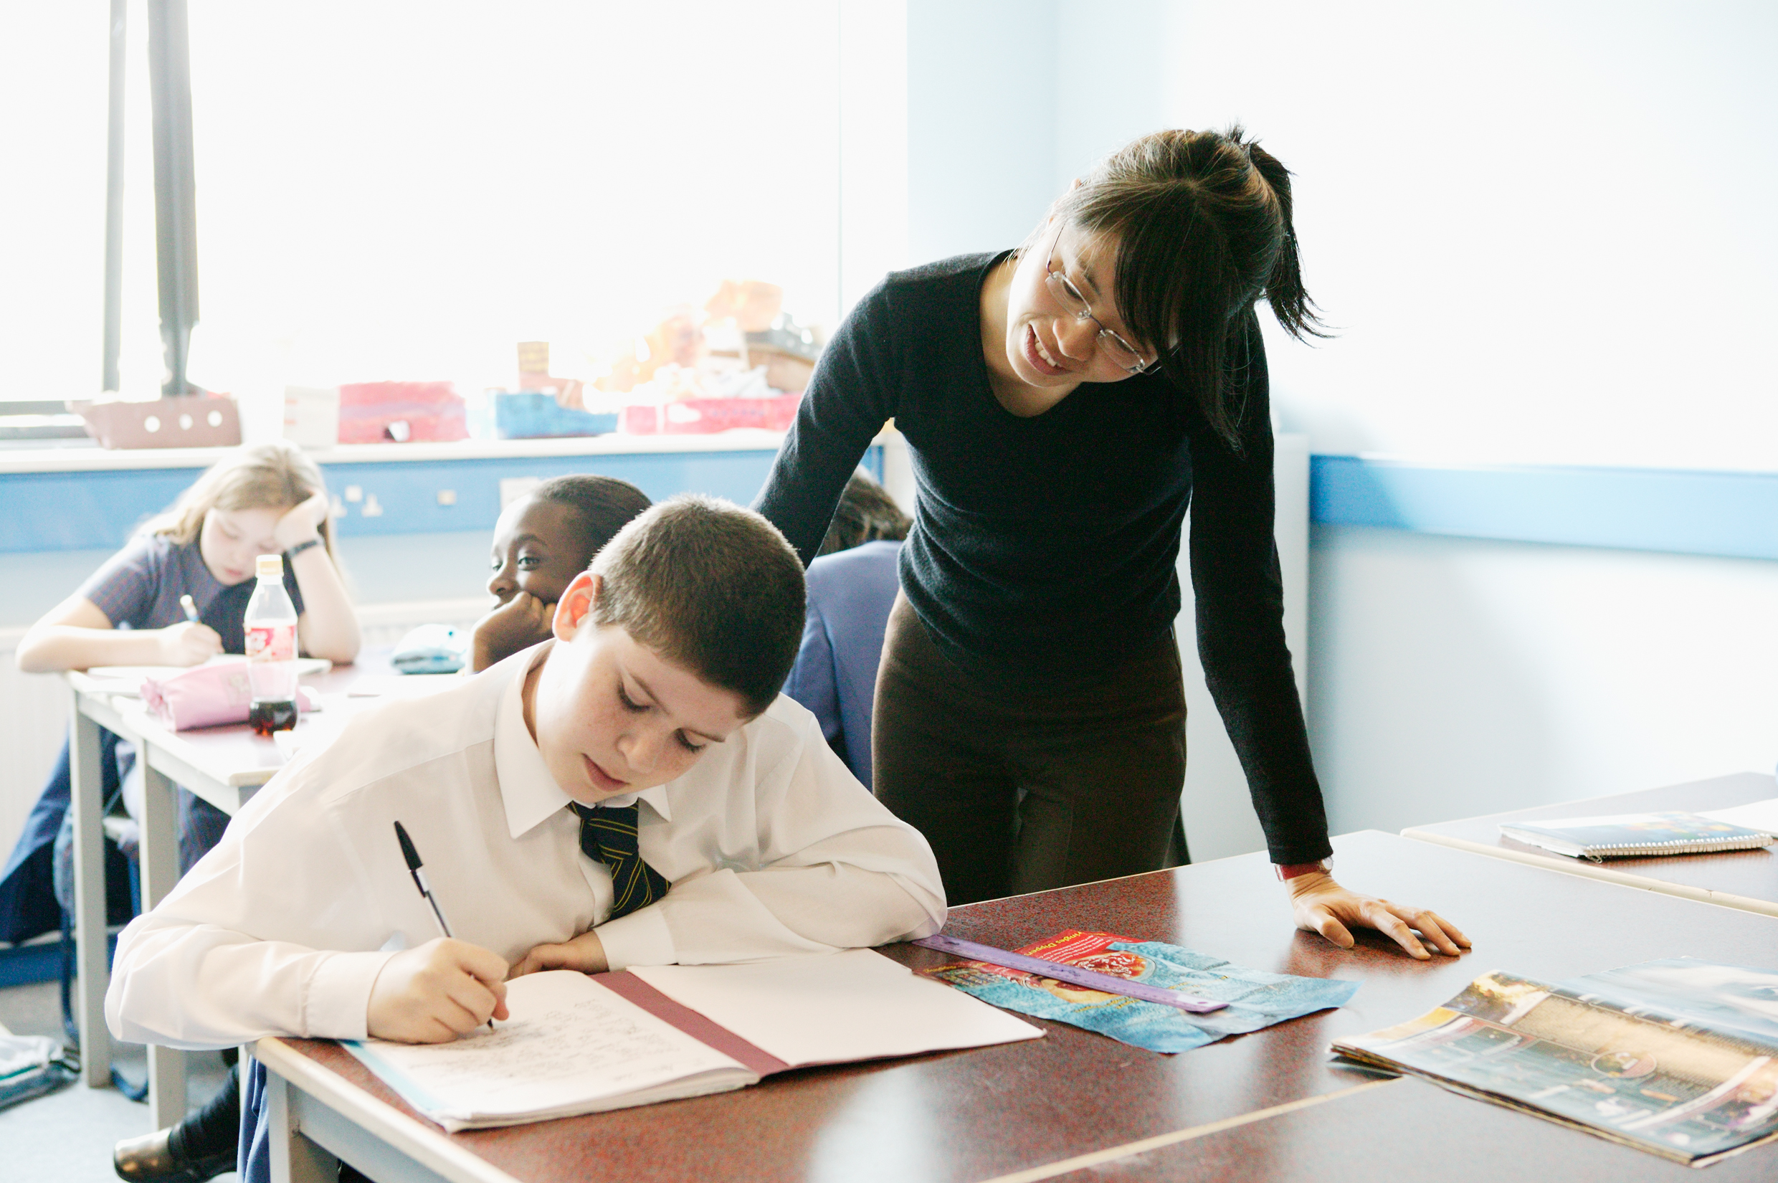
“…This dynamic and enhancing connection between ethos and outcomes is what we mean by ‘Bringing the Vision Alive.’”

Slide 39
What outcomes are you trying to improve?
What are the pressures and challenges?
Who defines this journey?
What help could the Vision offer you?
ethos
enhancing
outcomes
How do you define this for your school?
(in a sentence…)
Where does your ethos come from?
What are the commonalities and differences between us?
What difference does it make to your lived reality?

Slide 40
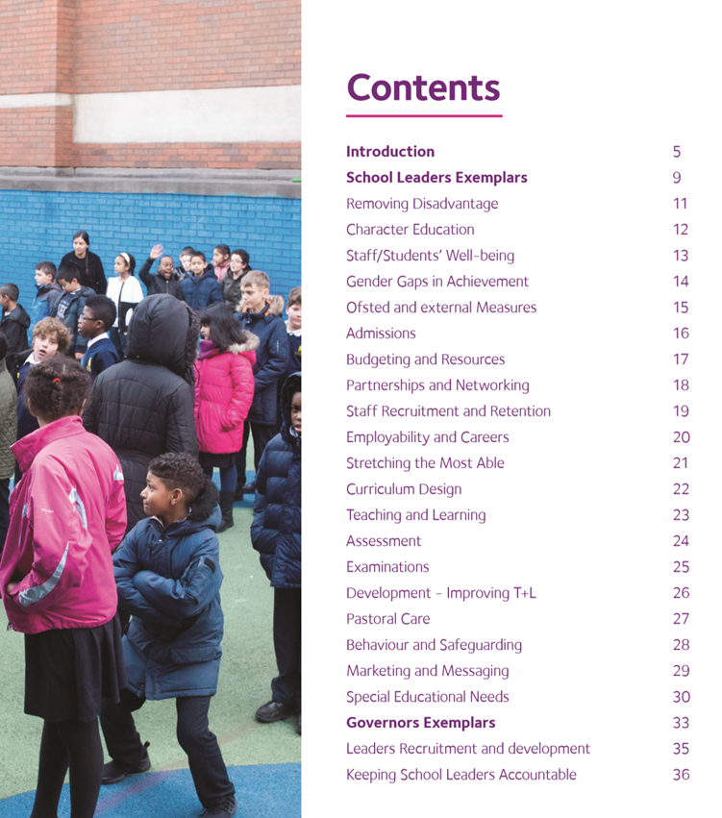
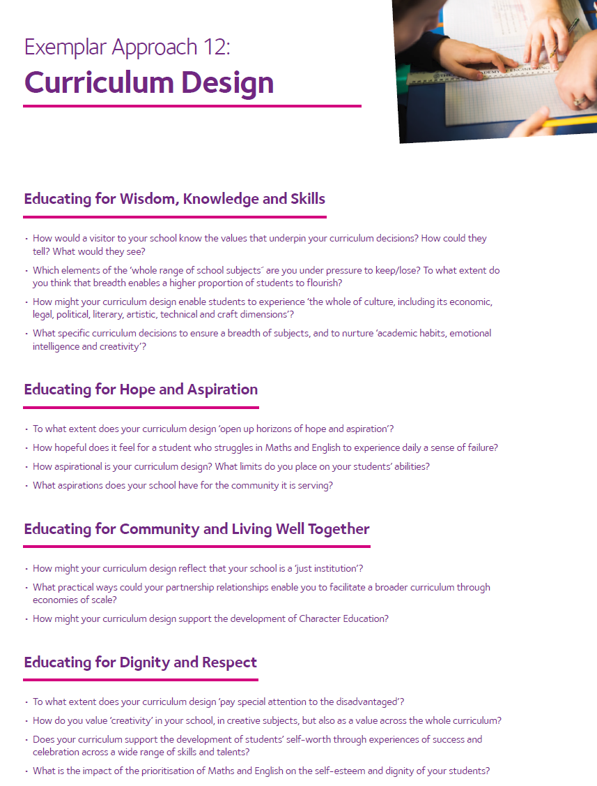

Slide 41
Called, Connected, Committed: Leadership Practices (2020)

Slide 42
Sage/Guide/Expert/
Enthusiast
Resourced/Trusted/
Revered
Expectations for Subject Leadership?
Storyteller/Evangelist/
Salesperson
Energy/Passion/Love/
Time

Slide 43
 | Called | Connected | Committed
Educating for Wisdom, Knowledge and Skills | Leading Learning - Refining Judgement | Creating Confidence - Embracing Interdependence | Deepening Understanding - Driving Improvement
Educating for Hope and Aspiration | Developing Imagination - Nurturing Ambition | Healing Relationships - Pursuing Renewal | Sustaining Vision - Building Resilience
Educating for Community and Living Well Together | Removing Disadvantage - Seeking Reconciliation | Accepting Vulnerability - Demonstrating Generosity | Inspiring Faithfulness -Embodying Integrity
Educating for Dignity and Respect | Celebrating Diversity - Enabling Flourishing | Offering Encouragement - Encouraging Service | Practising Humility - Learning Love

Slide 44
Called:
“Leaders who are called can articulate a strong sense of personal vocation to their role, and demonstrate this through their words, actions and decision making, exemplifying a strong moral purpose, confident vision, and ambitious trajectory of improvement. For some, this sense of vocation will be driven by an established or developing faith commitment. They show integrity, honesty and a deep sense of resilience, underpinned by their personal sense of vocation as a leader.”
Notes:
BEFORE GOING TO LUNCH, lets go back to our starting point.
Take a moment on your own to note down:
What has struck you during this morning’s session.
What actions will you take as a consequence
Share with a partner.

Slide 45
 | Called | Connected | Committed
Educating for Wisdom, Knowledge and Skills | Leading Learning - Refining Judgement | Creating Confidence - Embracing Interdependence | Deepening Understanding - Driving Improvement
Educating for Hope and Aspiration | Developing Imagination - Nurturing Ambition | Healing Relationships - Pursuing Renewal | Sustaining Vision - Building Resilience
Educating for Community and Living Well Together | Removing Disadvantage - Seeking Reconciliation | Accepting Vulnerability - Demonstrating Generosity | Inspiring Faithfulness -Embodying Integrity
Educating for Dignity and Respect | Celebrating Diversity - Enabling Flourishing | Offering Encouragement - Encouraging Service | Practising Humility - Learning Love

Slide 46
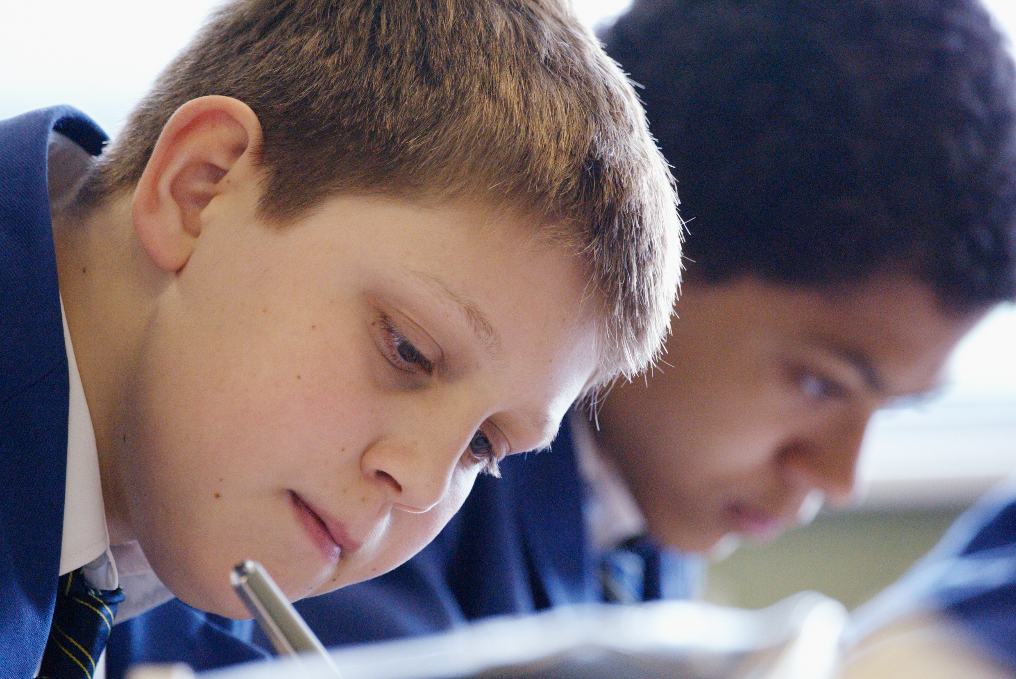
Educating for Hope and Aspiration:
Seeking healing, repair and renewal, coping wisely with things and people going wrong, opening horizons and guiding people into ways of fulfilling them.

Slide 47
 | Called | Connected | Committed
Educating for Wisdom, Knowledge and Skills | Leading Learning - Refining Judgement | Creating Confidence - Embracing Interdependence | Deepening Understanding - Driving Improvement
Educating for Hope and Aspiration | Developing Imagination - Nurturing Ambition | Healing Relationships - Pursuing Renewal | Sustaining Vision - Building Resilience
Educating for Community and Living Well Together | Removing Disadvantage - Seeking Reconciliation | Accepting Vulnerability - Demonstrating Generosity | Inspiring Faithfulness -Embodying Integrity
Educating for Dignity and Respect | Celebrating Diversity - Enabling Flourishing | Offering Encouragement - Encouraging Service | Practising Humility - Learning Love

Slide 48

Developing Imagination
Nurturing Ambition

Slide 50

The Leadership Practice ‘deep dive’

Slide 51


Slide 52

Formulating research questions
What would you like to explore around how outstanding curriculum leadership in your school can enable the flourishing of pupils, adults and teams?
How will you go about finding this out?
Who will you need to involve?

Slide 53


