Slide 1
National Secondary Leadership Network – National Event 4
Removing Disadvantage
17 July 2019
William Perkin School, London

Slide 2
Opening Reflection:
What kind of education?

Slide 3
Stimulus 1: Evidence-led approaches to Removing Disadvantage: New EEF toolkit resources
Robbie Coleman, Head of Policy, Education Endowment Fund

Slide 4
A Tale of Two Gaps:
Using Evidence to Reduce Disadvantage
Robbie Coleman
17th October 2019
London

Slide 5
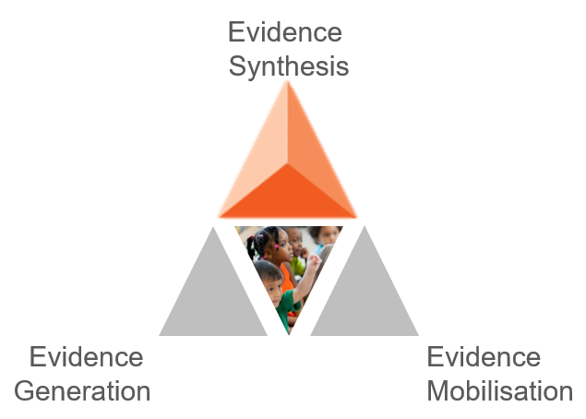
EEF Overview
Dedicated to improving the outcomes of 3-18 year-olds, particularly those facing disadvantage.
We focus where we think the biggest difference can be made: teaching and learning.
We support teachers and school leaders to use evidence to inform their decision-making.
We are independent and can take a long term, objective view.
We believe that evidence is strongest when used alongside professional judgement.

Slide 6
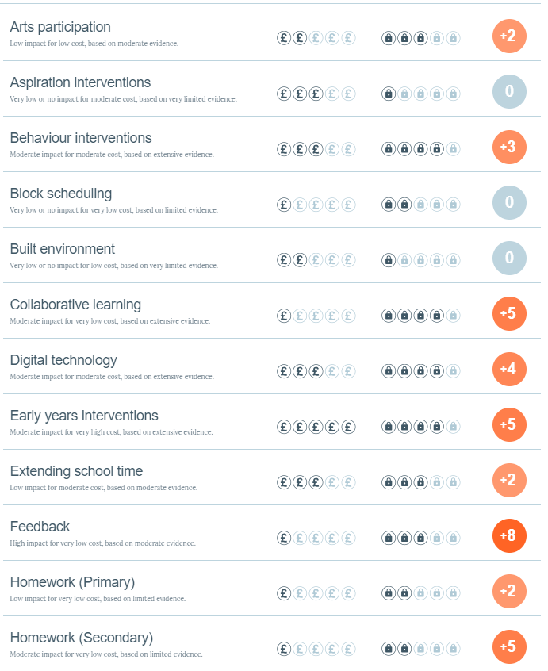
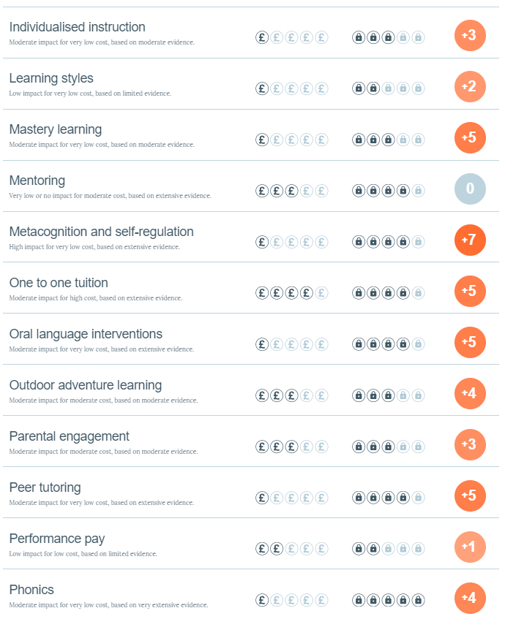
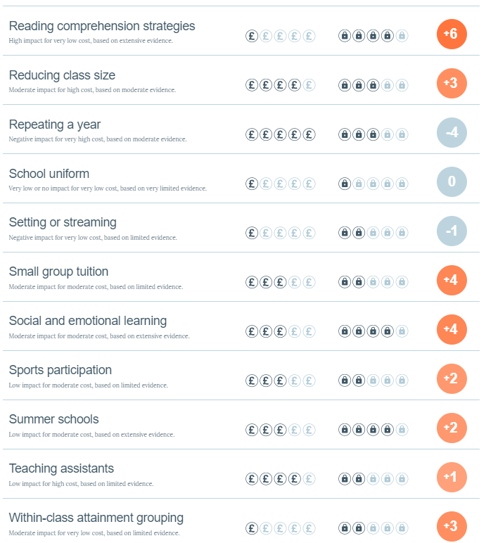
What we do: Synthesis
The Teaching and Learning Toolkit

Slide 7
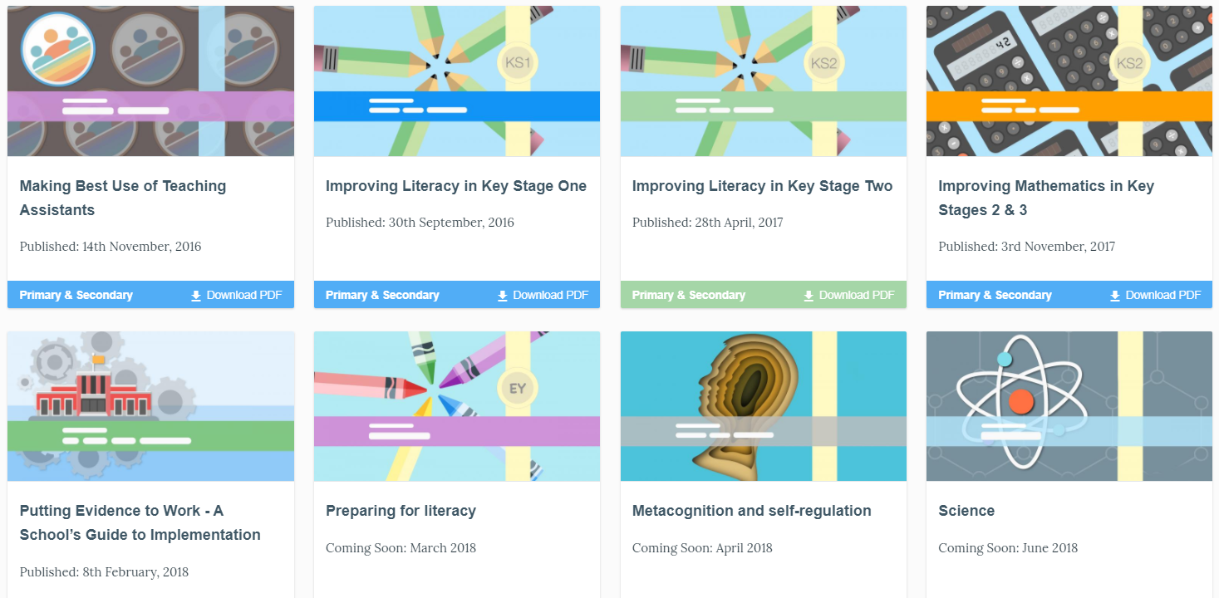
Guidance Reports

Slide 8

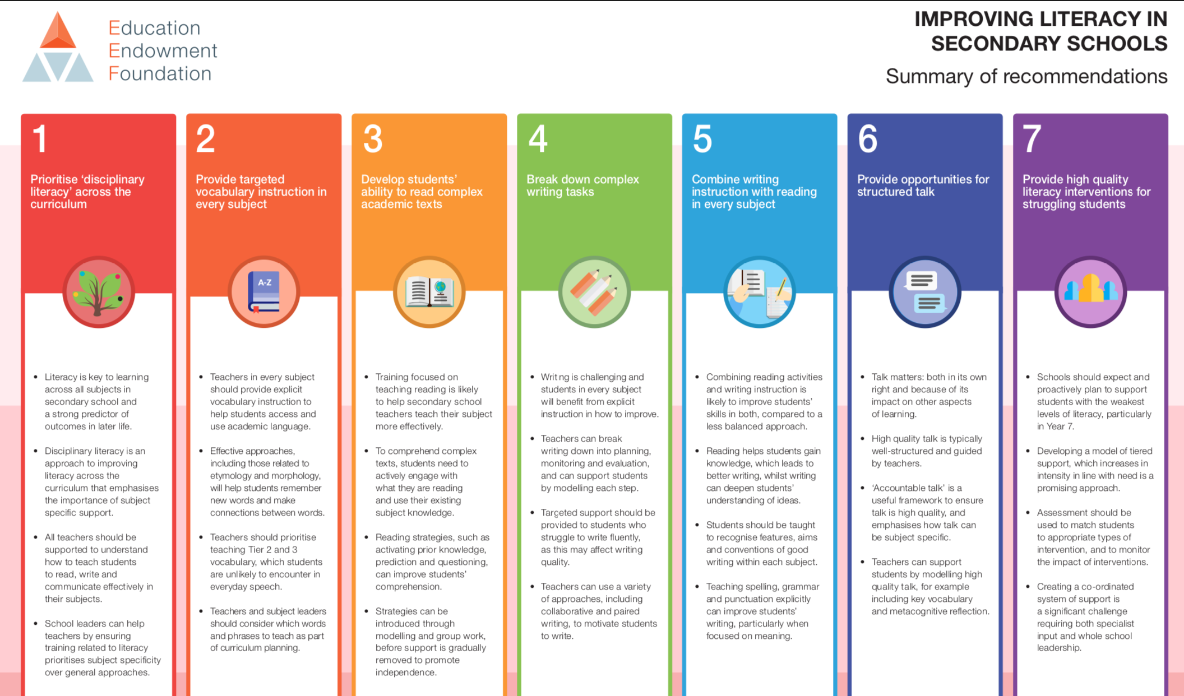

Slide 9
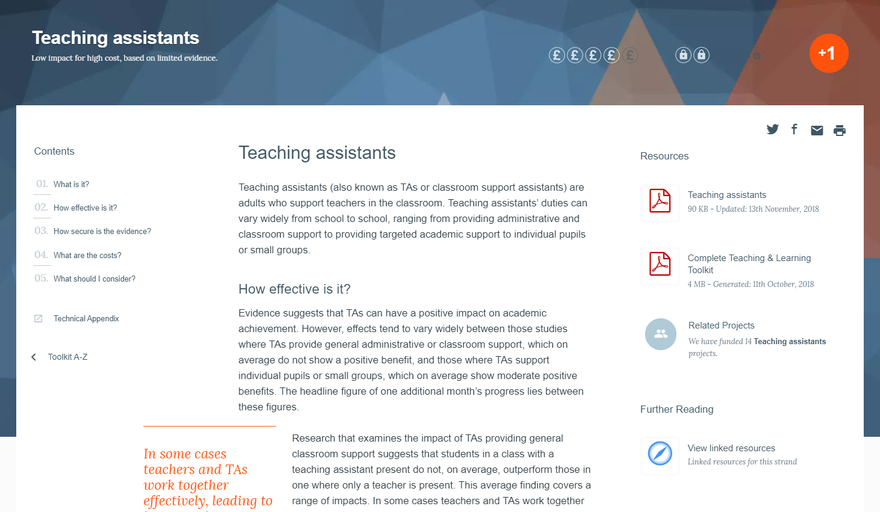
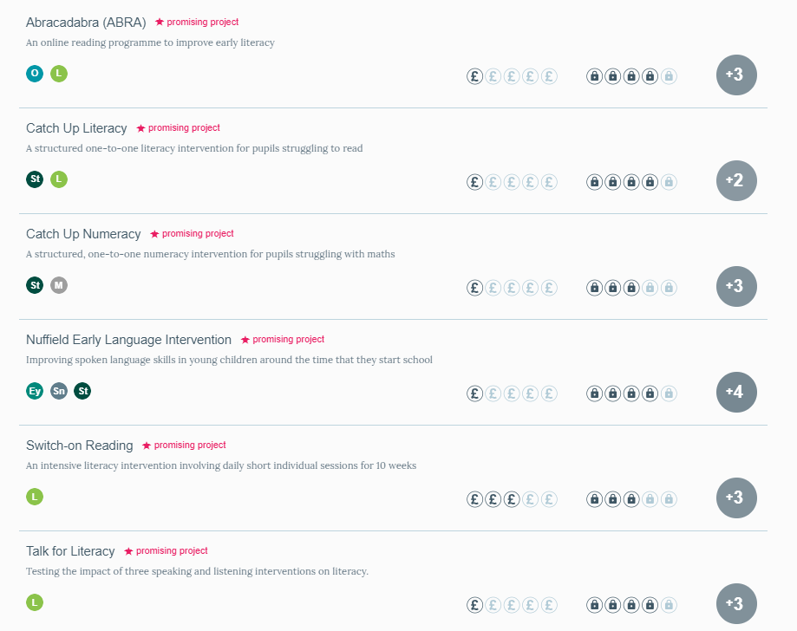
What we do: Generation

Slide 10
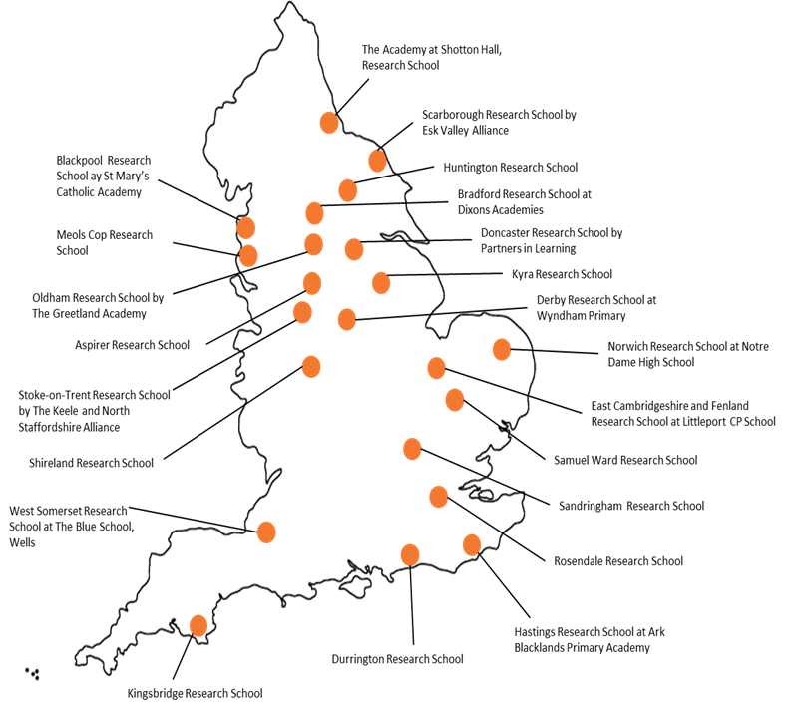
What we do: Mobilisation
Research Schools

Slide 11

Focus on: The Pupil Premium
Key principles
Myths
Case studies
A tiered approach

Slide 12
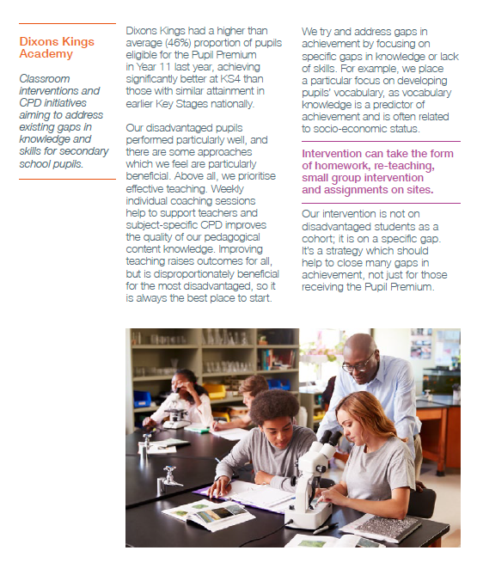
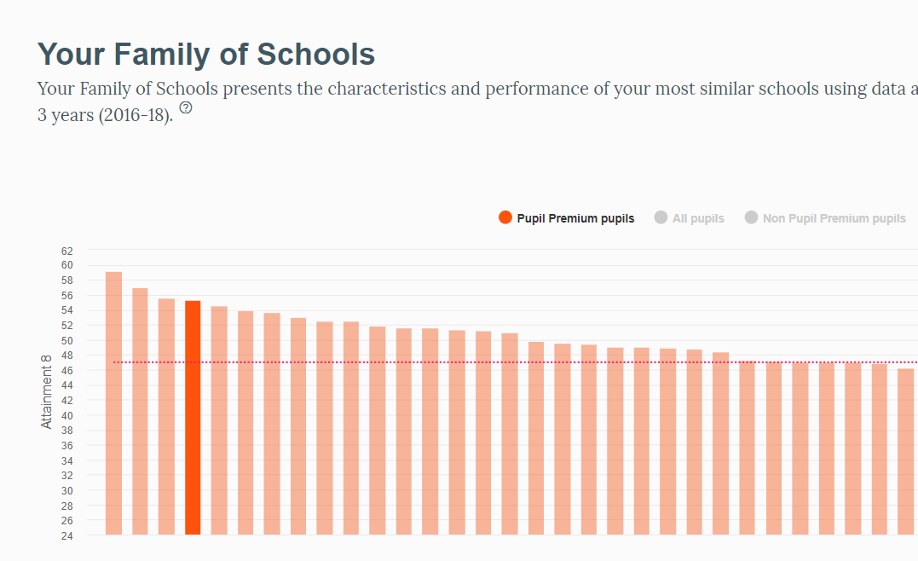
Key Idea #1: Schools can make a difference

Slide 13
Key Idea #2: Quality first teaching helps every student
Effect size

Slide 14
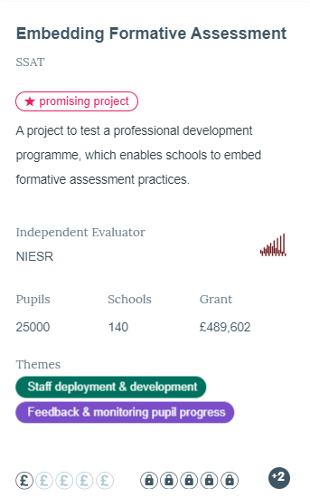

Myth: Only eligible children can benefit

Slide 15

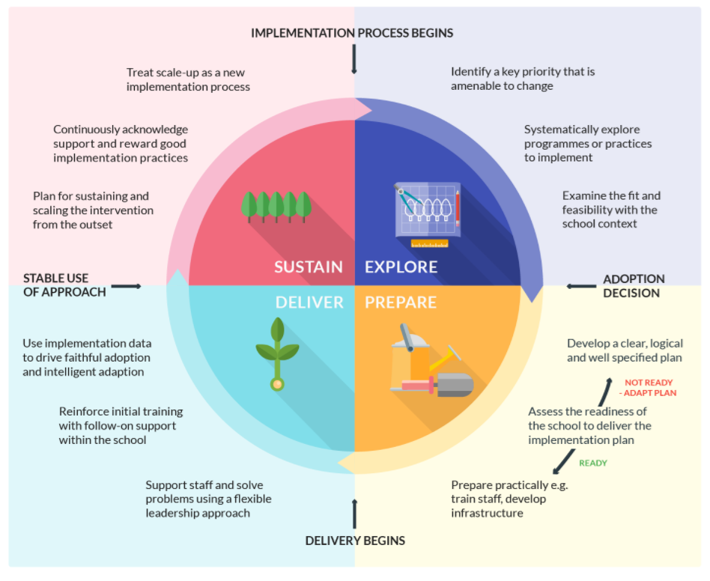
Key Idea #3: Implementation matters

Slide 16
Even the strongest approach will fail with poor implementation

Slide 17
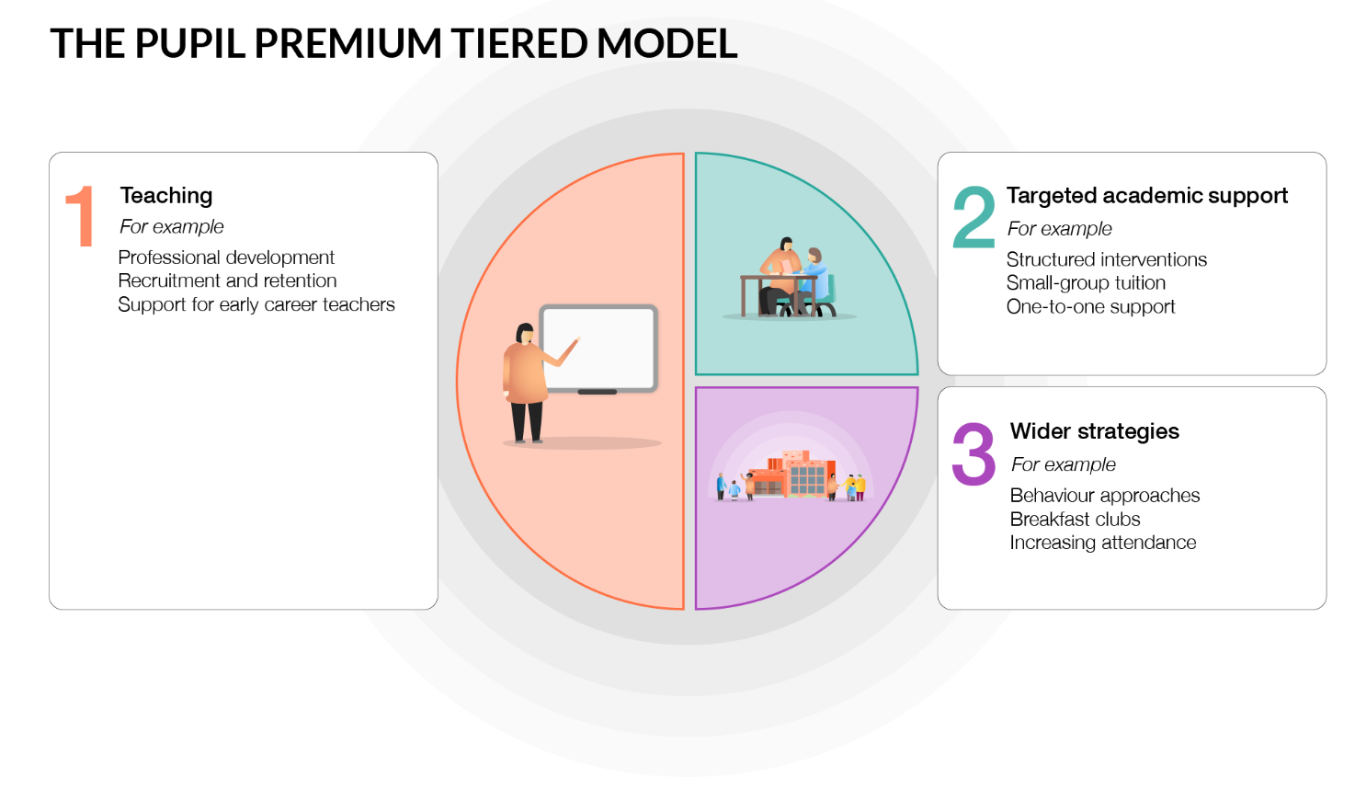
A tiered approach

Slide 18
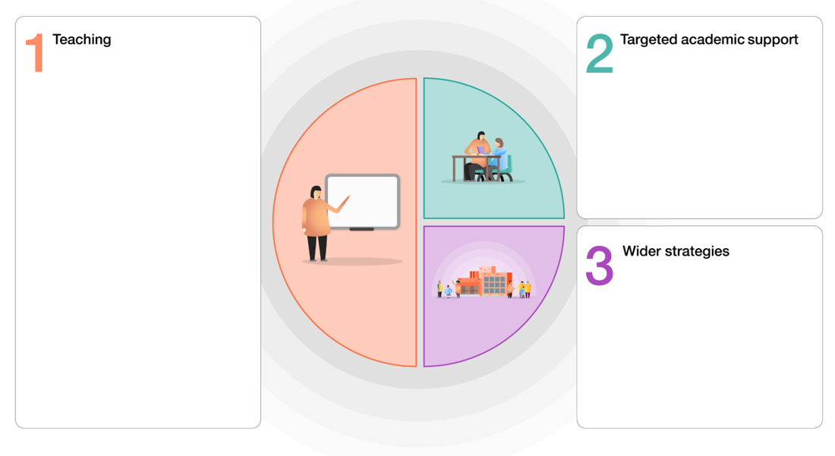
Discussion
1. What role do interventions have in an effective Pupil Premium strategy?
2. What role should data play in an effective Pupil Premium strategy?
3. What sources of information inform your decision-making?

Slide 19



Thank you
robbie.coleman@eefoundation.org.uk
www.educationendowmentfoundation.org.uk

Slide 20
Group Networking Activity 1:
Interventions and Raising Achievement

Slide 21
Stimulus 2: Attainment Grouping and Social Justice
Professor Becky Francis, Director, Institute of Education, UCL

Slide 22
Group Networking Activity 2:
Approaches to Student Groupings

Slide 23
Group Networking Activity 3: Defining Disadvantage
Craig Watson, Headteacher, Bury Church of England High School

Slide 24


Defining Disadvantage

Slide 25
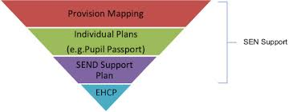
Introducing Joshua
New arrival in the UK
Black African ethnicity
Substantial SEN
Previous school a Special School
Christian family
Cognition level well below GCSE
Family considering mainstream
What would you advise?

Slide 26
God founded the world
Good news to the poor
The lost son
What kind of Education?
You are precious in my sight
See I am doing a new thing
Remember the poor
He stretched out the heavens by His understanding
The lost sheep
The lost coin
Speak up for those who cannot
Value
Creativity
Social Justice
Impatient with mediocrity, and passionate about improvement.
Design and implement curriculum and pedagogy that redress inequality.
Build resilience for challenging moments or when things change.
Imagination is a raw force present in children, for the Teacher to draw out and cheer on.
Our vision for education must show special concern for the disadvantaged.
Redress the impact of middle-class cultural subsidy.
Enabling others to come back the next day with the imagination of something new.
Leadership notices others, spots the good and catches people doing well.
Courage
Take heart! I have overcome the world
Spur one another on toward love and good deeds
When you pass through the waters I will be with you

Slide 27
Dignity and Respect
How do we identify children who have lost their dignity or lack respect?
Is it only those who can be identified by measures of affluence?
Identifying disadvantage
Community and Living Well Together
Do children experience disadvantage because of the influence of their community?
How might such disadvantage be addressed?

Slide 28
Identifying disadvantage
Hope, Aspiration and Courageous Advocacy
Is a lack of hope or aspiration disadvantage?
How do we recognise where hope is lacking or aspiration is low?
In what ways might we need to be courageous in addressing this?
Wisdom, Knowledge and Skills
How might cultural capital affect disadvantage?
How do we ensure that those who have a cultural capital deficit can have it addressed?

Slide 29
We have different gifts, according to the grace given to each of us.
How do you address disadvantage in your educational setting?
Share effective systems from other educational settings that address disadvantage.
How do your finances support addressing disadvantage?

Slide 30
To what degree does your vision influence how you approach supporting disadvantaged pupils?
Vision for the disadvantaged
Can you outline an example of how your educational setting’s vision links to how you support pupils who are disadvantaged?
The Church of England’s vision in education is to encourage
“Life in all its fullness.”
What more might we do as a result of today?

Slide 31
Group Networking Activity 4: Removing Disadvantage
Dame Alice Hudson & Team, William Perkin School

Slide 32
Plenary and Next Steps: Regional Dates
South East: 28 November, 10.00-1.00, Twyford CofE High School, London
South West: 5 December, 1.00-4.00, Selwood Academy, Frome
North East:12 November, 10.00-1.00, Barlby High School, nr York
North West: 28 November, 9.00-12.00, Archbishop Blanch School, Liverpool
Midlands: 10 January 10.00-1.00, Minster School, Southwell

Slide 33
Plenary and Next Steps
Growing Faith Funded Development Opportunity – 25 November, Church House
ASSH Conference – 9-11 October 2019
National Conference: Visionary Curriculum Leadership – Save the Date 6 Feb 2020
  Staff places
  Student Leadership Stream

