Slide 1
National Secondary Leadership Network – National Event 3
Growing Faith:
Faith Development and Chaplaincy
10 July 2019
St Gabriel’s College, London

Slide 2
#1 Opening Reflection: Leading Courageously

Slide 3
COURAGE
Heart

Slide 4

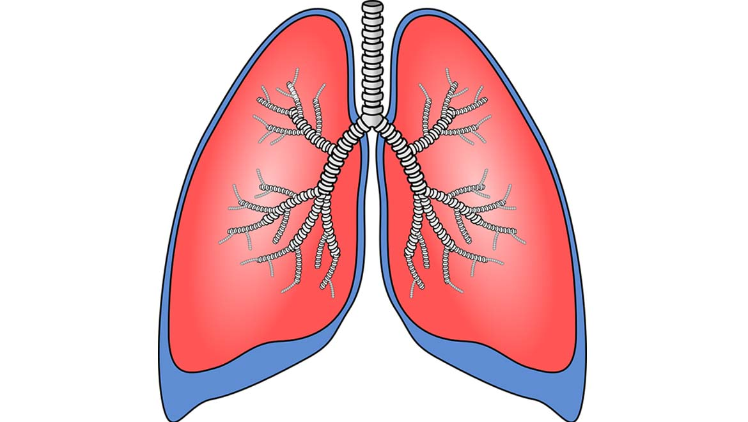
‘en-courage’ – to put heart into
‘in-spire’ – to put breath into

Slide 5

“…to nurture, nourish and evoke a consciousness and perception alternative to the consciousness and perception of the dominant culture around us.”

Slide 6
COURAGE
Heart
Story

Slide 7
“A community rooted in energizing memories and summoned by radical hopes”
Shared Narrative
Rhythm of Prayer
Visionary Leadership

Slide 8
COURAGE
Heart
Story
Passion

Slide 9

“Passion is the capacity and readiness to care, to suffer, to die and to feel.”

Slide 10
“And we boast in the hope of the glory of God. Not only so, but we also glory in our sufferings, because we know that suffering produces perseverance;
perseverance, character; and character, hope. And hope does not put us to shame, because God’s love has been poured out into our hearts through the Holy Spirit, who has been given to us.”
(Romans 5.2-5)
Notes:
To put into perspective..
“A Christian understanding of resilience is more than simply bouncing back, grit, toughness or ‘stickability’. In our most challenging or painful times, God is at work in us, both as individuals and teams – guiding, strengthening, refining and re-focusing us – as his Holy Spirit helps us to build our character, be filled with hope and to thus bounce back stronger.”

Slide 11
COURAGE
Heart
Imagination
Story
Passion

Slide 12
“The imagination must come before the implementation.
Our culture is competent to implement almost anything and imagine almost nothing.
It is our vocation to keep alive the ministry of imagination”

Slide 13
COURAGE
Heart
Imagination
Story
Passion

Slide 14
Leading Courageously, Inspiring Hope
CRITICISE
ENERGISE

Slide 15
‘Growing Faith’
Nigel Genders
Chief Education Officer

Slide 16

One could quite easily imagine an effective approach that focused on developing work in each of these 3 discrete areas
Growing Faith in Schools
Growing Faith ‘separately’ in Schools, Churches and Households
Some of our GF activities may indeed focus on the empowering of work within each circle
Growing Faith in Churches
Growing Faith in Households
Notes:
In many ways, the join up between the 3 sections could make this work much more difficult, and one could argue the case for 3 separate projects that sought to impact each of the 3 areas, with little interaction.
However….

Slide 17
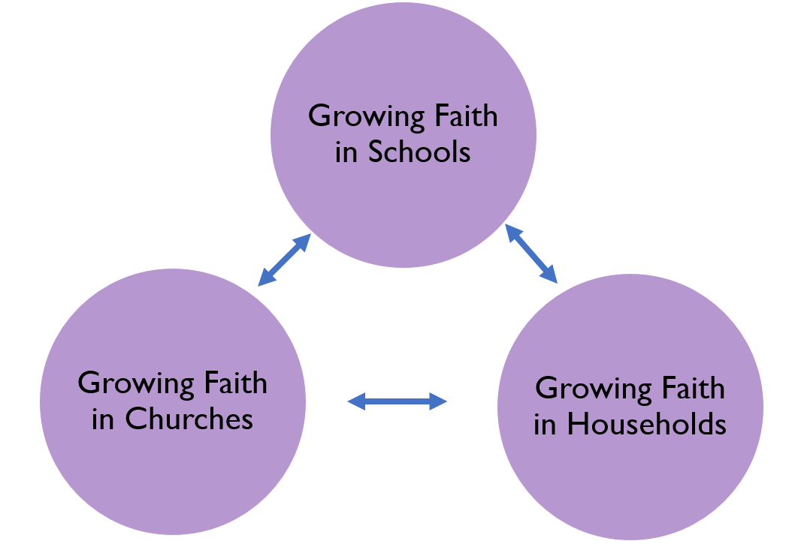
Questions for discussion
What is already going on these spaces that is specifically around Growing Faith?
What are the other pressures/values of each of these spaces?
What might the development needs be in each of these spaces?
What are the other cultural influencers of young people, and which are the loudest voices?
Is this an equal relationship? Or is any one of these served most by Growing Faith? (for example, are we seeking to redress church engagement by CYP, or would we mind if no difference was made to that statistically?)
Notes:
Before diving into the GF intersections, giving people the chance to think about the 3 areas, and their respective challenges and opportunities

Slide 18
Schools
Households
Churches
What happens in each circle is still very important, and highly valued
Growing Faith in Schools, Churches and Households
However, if there is nothing in the individual circle, there may be limited value in focusing on the intersection
Notes:
Setting up the intersection

Slide 19
Schools
Households
Churches
The
Growing Faith Intersection
However, our primary focus for Growing Faith is the intersection between 2 or more of the elements
Our understanding of young people’s faith development is that it much more likely to happen, and be sustained if it happens in the intersection
Notes:
Showing the USP of GF approach – i.e. what happens in the intersections…

Slide 20
The Intersections
Church/ School (2)
School/ Household (2)
Church/ Household (2)
Strategic Church/ School partnerships
Chaplaincy
Transition
NWCs in schools?
Pedagogy in Church
Structural Changes:
GF Collaboration Group
Diocese Vision
Trailblazer Dioceses (4-5)
GF Champions
GFPCs
New Provision:
Clergy Selection/Training/
Formation Networks
TEI Curricula
‘The Big Story’ App
Resource Hub (incl. any new writing/thinking)
Normalising ‘faith’ talk in school
Exploring faith programmes
SIAMS/SMSC
Community Engagement/ Social Action
Church/School/
Household (3)
Building parents’ confidence in sharing faith
Role of YC workers/advisors re: family
Family discipleship
Church attendance?
Notes:
This slide gives some ideas of would could potentially happen in the intersections as a result of GF – the national things on the left are primarily concerned with the central intersection between all 3 (quite rightly!) – but equally, there will be hugely positive work to be done in the 3 other intersections in the diagram between the pairs of church-school etc.

Slide 21
Group Networking Activity 1:
The Growing Faith ‘Intersections’

Slide 22
The Intersections
Church/ School (2)
School/ Household (2)
Church/ Household (2)
Strategic Church/ School partnerships
Chaplaincy
Transition
NWCs in schools?
Pedagogy in Church
Structural Changes:
GF Collaboration Group
Diocese Vision
Trailblazer Dioceses (4-5)
GF Champions
GFPCs
New Provision:
Clergy Selection/Training/
Formation Networks
TEI Curricula
‘The Big Story’ App
Resource Hub (incl. any new writing/thinking)
Normalising ‘faith’ talk in school
Exploring faith programmes
SIAMS/SMSC
Community Engagement/ Social Action
Church/School/
Household (3)
Building parents’ confidence in sharing faith
Role of YC workers/advisors re: family
Family discipleship
Church attendance?
Notes:
This slide gives some ideas of would could potentially happen in the intersections as a result of GF – the national things on the left are primarily concerned with the central intersection between all 3 (quite rightly!) – but equally, there will be hugely positive work to be done in the 3 other intersections in the diagram between the pairs of church-school etc.

Slide 23
Going Deeper – Theology, Structures and Pedagogy in Young People’s Faith Development
Mary Hawes
National Children & Youth Adviser

Slide 24
Going Deeper – Theology, Structures and Pedagogy in Young People’s Faith Development
Mary Hawes
National Children & Youth Adviser

Slide 25
What is the difference between spirituality and faith?
Notes:
My very simple distinctions.
There are as many definitions as there are people in the room – and more!
Some people cannot separate out spirituality and faith or religion. But as responsible educators we need to respect the distinction.
Although spirituality may be a human attribute which all have, faith is the response to that.
I think this helps schools which are anxious about accusations of proselytising understand that creating space for the spiritual is different to the space for Collective Worship where faith is embraced.

Slide 26
What is the difference between spirituality and faith?
Spirituality:
an innate sense of awe and wonder; there’s something or someone more than just me
Faith:
our response to God;
making a difference to the life that we live
Notes:
My very simple distinctions.
There are as many definitions as there are people in the room – and more!
Some people cannot separate out spirituality and faith or religion. But as responsible educators we need to respect the distinction.
Although spirituality may be a human attribute which all have, faith is the response to that.
I think this helps schools which are anxious about accusations of proselytising understand that creating space for the spiritual is different to the space for Collective Worship where faith is embraced.

Slide 27
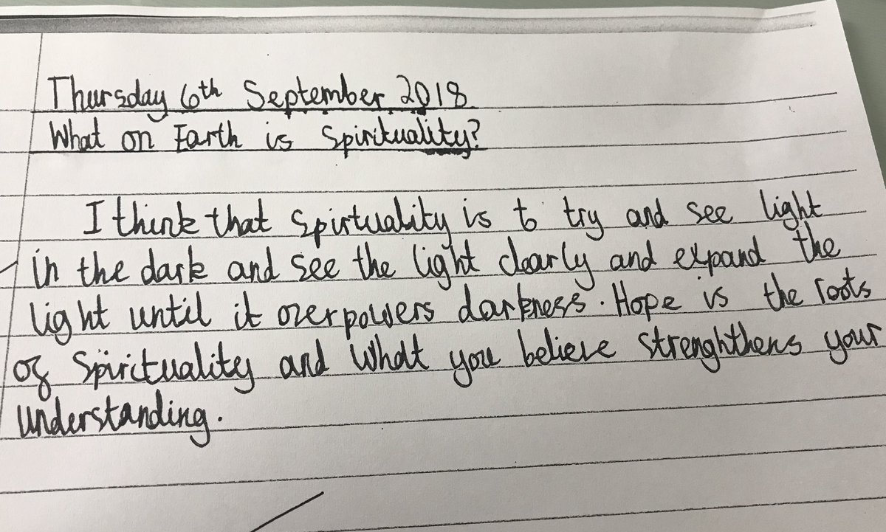
Year 6 pupil

Slide 28

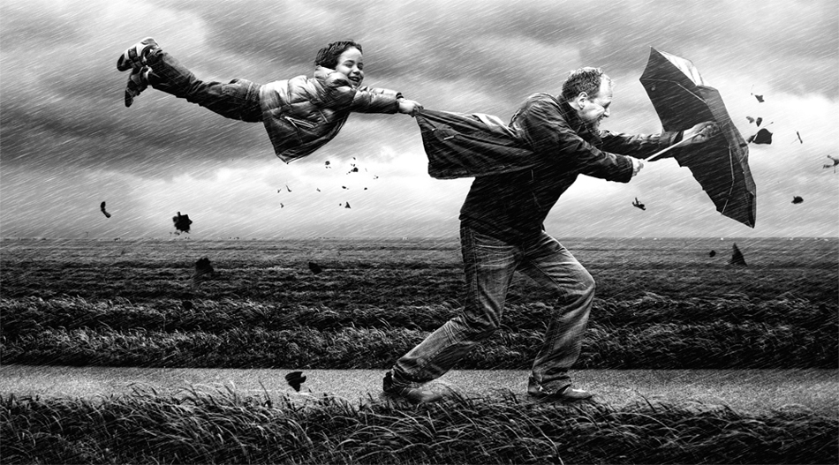
Spirituality is like the wind
Notes:
Very hard to pin down!! And very difficult to define – so much so that most people have their own understanding or working definition.

Slide 29
Spirituality/Faith Formation – is not…
About learning
About developmental milestones
About getting close to the ideal
Linear or hierarchical
Possible to teach it
Notes:
Easier to describe what it ISN’T.
It’s not about a lot of the things that happen in school – there isn’t a grade that can be given to spirituality.
And yet, in a world where truth (too often mediated in 280 Twitter characters) and proof are highly regarded, this unpindownable concept still holds sway.
Still in OFSTED

Slide 30
UNCRC 1989
Religion is identified as a matter of mind, belief and practise, part of cultural expression associated with minority rights and human equality.
Spirituality is identified as an aspect of human development and overall human health.
Notes:
In 1989 the UNCRC recognised both religion and spirituality, made provision for both within the convention, and saw both as a right
RELIGION – a matter of mind, choice
SPIRITUALITY – important for healthy development
Articles 14, 29 & 30 are concerned with religious rights
Articles 17, 27 & 32 are concerned with spirituality
Article 14 States Parties shall respect the right of the child to freedom of thought, conscience and religion
Article 17 States Parties recognize the important function performed by the mass media and shall ensure that the child has access to information and material from a diversity of national and international sources, especially those aimed at the promotion of his or her social, spiritual and moral well-being and physical and mental health.
Article 27 1. States Parties recognize the right of every child to a standard of living adequate for the child’s physical, mental, spiritual, moral and social development.
Article 29 (d) The preparation of the child for responsible life in a free society, in the spirit of understanding, peace, tolerance, equality of sexes, and friendship among all peoples, ethnic, national and religious groups and persons of indigenous origin;
Article 30 In those States in which ethnic, religious or linguistic minorities or persons of indigenous origin exist, a child belonging to such a minority or who is indigenous shall not be denied the right, in community with other members of his or her group, to enjoy his or her own culture, to profess and practise his or her own religion, or to use his or her own language.
Article 32 States Parties recognize the right of the child to be protected from economic exploitation and from performing any work that is likely to be hazardous or to interfere with the child’s education, or to be harmful to the child’s health or physical, mental, spiritual, moral or social development.

Slide 31
The Children Act 1989
The Children Act 1989 Guidance and Regulations (Volume 2: Care Planning, Placement and Case Review) state:
“The child’s carers should be aware of the child’s religion and culture and the manner in which these are reflected in their daily life, including any help the child will need to maintain these links. Even where the child does not have a formal religion s/he may have needs for a spiritual dimension to his/her life and should be supported and encouraged to develop it. These experiences contribute to the child’s sense of identity” (DfE 2010:69).

Slide 32
Measuring spirituality
OFSTED
ability to be reflective about their own beliefs…... and their interest in and respect for different people’s faiths, feelings and values
sense of enjoyment and fascination in learning about themselves, others and the world around them
use of imagination and creativity in their learning
willingness to reflect on their experiences.
Notes:
Those of you who remember the Every Child Matters agenda, will recall that spirituality was one of the original areas – though it quickly disappeared from published documents.
But still requirement for it to be measured in OFSTED inspections.

Slide 33
Spirituality and SIAMS
I have come in order that you might have life - life in all its fullness. John 10:10
How well does the school support all pupils in their spiritual development, enabling all pupils to flourish?
How well do leaders ensure there is support for good mental health in children and adults and a sense of belonging that embraces and celebrates difference?
(Does Collective Worship offer) the opportunity, without compulsion, to all pupils and adults to grow spiritually through experiences of prayer, stillness, worship and reflection
How well does RE give pupils a safe space to critically reflect on their own religious, spiritual and /or philosophical convictions?
Notes:
Spirituality and SIAMS – some connections

Slide 34

James Fowler 1981
7 stages of faith development
Undifferentiated
Intuitive/Projective
Mythic/Literal
Synthetic/Conventional
Individuative/reflective
Conjunctive
Universalising
Notes:
Theory developed partly to make explicit what his Methodist minister father & other clergy knew by intuition
Connects childhood and adulthood – higher ‘stage’ doesn’t mean higher order of faith.

Slide 35
Stage 2: Mythic/Literal
6 – 12
Ordering Faith
Story – making sense and order
Is this true?
Ethic of fairness and justice
World losing its enchantment
Club-able

Slide 36
Stage 3: Synthetic/Conventional
11 – 18
Conforming
Abstract and reflective thinking
Interpersonal relationships
Social awareness – involved in causes
Conforming to significant others
Juggling influences
Having beliefs and values but not always knowing what or why: ‘just because’

Slide 37

John Westerhoff
Styles of faith
Experienced
Affiliative
Searching
Owned

Slide 38

Mary Stone, 1995
A significant difficulty for many teachers is to identify what is meant by ‘spiritual development’…
The spiritual is in essence open-ended and undetermined. It is not a matter of getting ‘right answers’.
Spiritual experience, whether or not derived from a religious tradition, is a key factor in the way in which a person sees the whole of life.
Notes:
Revelatory – the notion that children NEED stillness and quiet in order to get in touch with their spiritual side.
But words can be slippy. On tables/in pairs – what for you is the difference between spirituality and faith?

Slide 39
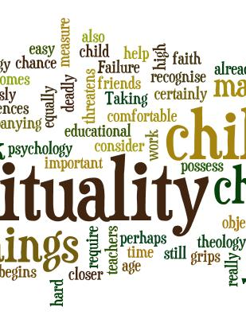
The 1990s
The Spiritual life of Children: Coles, 1990
The Religious Potential of the Child: Cavalletti, 1992
Caring for the whole child: Bradford, 1995
Unfinished Business: CMGC, 1995
Don’t just do something, sit there! Stone, 1995
The Spirit of the Child: Hay & Nye, 1998
Notes:
Boom time for writing and research around spirituality, bringing the notion of children’s spiritual capacity into the mainstream.
Stone – ground breaking practice.
Hay & Nye – ground breaking research

Slide 40
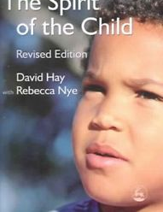
Hay & Nye 1998:
The Spirit of the Child
In every child there is a spiritual potential no matter what the child’s cultural or religious context may be.
Notes:
A universal potential – stop and look at the quotes on the tables. Ways of relating.
Have you heard or observed similar things in children?
Outline the research. Nottingham schools. Academic focus.

Slide 41
Relational Consciousness
Child
People
World
Self
God

Slide 42
Dr Rebecca Nye
….. a growing body of research demonstrates that children’s spirituality is not something esoteric, nor something exclusive to precocious children. Also, it is not limited to particular religious exercises…..
Notes:
Spirituality is not:
Middle class
Reserved for pious children
An elite hobby
Expressed in identical ways

Slide 43
Left to their own devices (children) will likely become religious in some sense but probably in a sense more like what you would call superstition than a thoughtful, sophisticated belief and behaviour system.
Failure to provide….a system of beliefs and practices refined and honed through generations of theological debate, philosophical scrutiny and collective experience, may leave them open to religious extremism, catchy anecdotes from charismatic spiritualists, or buffet-style ……from various available traditions, whether or not they actually make sense together.
Justin L. Barrett – Born Believers, 2012

Slide 44
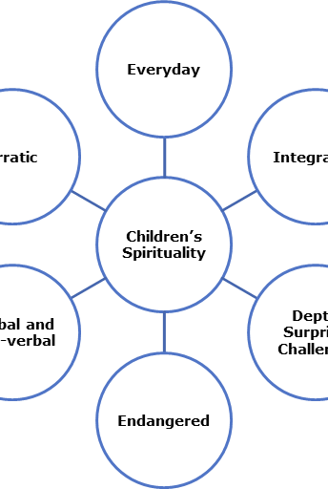
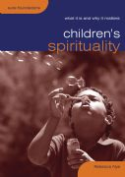
Dr Rebecca Nye
2009
Childhood Spirituality
Innate
Everyday
Endangered
Notes:
Nye moved from an academic-only focus to ask how this could be used in practice. Highly influenced by Godly Play – work of Jerome Berryman.
In Children’s Spirituality, combined her PhD conclusions with subsequent empirical work among children to help practitioners understand the spiritual life of a child:
Innate
Everyday
Endangered – something to grow out of. Who to talk to?

Slide 45
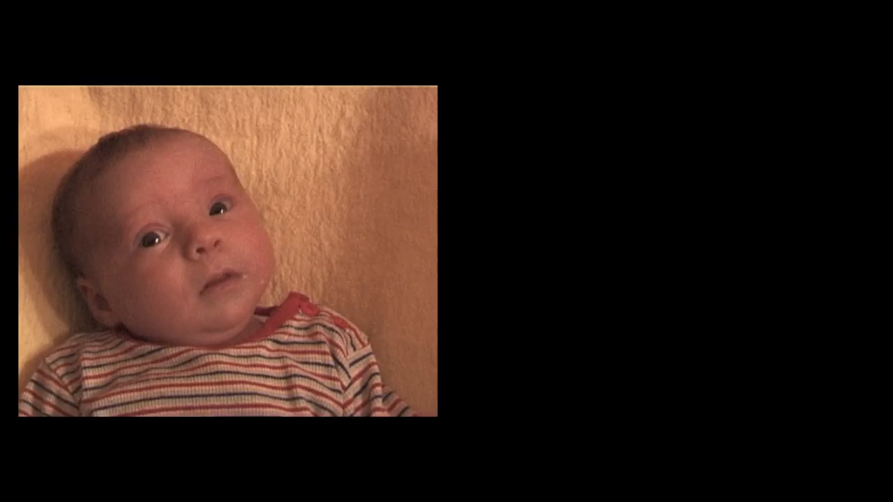

Slide 46
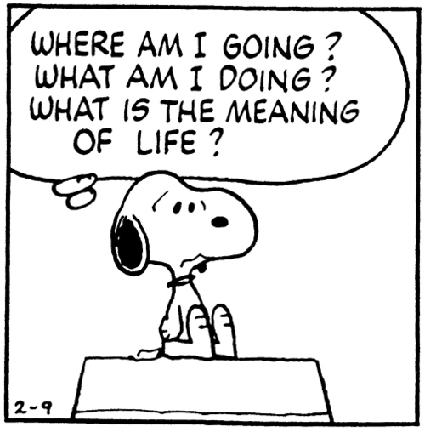
Existential questions
Aloneness
Identity
Freedom
The meaning of life
Death
Notes:
Barrett highlights the need to help children and young people develop a framework for thinking about or supporting their spirituality.
A spiritual framework or belief system which helps them tackle the existential questions of humanity.
Into adolescence – where is the safe space for this to happen? If we are thinking of fullness of life, that HAS to include more than just academic success. Wisdom, ability to think, reason. Turing House – Philosophy Club.

Slide 47
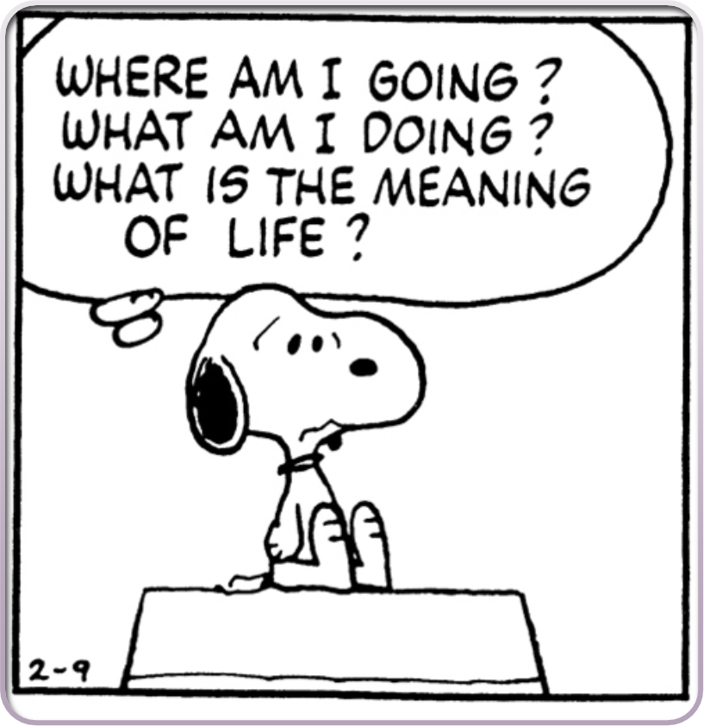
What might trigger the questions?
Family separation
Death of a close family member/friend
Stress
Self esteem
Bullying
Breakdown of friendship/relationship
Anxiety about the world

Slide 48


Slide 49
Formation and education
Faith formation is a process – a journey that starts with spirituality and may be expressed through faith.
There is a difference between creating an ethos of spiritual/faith formation and the provision of religious education.

Slide 50
What might make you think about God or spirituality?
15% When things don’t turn out really well
15% Answered prayer
17% People I know
17% Experiences had by other people
18% Kind gestures by others
22% Others talking about their experiences of God
24% Thinking about life
35% I don’t think about God or spirituality
Gen Z – rethinking culture
Youth for Christ 2017

Slide 51
Dr Rebecca Nye
Criteria for best practice
Space
Process
Imagination
Relationship
Intimacy
Trust
Notes:
Criteria for best practice

Slide 52
Dr Rebecca Nye
Criteria for best practice
Space….
Physical
Spiritual
Relational
For prayer/reflection
In a crowded curriculum
To explore without a pre-determined outcome
Pause Days
Notes:
Criteria for best practice

Slide 53
Practices which can develop spiritual awareness
Developing an appreciation of nature
Stories which don’t just lead to a moral lesson
Rituals and traditions
Silence/stillness
Prayer
Acts of service

Slide 54
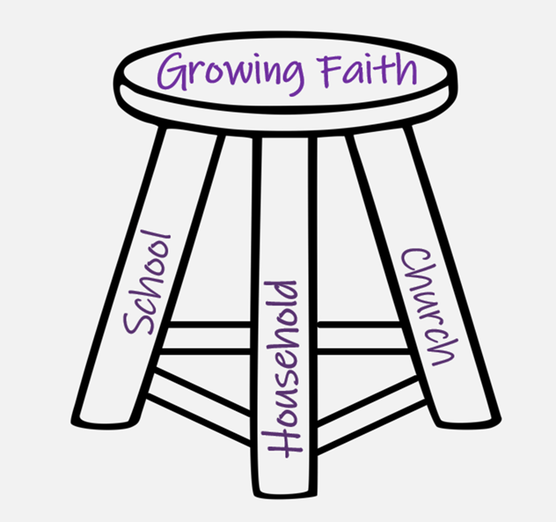
Creating the Connections
Notes:
But school is not the only place where we find children. How do we create a wider conversation between school, church and home to help nurture and support the child’s spirituality and/or faith?
How can we learn from each other (not least from children and young people), collaborate, share good practice, be innovative?
Our schools are cross-generational, cross-cultural places.
TIME TO CHAT
Where have you seen good models in practice?
Where are the opportunities for connections to be made?
What are the challenges which need to be overcome?

Slide 55

What gets in the way of spiritual flourishing?
Notes:
Exercise forgiveness if it doesn’t work

Slide 56
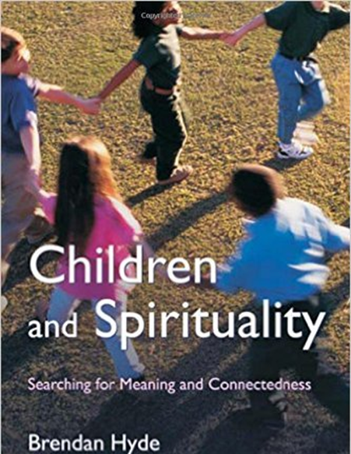
Getting in the way of spiritual flourishing
Material pursuit
  Disconnection with Other
  Affirmation in material excess
Trivialising
  Masking of inner feelings and values
Lack of time
  Busyness of adults
  Lack of space for stillness and listening
Notes:
Brendan Hyde in Children and Spirituality

Slide 57


Turning left on the plane

Slide 58
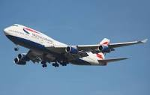
The same but different?
Economy
First Class
Cramped
Being given the minimum
Uniformity
Few options
Space
Abundance
Attention to detail
Choice

Slide 59
Bonnie J. Miller-McLemore
Children and young people..…have spiritual abilities that defy conventional chronological categories of faith development.
Religious faith does not develop in quite the same way as other parts of our bodies and minds from small to large or from immature to mature. Growing up, in fact, does not guarantee spiritual development.

Slide 60
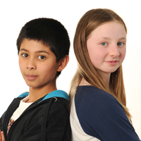
To flourish spiritually, children need:
Time be listened to
Respectful adults
Space to explore
Opportunities to wonder
To know there is another way
Notes:
Children and young people won’t flourish spiritually just because we added it as another project or a box to be ticked. We need to find ways to offer them a different way of being.
It’s when the threads of spiritual practices, the opportunities to pause, to question, to wonder, are woven together into the very being of our schools that possibly, just possibly, the shades of the prison house will not close in upon our children and young people and they can

Slide 61
Group Networking Activity 2:
Opportunities and Challenges for Secondary Schools

Slide 62
Lessons from the Ten Leading Schools Project
Dr Ann Casson & Nick Taunt, Canterbury Christ Church University

Slide 63
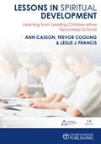
PREPARING THE SOIL:
GROWING FAITH, A COLLABORATIVE APPROACH
Ann Casson & Nick Taunt
National Institute for Christian Education Research (NICER)

Slide 64
REFLECTION
God has created me to do Him some definite service.
He has committed some work to me which He has not committed to another.
I have my mission..
I am a link in a chain, a bond of connection between persons.
He has not created me for naught.
I shall do good; I shall do His work.
I shall be an angel of peace, a preacher of truth in my own place,
while not intending it if I do but keep His commandments.
Therefore, I will trust Him..

Slide 65
..whatever I am, I can never be thrown away.
If I am in sickness, my sickness may serve Him,
in perplexity, my perplexity may serve Him.
If I am in sorrow, my sorrow may serve Him.
He does nothing in vain.
He knows what He is about.
Cardinal John Henry Newman

Slide 66
What does Christian ethos mean?
It’s about treating people with decency, respect blah, blah, and that kind of thing. Digitalspy post
Deeply Christian, Serving the Common Good. Church of England Vision for Education Report
A Christian Ethos in our school means that you support the aim to respect everyone within the school community, treat others as you expect to be treated, be kind, well behaved - really adopting a 'moral' way of behaving. Mumsnet.com
The Glory of God is a human being fully alive (Irenaeus). Each member of our school community is created by God and our aim is to achieve our full potential. All we do is rooted in this hope of who we are as people and who we can become (St Mary Redcliffe and Temple school)

Slide 67
POST-ITS [1]
Are these definitions useful in school?
What words or phrases resonate?
What could be improved?

Slide 68

The Research Project
Ann Casson, Trevor Cooling, & Leslie Francis
Telling the stories of 10 Christian-ethos secondary schools, to stimulate other schools to reflect on, and improve their own work of spiritual development with their students
Contributing to the international academic debate on the distinctiveness and effectiveness of Christian-ethos secondary schools

Slide 69
What do students understand by spiritual development?
Self: fulfilling one’s potential
Belonging to a community
Developing knowledge and understanding
Making a connection to God
It is about having an out of and in school connection to God obviously (Pupil)

Slide 70
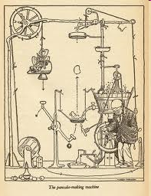

Young people as bricoleurs
Bricolage in a fragmented world:
The individual’s construction of their own religious identity, from the materials available to them - a ‘playing of the code’ (Hervieu-Léger, 1998, p. 217).

Slide 71
Examples from NICER research
Active agency of young people
Young people connecting with ‘church’ outside school rarely in form of parish, but Retreats, Soul Survivor, Taize & pilgrimages
The importance of parental influence, church attendance and talking about faith in the home
Different models of chaplaincy in church schools

Slide 72
Growing Faith (GS212)
Common to all good schools is a focus on pupils being active participants in their own learning and their development as leaders
In Church of England schools, pupils will increasingly experience a dynamic approach to developing their understanding about Christianity through our Understanding Christianity9 resource
Outstanding Collective Worship in Church of England schools is participatory, engaging, contemporary and relevant.

Slide 73
Growing Faith (GS212)
Church of England schools are encouraged to work closely with their local parish church to ensure that spiritual development is seen as fundamental to the life of the school and the education offer
Promoting and supporting effective chaplaincy and other forms of missional leadership in schools, colleges and universities to ensure greater connection with churches and households

Slide 74
WHERE?

Slide 75
Questions
Should Confirmation (and Baptism) take place in school? What are the opportunities and challenges?
How can spiritual development in schools in collaboration with local church be inclusive?
How are student leaders encouraged, developed and sustained in your school? In what ways are they encouraged to be leaders in their faith communities?

Slide 76
HOW?

Slide 78
WHAT NEXT?

Slide 79
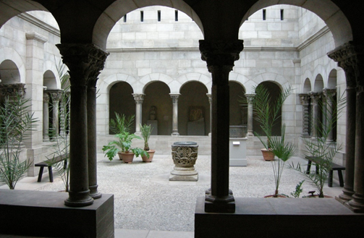
Developing schools as a space for fruitful spiritual development, in collaboration with other schools, local church and households?
A narthical learning space is not a stepping stone into the Christian faith, but offers a space ‘to look at [life] from a completely different perspective’ and invites the learner into ‘productive otherness’’ (Roebben, 2009). …It is a safe space to encounter, explore and reflect on religious experience.

Slide 80
Collaboration POST-ITS [2]
Three ideas that you want to explore further
Post-its under headings
Form groups
Plan for regional meetings

Slide 81
Questions
Contact information for NICER - Dr Ann Casson & Nick Taunt
Ann.casson@Canterbury.ac.uk
National Institute For Christian Education Research
Canterbury Christ Church University

Slide 82
Group Networking Activity 3:
Growing Faith in Practice – National and Regional Opportunities

Slide 83
Questions for Discussion:
What does this relationship look like locally (for your school/church, Diocese)?
What might the possibilities of working together across our network?
What do you have to give? What would you like to learn?
What resources would be helpful?
Is this another ‘project’?

Slide 84
Plenary and Next Steps
Next National Event –17 October – Removing Disadvantage
Regional Hub dates circulation
AASSH Conference – 9-11 October 2019
National Conference: Visionary Curriculum Leadership – Save the Date 6 Feb 2020

