Slide 1
Peer Support Network: Well-being
Liverpool
6th November

Slide 2
Reflection

Slide 4
‘Encouragement takes some of the strain of leadership, giving perspective to the pressure of success or fear of failure, and replacing this with the call to faithfulness.
The Psalmist speaks of a God who is both our shade and our shadow, countering our dominant educational meta-narrative of ‘not good enough’, while Jesus offers peace and rest for the busy and fearful:
“Come to me, all you who are weary and burdened and I will give you rest.”’

Slide 6
‘Life in all its fullness’
Educating for Wisdom, Knowledge and Skills
Educating for
Hope and Aspiration
Educating for Community and Living Well Together
Educating for Dignity and Respect

Slide 7
The Church of England Foundation
for Educational Leadership’s mission is:
“To develop inspirational leaders who are called, connected and committed to delivering the Church of England’s vision for education”

Slide 8
Called:
“Leaders who are called can articulate a strong sense of personal vocation to their role, and demonstrate this through their words, actions and decision making, exemplifying a strong moral purpose, confident vision, and ambitious trajectory of improvement. For some, this sense of vocation will be driven by an established or developing faith commitment. They show integrity, honesty and a deep sense of resilience, underpinned by their personal sense of vocation as a leader.”

Slide 9
Connected:
“Leaders who are connected operate deliberately within communities of practice, positioning themselves within positive relationships that sustain and encourage all parties. They embrace interdependence, demonstrate compassion and embody service to others humbly. They create shared identity within their teams and draw colleagues around a common purpose.”

Slide 10
Committed:
“Leaders who are committed exude energy and passion in all they do, inspiring confidence and faithfulness in their teams. They are clear about their purpose and resilient in the face of challenge. They take long-term decisions and not easily swayed by short-term changes of policy or procedure. They articulate a sense of mission in their approach to education to which they draw others, and are committed to the flourishing of their pupils and colleagues.”

Slide 11
Why focus on well-being?

Slide 12
Children
‘Life in all its fullness’
Adults
Teams

Slide 13
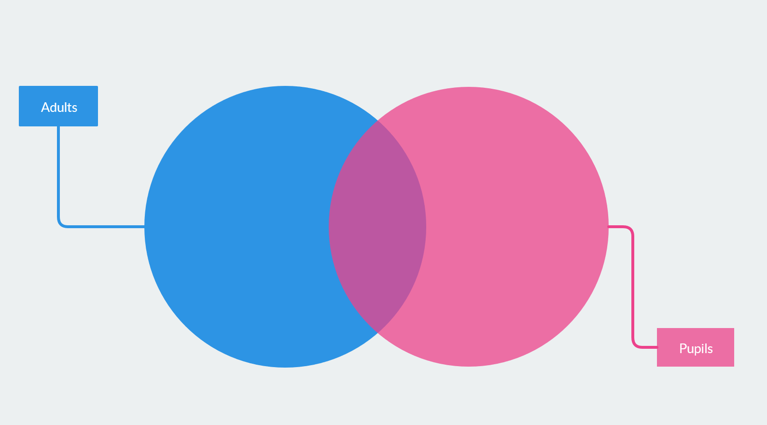
Flourishing of pupils AND adults

Slide 14
SIAMS 2018

Slide 15
What do we mean by ‘human flourishing’?

Slide 16
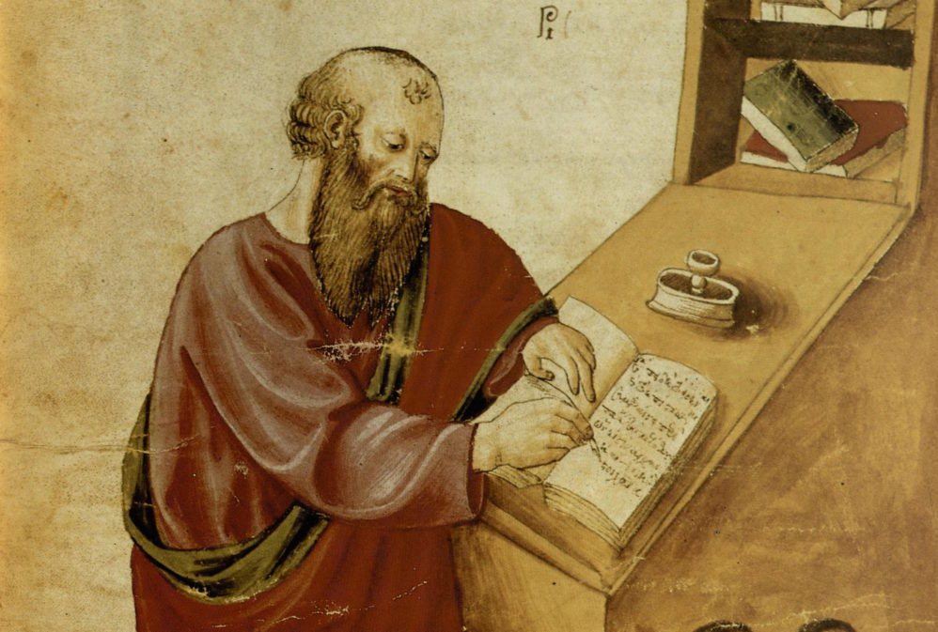
‘The notion of human flourishing set out in our thinking draws significantly on Aristotle, and especially on his conception of eudaimonia. The meaning of eudaimonia can be traced etymologically from its roots of ‘eu’ (good) and ‘daimon’ (spirit), refers to the notion of human flourishing and can…[refer to] physical flourishing, emotional flourishing, societal flourishing and fourthly, flourishing in terms of personal creativity, self-expression and knowledge seeking.’
Leadership of Character Education, 18

Slide 17
Flourishing in the Old Testament

Slide 18
Flourishing in the New Testament

Slide 19
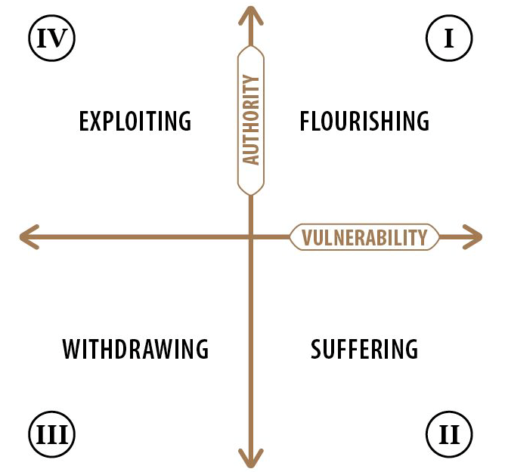

Slide 20
Where might different members of your school community be on this chart?
What needs to happen for them in order for them to flourish?
Where would the different case study characters be on this chart?
What needs to happen for them in order for them to flourish?

Slide 21
We flourish because of our diversity and relationships
We flourish at different times and different speeds
Flourishing Teams
Flourishing Adults
We flourish so we can look outwards and give
Flourishing Children
We flourish when we stop doing things

Slide 23
Transference of fear
MACRO
Ecology of blessing
OR
SCHOOL LEADERS
STAFF
PUPILS

Slide 24
Pedagogy Leadership Theology

Slide 25
Theology
Leadership
Pedagogy
Can you sum up, in a sentence, what each of these words mean for your school?
How confident might you be talking about each and why?
How might this be the start of an effective coaching conversation around the Vision?

Slide 27
Activity: Leadership Pedagogy Theology

Slide 29
Theology of Educational Leadership Practices Matrix (2019)

Slide 30
 | Called | Connected | Committed
Educating for Wisdom, Knowledge and Skills | Leading Learning - Refining Judgement | Creating Confidence - Embracing Interdependence | Deepening Understanding - Driving Improvement
Educating for Hope and Aspiration | Developing Imagination - Nurturing Ambition | Healing Relationships - Pursuing Renewal | Sustaining Vision - Building Resilience
Educating for Community and Living Well Together | Removing Disadvantage - Seeking Reconciliation | Accepting Vulnerability - Demonstrating Generosity | Inspiring Faithfulness -Embodying Integrity
Educating for Dignity and Respect | Celebrating Diversity - Enabling Flourishing | Offering Encouragement - Encouraging Service | Practising Humility - Learning Love

Slide 31
Connected:
“Leaders who are connected operate deliberately within communities of practice, positioning themselves within positive relationships that sustain and encourage all parties. They embrace interdependence, demonstrate compassion and embody service to others humbly. They create shared identity within their teams and draw colleagues around a common purpose.”

Slide 32
 | Called | Connected | Committed
Educating for Wisdom, Knowledge and Skills | Leading Learning - Refining Judgement | Creating Confidence - Embracing Interdependence | Deepening Understanding - Driving Improvement
Educating for Hope and Aspiration | Developing Imagination - Nurturing Ambition | Healing Relationships - Pursuing Renewal | Sustaining Vision - Building Resilience
Educating for Community and Living Well Together | Removing Disadvantage - Seeking Reconciliation | Accepting Vulnerability - Demonstrating Generosity | Inspiring Faithfulness -Embodying Integrity
Educating for Dignity and Respect | Celebrating Diversity - Enabling Flourishing | Offering Encouragement - Encouraging Service | Practising Humility - Learning Love

Slide 33
Educating for
Dignity and Respect:
Ensuring the basic principle of respect for the value and preciousness of each person, treating each person as a unique individual of inherent worth.

Slide 34
 | Called | Connected | Committed
Educating for Wisdom, Knowledge and Skills | Leading Learning - Refining Judgement | Creating Confidence - Embracing Interdependence | Deepening Understanding - Driving Improvement
Educating for Hope and Aspiration | Developing Imagination - Nurturing Ambition | Healing Relationships - Pursuing Renewal | Sustaining Vision - Building Resilience
Educating for Community and Living Well Together | Removing Disadvantage - Seeking Reconciliation | Accepting Vulnerability - Demonstrating Generosity | Inspiring Faithfulness -Embodying Integrity
Educating for Dignity and Respect | Celebrating Diversity - Enabling Flourishing | Offering Encouragement - Encouraging Service | Practising Humility - Learning Love

Slide 35
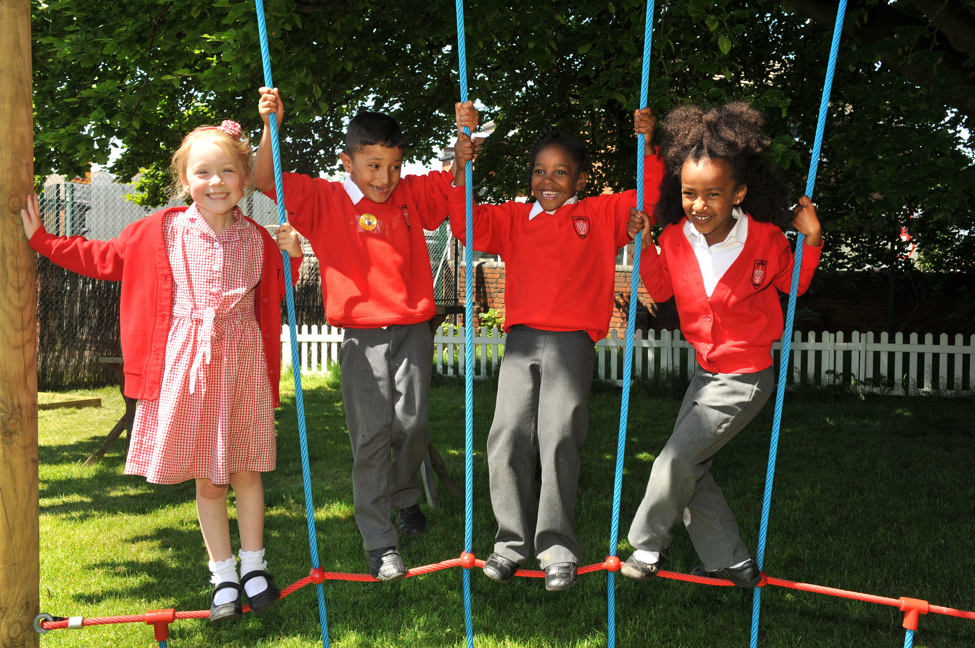
Educating for Community and Living Well Together:
Ensuring a core focus on relationships, participation in communities and the qualities of character that enable people to flourish together.

Slide 36
 | Called | Connected | Committed
Educating for Wisdom, Knowledge and Skills | Leading Learning - Refining Judgement | Creating Confidence - Embracing Interdependence | Deepening Understanding - Driving Improvement
Educating for Hope and Aspiration | Developing Imagination - Nurturing Ambition | Healing Relationships - Pursuing Renewal | Sustaining Vision - Building Resilience
Educating for Community and Living Well Together | Removing Disadvantage - Seeking Reconciliation | Accepting Vulnerability - Demonstrating Generosity | Inspiring Faithfulness -Embodying Integrity
Educating for Dignity and Respect | Celebrating Diversity - Enabling Flourishing | Offering Encouragement - Encouraging Service | Practising Humility - Learning Love

Slide 38
If you replaced the word ‘teachers’ with ‘school leaders’ and the word ‘students’ with ‘school staff’, what might need to change in your school?

Slide 39
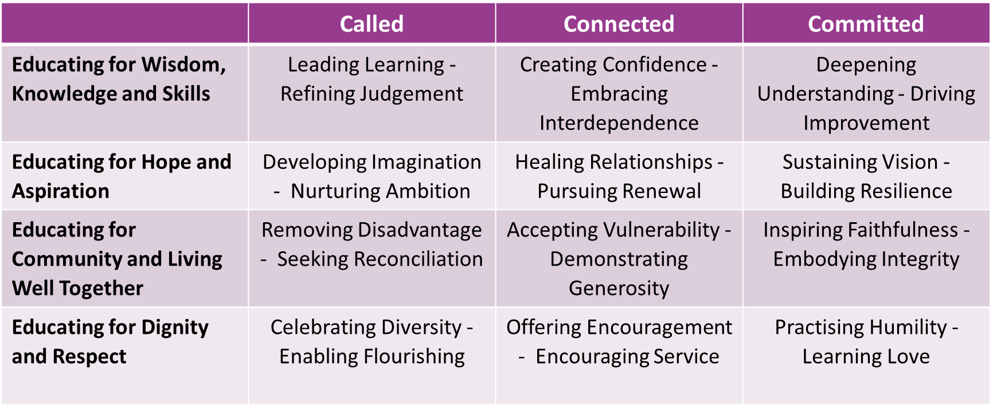

Slide 40
Formulating research questions
What would you like to explore around well-being in your school to enable the flourishing of pupils, adults and teams?
How will you go about finding this out?
Who will you need to involve?

Slide 41
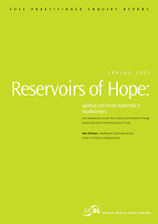
Further Reading
For next time:
https://dera.ioe.ac.uk/5117/1/media-75c-a0-reservoirs-of-hope-full.pdf
Conduct a walk round or survey to try and honestly gauge the well-being of different members of your school community. Where are people truly flourishing? Where are the pressure points?
How can I use my leadership strengths to increase well-being where it is less evident?

