Slide 1
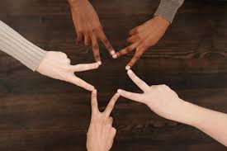
In Memory of Many: Remembering the Victims of the Holocaust

Slide 2
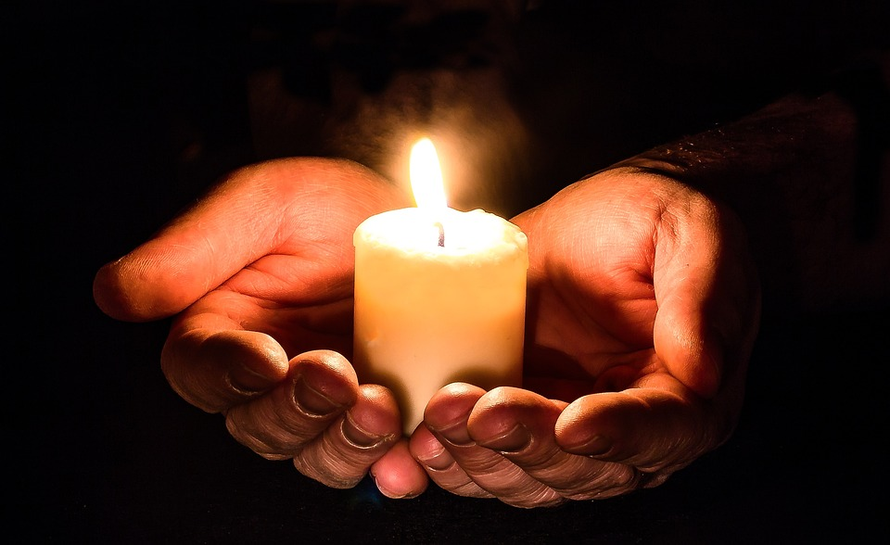
Gathering
Almighty God,
We remember before You all those who suffered and perished in the Holocaust.
On this day of remembrance, help us to honour their lives and the lessons they teach us.
Grant us the strength to stand against hatred, And the compassion to show kindness and respect to all people.
May we work together to build a world of peace, justice, and dignity for all.
Through Jesus Christ, our Lord. Amen.

Slide 3
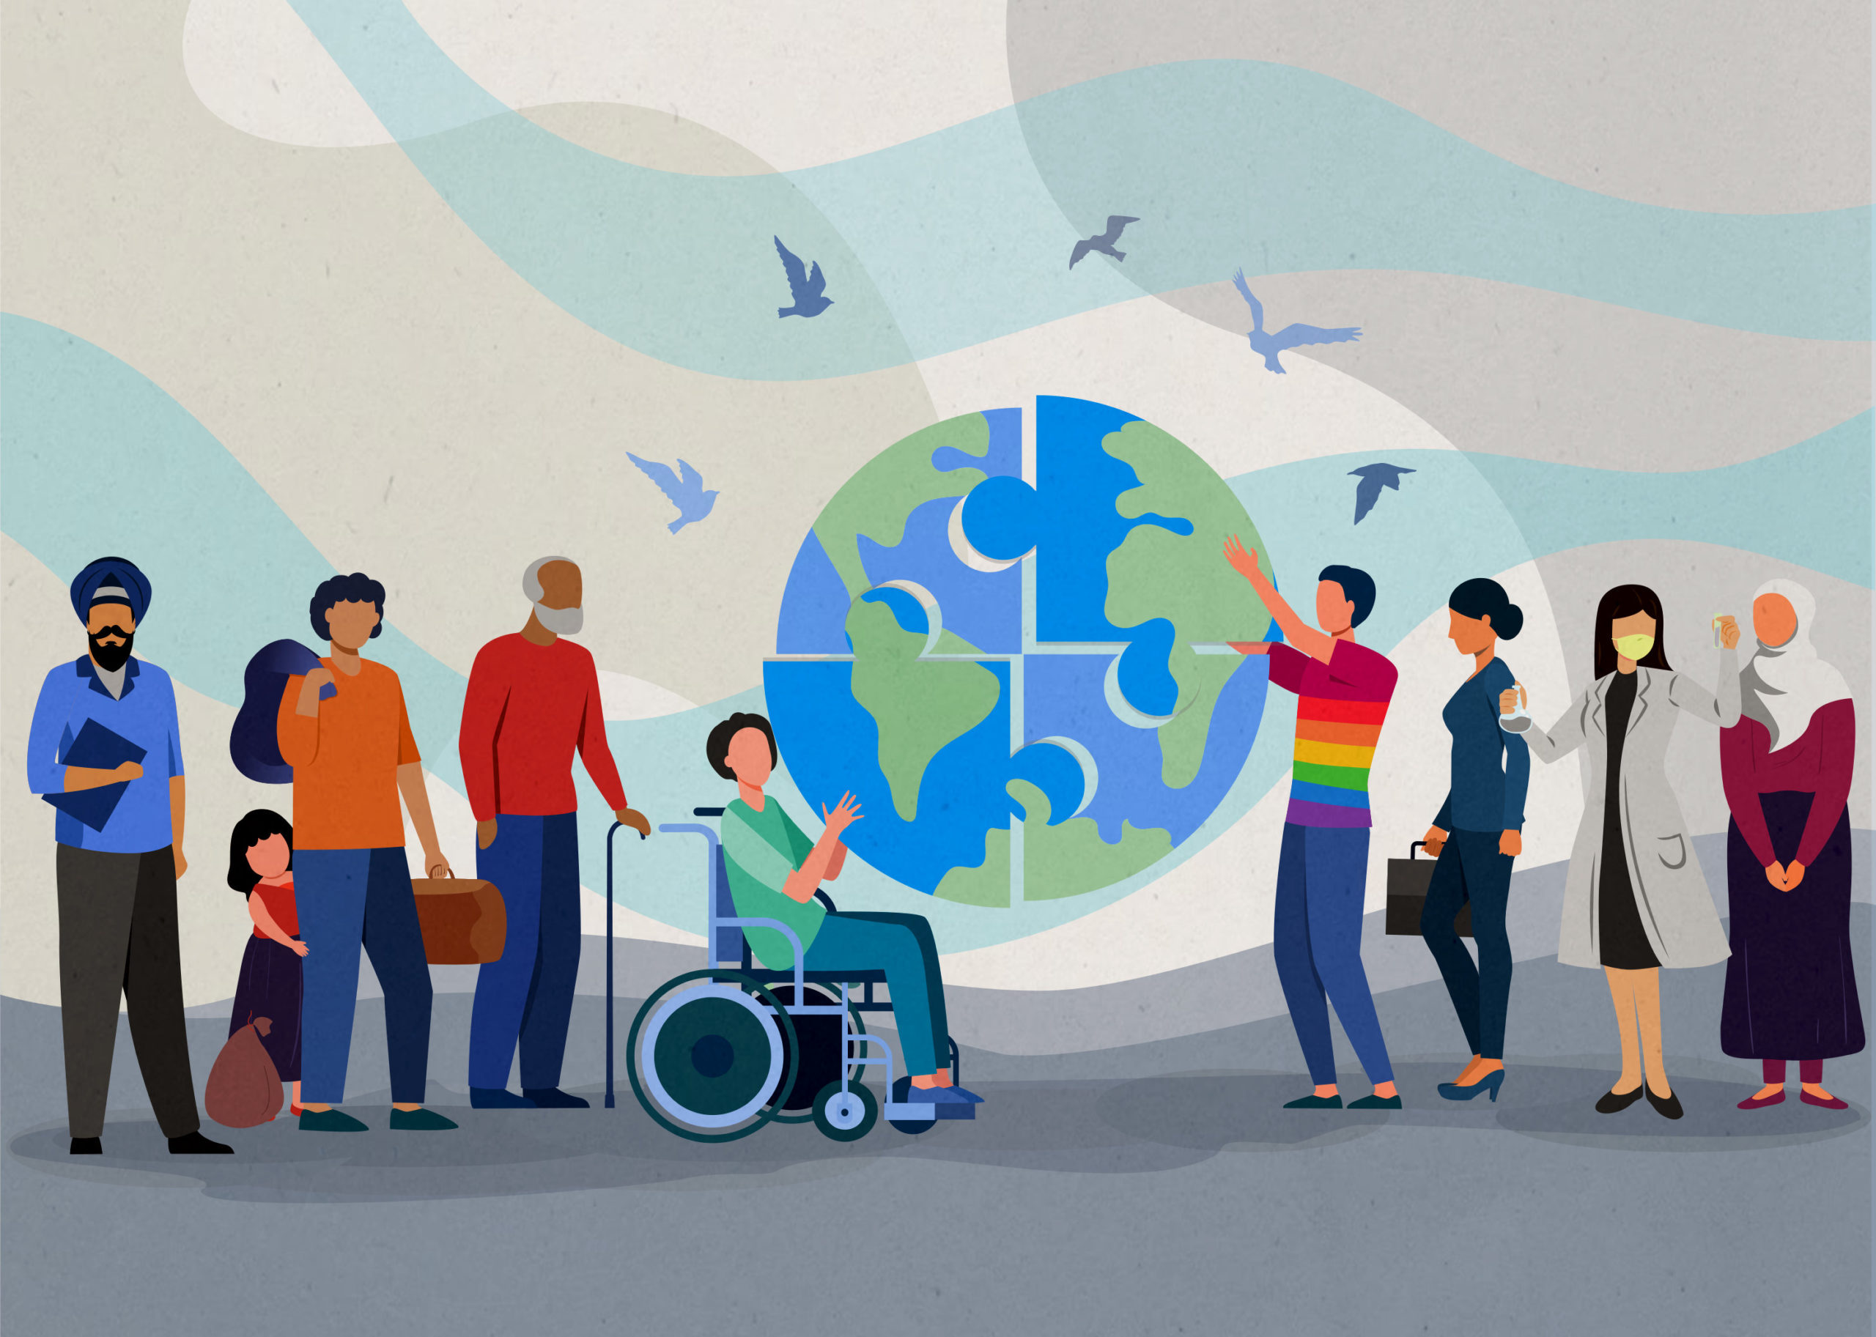
Matthew 25:35-40
"For I was hungry and you gave me something to eat, I was thirsty and you gave me something to drink, I was a stranger and you invited me in, I needed clothes and you clothed me, I was sick and you looked after me, I was in prison and you came to visit me."
"Then the righteous will answer him, 'Lord, when did we see you hungry and feed you, or thirsty and give you something to drink? When did we see you a stranger and invite you in, or needing clothes and clothe you? When did we see you sick or in prison and go to visit you?'
The King will reply, 'Truly I tell you, whatever you did for one of the least of these brothers and sisters of mine, you did for me.'"

Slide 4
Listening
Empathy
Forgiveness
Why is it important to listen to the voices of those who have suffered, both in the past and today?
How can we show empathy and kindness to people who are suffering, even if we don't fully understand their pain?
How can forgiveness help to break the cycle of hurt and suffering, and why is it important for building a better future?

Slide 5
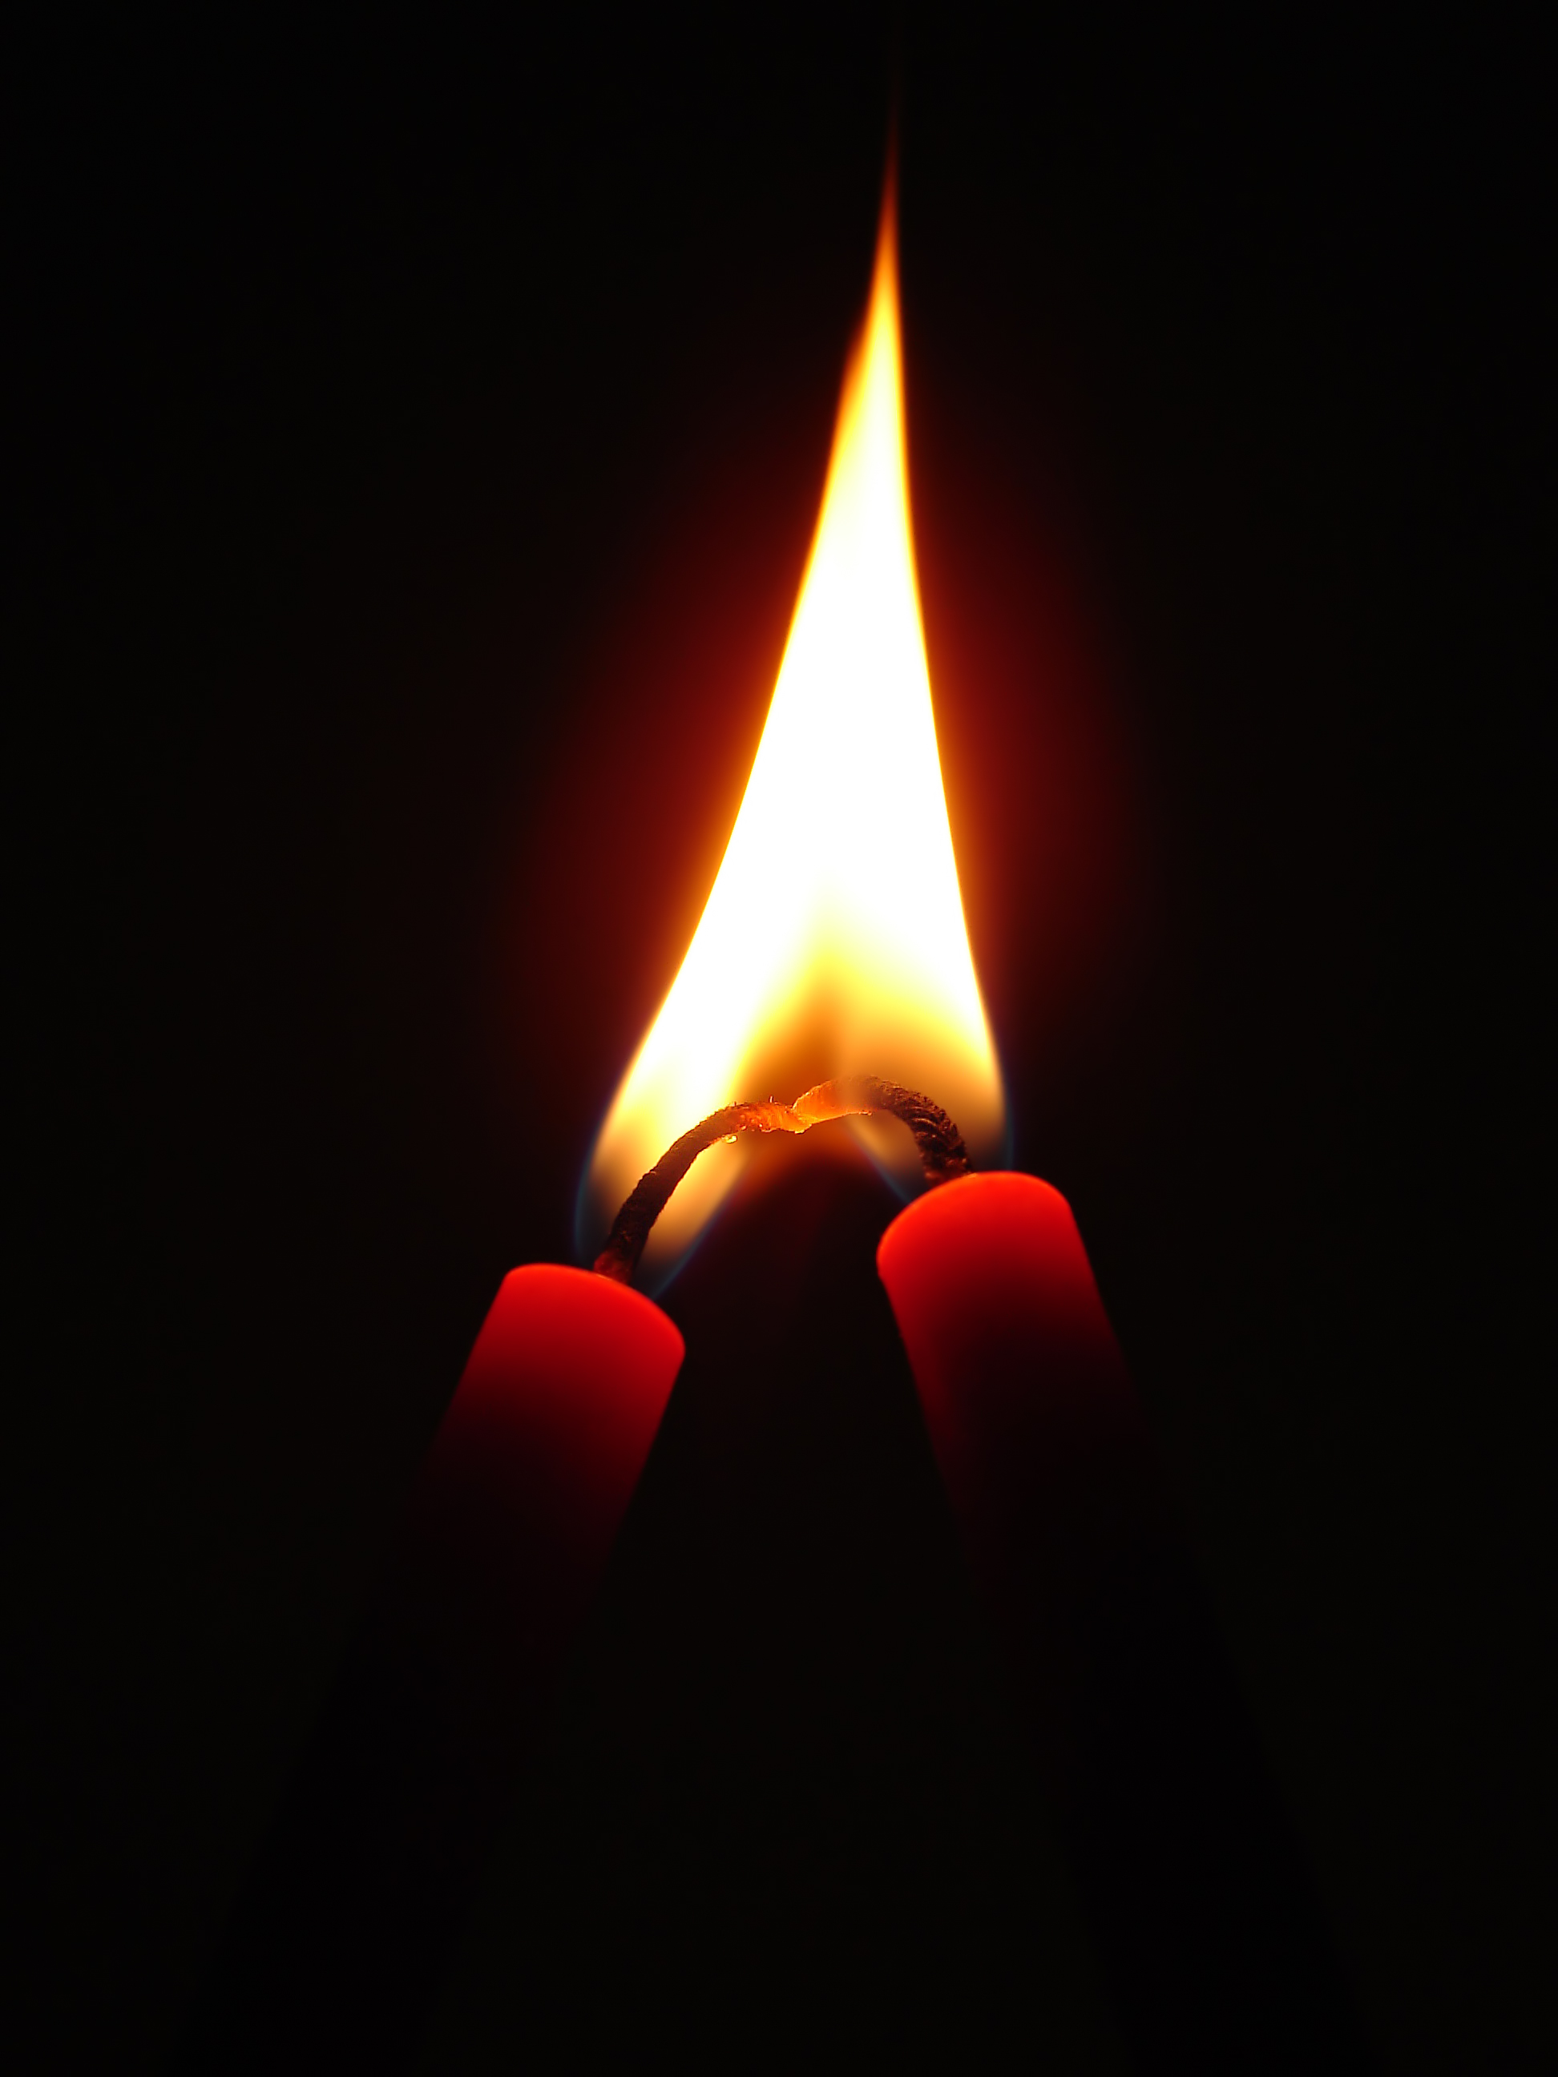
Our prayer
Loving God, As we close this time of remembrance, we thank You for all the lives we have honoured today on Holocaust Memorial Day.
Grant us the strength to stand against hatred and the compassion to value every life, regardless of identity, faith, or background. May we work for a world where all people are treated with justice, dignity, and love.
In the name of Your Son, Jesus Christ, Amen.

