Slide 1
Peer Support Network: Curriculum – Guildford 16th October

Slide 2
Reflection

Slide 3
Developing Imagination

Slide 4
‘The imagination must come before the implementation. Our culture is competent to implement almost anything and imagine almost nothing. It is our vocation to keep alive the ministry of imagination.’
Walter Brueggemann The Prophetic Imagination

Slide 6
‘Life in all its fullness’
Educating for Wisdom, Knowledge and Skills
Educating for
Hope and Aspiration
Educating for Community and Living Well Together
Educating for Dignity and Respect

Slide 7
The Church of England Foundation
for Educational Leadership’s mission is:
“To develop inspirational leaders who are called, connected and committed to delivering the Church of England’s vision for education”

Slide 8
Called:
“Leaders who are called can articulate a strong sense of personal vocation to their role, and demonstrate this through their words, actions and decision making, exemplifying a strong moral purpose, confident vision, and ambitious trajectory of improvement. For some, this sense of vocation will be driven by an established or developing faith commitment. They show integrity, honesty and a deep sense of resilience, underpinned by their personal sense of vocation as a leader.”
Notes:
5 minutes
BEFORE GOING TO LUNCH, lets go back to our starting point.
Take a moment on your own to note down:
What has struck you during this morning’s session.
What actions will you take as a consequence
Share with a partner.

Slide 9
Connected:
“Leaders who are connected operate deliberately within communities of practice, positioning themselves within positive relationships that sustain and encourage all parties. They embrace interdependence, demonstrate compassion and embody service to others humbly. They create shared identity within their teams and draw colleagues around a common purpose.”
Notes:
5 minutes
BEFORE GOING TO LUNCH, lets go back to our starting point.
Take a moment on your own to note down:
What has struck you during this morning’s session.
What actions will you take as a consequence
Share with a partner.

Slide 10
Committed:
“Leaders who are committed exude energy and passion in all they do, inspiring confidence and faithfulness in their teams. They are clear about their purpose and resilient in the face of challenge. They take long-term decisions and not easily swayed by short-term changes of policy or procedure. They articulate a sense of mission in their approach to education to which they draw others, and are committed to the flourishing of their pupils and colleagues.”
Notes:
5 minutes
BEFORE GOING TO LUNCH, lets go back to our starting point.
Take a moment on your own to note down:
What has struck you during this morning’s session.
What actions will you take as a consequence
Share with a partner.

Slide 11
What is the Curriculum for?

Slide 12
Children
‘Life in all its fullness’
Adults
Teams

Slide 13
Knowledge or Skills?

Slide 14
Where would you place your curriculum on this diagram?
Is this true for all subjects, or is there variation?
Why is that?

Slide 15
What do we mean by ‘human flourishing’?

Slide 16
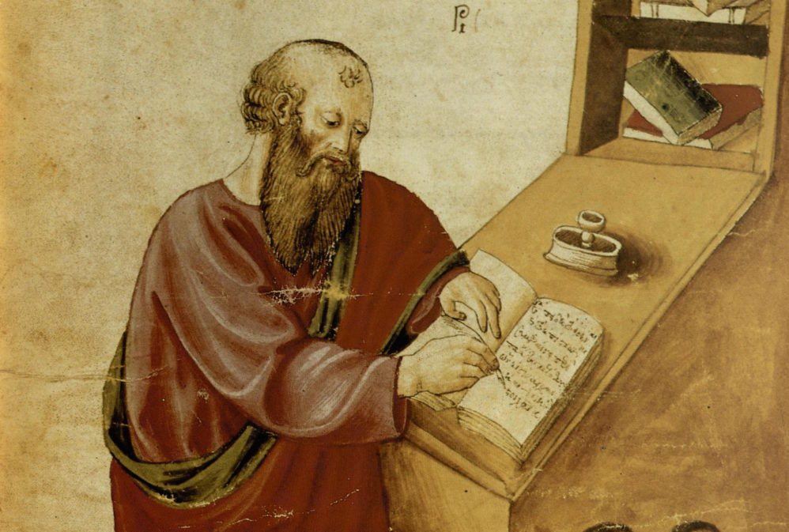
‘The notion of human flourishing set out in our thinking draws significantly on Aristotle, and especially on his conception of eudaimonia. The meaning of eudaimonia can be traced etymologically from its roots of ‘eu’ (good) and ‘daimon’ (spirit), refers to the notion of human flourishing and can…[refer to] physical flourishing, emotional flourishing, societal flourishing and fourthly, flourishing in terms of personal creativity, self-expression and knowledge seeking.’
Leadership of Character Education, 18

Slide 17
‘In the New Testament, the notion of ‘life in all its fullness’ cannot be understood without explicit reference to the Christian’s response to God. Jesus says clearly what he was specifically looking for in his followers, and the kind of defining love-in-action that he hoped would mark them out:
‘Love one another. As I have loved you, so you must love one another.
By this, everyone will know that you are my disciples.’ (John 13:34-5).
Jesus models this frequently, for example, showing his closest followers what the virtues of service and humility meant, not merely talking about them, but by washing their feet shortly before his own arrest, trial and crucifixion. [It] was not simply the task of the individual to become better by human effort alone, but rather improvement and development is the work of the Spirit in each individual.
The implications for school leadership are releasing, recognising that virtues can be prayed for and infused, rather than simply exhorting one another to work harder at developing them.’
Leadership of Character Education, 19

Slide 18
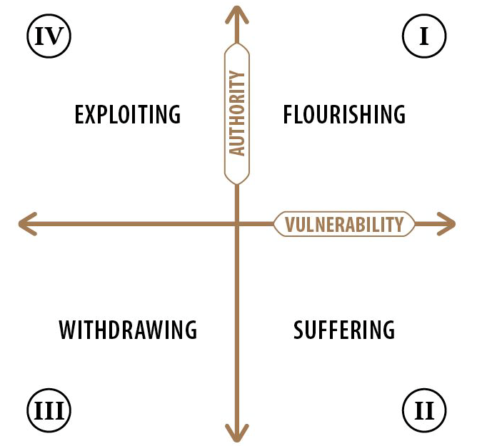

Slide 19
We flourish because of our diversity and relationships
Flourishing Teams
Flourishing Adults
Flourishing Children

Slide 20
What could this look like for the Curriculum?

Slide 21
We flourish because of our diversity and relationships
We flourish at different times and different speeds
Flourishing Teams
Flourishing Adults
Flourishing Children

Slide 22
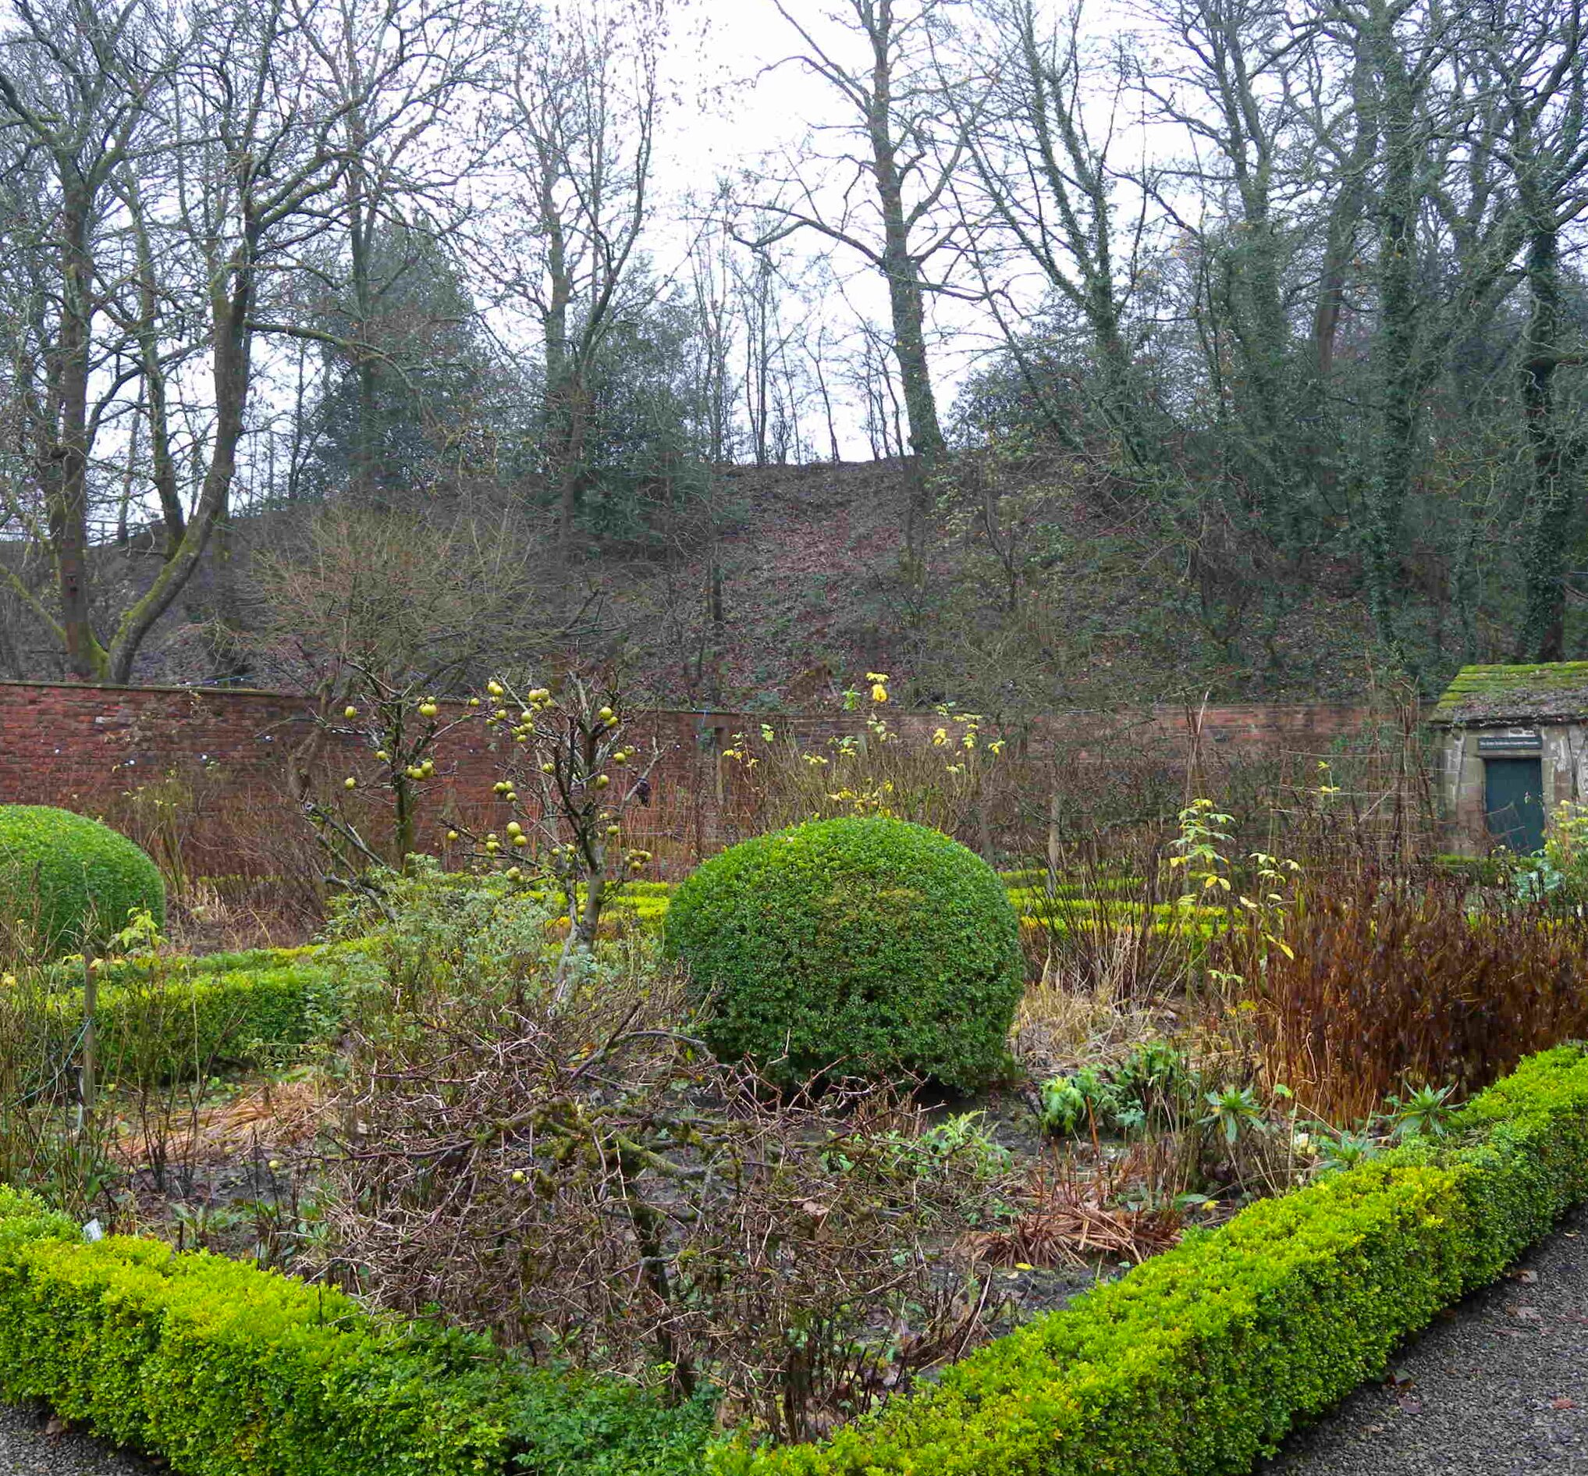
A garden that’s bursting into life…?

Slide 23
We flourish because of our diversity and relationships
We flourish at different times and different speeds
Flourishing Teams
Flourishing Adults
Flourishing Children
We flourish when we stop doing things

Slide 24
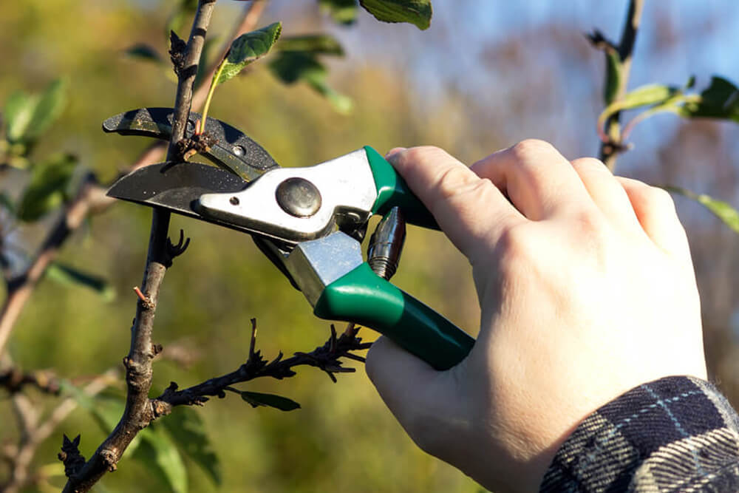
What should we stop doing?

Slide 25
We flourish because of our diversity and relationships
We flourish at different times and different speeds
Flourishing Teams
Flourishing Adults
We flourish so we can look outwards and give
Flourishing Children
We flourish when we stop doing things

Slide 26
“But since you excel in everything – in faith, in speech, in knowledge, in complete earnestness and in the love we have kindled in you – see that you also excel in this grace of giving.”
(2 Corinthians 8.7)

Slide 27
We flourish because of our diversity and relationships
We flourish at different times and different speeds
Flourishing Teams
Flourishing Adults
We flourish so we can look outwards and give
Flourishing Children
We flourish when we stop doing things

Slide 28
Theology
Leadership
Pedagogy
What do each of these words mean:
for you?
for your school?
How confident might you be talking about each and why?
What about your school community?

Slide 29
Ethos Enhancing Outcomes

Slide 30
“If the Vision for Education fails to make and sustain meaningful connections between a school’s ethos and its outcomes, it will become nothing more than a deeply eloquent and well-meaning piece of writing…”

Slide 31
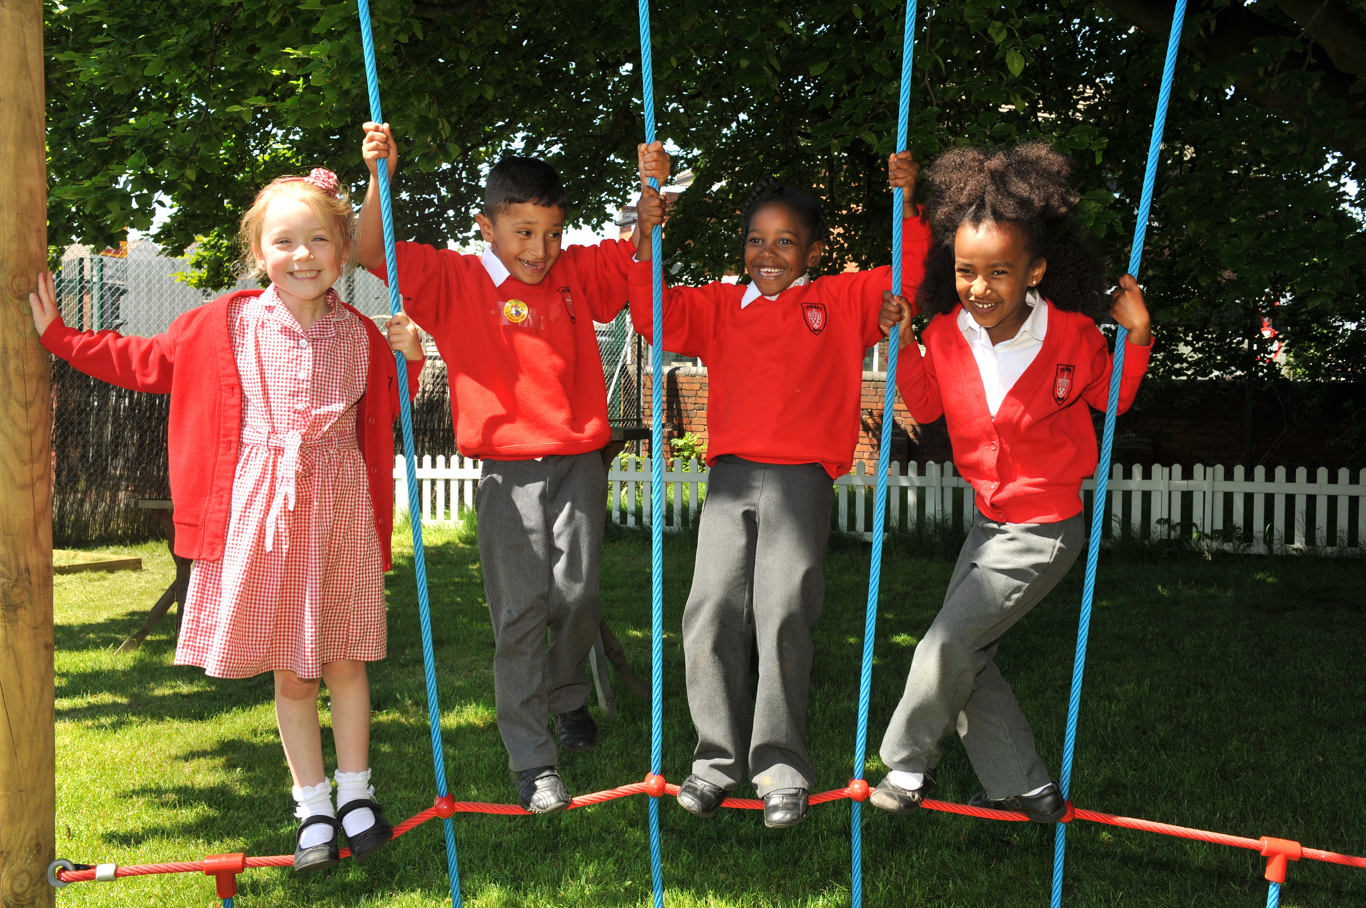
“..It must come off the shelf and be brought to life through leaders evaluating its potential impact on every area of day-to-day school life…”

Slide 32
“…This dynamic and enhancing connection between ethos and outcomes is what we mean by ‘Bringing the Vision Alive.’”

Slide 33
What outcomes are you trying to improve?
What are the pressures and challenges?
Who defines this journey?
What help could the Vision offer you?
ethos
enhancing
outcomes
How do you define this for your school?
(in a sentence…)
Where does your ethos come from?
What are the commonalities and differences between us?
What difference does it make to your lived reality?

Slide 34
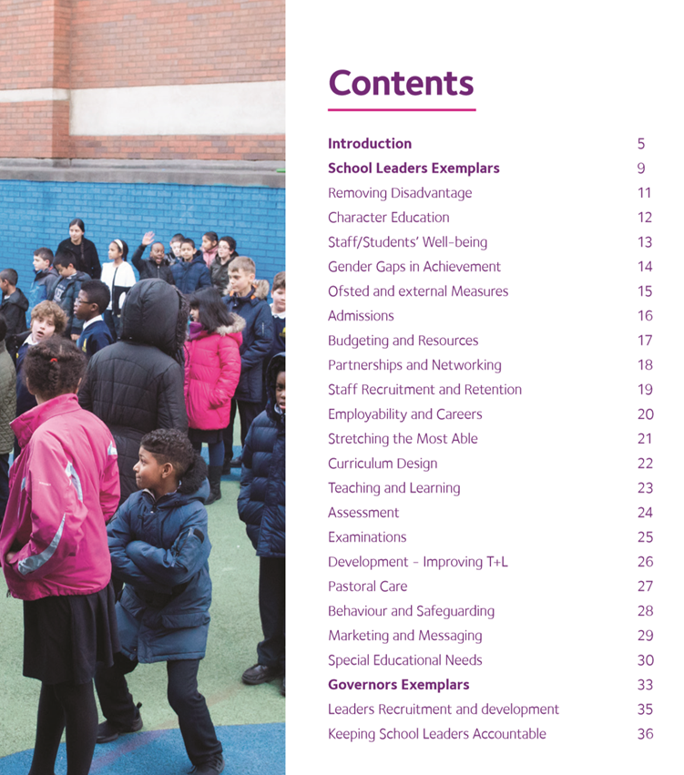
Notes:
Look together at Removing Disadvantage (as an example) – one group to take each strand… what resonated for you?

Slide 35
Theology of Educational Leadership Practices Matrix (2019)

Slide 36
 | Called | Connected | Committed
Educating for Wisdom, Knowledge and Skills | Leading Learning - Refining Judgement | Creating Confidence - Embracing Interdependence | Deepening Understanding - Driving Improvement
Educating for Hope and Aspiration | Developing Imagination - Nurturing Ambition | Healing Relationships - Pursuing Renewal | Sustaining Vision - Building Resilience
Educating for Community and Living Well Together | Removing Disadvantage - Seeking Reconciliation | Accepting Vulnerability - Demonstrating Generosity | Inspiring Faithfulness -Embodying Integrity
Educating for Dignity and Respect | Celebrating Diversity - Enabling Flourishing | Offering Encouragement - Encouraging Service | Practising Humility - Learning Love

Slide 37
Called:
“Leaders who are called can articulate a strong sense of personal vocation to their role, and demonstrate this through their words, actions and decision making, exemplifying a strong moral purpose, confident vision, and ambitious trajectory of improvement. For some, this sense of vocation will be driven by an established or developing faith commitment. They show integrity, honesty and a deep sense of resilience, underpinned by their personal sense of vocation as a leader.”
Notes:
5 minutes
BEFORE GOING TO LUNCH, lets go back to our starting point.
Take a moment on your own to note down:
What has struck you during this morning’s session.
What actions will you take as a consequence
Share with a partner.

Slide 38
 | Called | Connected | Committed
Educating for Wisdom, Knowledge and Skills | Leading Learning - Refining Judgement | Creating Confidence - Embracing Interdependence | Deepening Understanding - Driving Improvement
Educating for Hope and Aspiration | Developing Imagination - Nurturing Ambition | Healing Relationships - Pursuing Renewal | Sustaining Vision - Building Resilience
Educating for Community and Living Well Together | Removing Disadvantage - Seeking Reconciliation | Accepting Vulnerability - Demonstrating Generosity | Inspiring Faithfulness -Embodying Integrity
Educating for Dignity and Respect | Celebrating Diversity - Enabling Flourishing | Offering Encouragement - Encouraging Service | Practising Humility - Learning Love

Slide 39
Educating for
Dignity and Respect:
Ensuring the basic principle of respect for the value and preciousness of each person, treating each person as a unique individual of inherent worth.

Slide 40
 | Called | Connected | Committed
Educating for Wisdom, Knowledge and Skills | Leading Learning - Refining Judgement | Creating Confidence - Embracing Interdependence | Deepening Understanding - Driving Improvement
Educating for Hope and Aspiration | Developing Imagination - Nurturing Ambition | Healing Relationships - Pursuing Renewal | Sustaining Vision - Building Resilience
Educating for Community and Living Well Together | Removing Disadvantage - Seeking Reconciliation | Accepting Vulnerability - Demonstrating Generosity | Inspiring Faithfulness -Embodying Integrity
Educating for Dignity and Respect | Celebrating Diversity - Enabling Flourishing | Offering Encouragement - Encouraging Service | Practising Humility - Learning Love

Slide 41
Celebrating Diversity -
Enabling Flourishing

Slide 42
Formulating research questions
What would you like to explore around how the Curriculum in your school enables the flourishing of pupils, adults and teams?
How will you go about finding this out?
Who will you need to involve?

Slide 43
Further Reading
Bring for next time:

