Slide 1
Peer Support Network: Character Development– Guildford 22nd October

Slide 2
Reflection

Slide 3
Does Education = Achievement/ Standards?

Slide 4
‘That which leaders choose to improve communicates much about their values. While academic success stands at the heart of great education, character development and wider flourishing stands as fundamental to any sustainable academic success.’

Slide 5
‘There is no such thing as a neutral education.’
Fruit of the Spirit (2015)

Slide 10
‘Life in all its fullness’
Educating for Wisdom, Knowledge and Skills
Educating for
Hope and Aspiration
Educating for Community and Living Well Together
Educating for Dignity and Respect

Slide 11
The Church of England Foundation
for Educational Leadership’s mission is:
“To develop inspirational leaders who are called, connected and committed to delivering the Church of England’s vision for education”

Slide 12
Called:
“Leaders who are called can articulate a strong sense of personal vocation to their role, and demonstrate this through their words, actions and decision making, exemplifying a strong moral purpose, confident vision, and ambitious trajectory of improvement. For some, this sense of vocation will be driven by an established or developing faith commitment. They show integrity, honesty and a deep sense of resilience, underpinned by their personal sense of vocation as a leader.”
Notes:
5 minutes
BEFORE GOING TO LUNCH, lets go back to our starting point.
Take a moment on your own to note down:
What has struck you during this morning’s session.
What actions will you take as a consequence
Share with a partner.

Slide 13
Connected:
“Leaders who are connected operate deliberately within communities of practice, positioning themselves within positive relationships that sustain and encourage all parties. They embrace interdependence, demonstrate compassion and embody service to others humbly. They create shared identity within their teams and draw colleagues around a common purpose.”
Notes:
5 minutes
BEFORE GOING TO LUNCH, lets go back to our starting point.
Take a moment on your own to note down:
What has struck you during this morning’s session.
What actions will you take as a consequence
Share with a partner.

Slide 14
Committed:
“Leaders who are committed exude energy and passion in all they do, inspiring confidence and faithfulness in their teams. They are clear about their purpose and resilient in the face of challenge. They take long-term decisions and not easily swayed by short-term changes of policy or procedure. They articulate a sense of mission in their approach to education to which they draw others, and are committed to the flourishing of their pupils and colleagues.”
Notes:
5 minutes
BEFORE GOING TO LUNCH, lets go back to our starting point.
Take a moment on your own to note down:
What has struck you during this morning’s session.
What actions will you take as a consequence
Share with a partner.

Slide 15
Why is character development important?

Slide 16
Children
‘Life in all its fullness’
Adults
Teams

Slide 17
‘Leaders who love their pupils recognise the transference of fear that can ensue from macro to school to teacher to pupil, and care deeply for the mental health and wellbeing of their pupils, taking great care with them, particularly at pressure points of examinations.’
What kind of education: Does Education = Achievement?
MACRO
SCHOOL LEADERS
STAFF
PUPILS

Slide 18
Evaluating Prevailing Narratives

Slide 19
How can we evaluate the prevailing educational narratives?
Narrowing the horizons of learning – keeping it tight until May in Year 6
Every percentage point counts
Your child? Our unit of economic capital
Their results? My job.
Most children matter, some matter more than others

Slide 20
Thin Narratives | Thick Narratives
Utilitarian/ Instrumentalist | Wisdom, Knowledge and Skills (for living well)
Competitive | Hope and Aspiration (through forgiveness and grace)
Individualistic | Community and Living Well Together (created for life together)
Reductionist | Dignity and Respect (of every person)

Slide 21
Developing and Celebrating Human Flourishing

Slide 22
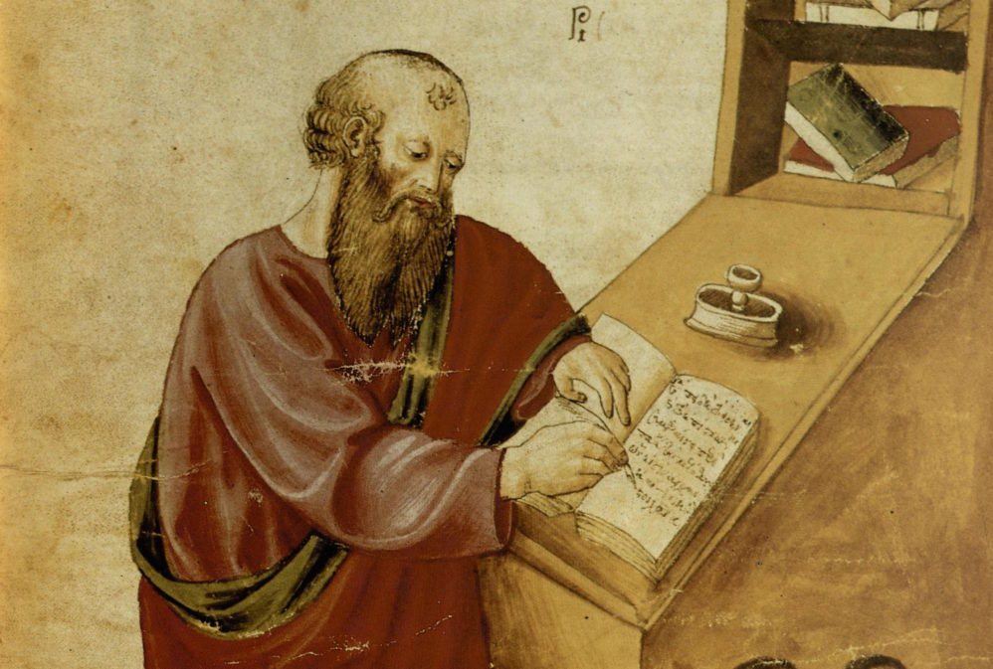
‘The notion of human flourishing set out in our thinking draws significantly on Aristotle, and especially on his conception of eudaimonia. The meaning of eudaimonia can be traced etymologically from its roots of ‘eu’ (good) and ‘daimon’ (spirit), refers to the notion of human flourishing and can…[refer to] physical flourishing, emotional flourishing, societal flourishing and fourthly, flourishing in terms of personal creativity, self-expression and knowledge seeking.’
Leadership of Character Education, 18

Slide 24
Our Christian Inspiration for Character Development

Slide 25
‘It is a Christian’s concern for the wholeness of the human being, for the quality of the common life, for the direction in which humanity goes, that turns us towards education now and sets us inside it and will not let us disengage.’
Fruit of the Spirit (2015)

Slide 26
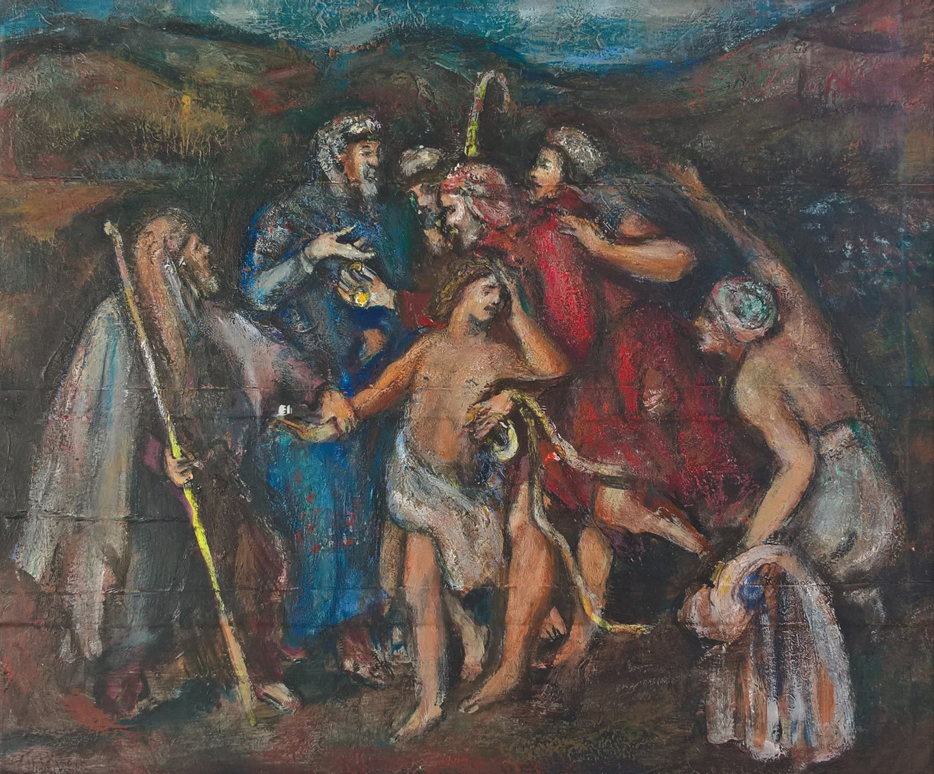
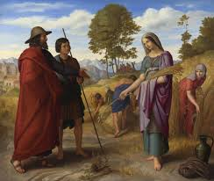
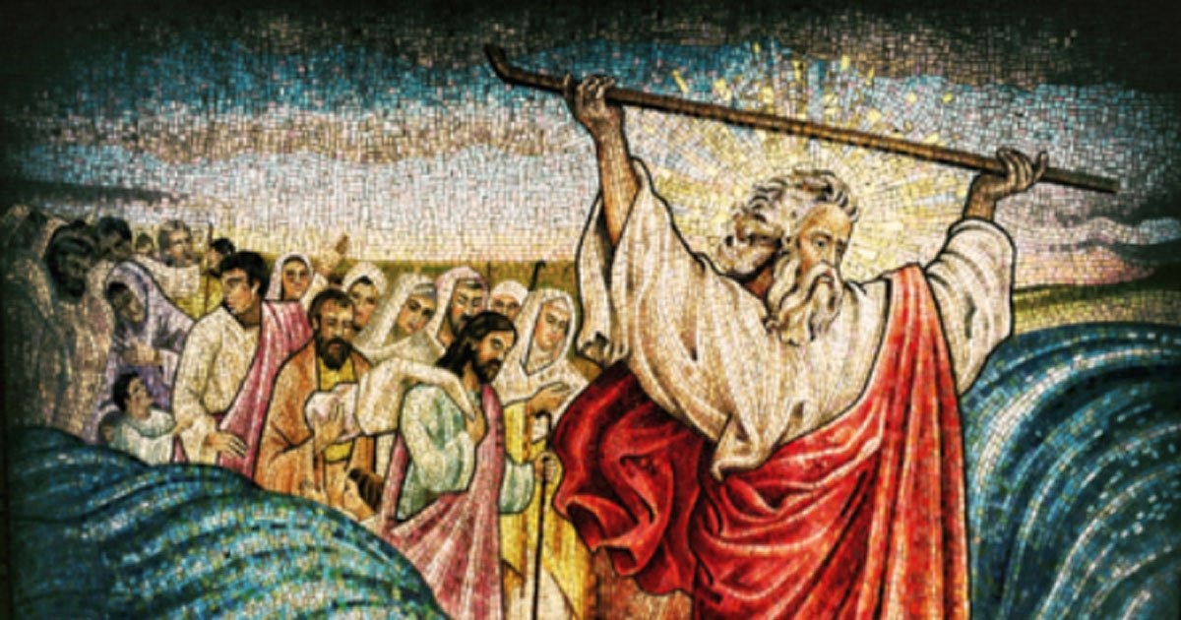
Character Development in the Old Testament

Slide 27
Who would you have included here?

Slide 28
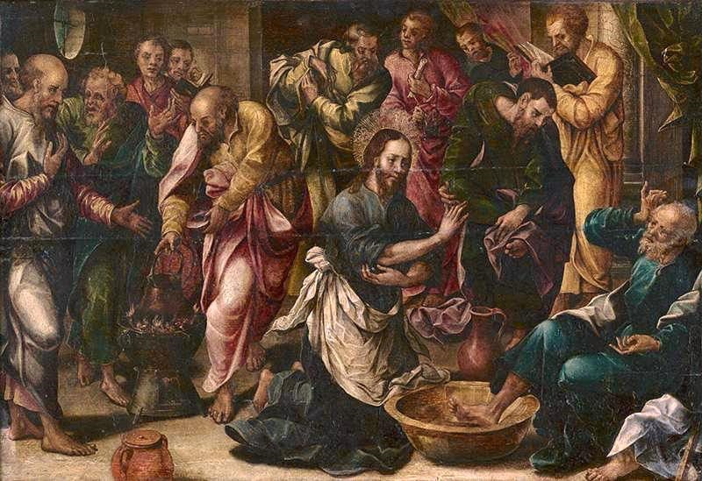
‘Love one another. As I have loved you, so you must love one another. By this, everyone will know that you are my disciples.’
John 13:34-5

Slide 29
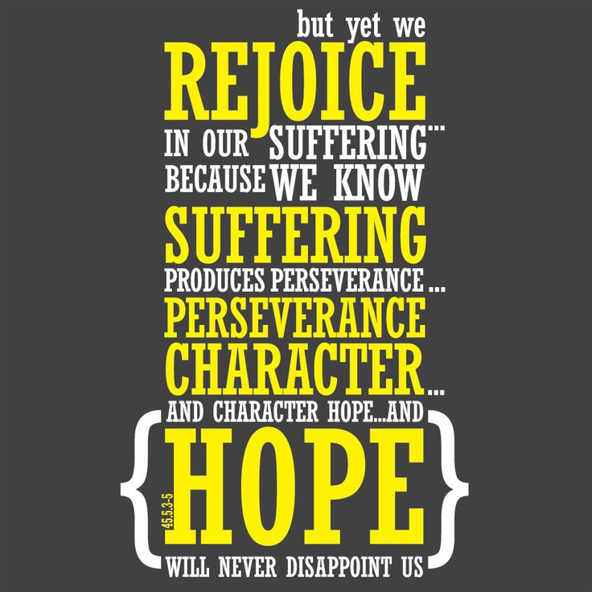
New Testament Letters

Slide 30
‘[It is] not simply the task of the individual to become better by human effort alone, but rather improvement and development is the work of the Spirit in each individual.
The implications for school leadership are releasing, recognising that virtues can be prayed for and infused, rather than simply exhorting one another to work harder at developing them.’
Leadership of Character Education, 19

Slide 31
We flourish because of our diversity and relationships
We flourish at different times and different speeds
Flourishing Teams
Flourishing Adults
We flourish so we can look outwards and give
Flourishing Children
We flourish when we stop doing things

Slide 32
Ethos Enhancing Outcomes

Slide 33
“If the Vision for Education fails to make and sustain meaningful connections between a school’s ethos and its outcomes, it will become nothing more than a deeply eloquent and well-meaning piece of writing…”

Slide 34
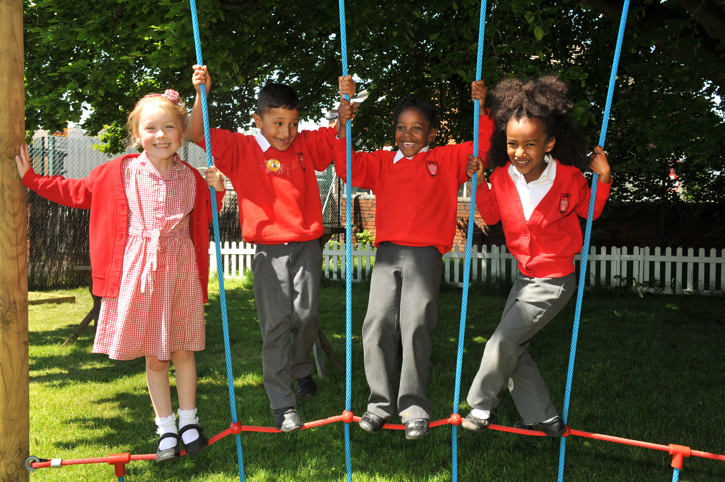
“..It must come off the shelf and be brought to life through leaders evaluating its potential impact on every area of day-to-day school life…”

Slide 35
“…This dynamic and enhancing connection between ethos and outcomes is what we mean by ‘Bringing the Vision Alive.’”

Slide 36
What outcomes are you trying to improve?
What are the pressures and challenges?
Who defines this journey?
What help could the Vision offer you?
ethos
enhancing
outcomes
How do you define this for your school?
(in a sentence…)
Where does your ethos come from?
What are the commonalities and differences between us?
What difference does it make to your lived reality?

Slide 37
Notes:
Look together at Removing Disadvantage (as an example) – one group to take each strand… what resonated for you?

Slide 38
Theology of Educational Leadership Practices Matrix (2019)

Slide 39
 | Called | Connected | Committed
Educating for Wisdom, Knowledge and Skills | Leading Learning - Refining Judgement | Creating Confidence - Embracing Interdependence | Deepening Understanding - Driving Improvement
Educating for Hope and Aspiration | Developing Imagination - Nurturing Ambition | Healing Relationships - Pursuing Renewal | Sustaining Vision - Building Resilience
Educating for Community and Living Well Together | Removing Disadvantage - Seeking Reconciliation | Accepting Vulnerability - Demonstrating Generosity | Inspiring Faithfulness -Embodying Integrity
Educating for Dignity and Respect | Celebrating Diversity - Enabling Flourishing | Offering Encouragement - Encouraging Service | Practising Humility - Learning Love

Slide 40
Called:
“Leaders who are called can articulate a strong sense of personal vocation to their role, and demonstrate this through their words, actions and decision making, exemplifying a strong moral purpose, confident vision, and ambitious trajectory of improvement. For some, this sense of vocation will be driven by an established or developing faith commitment. They show integrity, honesty and a deep sense of resilience, underpinned by their personal sense of vocation as a leader.”
Notes:
5 minutes
BEFORE GOING TO LUNCH, lets go back to our starting point.
Take a moment on your own to note down:
What has struck you during this morning’s session.
What actions will you take as a consequence
Share with a partner.

Slide 41
 | Called | Connected | Committed
Educating for Wisdom, Knowledge and Skills | Leading Learning - Refining Judgement | Creating Confidence - Embracing Interdependence | Deepening Understanding - Driving Improvement
Educating for Hope and Aspiration | Developing Imagination - Nurturing Ambition | Healing Relationships - Pursuing Renewal | Sustaining Vision - Building Resilience
Educating for Community and Living Well Together | Removing Disadvantage - Seeking Reconciliation | Accepting Vulnerability - Demonstrating Generosity | Inspiring Faithfulness -Embodying Integrity
Educating for Dignity and Respect | Celebrating Diversity - Enabling Flourishing | Offering Encouragement - Encouraging Service | Practising Humility - Learning Love

Slide 42
Educating for
Dignity and Respect:
Ensuring the basic principle of respect for the value and preciousness of each person, treating each person as a unique individual of inherent worth.

Slide 43
 | Called | Connected | Committed
Educating for Wisdom, Knowledge and Skills | Leading Learning - Refining Judgement | Creating Confidence - Embracing Interdependence | Deepening Understanding - Driving Improvement
Educating for Hope and Aspiration | Developing Imagination - Nurturing Ambition | Healing Relationships - Pursuing Renewal | Sustaining Vision - Building Resilience
Educating for Community and Living Well Together | Removing Disadvantage - Seeking Reconciliation | Accepting Vulnerability - Demonstrating Generosity | Inspiring Faithfulness -Embodying Integrity
Educating for Dignity and Respect | Celebrating Diversity - Enabling Flourishing | Offering Encouragement - Encouraging Service | Practising Humility - Learning Love

Slide 44
Enabling Flourishing

Slide 45
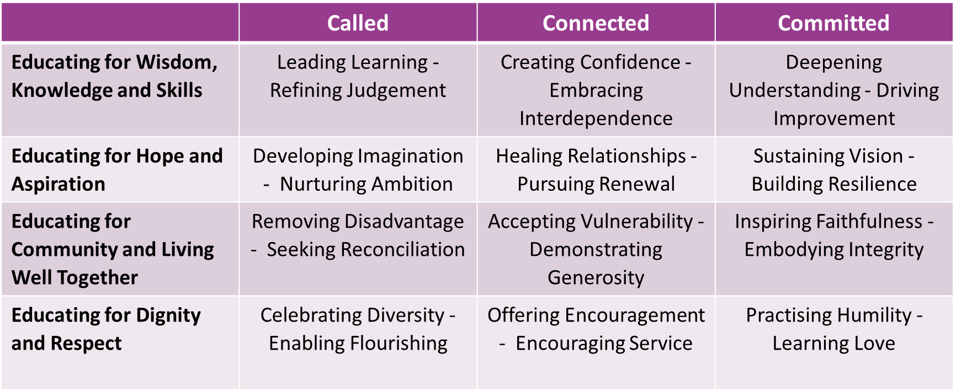
Notes:
Use the Leadership Matrix cards to self-evaluate – choose 2 strengths and 1 area for development to focus on for the year. Record (self-evaluation sheet??)

Slide 46
How far do your own personal strengths and areas of development influence which character virtues are prioritised in your school?

Slide 47
Formulating research questions
What would you like to explore around Character Education in your school to enable the flourishing of pupils, adults and teams?
How will you go about finding this out?
Who will you need to involve?

Slide 48
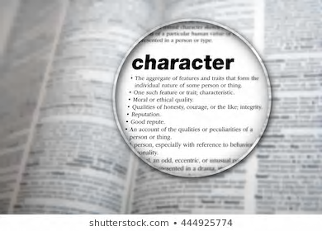
Further Reading
Bring for next time:
https://www.cefel.org.uk/character/
Examples of character education already happening in your schools

