Slide 1
Unpacking the
Church of England Vision for Education
- Governance
Introduced by: Mike Simmonds,
Education Consultant, Chelmsford Diocese & GO Ministries Ltd
@GOMikeS

Slide 2
Educating for Wisdom, Knowledge and Skills
Educating for
Hope and Aspiration
‘Life in all its fullness’
Educating for Community and Living Well Together
Educating for Dignity and Respect

Slide 3
Vision:
Seeing the masterpiece
while you mix the paints.
How can governance boards mix the paints?

Slide 4
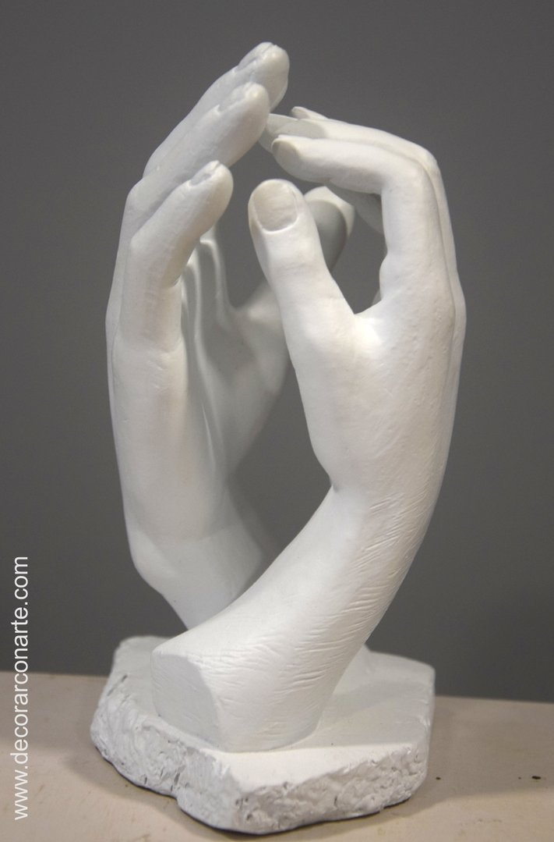
“Vision is a picture of the future that produces passion.”
Bill Hybels
THE CATHEDRAL by Auguste Rodin (1840 -1917)
Carved in stone The Cathedral is a combination of two right hands, belonging to two different figures.
Notes:
THE CATHEDRAL
Auguste Rodin (1840 -1917)
Carved in stone The Cathedral is a combination of two right hands, belonging to two different figures.

Slide 5
How can we evaluate the prevailing educational narratives?
The importance of teaching (2010)
Every Child Matters (2003)
Schools that work for everyone (2016)
Educational Excellence Everywhere (2016)
Your child, your schools, our future (2009)

Slide 6
How can we evaluate the prevailing educational narratives?
‘A building with 4 walls and tomorrow inside’
‘Building a better world, one student at a time’
Learners Today. Leaders Tomorrow.
Imagine greatness. Knowledge is Power
‘Be safe. Be Kind. Be smart’

Slide 7
How can we evaluate the prevailing educational narratives?
Narrowing the horizons of learning – keeping it tight until May in Year 6
Every percentage point counts
Your child? Our unit of economic capital
Their results? My job.
Most children matter, some matter more than others

Slide 8
Setting the Context
Defining our Current Reality
Bringing the Vision Alive

Slide 9
Setting the Context
Defining our Current Reality
Bringing the Vision Alive

Slide 10
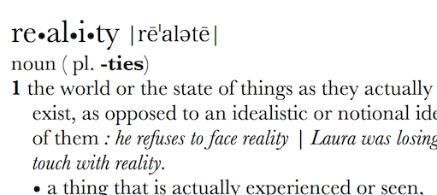
Can Vision be too idealistic? Rose-tinted? Inspirational? Transformational?
What is your actual lived experience? Is the first step of great governance defining reality accurately?

Slide 11
Educating for Wisdom, Knowledge and Skills:
Fostering discipline, confidence and delight in seeking wisdom and knowledge, and fully developing talents in all areas of life.

Slide 12
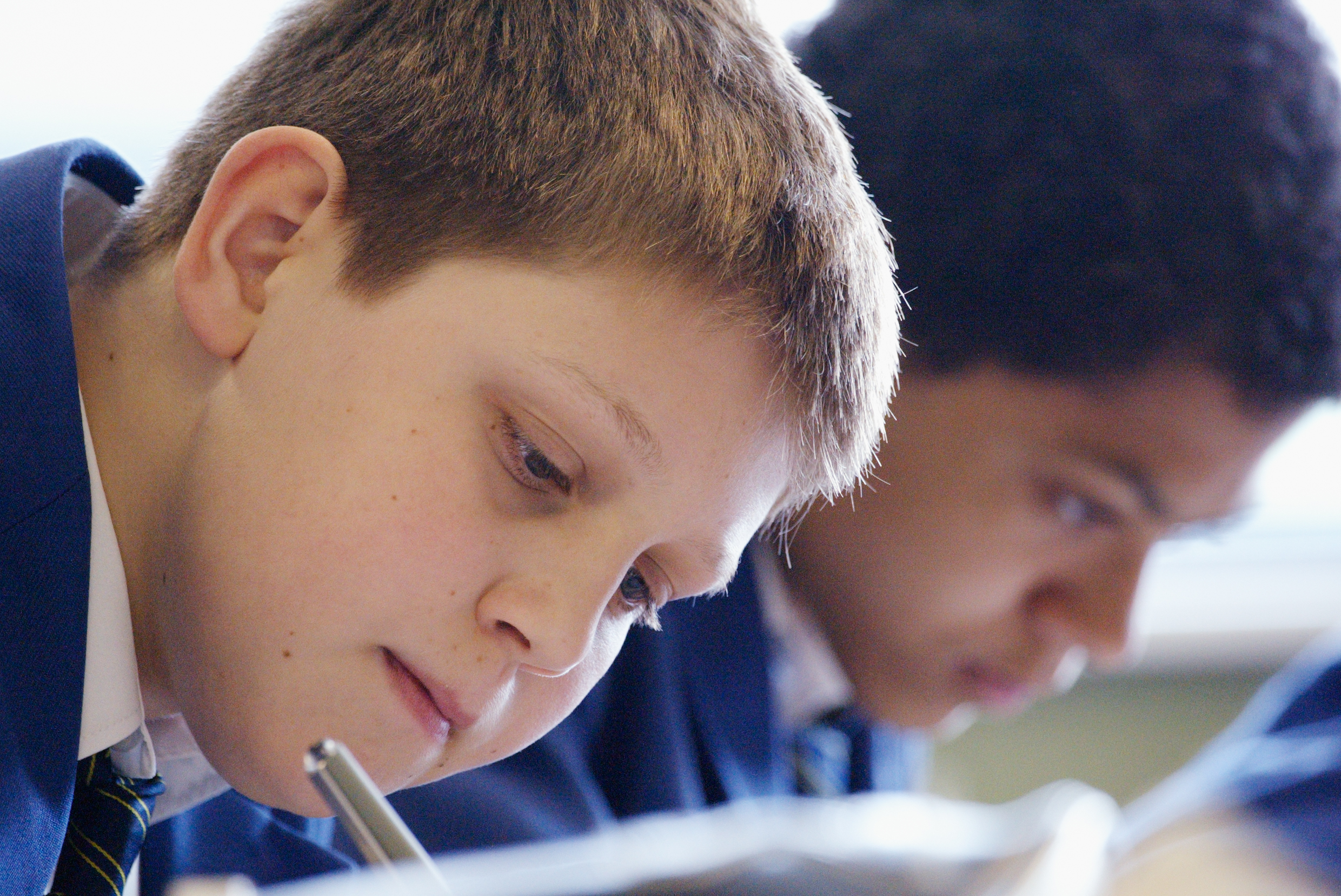
Educating for Hope and Aspiration:
Seeking healing, repair and renewal, coping wisely with things and people going wrong, opening horizons and guiding people into ways of fulfilling them.

Slide 13
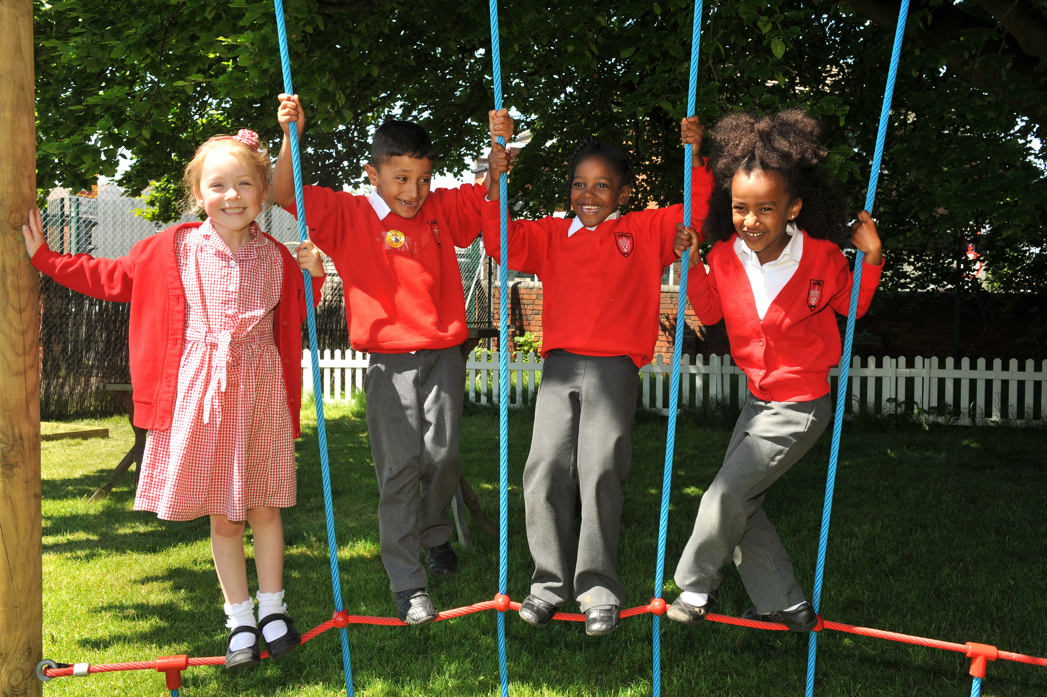
Educating for Community and Living Well Together:
Ensuring a core focus on relationships, participation in communities and the qualities of character that enable people to flourish together.

Slide 14
Educating for
Dignity and Respect:
Ensuring the basic principle of respect for the value and preciousness of each person, treating each person as a unique individual of inherent worth.

Slide 15
Setting the Context
Defining our Current Reality
Bringing the Vision Alive

Slide 16
“If the Vision for Education fails to make and sustain meaningful connections between a school’s ethos and its outcomes, it will become nothing more than a deeply eloquent and well-meaning piece of writing…”

Slide 17
Opening Reflection
What are your greatest hopes and aspirations as a leader?
What are the greatest challenges you are facing at the moment?
(for both questions, try and answer for your school and yourself)

Slide 18
“..It must come off the shelf and be brought to life through leaders evaluating its potential impact on every area of day-to-day school life…”

Slide 19
Educating for Wisdom, Knowledge and Skills
Educating for
Hope and Aspiration
‘Life in all its fullness’
Educating for Community and Living Well Together
Educating for Dignity and Respect
Bringing the Vision Alive in Governance

Slide 20
“…This dynamic and enhancing connection between ethos and outcomes is what we mean by ‘Bringing the Vision Alive.’”

Slide 21
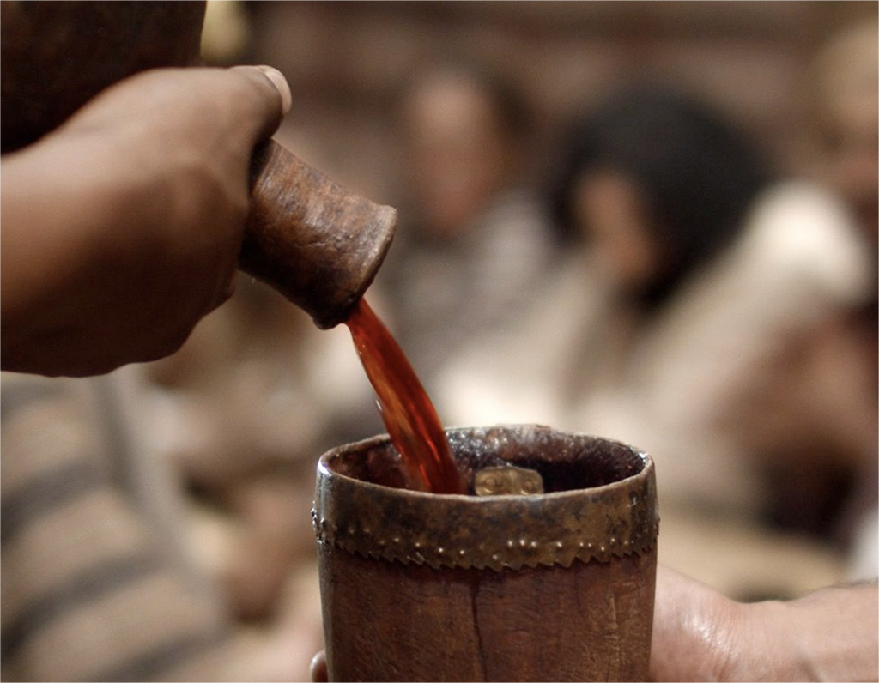
“Many will enjoy the wine and not recognise where it comes from; some will, with our help, trace it to who is responsible for it; but whether our inspiration for doing what we do is acknowledged or not, it is the right thing to do – as followers of the One who came to bring life in all its fullness, to do signs that bring glory to God.”
The Church of England Vision For Education GS 2039, p.11

Slide 22
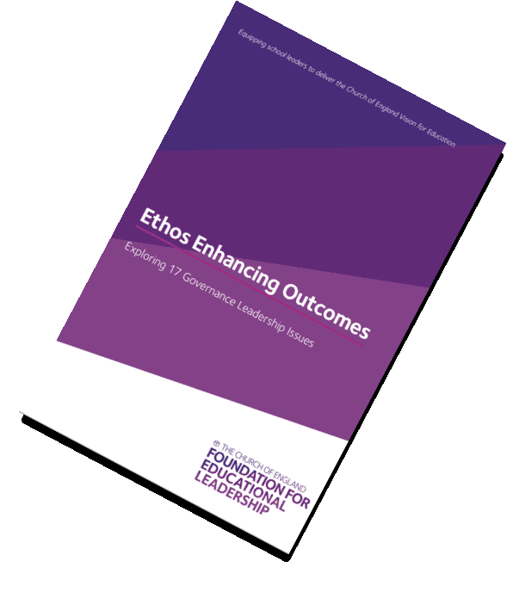
Ethos Enhancing Outcomes for governance

Slide 23
Using the resource
Introduced by:
Belinda Copson
Diocese of St Albans
Cathy Slow
Diocese of Chichester
Julia Steward
Chrysalis Leadership Development

Slide 24
Personal reading and reflection – linked to other resources eg. Church School Governance (Grove Book)
Questions considered relating to a specific agenda item in a governance meeting
Planned discussion before, during or after a governance meeting
Themes for a retreat, training day, self-evaluation exercise, strategic development meeting(s)
Bespoke Conference or Workshop introducing and using the resource
Conclusion:
Mike Simmonds
Using the resource

Slide 25
What outcomes are you trying to improve?
What are the pressures and challenges to your governance?
Who defines this journey?
How could the Church of England Vision help you?
ethos
enhancing
outcomes
How is your governance practice informed?
By your ethos and vision?
By the Church of England’s Vision?
What difference do either or both make to your lived reality?

Slide 26
Don’t think outside the box, think like there is no box!
Nicky Gumbel

Slide 27
