Slide 1
Diocese of Peterborough –
Peer Support Network Session 1
Andy Wolfe, Deputy Chief Education Officer
Church of England
@mrawolfe

Slide 2
Opening Reflection: What kind of education?

Slide 3
Introducing the Peer Support Network

Slide 4
The Church of England Foundation
for Educational Leadership’s mission is:
“To develop inspirational leaders who are called, connected and committed to delivering the Church of England’s vision for education”

Slide 5
Called:
“Leaders who are called can articulate a strong sense of personal vocation to their role, and demonstrate this through their words, actions and decision making, exemplifying a strong moral purpose, confident vision, and ambitious trajectory of improvement. For some, this sense of vocation will be driven by an established or developing faith commitment. They show integrity, honesty and a deep sense of resilience, underpinned by their personal sense of vocation as a leader.”
Notes:
5 minutes
BEFORE GOING TO LUNCH, lets go back to our starting point.
Take a moment on your own to note down:
What has struck you during this morning’s session.
What actions will you take as a consequence
Share with a partner.

Slide 6
Connected:
“Leaders who are connected operate deliberately within communities of practice, positioning themselves within positive relationships that sustain and encourage all parties. They embrace interdependence, demonstrate compassion and embody service to others humbly. They create shared identity within their teams and draw colleagues around a common purpose.”
Notes:
5 minutes
BEFORE GOING TO LUNCH, lets go back to our starting point.
Take a moment on your own to note down:
What has struck you during this morning’s session.
What actions will you take as a consequence
Share with a partner.

Slide 7
Committed:
“Leaders who are committed exude energy and passion in all they do, inspiring confidence and faithfulness in their teams. They are clear about their purpose and resilient in the face of challenge. They take long-term decisions and not easily swayed by short-term changes of policy or procedure. They articulate a sense of mission in their approach to education to which they draw others, and are committed to the flourishing of their pupils and colleagues.”
Notes:
5 minutes
BEFORE GOING TO LUNCH, lets go back to our starting point.
Take a moment on your own to note down:
What has struck you during this morning’s session.
What actions will you take as a consequence
Share with a partner.

Slide 8
Rural Schools Networks – 7 Dioceses – around 300 schools
MAT Peer Support Network – 16 MATs – around 280 schools
Diocese PSN – 15 Dioceses – around 400 schools
Peer Support Network
International – 2 groups in USA – around 30 schools
National Secondary Leadership Network – around 70 schools

Slide 9
Sharing and Ownership of Focus
Expert Facilitation with high-quality Resources
Peer Support Network Principles
Longer-term Commitment and Developing a Movement
Clear Logistics and School-based Delivery

Slide 11
Network Themes 2019 onwards:
Curriculum design and innovation
Teaching and Learning
Character Education
Resilience/wellbeing of pupils and staff

Slide 12
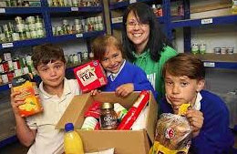
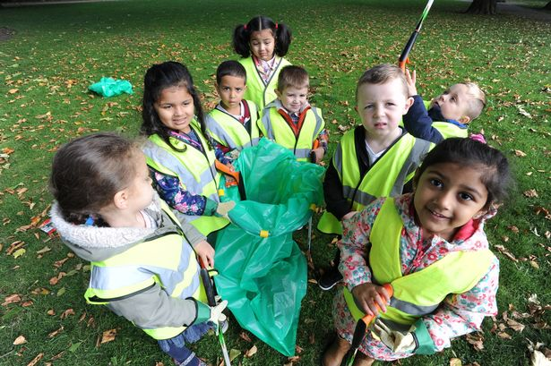
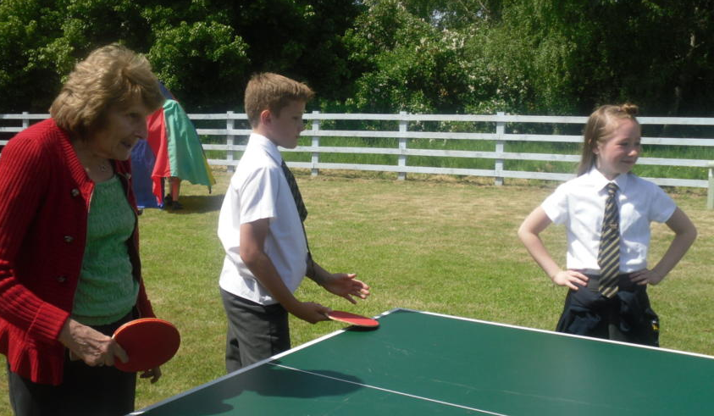
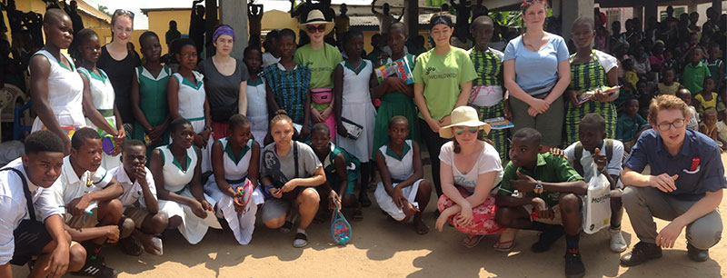
“Your vocation in life is where your greatest joy meets the world’s deepest need.”
Frederick Buechner

Slide 13
‘Deeply Christian, Serving the Common Good’ – published Autumn 2016
Leadership, Pedagogy and Theology brought together
Clear vision for education for all schools, not just church schools
Educating for life in all its fullness

Slide 14
‘Life in all its fullness’
Educating for Wisdom, Knowledge and Skills
Educating for
Hope and Aspiration
Educating for Community and Living Well Together
Educating for Dignity and Respect

Slide 15
Educating for Wisdom, Knowledge and Skills:
Fostering discipline, confidence and delight in seeking wisdom and knowledge, and fully developing talents in all areas of life.

Slide 16
Educating for Hope and Aspiration:
Seeking healing, repair and renewal, coping wisely with things and people going wrong, opening horizons and guiding people into ways of fulfilling them.

Slide 17
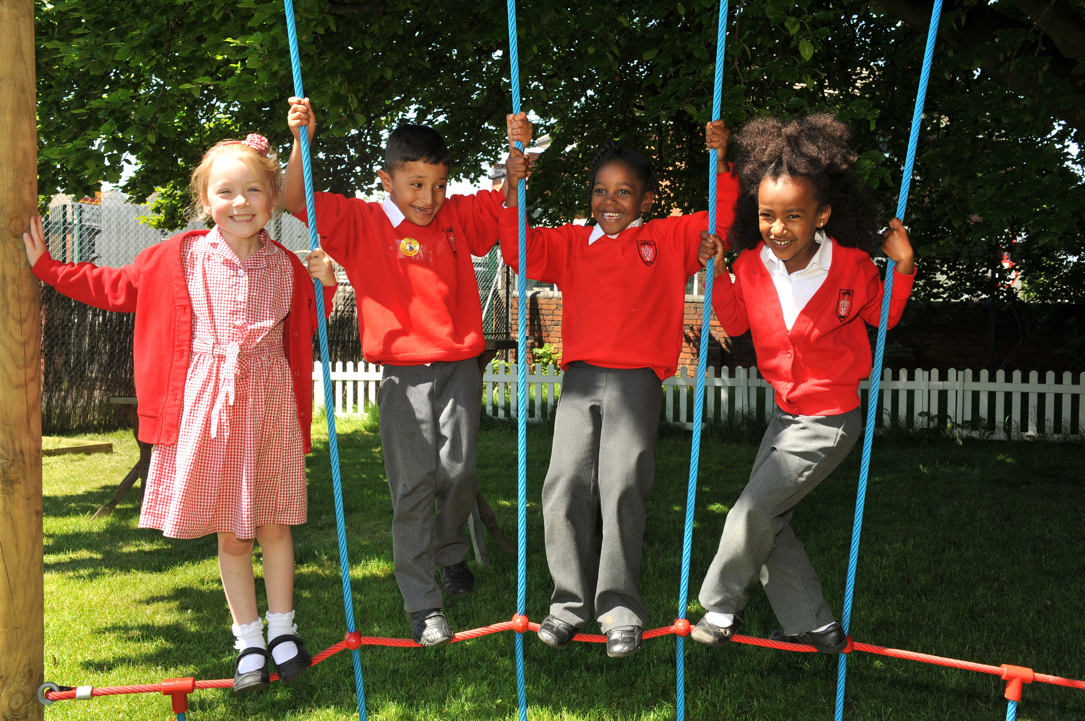
Educating for Community and Living Well Together:
Ensuring a core focus on relationships, participation in communities and the qualities of character that enable people to flourish together.

Slide 18
Educating for
Dignity and Respect:
Ensuring the basic principle of respect for the value and preciousness of each person, treating each person as a unique individual of inherent worth.

Slide 19
“If the Vision for Education fails to make and sustain meaningful connections between a school’s ethos and its outcomes, it will become nothing more than a deeply eloquent and well-meaning piece of writing…”

Slide 20
“..It must come off the shelf and be brought to life through leaders evaluating its potential impact on every area of day-to-day school life…”

Slide 21
“…This dynamic and enhancing connection between ethos and outcomes is what we mean by ‘Bringing the Vision Alive.’”

Slide 22
Stream 1: Curriculum Development

Slide 23
Wisdom in Curriculum Design

Slide 24
Pedagogy: Freedoms and Opportunities
Knowledge
Wisdom
Tension – necessary, symbiotic, empowering?

Slide 25
Pedagogy: Freedoms and Opportunities
Wisdom
Is Vision not simply where we’re headed, but how we see things?
Knowledge
Wisdom

Slide 26
Hope in Curriculum Design

Slide 27
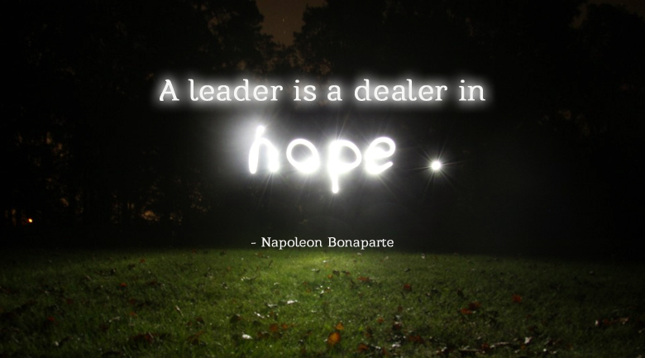

Slide 28
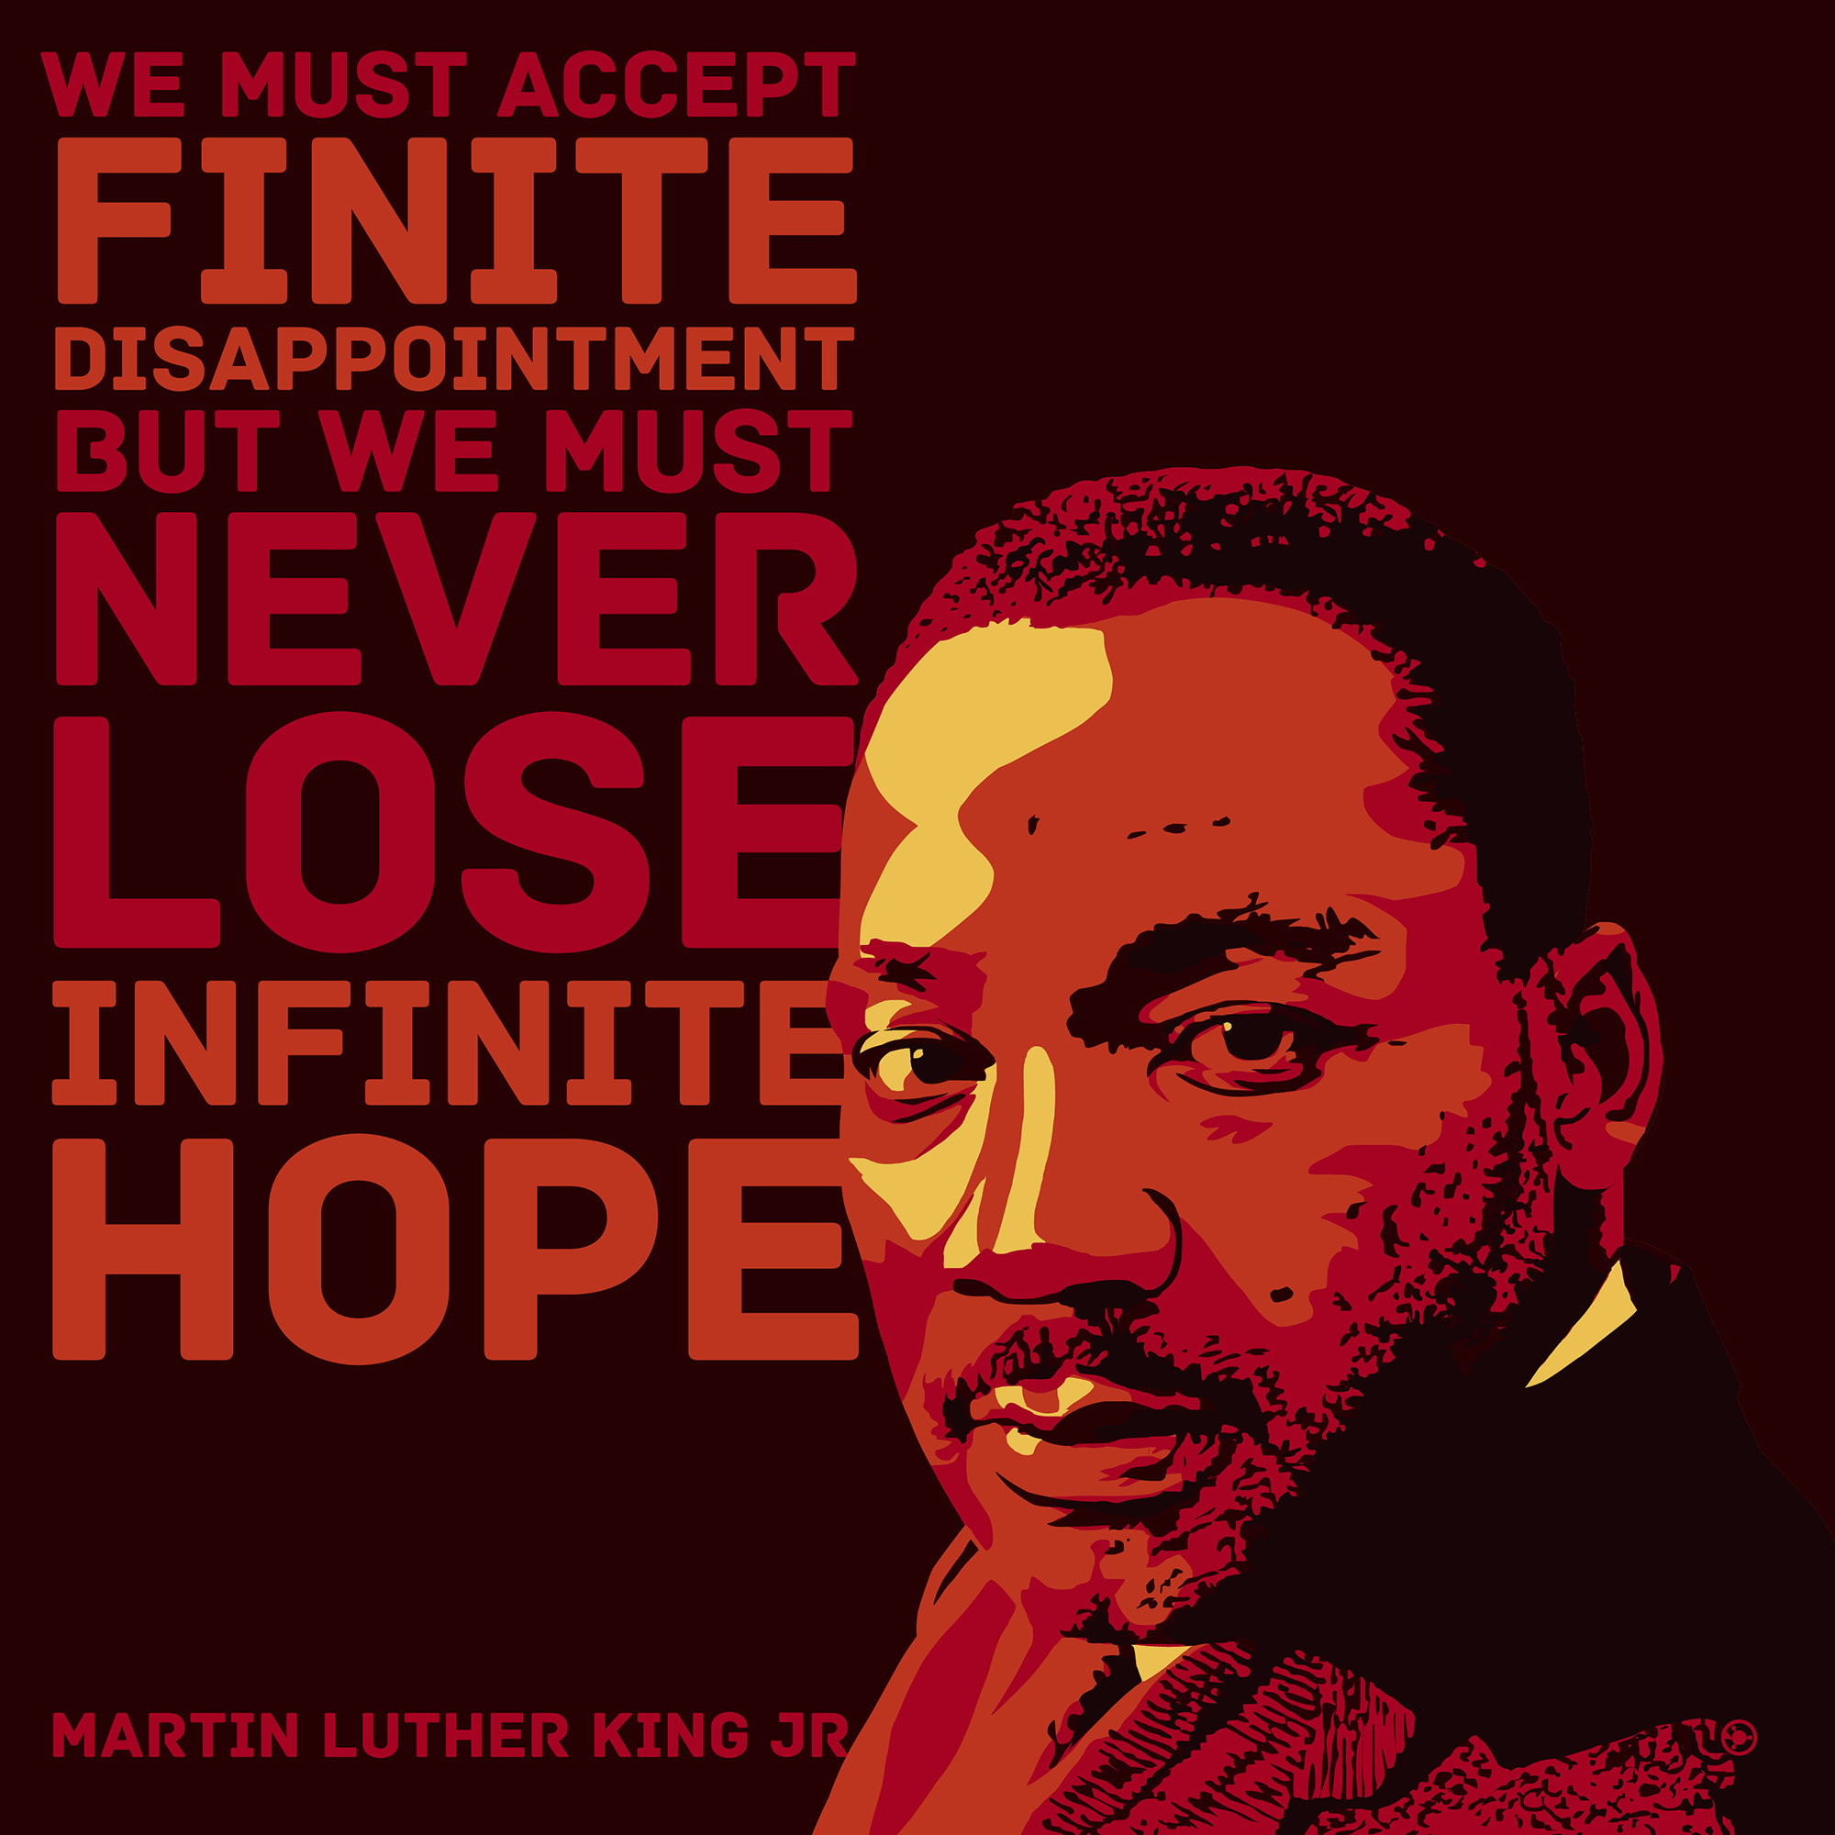

Slide 29
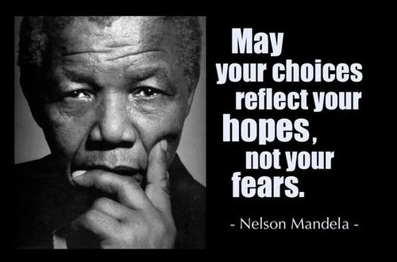

Slide 32
‘Middle-class cultural subsidy’ (Young, 2018) and social justice in curriculum design
‘Breadth vs Depth’ of learning in pre-exam specification learning
Non-examined curriculum – careers/employability/ service/enrichment
Hopeful Choice Process
What does Hope look like in the curriculum?
What kind of individuals are you hoping will leave your school?
Inter-disciplinary curriculum choices and balance of hours/modelling
Access to and encouragement of out-of-lesson learning (including homework and/or reading)
Setting, mobility and ability-related curriculum limitations

Slide 33
Stream 2: Teaching & Learning

Slide 34
Professor Michael Young, Institute of Education
What are schools actually for?
‘Powerful Knowledge’ = Social Justice

Slide 35
Professor Michael Young, Institute of Education
Subject-led curriculum that:
sees knowledge as an entitlement of children
enlightens, stretches and challenges
liberates through the empowering knowledge it provides
Teacher as:
‘Sage’ or ‘Guide’ (wisdom?) vs ‘Instructor’
Academic professional, proactively engaging in a subject-disciplinary community with their peers

Slide 36
Sage/Guide/Expert/
Enthusiast
Resourced/Trusted/
Revered
Middle Curriculum Leadership
Storyteller/Evangelist/
Salesperson
Energy/Passion/Love/
Time

Slide 37
Stream 3: Character Education

Slide 38
Leadership of Character Education: Developing Virtues and Celebrating Human Flourishing in Schools (2017)
Available to download free at www.cefel.org.uk/character

Slide 39
seeks to develop and celebrate the flourishing of individuals, communities, families and societies
is fundamental to the pursuit of academic excellence
is central to a Christian vision for education for ‘life in all its fullness’
Character Education
is caught implicitly through role-modelling and relationship, and the deliberate embedding of leadership virtues in staff teams
invests in a legacy far beyond the school gates, impacting young people as friends, neighbours, parents, team members and employees

Slide 40
What achievements matter most? How much does one subject impact another? Who knows about my achievements? Do they need validating?
Performance Under Pressure - TCUP
CHARACTER
ACHIEVEMENT
Self-affirmation, Peer Praise, Increased Risk-Taking in Learning
Where does this come from? Can you be disadvantaged in character? If so how? What would need to happen to build this?

Slide 41
Stream 4: Resilience and Wellbeing

Slide 42
We flourish because of our diversity and relationships
Flourishing Teams
Flourishing Adults
Flourishing Children

Slide 43
Learning Plantation | Learning Rainforest
‘A right way to do things’ – set routines – e.g. L.O. on the board every lesson | Nourishing individual talents - high trust/high challenge
Leaders driven by compliance to external voices | Great variety in pedagogy and OK to try new things all the time
T+L focused on what can be examined | If creative approaches deliver, there is high level of autonomy
Data has very high status | Data is part of the picture of learning
Interventions heavily focused on short-term gains | T+L structures are dynamic/organic, aligning T+L to stated school values
Creativity becomes rules – e.g. standardised homework format etc. | Highly personalised CPD

Slide 44
We flourish because of our diversity and relationships
We flourish at different times and different speeds
Flourishing Teams
Flourishing Adults
Flourishing Children

Slide 45
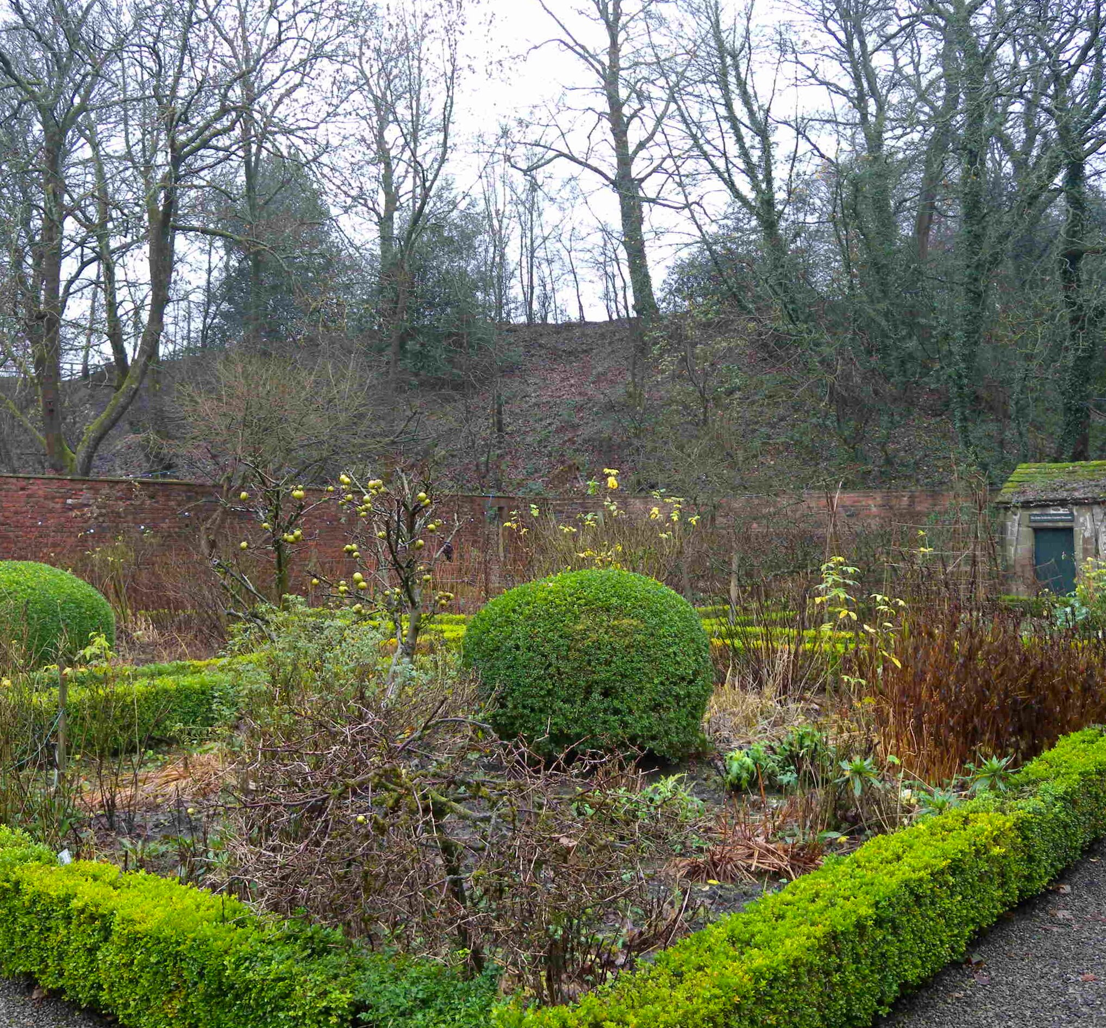
A garden that’s bursting into life…?

Slide 46
We flourish because of our diversity and relationships
We flourish at different times and different speeds
Flourishing Teams
Flourishing Adults
Flourishing Children
We flourish when we stop doing things

Slide 47
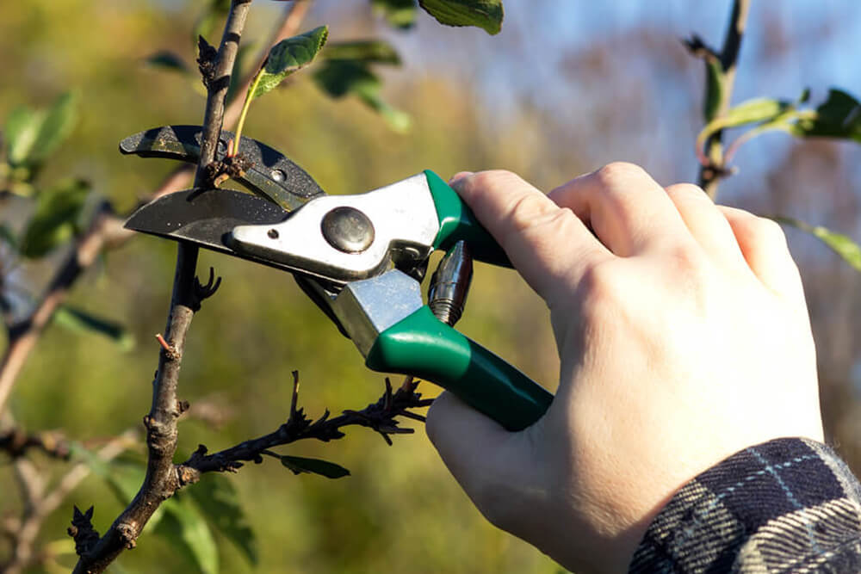
What should we stop doing?

Slide 48
We flourish because of our diversity and relationships
We flourish at different times and different speeds
Flourishing Teams
Flourishing Adults
We flourish so we can look outwards and give
Flourishing Children
We flourish when we stop doing things

Slide 49
“But since you excel in everything – in faith, in speech, in knowledge, in complete earnestness and in the love we have kindled in you – see that you also excel in this grace of giving.”
(2 Corinthians 8.7)

Slide 50
We flourish because of our diversity and relationships
We flourish at different times and different speeds
Flourishing Teams
Flourishing Adults
We flourish so we can look outwards and give
Flourishing Children
We flourish when we stop doing things

Slide 51
“Leaders who love their pupils recognise the transference of fear that can ensue from macro to school to teacher to pupil, and care deeply for the mental health and wellbeing of their pupils, taking great care with them, particularly at pressure points of examinations.”
MACRO
Transference of Fear?
SCHOOL
TEACHER
PUPIL

Slide 52
“Leaders who love their pupils recognise the transference of fear that can ensue from macro to school to teacher to pupil, and care deeply for the mental health and wellbeing of their pupils, taking great care with them, particularly at pressure points of examinations.”
MACRO
Transference of Hope?
Building of Character?
SCHOOL
TEACHER
PUPIL

Slide 53
Lunch

Slide 54
Ethos Enhancing Outcomes

Slide 55
“If the Vision for Education fails to make and sustain meaningful connections between a school’s ethos and its outcomes, it will become nothing more than a deeply eloquent and well-meaning piece of writing…”

Slide 56
“..It must come off the shelf and be brought to life through leaders evaluating its potential impact on every area of day-to-day school life…”

Slide 57
“…This dynamic and enhancing connection between ethos and outcomes is what we mean by ‘Bringing the Vision Alive.’”

Slide 58
My hope is that the lessons of the Foundation will resonate not just within Anglican schools, but also beyond, supporting improvement right across the system.
One of those lessons, that I certainly hope echoes in schools of all faiths and none, is the Foundation’s affirmation that there should not, indeed cannot, be a trade-off between school ethos and school outcomes.
Amanda Spielman, HMCI, Feb 2018

Slide 59
What outcomes are you trying to improve?
What are the pressures and challenges?
Who defines this journey?
What help could the Vision offer you?
ethos
enhancing
outcomes
How do you define this for your school?
(in a sentence…)
Where does your ethos come from?
What are the commonalities and differences between us?
What difference does it make to your lived reality?

Slide 60
Activity: Ethos Enhancing Outcomes

Slide 61
Group Networking Activities
(small groups by theme)

Slide 62
Leadership Practices Matrix (2019)

Slide 63
 | Called | Connected | Committed
Educating for Wisdom, Knowledge and Skills | Leading Learning - Refining Judgement | Creating Confidence - Embracing Interdependence | Deepening Understanding - Driving Improvement
Educating for Hope and Aspiration | Developing Imagination - Nurturing Ambition | Healing Relationships - Pursuing Renewal | Sustaining Vision - Building Resilience
Educating for Community and Living Well Together | Removing Disadvantage - Seeking Reconciliation | Accepting Vulnerability - Demonstrating Generosity | Inspiring Faithfulness -Embodying Integrity
Educating for Dignity and Respect | Celebrating Diversity - Enabling Flourishing | Offering Encouragement - Encouraging Service | Practising Humility - Learning Love

Slide 64
Plenary, Planning your sessions and next steps
Next PSN slots
National Conference – 6 February
Connecting with the wider national network

Slide 65
Reflection – 1 Corinthians 13
If I tirelessly teach five outstanding lessons a day, and see my students make excellent progress against their targets, but have not love, I am only a broken window or a wall covered in graffiti. If I create a perfect climate for learning, have excellent meetings with parents and resolve all the problems of the day through focused toil, but have not love, I am only an uneaten school dinner or a messy office. If I give all I have to my school and work a 70 hour week, marking, planning, preparing and evaluating and have the most perfect
colour-coded action plan to guide my path, but have not love, I gain nothing.

Slide 66
Reflection – 1 Corinthians 13
Love is patient. Love is kind. It does not envy, it does not boast, it is not proud. It is not rude, it is not self-seeking, it is not easily angered, it keeps no record of wrongs. Love does not delight in evil but rejoices with the truth. It always protects, always trusts, always hopes, always perseveres. Love never fails.

