Slide 1
Derby Diocese Peer Support Network:
How Vision Impacts our Approach to Teaching and Learning

Slide 2
Reflection

Slide 3
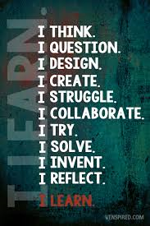
What kind of education?

Slide 4

‘That which leaders choose to improve communicates much about their values.’
Notes:
Sieger Koder (1925-2015)

Slide 5

‘The imagination must come before the implementation…
…Leaders who develop this imagination in their teams, like teachers who do the same with their children, build resilience for challenging moments or when things change.’

Slide 6
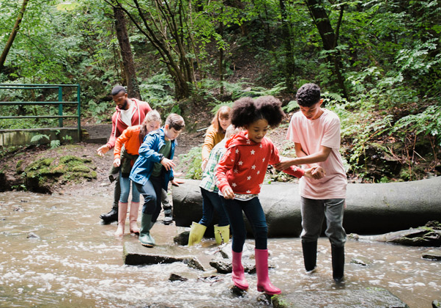
‘Leaders understand that wisdom, knowledge and skills liberate children, giving freedom to create, grow, earn, flourish and relate.’
Notes:
Image from DfE Character Ed

Slide 7

‘Encouraging leaders… take challenge seriously, and they define reality accurately, even when it presents uncomfortable truth.’

Slide 8
‘Life in all its fullness’
Educating for Wisdom, Knowledge and Skills
Educating for
Hope and Aspiration
Educating for Community and Living Well Together
Educating for Dignity and Respect

Slide 9
The Church of England Foundation
for Educational Leadership’s mission is:
“To develop inspirational leaders who are called, connected and committed to delivering the Church of England’s vision for education”

Slide 10
Called:
“Leaders who are called can articulate a strong sense of personal vocation to their role, and demonstrate this through their words, actions and decision making, exemplifying a strong moral purpose, confident vision, and ambitious trajectory of improvement. For some, this sense of vocation will be driven by an established or developing faith commitment. They show integrity, honesty and a deep sense of resilience, underpinned by their personal sense of vocation as a leader.”
Notes:
5 minutes
BEFORE GOING TO LUNCH, lets go back to our starting point.
Take a moment on your own to note down:
What has struck you during this morning’s session.
What actions will you take as a consequence
Share with a partner.

Slide 11
Connected:
“Leaders who are connected operate deliberately within communities of practice, positioning themselves within positive relationships that sustain and encourage all parties. They embrace interdependence, demonstrate compassion and embody service to others humbly. They create shared identity within their teams and draw colleagues around a common purpose.”
Notes:
5 minutes
BEFORE GOING TO LUNCH, lets go back to our starting point.
Take a moment on your own to note down:
What has struck you during this morning’s session.
What actions will you take as a consequence
Share with a partner.

Slide 12
Committed:
“Leaders who are committed exude energy and passion in all they do, inspiring confidence and faithfulness in their teams. They are clear about their purpose and resilient in the face of challenge. They take long-term decisions and not easily swayed by short-term changes of policy or procedure. They articulate a sense of mission in their approach to education to which they draw others, and are committed to the flourishing of their pupils and colleagues.”
Notes:
5 minutes
BEFORE GOING TO LUNCH, lets go back to our starting point.
Take a moment on your own to note down:
What has struck you during this morning’s session.
What actions will you take as a consequence
Share with a partner.

Slide 13
Defining our Current Reality

Slide 14
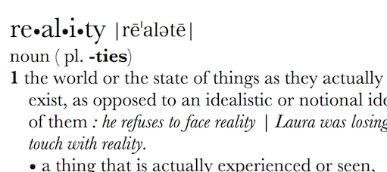
Can Vision be too idealistic? Rose-tinted? Inspirational? Transformational?
What is your actual lived experience? Is the first step of great leadership defining reality accurately?

Slide 15
How might we define our current lived reality?
Which CofE reports/ key policy statements/White Papers have affected us the most? (how and why?)
How do we articulate our current vision for our school – how embedded is this vision in the lived experience of our community?
How does the changing educational landscape affect the way we think and plan? What are the key challenges and opportunities?

Slide 16
How can we evaluate the prevailing educational narratives?
The importance of teaching (2010)
Schools that work for everyone (2016)
Every Child Matters (2003)
Educational Excellence Everywhere (2016)
Your child, your schools, our future (2009)

Slide 17
How can we evaluate the prevailing educational narratives?
‘A building with 4 walls and tomorrow inside’
‘Building a better world, one student at a time’
Learners Today. Leaders Tomorrow.
Imagine greatness. Knowledge is Power
‘Be safe. Be Kind. Be smart’

Slide 18
How can we evaluate the prevailing educational narratives?
Narrowing the horizons of learning – keeping it tight until May in Year 6
Every percentage point counts
Your child? Our unit of economic capital
Their results? My job.
Most children matter, some matter more than others

Slide 19
Thin Narratives | Thick Narratives
Utilitarian/ Instrumentalist | Wisdom, Knowledge and Skills (for living well)
Competitive | Hope and Aspiration (through forgiveness and grace)
Individualistic | Community and Living Well Together (created for life together)
Reductionist | Dignity and Respect (of every person)
Notes:
Activity – evaluating prevailing narratives

Slide 20
Children
‘Life in all its fullness’
Adults
Teams

Slide 21
A vision for ‘human flourishing’

Slide 22
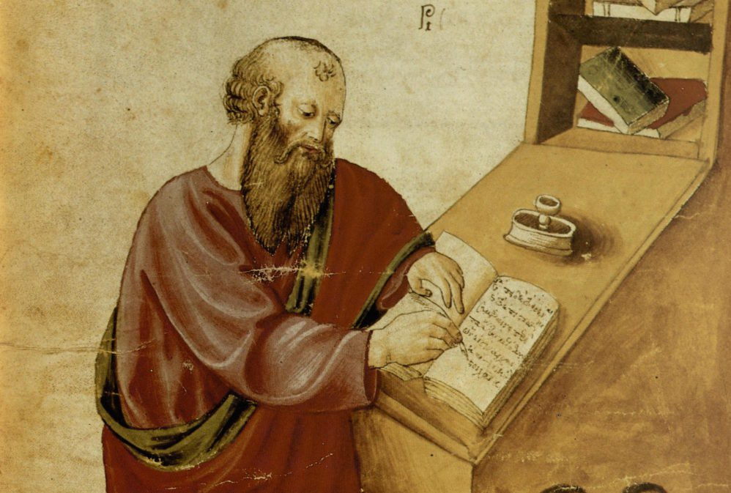
‘The notion of human flourishing set out in our thinking draws significantly on Aristotle, and especially on his conception of eudaimonia. The meaning of eudaimonia can be traced etymologically from its roots of ‘eu’ (good) and ‘daimon’ (spirit), refers to the notion of human flourishing and can…[refer to] physical flourishing, emotional flourishing, societal flourishing and fourthly, flourishing in terms of personal creativity, self-expression and knowledge seeking.’
Leadership of Character Education, 18

Slide 23

Genesis provides a picture of how things were meant to be – what it would mean to truly flourish…
Which, if any, of these words feel like ‘flourishing’ to you?

Slide 24
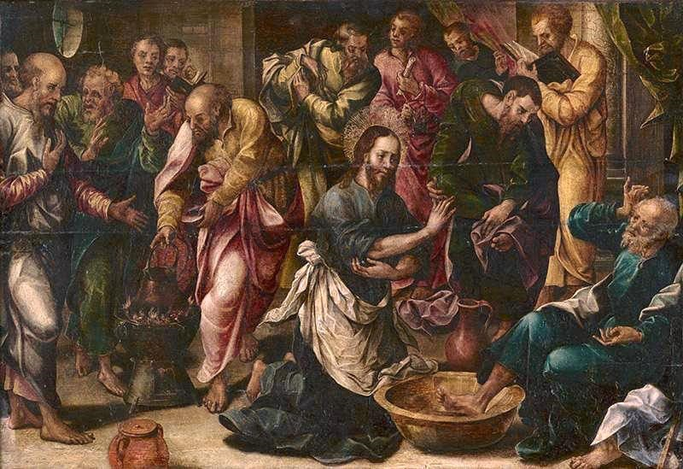
‘Love one another. As I have loved you, so you must love one another. By this, everyone will know that you are my disciples.’
John 13:34-5
How far do we consider ‘service’ to be important to human flourishing? Is it?

Slide 25

‘[It is] not simply the task of the individual to become better by human effort alone, but rather improvement and development is the work of the Spirit in each individual.
The implications for school leadership are releasing, recognising that virtues can be prayed for and infused, rather than simply exhorting one another to work harder at developing them.’
Leadership of Character Education, 19

Slide 26
We flourish because of our diversity and relationships
We flourish at different times and different speeds
Flourishing Teams
Flourishing Adults
We flourish so we can look outwards and give
Flourishing Children
We flourish when we stop doing things

Slide 27

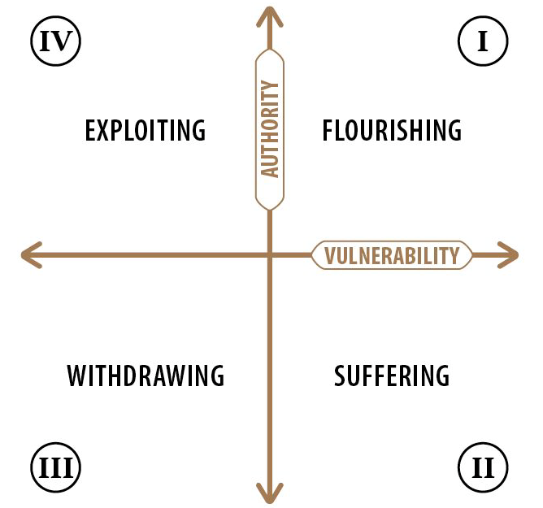

Slide 28

What does flourishing in Teaching and Learning look like…
For pupils?

Slide 29
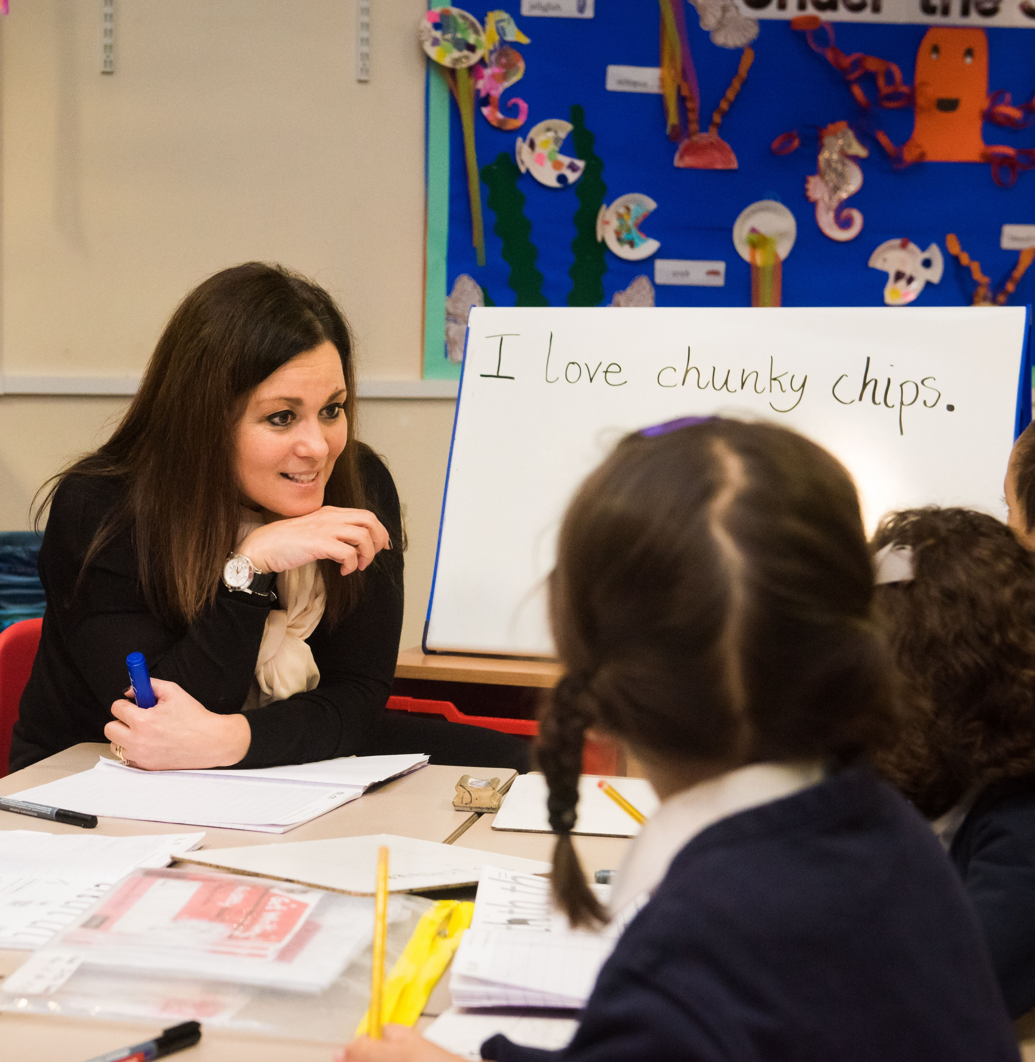
What does flourishing in Teaching and Learning look like…
For adults?

Slide 30
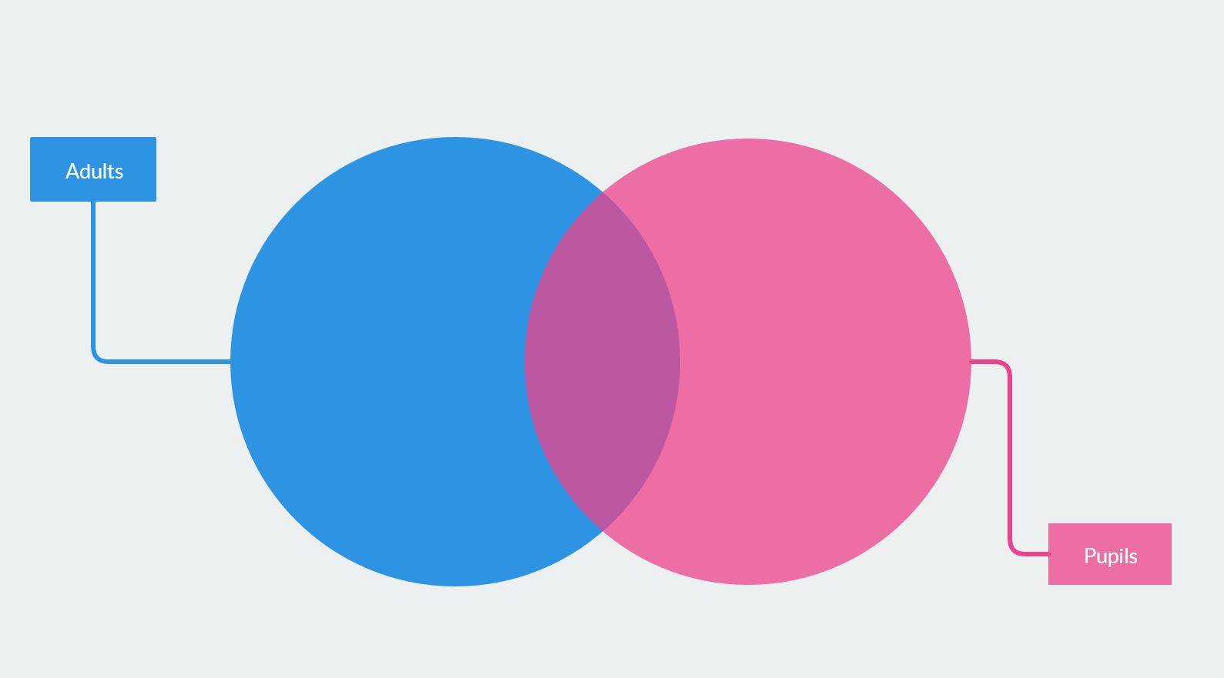
What does flourishing in Teaching and Learning look like…
For both pupils and adults?

Slide 31

What sort of Teaching and Learning do we aim for?

Slide 32
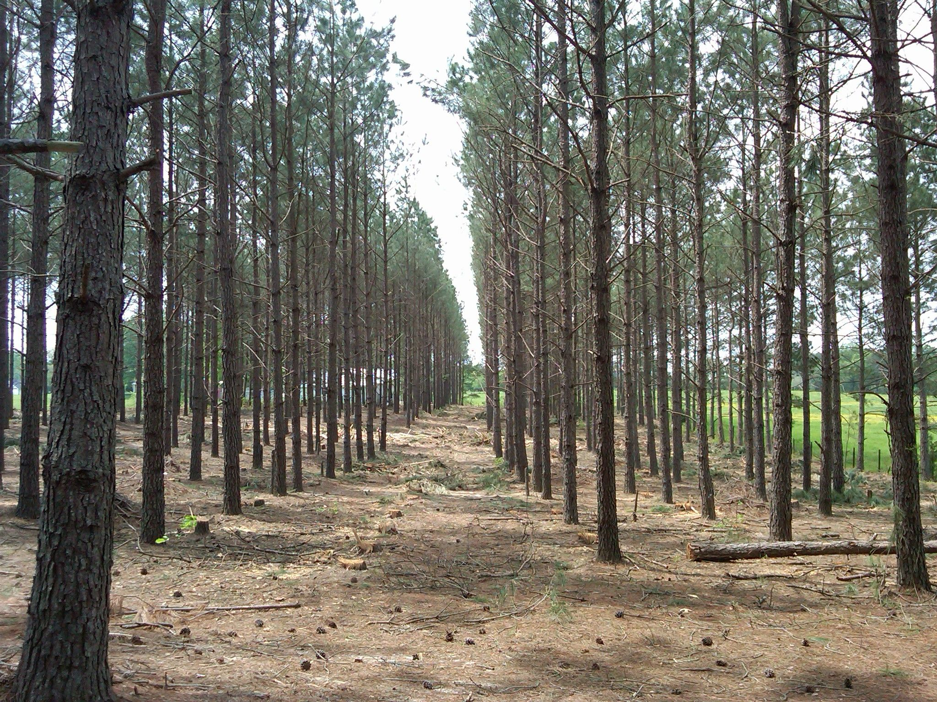

Plantation?
Or Rainforest?

Slide 33
Learning Plantation | Learning Rainforest
‘A right way to do things’ – set routines – e.g. L.O. on the board every lesson | Nourishing individual talents - high trust/high challenge
Leaders driven by compliance to external voices | Great variety in pedagogy and OK to try new things all the time
T+L focused on what can be examined | If creative approaches deliver, there is high level of autonomy
Data has very high status | Data is part of the picture of learning
Interventions heavily focused on short-term gains | T+L structures are dynamic/organic, aligning T+L to stated school values
Creativity becomes rules – e.g. standardised homework format etc. | Highly personalised CPD
Notes:
Look back at your venn diagram – which parts are rainforest, which are plantation?

Slide 34
Leading Teaching & Learning with vision

Slide 35


Slide 36
Why?
How?
What?
Do staff know WHY they are teaching what they are teaching?
Do pupils know WHY they are learning what they are learning?

Slide 37
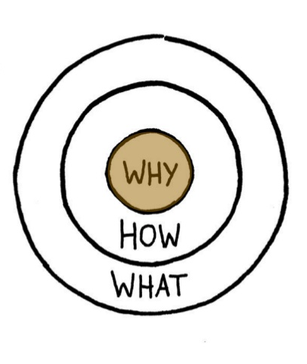
Does Teaching and Learning in your school address:
the ‘what’?
the ‘how’?
the ‘why’?
How do you know?

Slide 38

When considering how to teach, what informs your decisions/ policies?
What is your why for the teaching methods you employ?

Slide 39
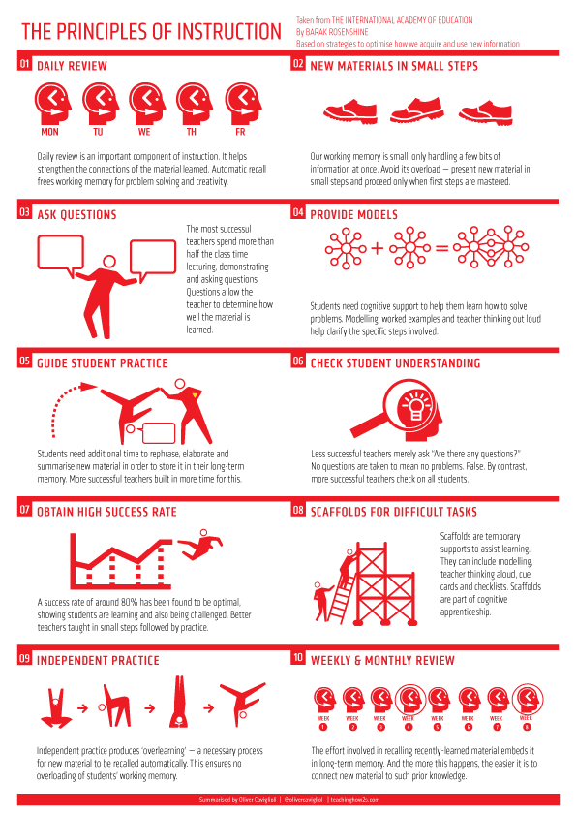
How far might each of these Principles of Instruction lead to flourishing for pupils AND adults?
Which align most with your vision for education?
Can you foresee any tensions or conflicts between these approaches and your vision?
How might you resolve these?
From Barak Rosenshine’s Principles of Instruction, as presented by Oliver Caviglioli

Slide 40
Ethos Enhancing Outcomes

Slide 41

“If the Vision for Education fails to make and sustain meaningful connections between a school’s ethos and its outcomes, it will become nothing more than a deeply eloquent and well-meaning piece of writing. It must come off the shelf and be brought to life through leaders evaluating its potential impact on every area of day-to-day school life…”

Slide 42
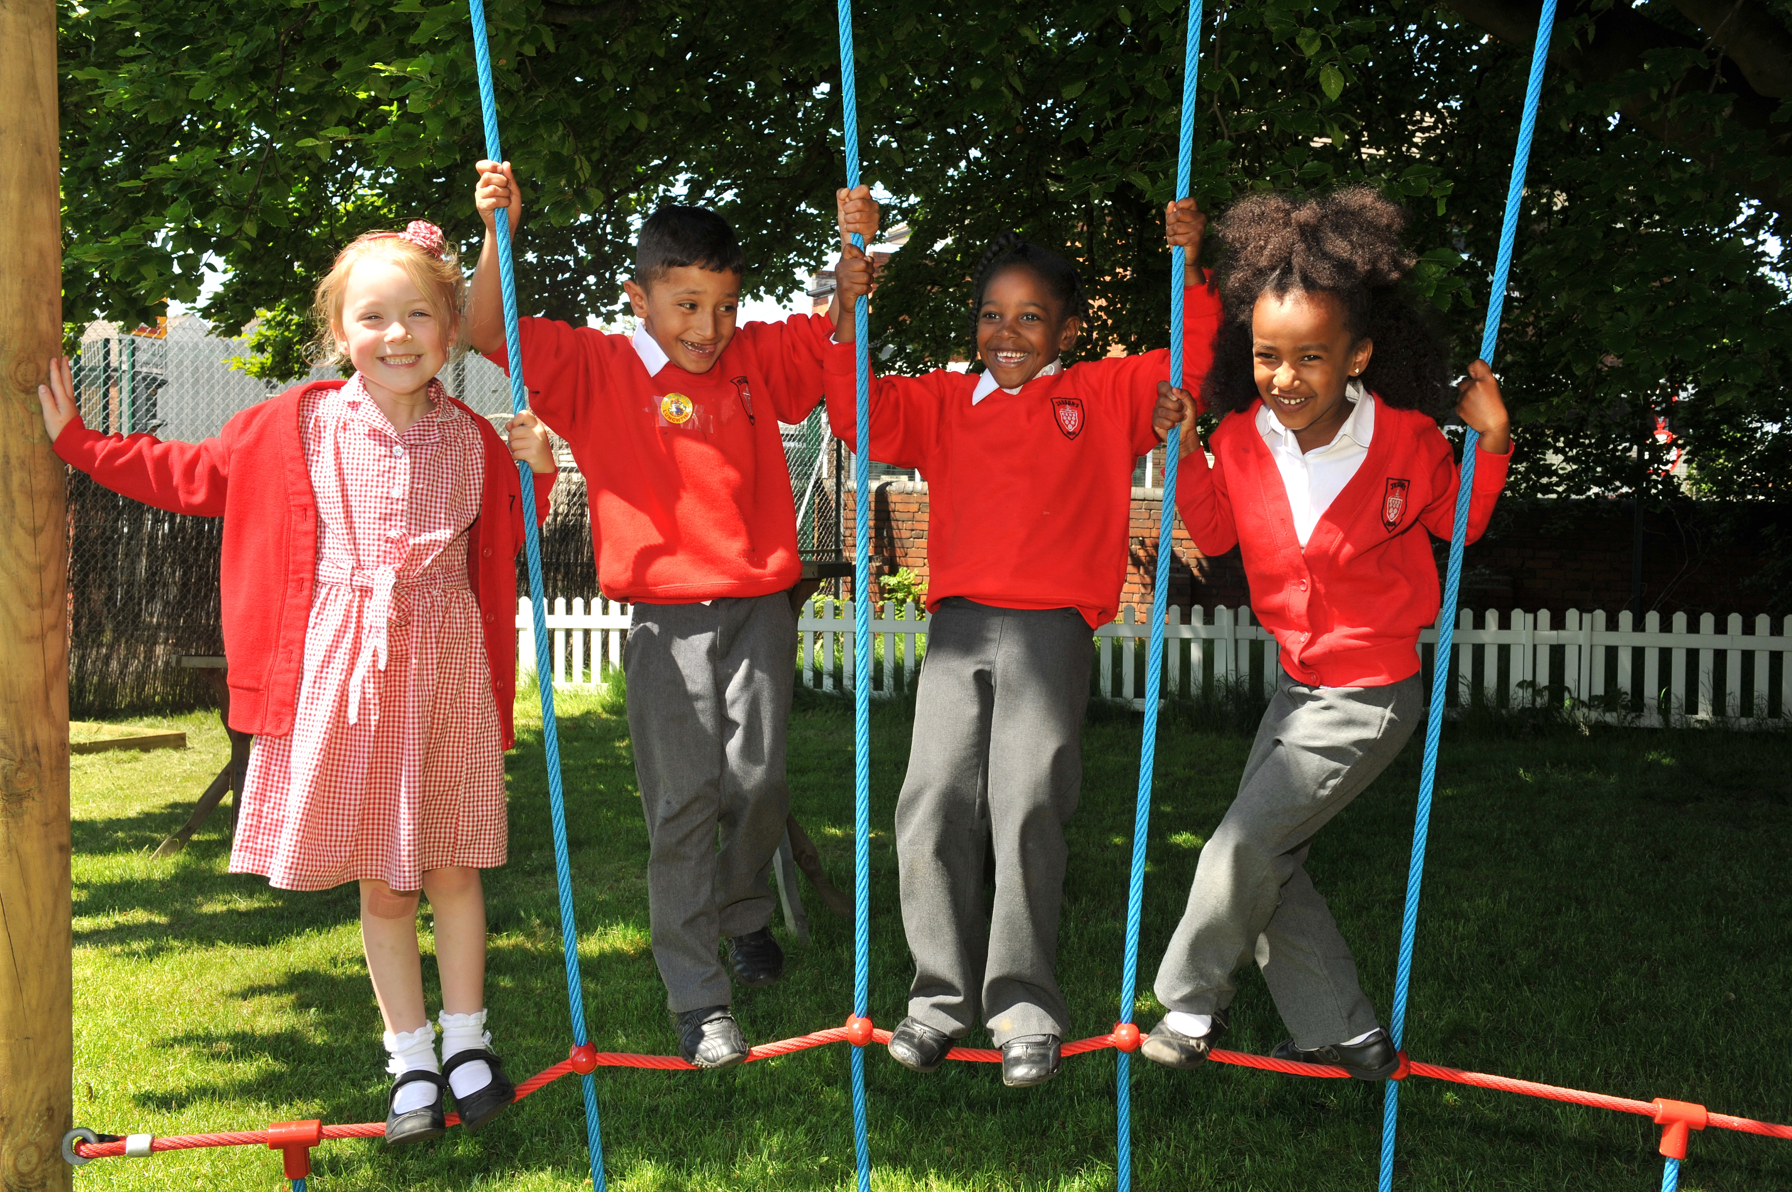
“…This dynamic and enhancing connection between ethos and outcomes is what we mean by ‘Bringing the Vision Alive.’”

Slide 44
What outcomes are you trying to improve?
What are the pressures and challenges?
Who defines this journey?
What help could the Vision offer you?
ethos
enhancing
outcomes
How do you define this for your school?
(in a sentence…)
Where does your ethos come from?
What are the commonalities and differences between us?
What difference does it make to your lived reality?

Slide 45
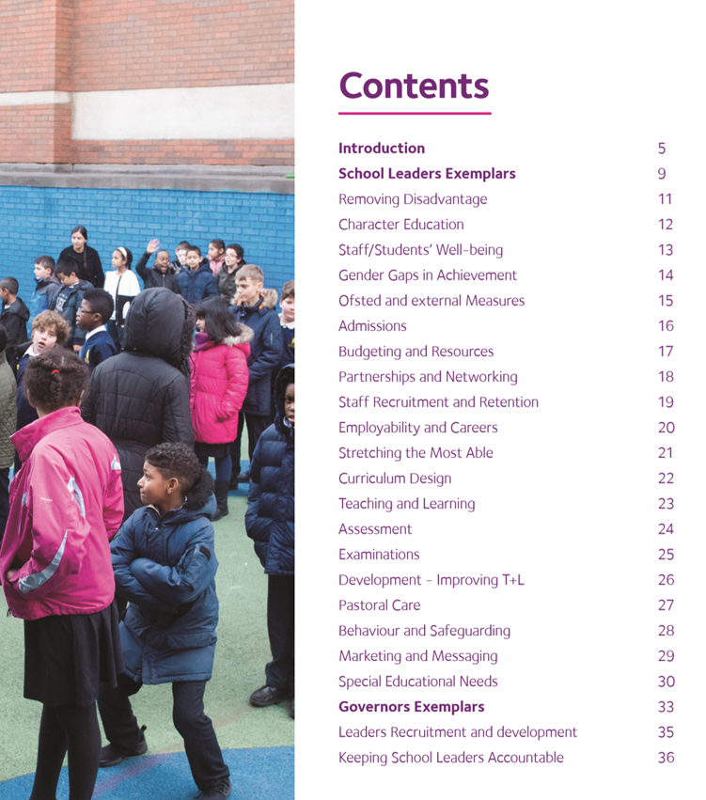
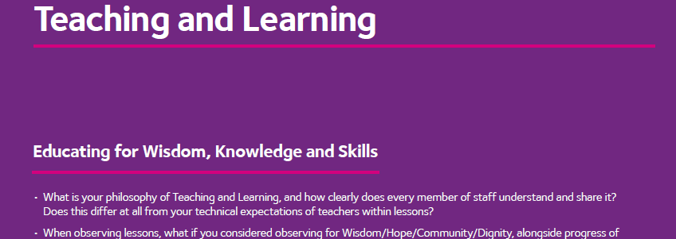
Notes:
Look together at Removing Disadvantage (as an example) – one group to take each strand… what resonated for you?

Slide 46
Called, Connected, Committed: 24 Leadership Practices (2020)

Slide 47
 | Called | Connected | Committed
Educating for Wisdom, Knowledge and Skills | Leading Learning - Refining Judgement | Creating Confidence - Embracing Interdependence | Deepening Understanding - Driving Improvement
Educating for Hope and Aspiration | Developing Imagination - Nurturing Ambition | Healing Relationships - Pursuing Renewal | Sustaining Vision - Building Resilience
Educating for Community and Living Well Together | Removing Disadvantage - Seeking Reconciliation | Accepting Vulnerability - Demonstrating Generosity | Inspiring Faithfulness -Embodying Integrity
Educating for Dignity and Respect | Celebrating Diversity - Enabling Flourishing | Offering Encouragement - Encouraging Service | Practising Humility - Learning Love

Slide 48

Which of these practices, if demonstrated consistently within your school community, would most enable your vision for Teaching and Learning to be realised within your school?

Slide 49


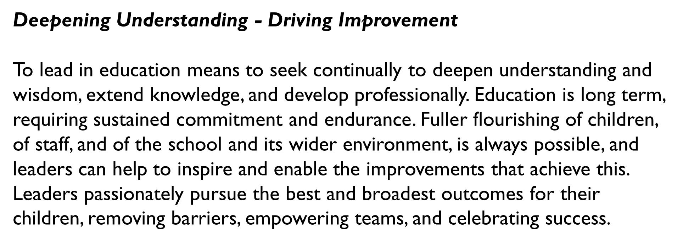
The Leadership Practice ‘deep dive’
Notes:
Try to focus on a LP which is under-represented in your gap analysis

Slide 50

Formulating research questions
What would you like to explore around how Teaching and Learning in your school enables the flourishing of pupils, adults and teams?
How will you go about finding this out?
Who will you need to involve?

Slide 51
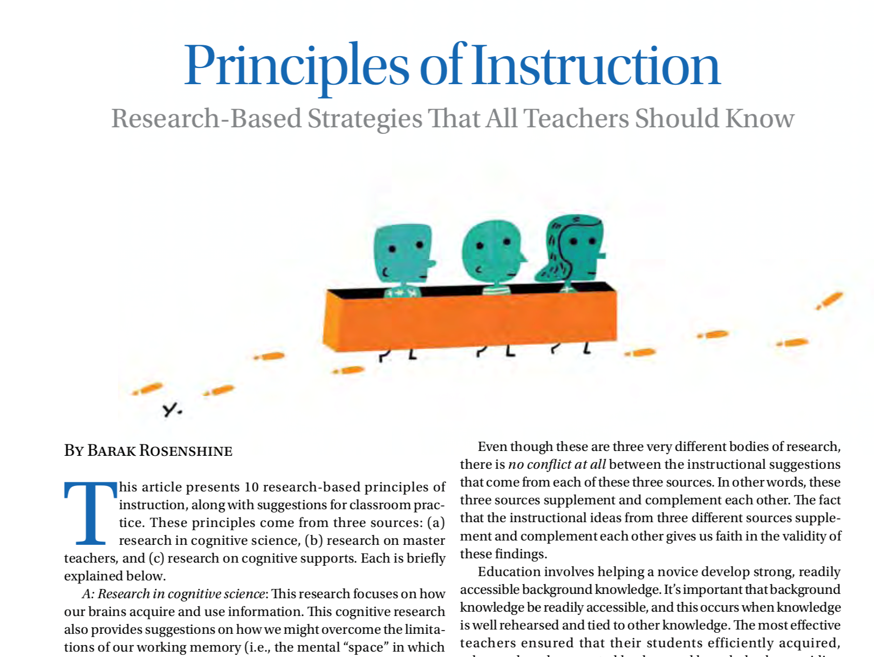
Further Reading
https://www.aft.org/sites/default/files/periodicals/Rosenshine.pdf
Please bring:
Your Teaching & Learning Policy
(if you have one)

