Slide 1
Derby Diocese Peer Support Network: Growing Faith
Building Partnerships between Schools, Churches and Households

Slide 2
Reflection

Slide 3


‘Leaders need to listen as deeply as possible to what constitutes the integrity of others…’
‘Inspiring faithfulness is often done in the most challenging circumstances where leaders show this by their reliability and steadfastness.’

Slide 5
‘Life in all its fullness’
Educating for Wisdom, Knowledge and Skills
Educating for
Hope and Aspiration
Educating for Community and Living Well Together
Educating for Dignity and Respect

Slide 6
The Church of England Foundation
for Educational Leadership’s mission is:
“To develop inspirational leaders who are called, connected and committed to delivering the Church of England’s vision for education”

Slide 7
Why do we need Growing Faith?

Slide 10
How do we view this?
The spring of hope?
Or the winter of despair?

Slide 11

How does this compare to your own community?
What reasons do you have for hope?
In what ways can you BE hope for your community?

Slide 12

‘All she could do was hope, and she kept trying to do that, in spite of the fear and the loneliness.’

Slide 13
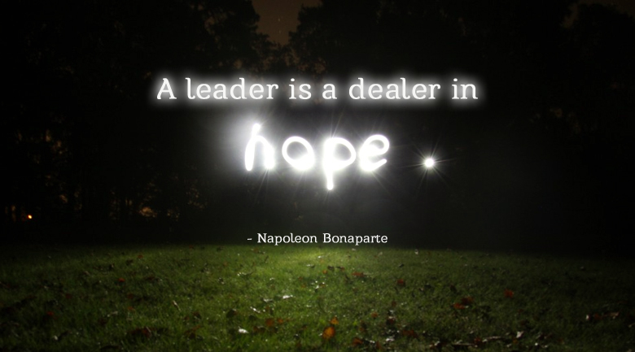

Slide 14
What do we mean by Growing Faith?

Slide 15
Growing Faith ‘separately’ in Schools, Churches and Households
Notes:
Handout p1

Slide 16
Schools
Households
Churches
The
Growing Faith Intersection
Our primary focus for Growing Faith is the intersection between 2 or more of the elements
Our understanding of young people’s faith development is that it much more likely to happen, and be sustained if it happens in the intersection
Notes:
Showing the USP of GF approach – i.e. what happens in the intersections…

Slide 17
Connected Communities

Slide 18
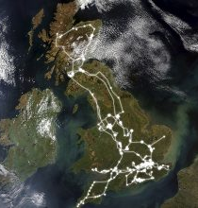

Slide 19
‘Christian faith is discovered, formed and grown in community.’
Who or what within your community do you think are the greatest influences on the way young people think about faith or religion?

Slide 20
Notes:
Handout – to annotate using next slide

Slide 21

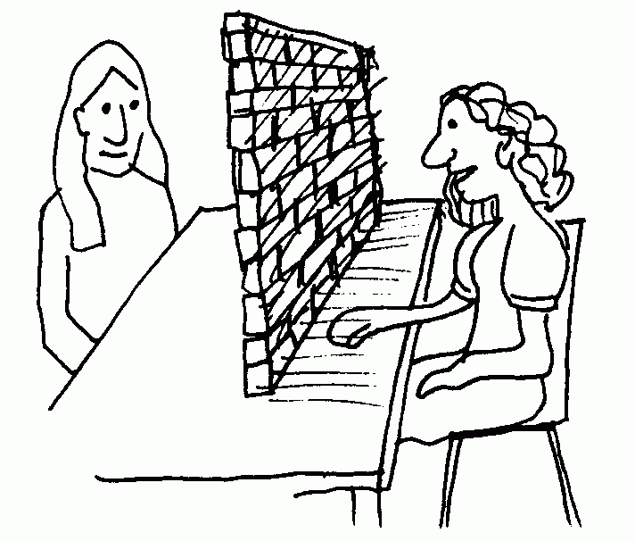
Which of these influences are we currently engaging with, discussing and/ or supporting?
How? What is already working well?
Which of these influences do we not engage with, discuss or support as much?
Why do you think this is? What barriers or challenges are there?

Slide 22
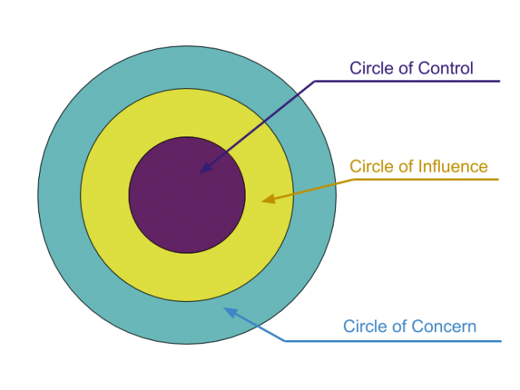
Circles of Influence
Adapted from Stephen Covey
Which do you have control over?
Which can you influence?
Which can you not control, but impact in some way?
Notes:
Handout p2

Slide 23

‘Faith is nurtured through interactions between people, and further enriched when this happens across generations.’
Notes:
Where are there existing or possible inter-generational activities taking place?

Slide 25
We flourish because of our diversity and relationships
We flourish at different times and different speeds
Flourishing Teams
Flourishing Adults
We flourish so we can look outwards and give
Flourishing Children
We flourish when we stop doing things

Slide 26
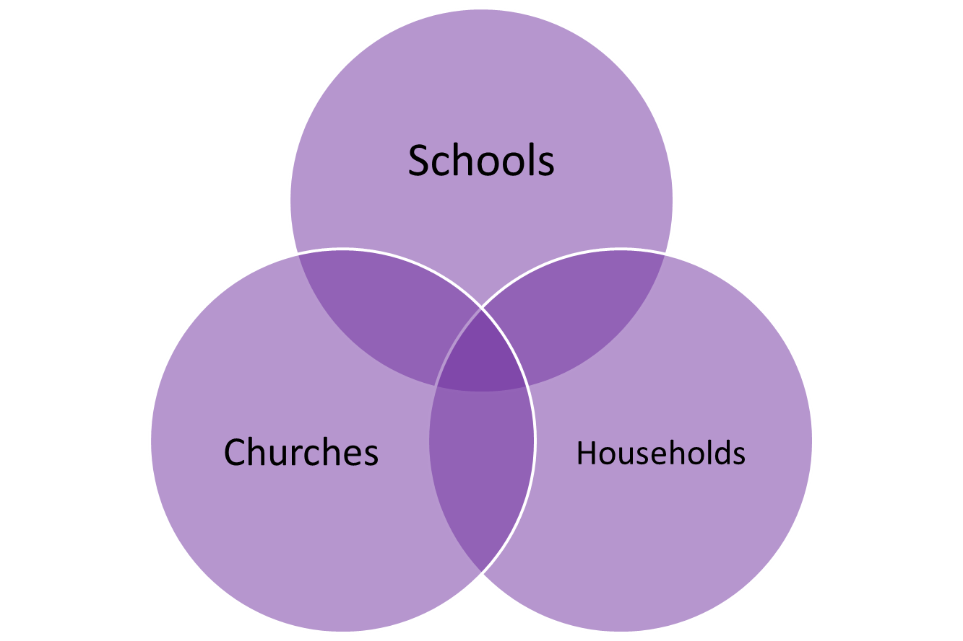
Discussion questions
In which sphere(s)…
are the relationships strongest and most diverse?
do we support different speeds of spiritual growth?
are there opportunities to serve and give to other parts of our community?
is there something we need to stop doing?

Slide 28
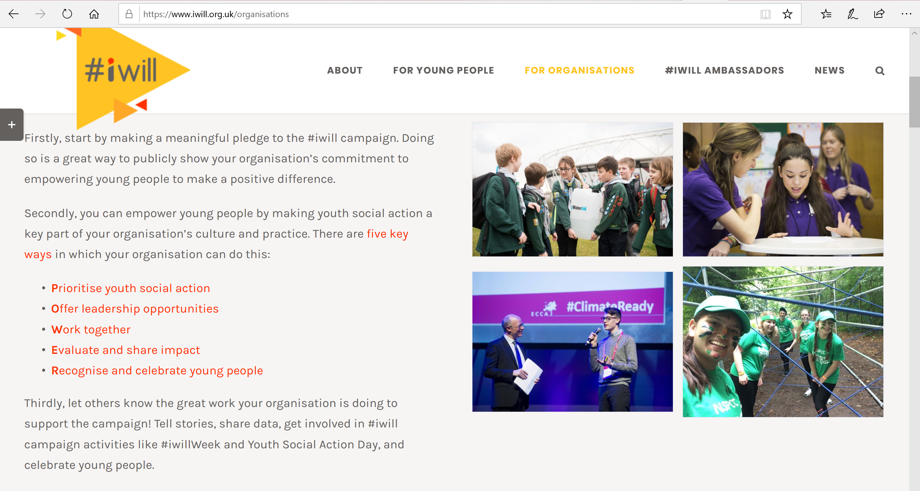

Slide 29
Spiritual Encounters

Slide 30


Slide 31
What is the difference between spirituality and faith?
Spirituality:
an innate sense of awe and wonder; there’s something or someone more than just me
Faith:
our response to God;
making a difference to the life that we live
Notes:
My very simple distinctions.
There are as many definitions as there are people in the room – and more!
Some people cannot separate out spirituality and faith or religion. But as responsible educators we need to respect the distinction.
Although spirituality may be a human attribute which all have, faith is the response to that.
I think this helps schools which are anxious about accusations of proselytising understand that creating space for the spiritual is different to the space for Collective Worship where faith is embraced.

Slide 32
UNCRC 1989
Religion is identified as a matter of mind, belief and practise, part of cultural expression associated with minority rights and human equality.
Spirituality is identified as an aspect of human development and overall human health.
Notes:
In 1989 the UNCRC recognised both religion and spirituality, made provision for both within the convention, and saw both as a right
RELIGION – a matter of mind, choice
SPIRITUALITY – important for healthy development
Articles 14, 29 & 30 are concerned with religious rights
Articles 17, 27 & 32 are concerned with spirituality
Article 14 States Parties shall respect the right of the child to freedom of thought, conscience and religion
Article 17 States Parties recognize the important function performed by the mass media and shall ensure that the child has access to information and material from a diversity of national and international sources, especially those aimed at the promotion of his or her social, spiritual and moral well-being and physical and mental health.
Article 27 1. States Parties recognize the right of every child to a standard of living adequate for the child’s physical, mental, spiritual, moral and social development.
Article 29 (d) The preparation of the child for responsible life in a free society, in the spirit of understanding, peace, tolerance, equality of sexes, and friendship among all peoples, ethnic, national and religious groups and persons of indigenous origin;
Article 30 In those States in which ethnic, religious or linguistic minorities or persons of indigenous origin exist, a child belonging to such a minority or who is indigenous shall not be denied the right, in community with other members of his or her group, to enjoy his or her own culture, to profess and practise his or her own religion, or to use his or her own language.
Article 32 States Parties recognize the right of the child to be protected from economic exploitation and from performing any work that is likely to be hazardous or to interfere with the child’s education, or to be harmful to the child’s health or physical, mental, spiritual, moral or social development.

Slide 33
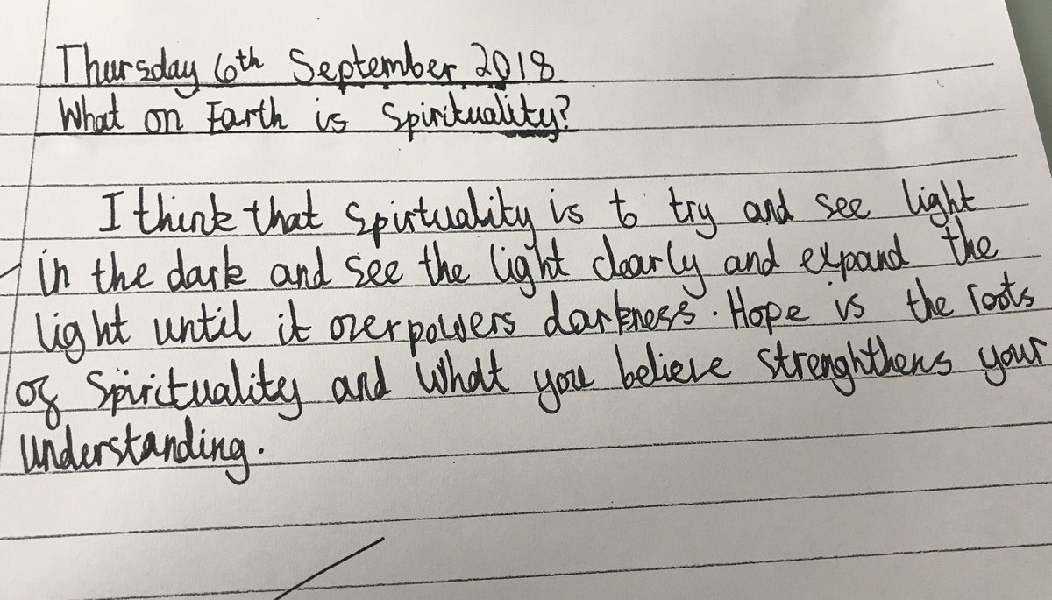
How do we understand Spirituality?
Year 6 pupil

Slide 34
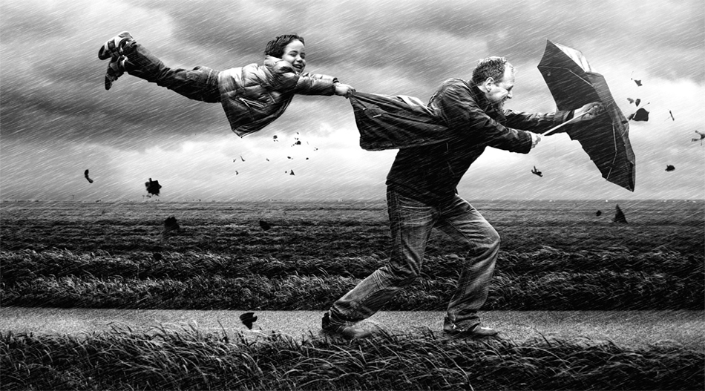
Spirituality is like the wind
Notes:
Very hard to pin down!! And very difficult to define – so much so that most people have their own understanding or working definition.

Slide 35
Left to their own devices (children) will likely become religious in some sense but probably in a sense more like what you would call superstition than a thoughtful, sophisticated belief and behaviour system.
Failure to provide….a system of beliefs and practices refined and honed through generations of theological debate, philosophical scrutiny and collective experience, may leave them open to religious extremism, catchy anecdotes from charismatic spiritualists, or buffet-style ……from various available traditions, whether or not they actually make sense together.
Justin L. Barrett – Born Believers, 2012

Slide 36
‘There is no such thing as a neutral education.’
Fruit of the Spirit (2015)

Slide 38
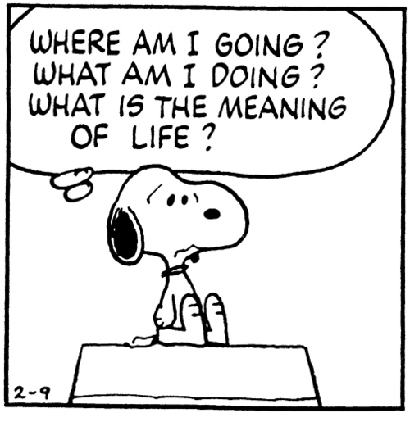
What sort of existential questions might arise for children and young people?
What might trigger these questions?
Notes:
Barrett highlights the need to help children and young people develop a framework for thinking about or supporting their spirituality.
A spiritual framework or belief system which helps them tackle the existential questions of humanity.
Into adolescence – where is the safe space for this to happen? If we are thinking of fullness of life, that HAS to include more than just academic success. Wisdom, ability to think, reason. Turing House – Philosophy Club.

Slide 39

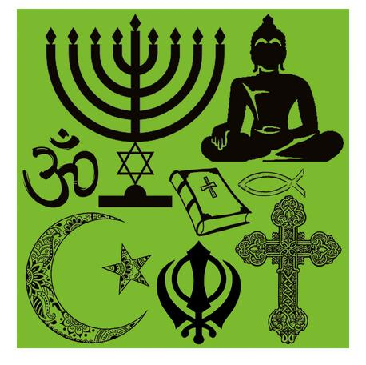
Faith formation is a process – a journey that starts with spirituality and may be expressed through faith.
There is a crucial difference between creating an ethos of spiritual/faith formation and the provision of religious education.

Slide 40
What might make you think about God or spirituality?
15% When things don’t turn out really well
15% Answered prayer
17% People I know
17% Experiences had by other people
18% Kind gestures by others
22% Others talking about their experiences of God
24% Thinking about life
35% I don’t think about God or spirituality
Gen Z – rethinking culture
Youth for Christ 2017

Slide 42

What gets in the way of spiritual flourishing?
Notes:
Build a wall of barriers to spiritual flourishing

Slide 43
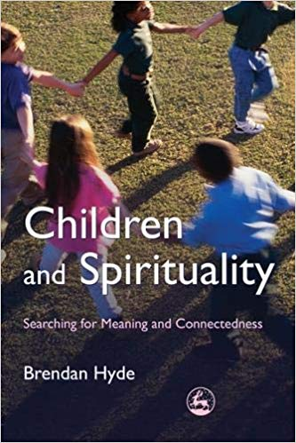
Getting in the way of spiritual flourishing
Material pursuit
  Disconnection with Other
  Affirmation in material excess
Trivialising
  Masking of inner feelings and values
Lack of time
  Busyness of adults
  Lack of space for stillness and listening
Notes:
Brendan Hyde in Children and Spirituality

Slide 44

What can break through these barriers?
Notes:
Place a tealight on a barrier once you have thought of a way to overcome it!

Slide 45

To flourish spiritually, children need:
Time be listened to
Respectful adults
Space to explore
Opportunities to wonder
To know there is another way
Notes:
Children and young people won’t flourish spiritually just because we added it as another project or a box to be ticked. We need to find ways to offer them a different way of being.
It’s when the threads of spiritual practices, the opportunities to pause, to question, to wonder, are woven together into the very being of our schools that possibly, just possibly, the shades of the prison house will not close in upon our children and young people and they can

Slide 46
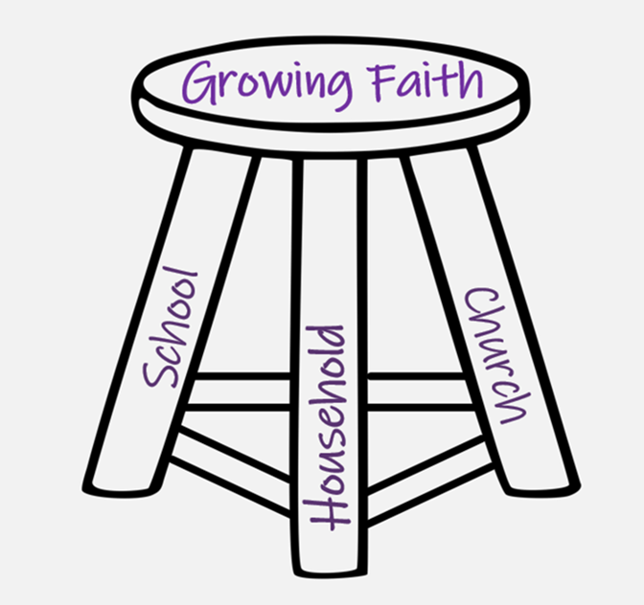
Where is this already happening…
in school?
at church?
within households?
Where are the opportunities to develop this further, in partnership?
Notes:
3 spheres handout

Slide 47
Imaginative Practices

Slide 48


Slide 49

‘Creation is only possible in the liminal space between order and chaos.’
John Polkinghorne
Notes:
What does this mean for your context? Are there opportunities for creation of new ideas? How comfortable are you with the idea of ‘chaos’? What sort of ‘order’ is required for faith to grow?

Slide 50

“…to nurture, nourish and evoke a consciousness and perception alternative to the consciousness and perception of the dominant culture around us.”

Slide 51
“The imagination must come before the implementation.
Our culture is competent to implement almost anything and imagine almost nothing.
It is our vocation to keep alive the ministry of imagination”

Slide 52
Leading Courageously, Inspiring Hope
CRITICISE
ENERGISE

Slide 53

“… Growing Faith requires ‘thinking in a new box’, not merely innovating within the existing box…
It requires an intentional choice to look for the new ideas together rather than accept the same old ideas repackaged as new resources and products.”

Slide 54

Old problems, new solutions
Identify 1 key issue/ barrier to Growing Faith within your community.
What different ideas can members of your group come up with that could potentially help?
Take turns so that everyone has the chance to share and hear different possibilities.

Slide 55
Called, Connected, Committed: 24 Leadership Practices (2020)

Slide 56
 | Called | Connected | Committed
Educating for Wisdom, Knowledge and Skills | Leading Learning - Refining Judgement | Creating Confidence - Embracing Interdependence | Deepening Understanding - Driving Improvement
Educating for Hope and Aspiration | Developing Imagination - Nurturing Ambition | Healing Relationships - Pursuing Renewal | Sustaining Vision - Building Resilience
Educating for Community and Living Well Together | Removing Disadvantage - Seeking Reconciliation | Accepting Vulnerability - Demonstrating Generosity | Inspiring Faithfulness -Embodying Integrity
Educating for Dignity and Respect | Celebrating Diversity - Enabling Flourishing | Offering Encouragement - Encouraging Service | Practising Humility - Learning Love

Slide 57
Which leadership practices might we need to develop in order to grow faith in our community?

Slide 58

How will we begin to develop this with...?
Parents
School staff
Children & young people
Church members

Slide 59
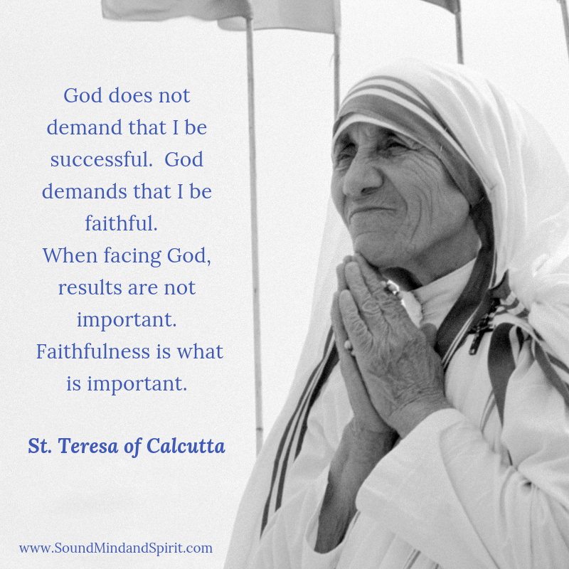
Inspiring Faithfulness

