Slide 1
Derby Diocese Headteacher Celebration: Growing Faith

Slide 2
Reflection

Slide 3


Slide 5
‘Life in all its fullness’
Educating for Wisdom, Knowledge and Skills
Educating for
Hope and Aspiration
Educating for Community and Living Well Together
Educating for Dignity and Respect

Slide 6
The Church of England Foundation
for Educational Leadership’s mission is:
“To develop inspirational leaders who are called, connected and committed to delivering the Church of England’s vision for education”

Slide 7
Why do we need Growing Faith?

Slide 10
What do we mean by Growing Faith?

Slide 11
Growing Faith ‘separately’ in Schools, Churches and Households

Slide 12

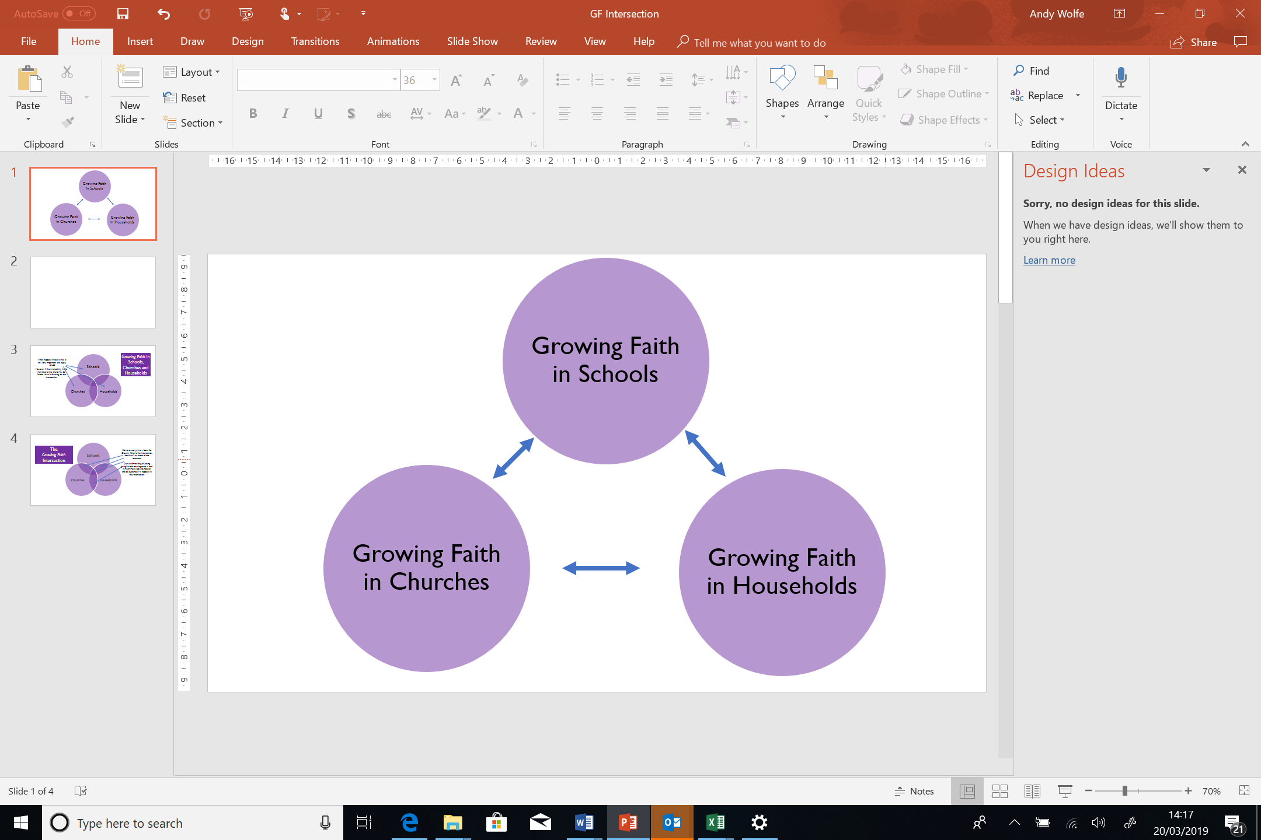
Questions for discussion
What is already going on these spaces that is specifically around Growing Faith?
What are the other pressures/values of each of these spaces?
What might the development needs be in each of these spaces?
What are the other cultural influencers of young people, and which are the loudest voices?
Is this an equal relationship? Or is any one of these served most by Growing Faith?
Notes:
Before diving into the GF intersections, giving people the chance to think about the 3 areas, and their respective challenges and opportunities

Slide 13
Schools
Households
Churches
The
Growing Faith Intersection
Our primary focus for Growing Faith is the intersection between 2 or more of the elements
Our understanding of young people’s faith development is that it much more likely to happen, and be sustained if it happens in the intersection
Notes:
Showing the USP of GF approach – i.e. what happens in the intersections…

Slide 14
Connected Communities

Slide 15
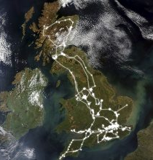

Slide 16
We flourish because of our diversity and relationships
We flourish at different times and different speeds
Flourishing Teams
Flourishing Adults
We flourish so we can look outwards and give
Flourishing Children
We flourish when we stop doing things

Slide 17
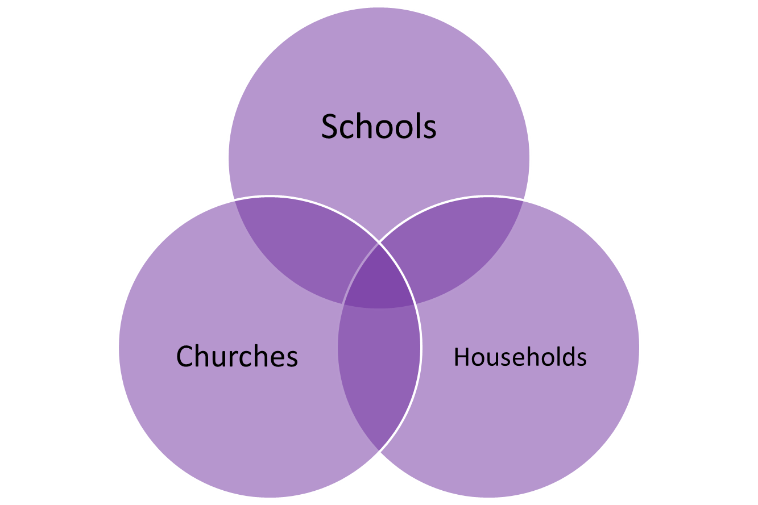
Discussion questions
In which sphere(s)…
are the relationships strongest and most diverse?
do we support different speeds of spiritual growth?
are there opportunities to serve and give to other parts of our community?
is there something we need to stop doing?

Slide 18
Spiritual Encounters

Slide 19


Slide 20
What is the difference between spirituality and faith?
Spirituality:
an innate sense of awe and wonder; there’s something or someone more than just me
Faith:
our response to God;
making a difference to the life that we live
Notes:
My very simple distinctions.
There are as many definitions as there are people in the room – and more!
Some people cannot separate out spirituality and faith or religion. But as responsible educators we need to respect the distinction.
Although spirituality may be a human attribute which all have, faith is the response to that.
I think this helps schools which are anxious about accusations of proselytising understand that creating space for the spiritual is different to the space for Collective Worship where faith is embraced.

Slide 21
UNCRC 1989
Religion is identified as a matter of mind, belief and practise, part of cultural expression associated with minority rights and human equality.
Spirituality is identified as an aspect of human development and overall human health.
Notes:
In 1989 the UNCRC recognised both religion and spirituality, made provision for both within the convention, and saw both as a right
RELIGION – a matter of mind, choice
SPIRITUALITY – important for healthy development
Articles 14, 29 & 30 are concerned with religious rights
Articles 17, 27 & 32 are concerned with spirituality
Article 14 States Parties shall respect the right of the child to freedom of thought, conscience and religion
Article 17 States Parties recognize the important function performed by the mass media and shall ensure that the child has access to information and material from a diversity of national and international sources, especially those aimed at the promotion of his or her social, spiritual and moral well-being and physical and mental health.
Article 27 1. States Parties recognize the right of every child to a standard of living adequate for the child’s physical, mental, spiritual, moral and social development.
Article 29 (d) The preparation of the child for responsible life in a free society, in the spirit of understanding, peace, tolerance, equality of sexes, and friendship among all peoples, ethnic, national and religious groups and persons of indigenous origin;
Article 30 In those States in which ethnic, religious or linguistic minorities or persons of indigenous origin exist, a child belonging to such a minority or who is indigenous shall not be denied the right, in community with other members of his or her group, to enjoy his or her own culture, to profess and practise his or her own religion, or to use his or her own language.
Article 32 States Parties recognize the right of the child to be protected from economic exploitation and from performing any work that is likely to be hazardous or to interfere with the child’s education, or to be harmful to the child’s health or physical, mental, spiritual, moral or social development.

Slide 22
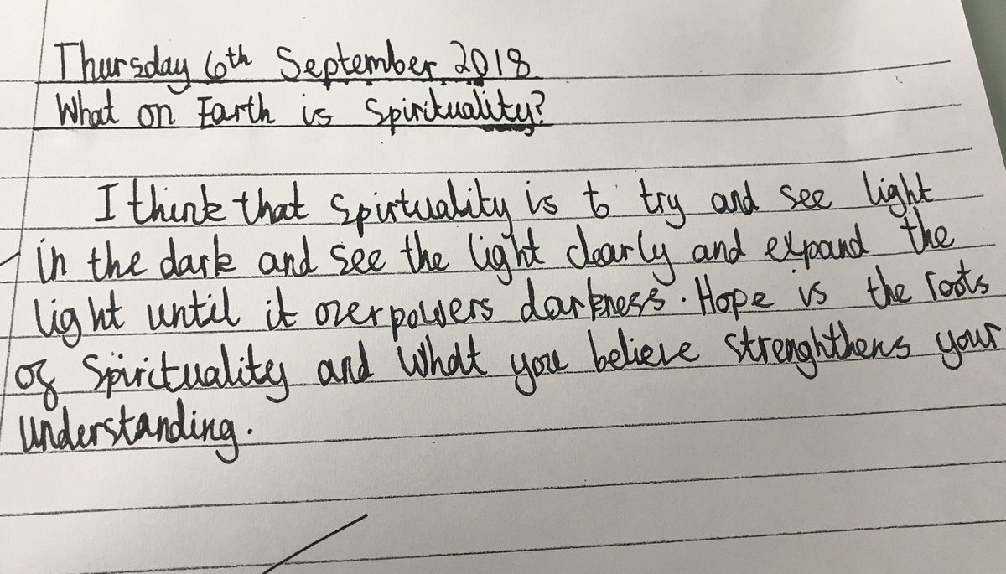
How do we understand Spirituality?
Year 6 pupil

Slide 23
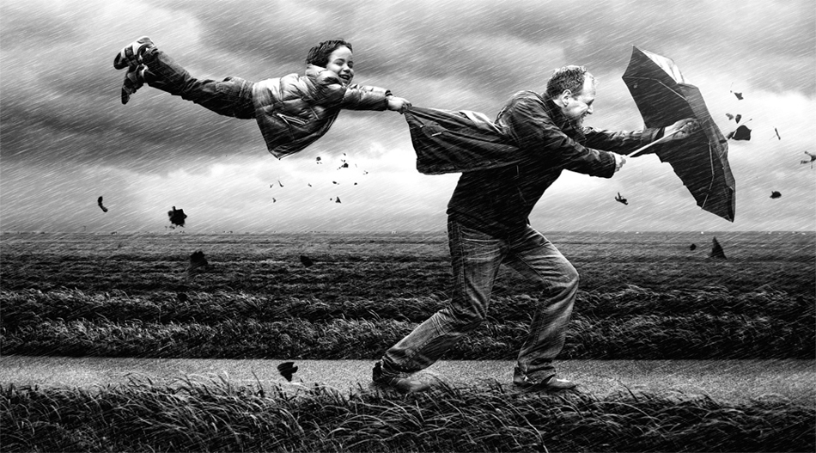
Spirituality is like the wind
Notes:
Very hard to pin down!! And very difficult to define – so much so that most people have their own understanding or working definition.

Slide 24
Left to their own devices (children) will likely become religious in some sense but probably in a sense more like what you would call superstition than a thoughtful, sophisticated belief and behaviour system.
Failure to provide….a system of beliefs and practices refined and honed through generations of theological debate, philosophical scrutiny and collective experience, may leave them open to religious extremism, catchy anecdotes from charismatic spiritualists, or buffet-style ……from various available traditions, whether or not they actually make sense together.
Justin L. Barrett – Born Believers, 2012

Slide 25
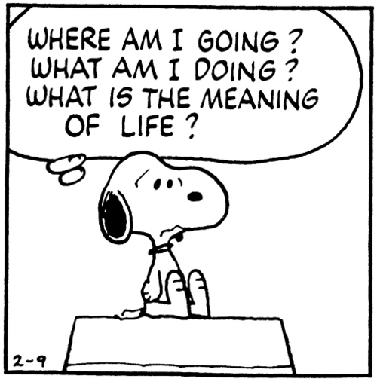
What sort of existential questions might arise for children and young people?
What might trigger these questions?
Notes:
Barrett highlights the need to help children and young people develop a framework for thinking about or supporting their spirituality.
A spiritual framework or belief system which helps them tackle the existential questions of humanity.
Into adolescence – where is the safe space for this to happen? If we are thinking of fullness of life, that HAS to include more than just academic success. Wisdom, ability to think, reason. Turing House – Philosophy Club.

Slide 26
What might make you think about God or spirituality?
15% When things don’t turn out really well
15% Answered prayer
17% People I know
17% Experiences had by other people
18% Kind gestures by others
22% Others talking about their experiences of God
24% Thinking about life
35% I don’t think about God or spirituality
Gen Z – rethinking culture
Youth for Christ 2017

Slide 28
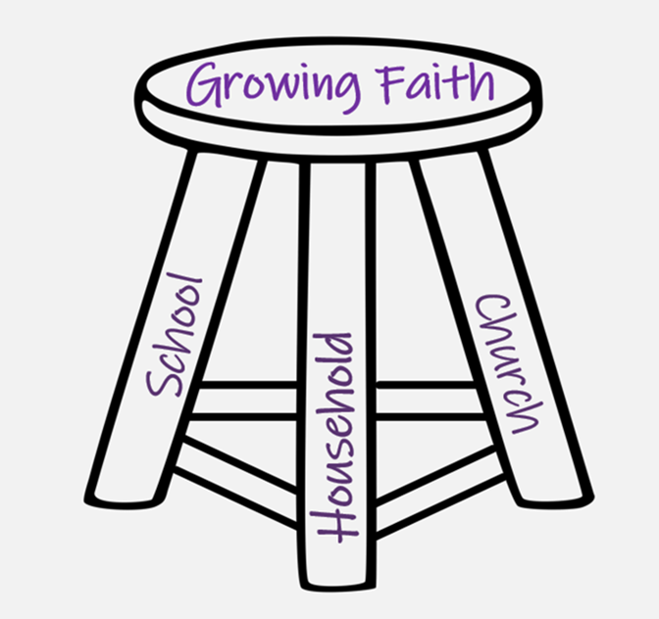
Where is this already happening…
in school?
at church?
within households?
Where are the opportunities to develop this further?

Slide 29

What gets in the way of spiritual flourishing?
Notes:
Exercise forgiveness if it doesn’t work

Slide 30
Imaginative Practices

Slide 31


Slide 32

“…to nurture, nourish and evoke a consciousness and perception alternative to the consciousness and perception of the dominant culture around us.”

Slide 33
“The imagination must come before the implementation.
Our culture is competent to implement almost anything and imagine almost nothing.
It is our vocation to keep alive the ministry of imagination”

Slide 34
Leading Courageously, Inspiring Hope
CRITICISE
ENERGISE

Slide 35

Making a new box

Slide 36
Theology of Educational Leadership Practices Matrix (2019)

Slide 37
 | Called | Connected | Committed
Educating for Wisdom, Knowledge and Skills | Leading Learning - Refining Judgement | Creating Confidence - Embracing Interdependence | Deepening Understanding - Driving Improvement
Educating for Hope and Aspiration | Developing Imagination - Nurturing Ambition | Healing Relationships - Pursuing Renewal | Sustaining Vision - Building Resilience
Educating for Community and Living Well Together | Removing Disadvantage - Seeking Reconciliation | Accepting Vulnerability - Demonstrating Generosity | Inspiring Faithfulness -Embodying Integrity
Educating for Dignity and Respect | Celebrating Diversity - Enabling Flourishing | Offering Encouragement - Encouraging Service | Practising Humility - Learning Love

Slide 38
Which leadership practices might we need to develop in order to grow faith in our community?

Slide 39
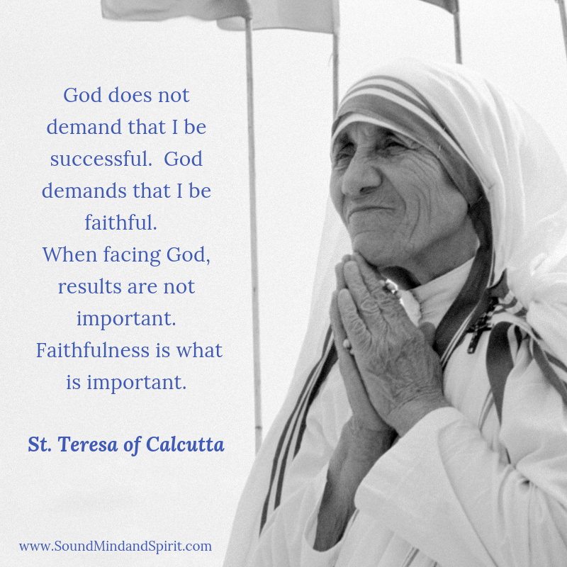
Inspiring Faithfulness

