Slide 1
Derby Diocese Headteacher Celebration: Teaching and Learning

Slide 2
Reflection

Slide 3
Driving
Improvement

Slide 4
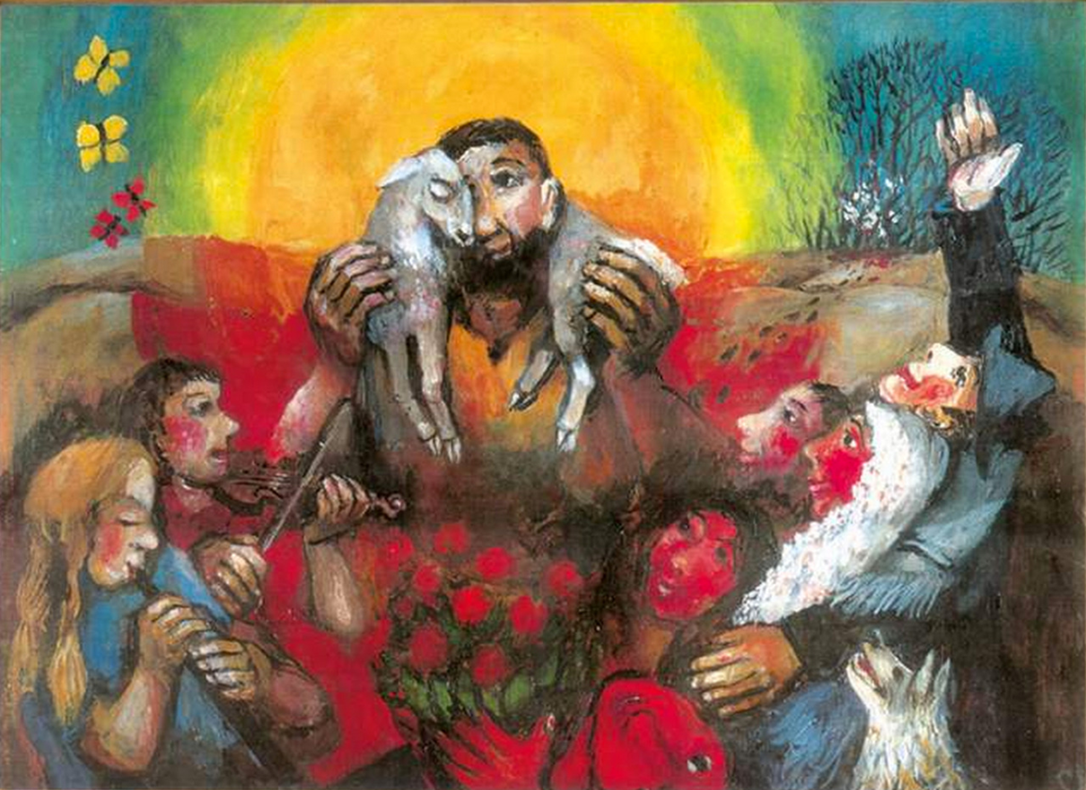
‘Driving improvement is about recognising that each child has one shot, and thus pursuing the very best for each one as a result.’

Slide 5
‘Life in all its fullness’
Educating for Wisdom, Knowledge and Skills
Educating for
Hope and Aspiration
Educating for Community and Living Well Together
Educating for Dignity and Respect

Slide 6
The Church of England Foundation
for Educational Leadership’s mission is:
“To develop inspirational leaders who are called, connected and committed to delivering the Church of England’s vision for education”

Slide 7
What is the purpose of Teaching and Learning?

Slide 8
Children
‘Life in all its fullness’
Adults
Teams

Slide 9
What could this look like for Teaching and Learning?

Slide 10
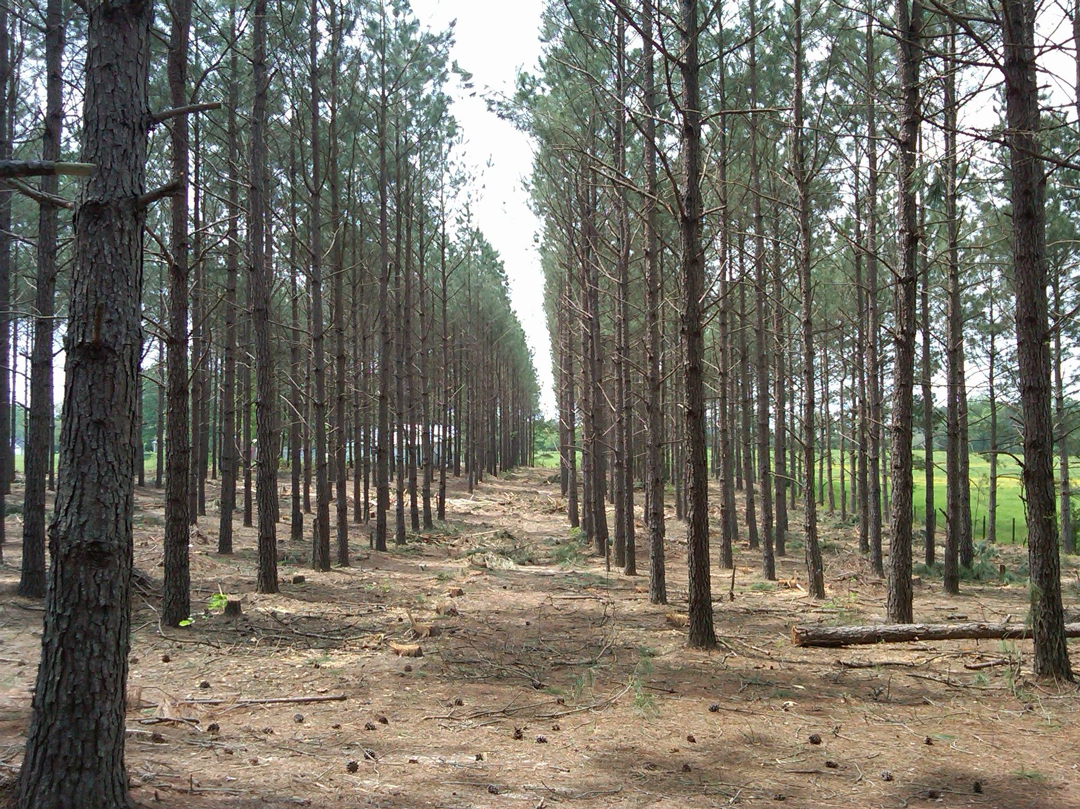
Plantation?
Or Rainforest?

Slide 11
Learning Plantation | Learning Rainforest
‘A right way to do things’ – set routines – e.g. L.O. on the board every lesson | Nourishing individual talents - high trust/high challenge
Leaders driven by compliance to external voices | Great variety in pedagogy and OK to try new things all the time
T+L focused on what can be examined | If creative approaches deliver, there is high level of autonomy
Data has very high status | Data is part of the picture of learning
Interventions heavily focused on short-term gains | T+L structures are dynamic/organic, aligning T+L to stated school values
Creativity becomes rules – e.g. standardised homework format etc. | Highly personalised CPD

Slide 12
We flourish because of our diversity and relationships
We flourish at different times and different speeds
Flourishing Teams
Flourishing Adults
We flourish so we can look outwards and give
Flourishing Children
We flourish when we stop doing things

Slide 13
Ethos Enhancing Outcomes

Slide 14
“If the Vision for Education fails to make and sustain meaningful connections between a school’s ethos and its outcomes, it will become nothing more than a deeply eloquent and well-meaning piece of writing…”

Slide 15
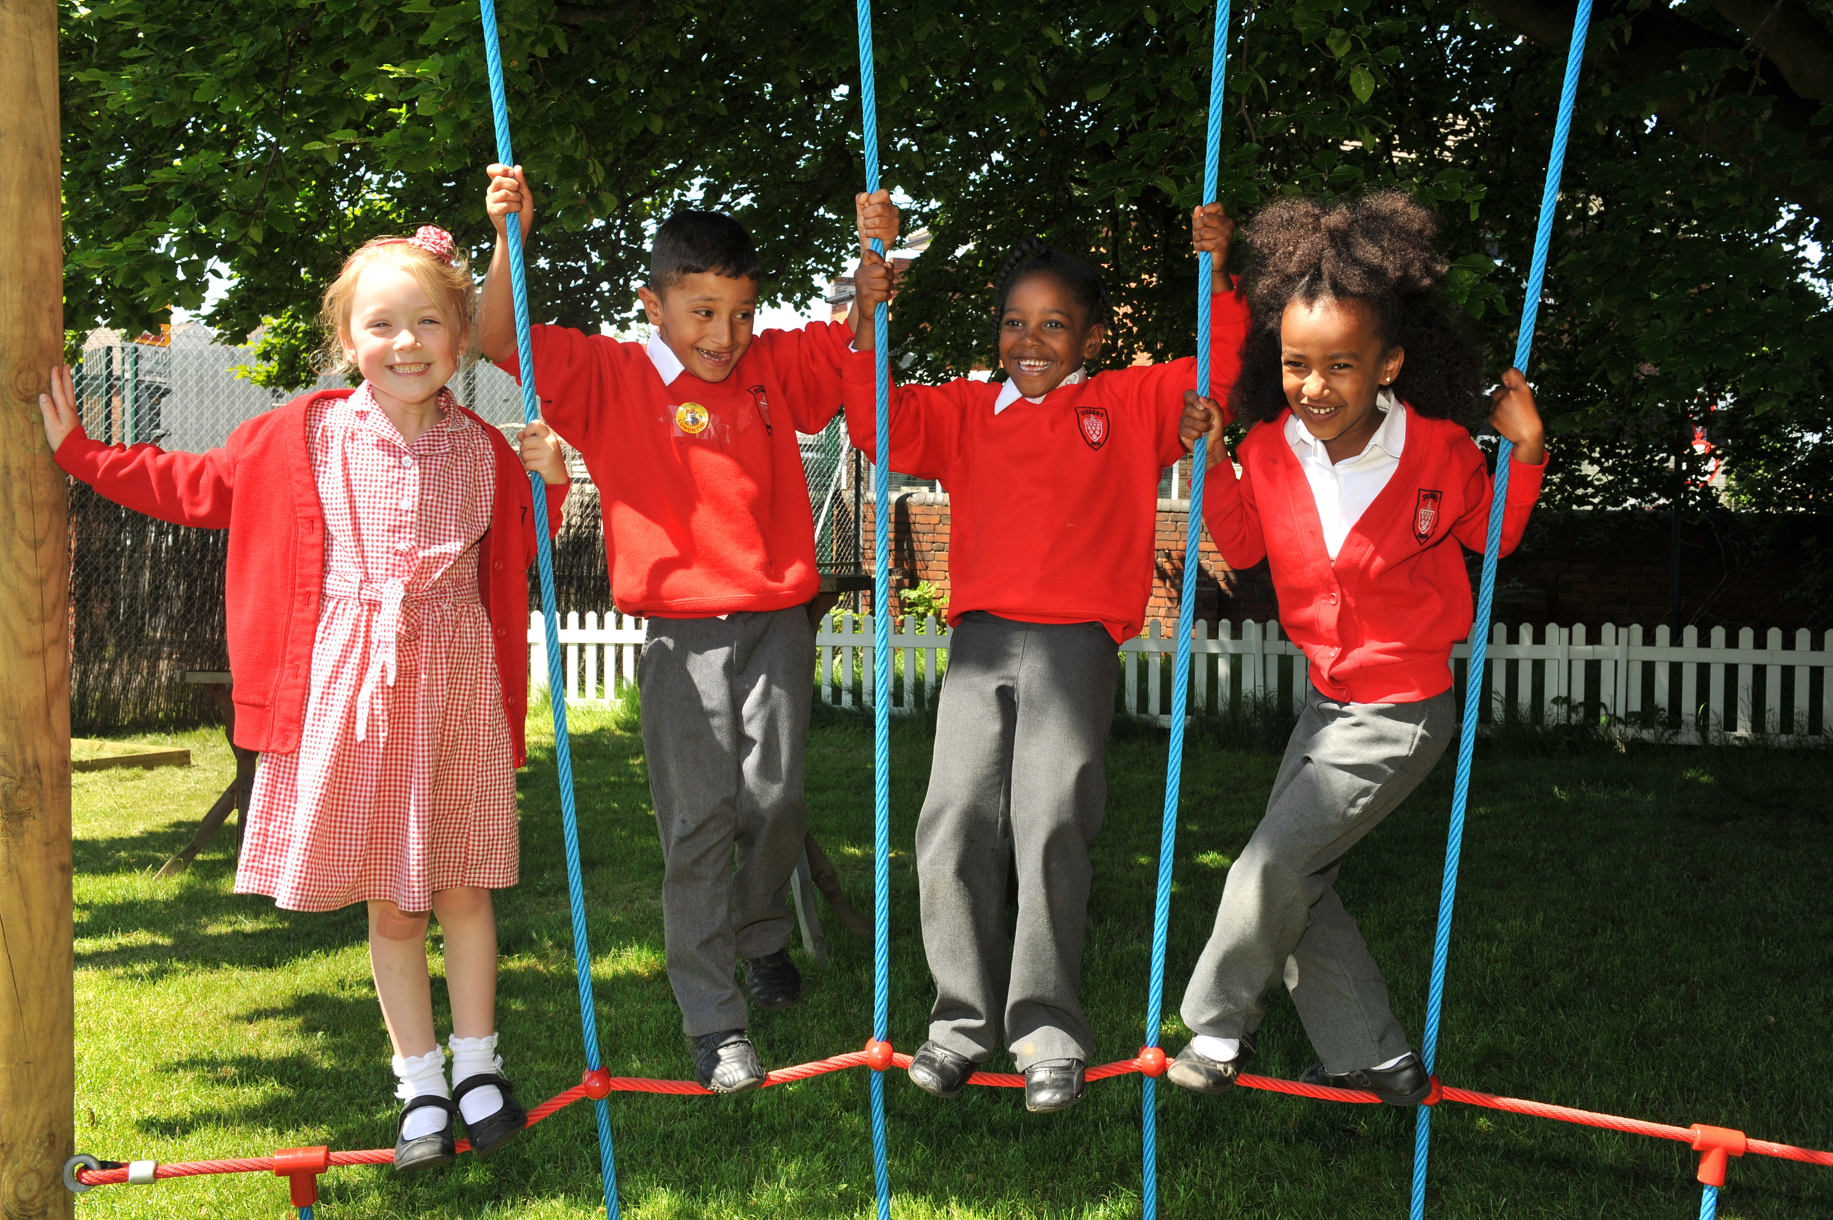
“..It must come off the shelf and be brought to life through leaders evaluating its potential impact on every area of day-to-day school life…”

Slide 16
“…This dynamic and enhancing connection between ethos and outcomes is what we mean by ‘Bringing the Vision Alive.’”

Slide 17
What outcomes are you trying to improve?
What are the pressures and challenges?
Who defines this journey?
What help could the Vision offer you?
ethos
enhancing
outcomes
How do you define this for your school?
(in a sentence…)
Where does your ethos come from?
What are the commonalities and differences between us?
What difference does it make to your lived reality?

Slide 18
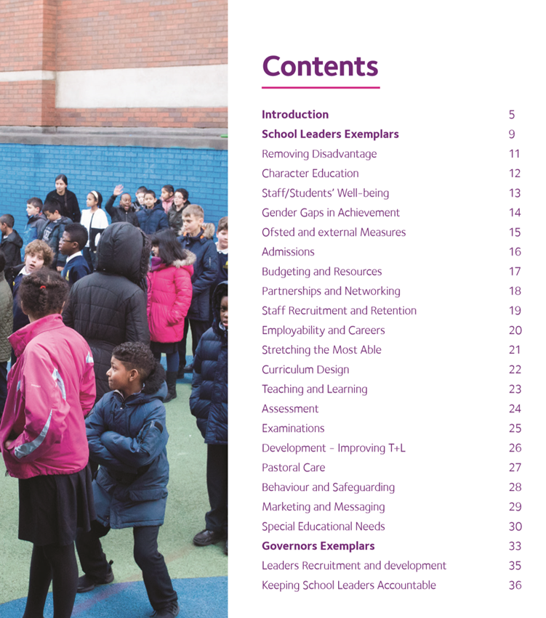
Notes:
Look together at Removing Disadvantage (as an example) – one group to take each strand… what resonated for you?

Slide 19
Educating for Wisdom, Knowledge and Skills
What is your philosophy of Teaching and Learning, and how clearly does every member of staff understand and share it? Does this differ at all from your technical expectations of teachers within lessons?

Slide 20
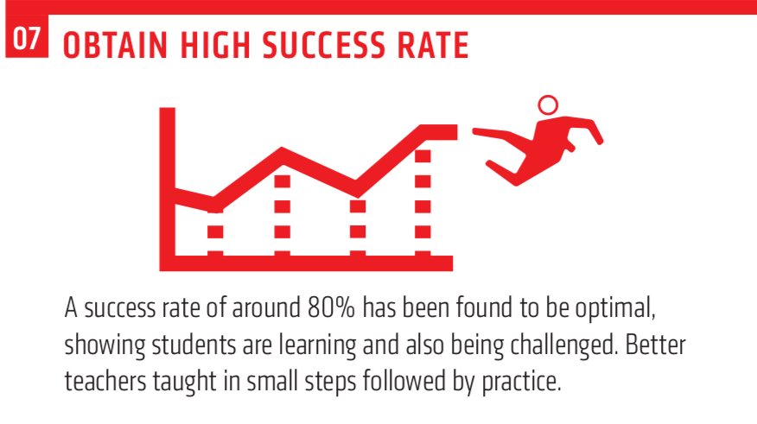
Does your philosophy of T&L differ at all from this technical expectation of teachers within lessons, for example?
From Barak Rosenshine’s Principles of Instruction, as presented by Oliver Caviglioli

Slide 21
Theology of Educational Leadership Practices Matrix (2019)

Slide 22
 | Called | Connected | Committed
Educating for Wisdom, Knowledge and Skills | Leading Learning - Refining Judgement | Creating Confidence - Embracing Interdependence | Deepening Understanding - Driving Improvement
Educating for Hope and Aspiration | Developing Imagination - Nurturing Ambition | Healing Relationships - Pursuing Renewal | Sustaining Vision - Building Resilience
Educating for Community and Living Well Together | Removing Disadvantage - Seeking Reconciliation | Accepting Vulnerability - Demonstrating Generosity | Inspiring Faithfulness -Embodying Integrity
Educating for Dignity and Respect | Celebrating Diversity - Enabling Flourishing | Offering Encouragement - Encouraging Service | Practising Humility - Learning Love

Slide 23
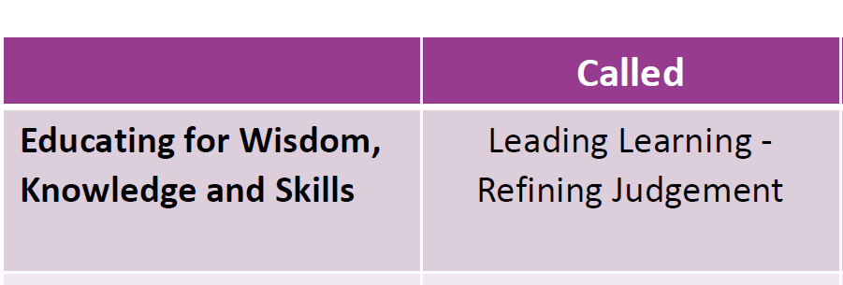
Models effective practice in the skills and understanding of pedagogy
Shows discerning judgement when difficult decisions need to be made

Slide 24
