Slide 1
Peer Support Network:
Well-being and resilience
Emily Norman
Head of Networks, Church of England Foundation for Educational Leadership
13th January 2020

Slide 2
Reflection

Slide 4
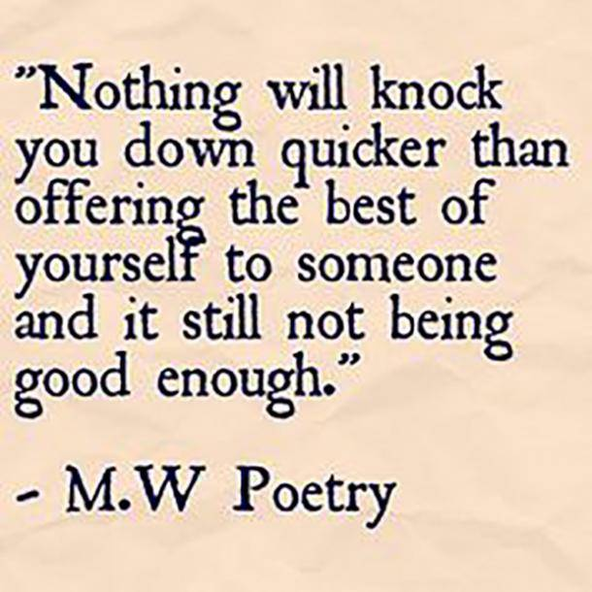
…countering our dominant educational meta-narrative of ‘not good enough’…

Slide 6
Defining our Current Reality

Slide 7
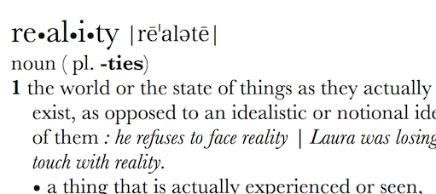
Can Vision be too idealistic? Rose-tinted? Inspirational? Transformational?
What is your actual lived experience? Is the first step of great leadership defining reality accurately?

Slide 8
Evaluating Prevailing Narratives

Slide 9
Thin Narratives | Thick Narratives
Utilitarian/ Instrumentalist | Wisdom, Knowledge and Skills (for living well)
Competitive | Hope and Aspiration (through forgiveness and grace)
Individualistic | Community and Living Well Together (created for life together)
Reductionist | Dignity and Respect (of every person)

Slide 10
Activity: Evaluating Prevailing Narratives

Slide 11
Are there any tensions between how I see my ‘calling’ and the educational landscape today?
Notes:
Is tension always a bad thing?

Slide 12
How far do the challenges we face provide opportunities for us to demonstrate our values?

Slide 13
‘Called’
Leadership

Slide 14
Called:
“Leaders who are called can articulate a strong sense of personal vocation to their role, and demonstrate this through their words, actions and decision making, exemplifying a strong moral purpose, confident vision, and ambitious trajectory of improvement. For some, this sense of vocation will be driven by an established or developing faith commitment. They show integrity, honesty and a deep sense of resilience, underpinned by their personal sense of vocation as a leader.”
Notes:
5 minutes
BEFORE GOING TO LUNCH, lets go back to our starting point.
Take a moment on your own to note down:
What has struck you during this morning’s session.
What actions will you take as a consequence
Share with a partner.

Slide 15
Notes:
From ‘Let your life speak’

Slide 16
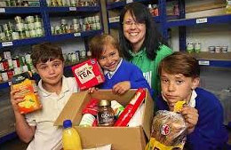
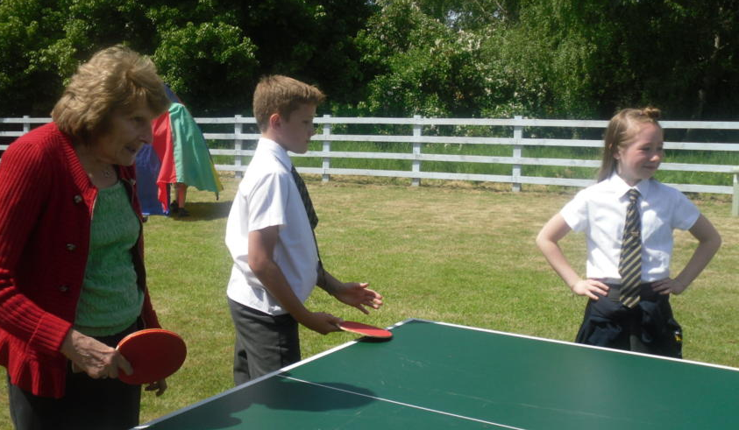
“Your vocation in life is where your greatest joy meets the world’s deepest need.”
Frederick Buechner

Slide 17
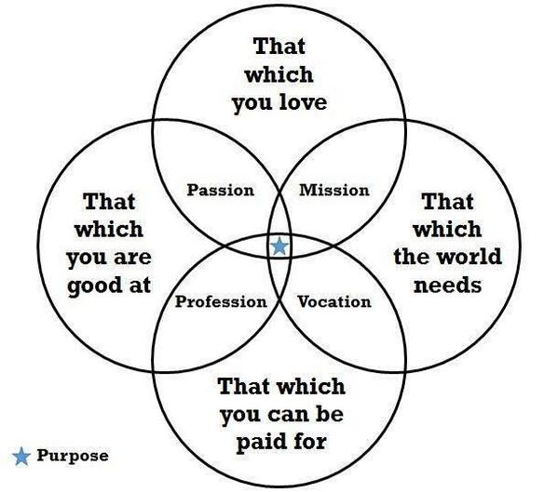
What do you consider your ‘calling’, ‘vocation’ or ‘purpose’ to be?
Is this something which has changed through your life?
What difference does this make to how you lead?
Notes:
Harold Koebler

Slide 18
Children
‘Life in all its fullness’
Adults
Teams

Slide 19
We flourish because of our diversity and relationships
We flourish at different times and different speeds
Flourishing Teams
Flourishing Adults
We flourish so we can look outwards and give
Flourishing Children
We flourish when we stop doing things

Slide 20
Transference of fear
MACRO
Ecology of blessing
OR
SCHOOL LEADERS
STAFF
PUPILS

Slide 21
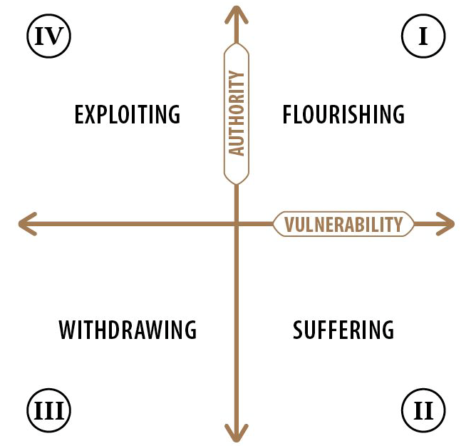

Slide 22
Where might different members of your school community be on this chart?
What needs to happen for them in order for them to flourish?
Where would the different case study characters be on this chart?
What needs to happen for them in order for them to flourish?

Slide 23
What one thing could you do (or stop doing) tomorrow that would increase your flourishing?
What difference would this make to those you lead, teach or meet?

Slide 24
Myself as a Leader

Slide 25
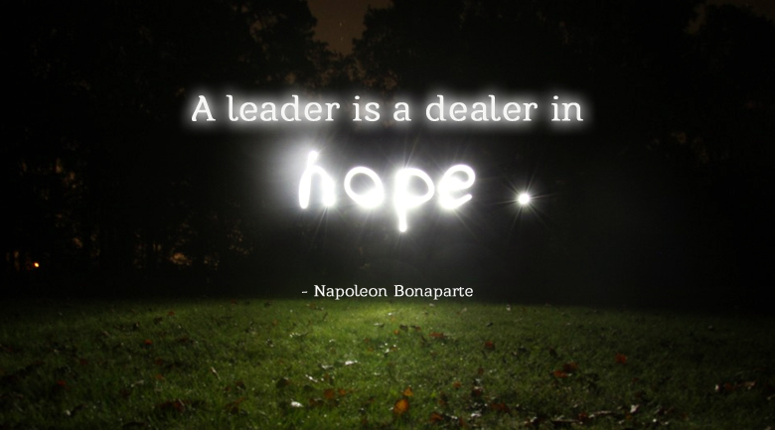

Slide 26
‘All she could do was hope, and she kept trying to do that, in spite of the fear and the loneliness.’

Slide 27
Sage/Guide/Expert/
Enthusiast
Resourced/Trusted/
Revered
Expectations for Leadership
Storyteller/Evangelist/
Salesperson
Energy/Passion/Love/
Time
Notes:
10 mins activity

Slide 29
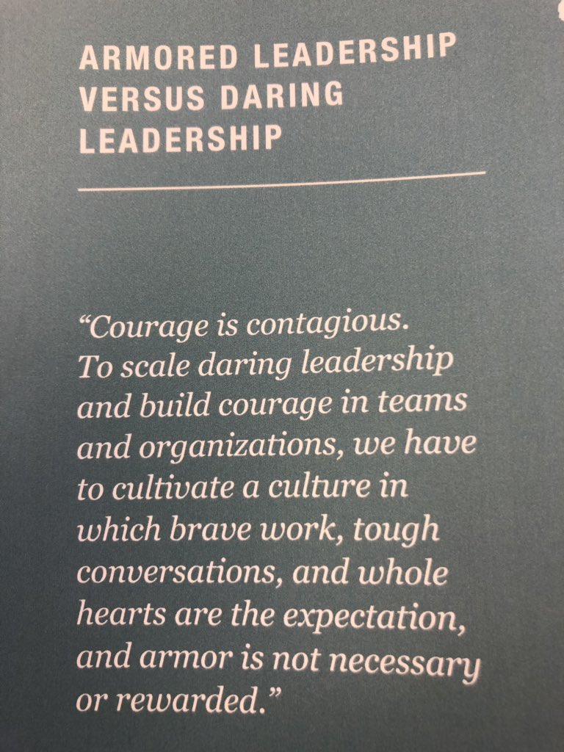
Daring leadership
Brené Brown
https://www.inc.com/dr-brene-brown/figure-out-what-makes-you-vulnerable.html

Slide 30
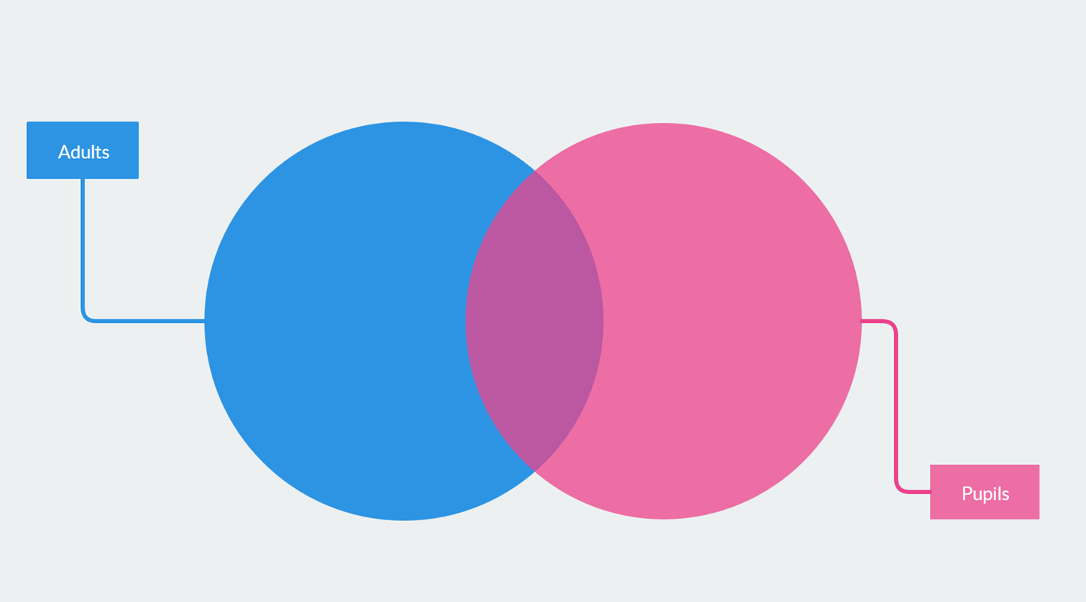
What difference would it make if you replaced the word ‘teachers’ with ‘school leaders’ and the word ‘students’ with ‘school staff’?

Slide 31
‘Leadership is an activity that leads other people into full humanity: which enables them to take hold of, and take responsibility for, the life that they, as a unique, particular person within the created human race, have been given to live.’
Simon P. Walker

Slide 32
Simon P Walker Undefended Leadership
‘Front stage and back stage’
Is who you are on the ‘front stage’ the same as who you are ‘backstage’?
Notes:
Think about appropriateness of ‘front stage’ behaviours – time and place. But what if our ‘back stage’ leaks out into our front stage? Eg through anxiety, anger, resentment, feeling unvalued…etc? how do these two impact on each other?

Slide 33
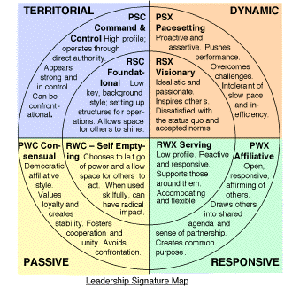
Where do you see yourself on this diagram?
What difference does that make to your school community?

Slide 34
Leadership of Character Education: 3 Leadership Models
Model | Fullan | Kotter | Spears
Type: | Transformational (based on relationship not transaction) | Change-management | Servant Leadership
From: | MacGregor Burns (1978) | Kotter (1995) | Greenleaf (1975)
Characterised by: | Energy, enthusiasm and hope; vision leading to higher moral purpose | Urgency, vision, motivating troops, acceleration via quick wins | Listening & empathy, looking to the needs of others, building community
Useful for: | Where the school needs re-energising with vision and purpose | When immediate change is required | Embedding values long-term
Leadership of Character Education, 30-37

Slide 35
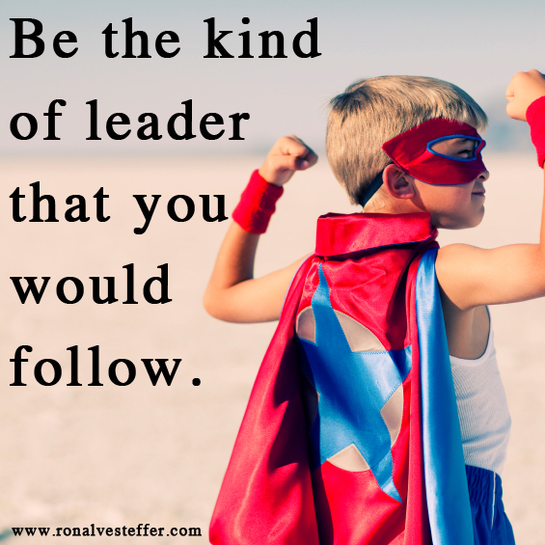
What sort of leader are you?
What does that mean for your school?

Slide 36
Called, Connected, Committed: 24 Leadership Practices (2020)

Slide 37
 | Called | Connected | Committed
Educating for Wisdom, Knowledge and Skills | Leading Learning - Refining Judgement | Creating Confidence - Embracing Interdependence | Deepening Understanding - Driving Improvement
Educating for Hope and Aspiration | Developing Imagination - Nurturing Ambition | Healing Relationships - Pursuing Renewal | Sustaining Vision - Building Resilience
Educating for Community and Living Well Together | Removing Disadvantage - Seeking Reconciliation | Accepting Vulnerability - Demonstrating Generosity | Inspiring Faithfulness -Embodying Integrity
Educating for Dignity and Respect | Celebrating Diversity - Enabling Flourishing | Offering Encouragement - Encouraging Service | Practising Humility - Learning Love

Slide 38
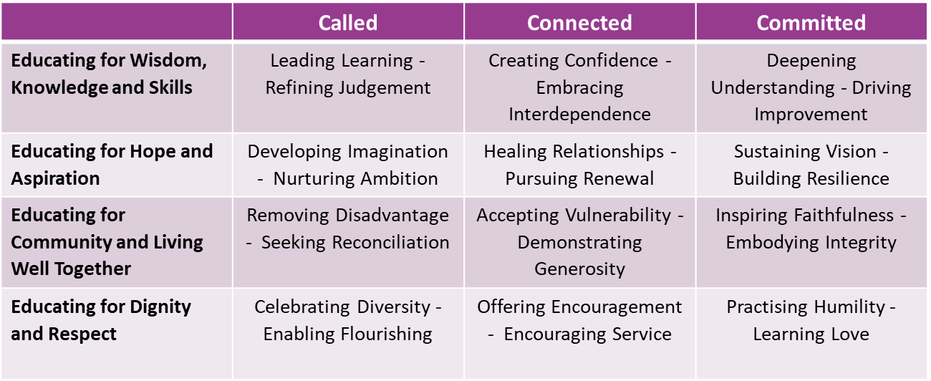
Leadership Practice Gap Analysis
For each leadership practice, think about where the strengths in your school are. Can you think of a person (or people) who particularly demonstrate(s) that practice?
Now look where the gaps are. What could you do to encourage this practice more within your organisation?

Slide 39
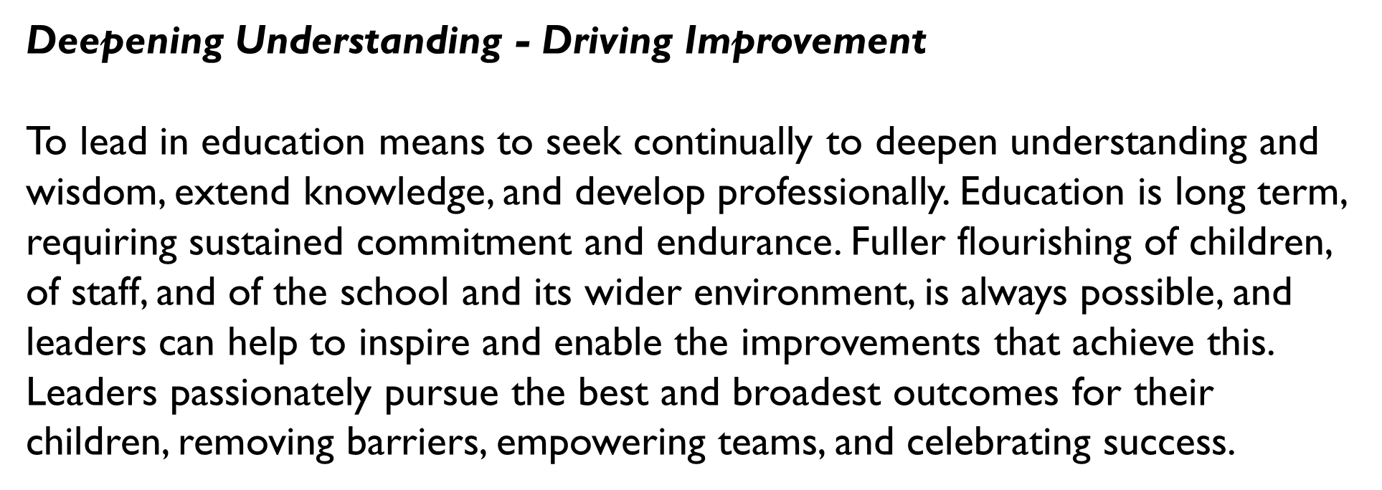
The Leadership Practice ‘deep dive’
Notes:
Try to focus on a LP which is under-represented in your gap analysis

Slide 40
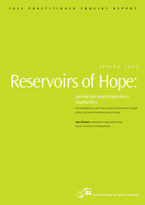
Further Reading
https://dera.ioe.ac.uk/5117/1/media-75c-a0-reservoirs-of-hope-full.pdf

Slide 41
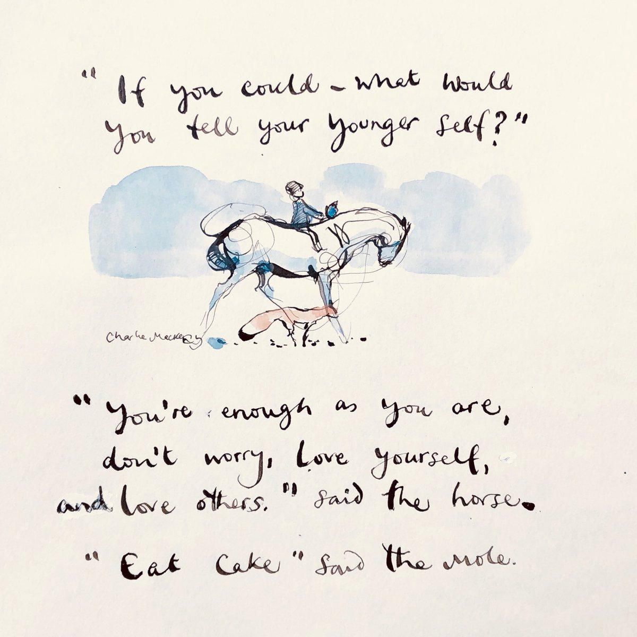
How far do you nurture your own flourishing?
What impact does this have on
your school community?
What are your next steps for
developing well-being within
your school?

