Slide 1
Chester Diocese Peer Support Network: Growing Faith
30.1.20

Slide 2
Reflection

Slide 3


Slide 4
‘Life in all its fullness’
Educating for Wisdom, Knowledge and Skills
Educating for
Hope and Aspiration
Educating for Community and Living Well Together
Educating for Dignity and Respect

Slide 6
Why a Growing Faith network?

Slide 7
What do we mean by Growing Faith?

Slide 8
Growing Faith ‘separately’ in Schools, Churches and Households

Slide 9
Schools
Households
Churches
The
Growing Faith Intersection
Our primary focus for Growing Faith is the intersection between 2 or more of the elements
Our understanding of young people’s faith development is that it much more likely to happen, and be sustained if it happens in the intersection

Slide 10
AIMING FOR THE CENTRE
…becoming a community of faith where children and young people are INCLUDED and
VALUED as
EQUAL MEMBERS – Fellow Pilgrims.

Slide 11
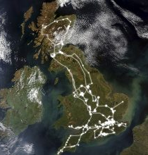


The Growing Faith Adventure seeks to look at this through thinking about:
Connected Communities
Spiritual Encounters
Imaginative Practices

Slide 12
Connected Communities

Slide 14
‘Christian faith is discovered, formed and grown in community.’
Who or what within your community do you think are the greatest influences on the way young people think about faith or religion?

Slide 16
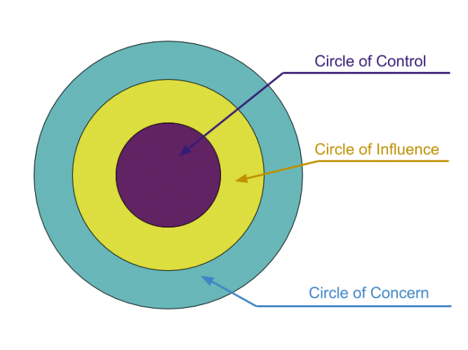
Circles of Influence
Adapted from Stephen Covey
Which do you have control over?
Which can you influence?
Which can you not control, but have the potential to impact?

Slide 17

‘Faith is nurtured through interactions between people, and further enriched when this happens across generations.’

Slide 19
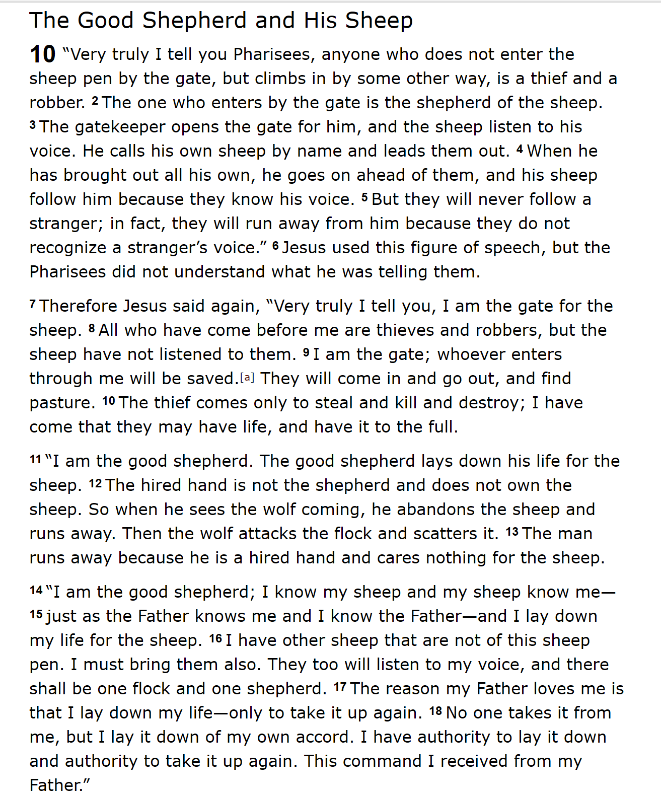
Identity – being known and heard
Commitment – investing for the long haul
Empowering – creating a pathway for possibilities
Inclusion – welcoming and including others
Authenticity – authority used to serve, not control

Slide 20
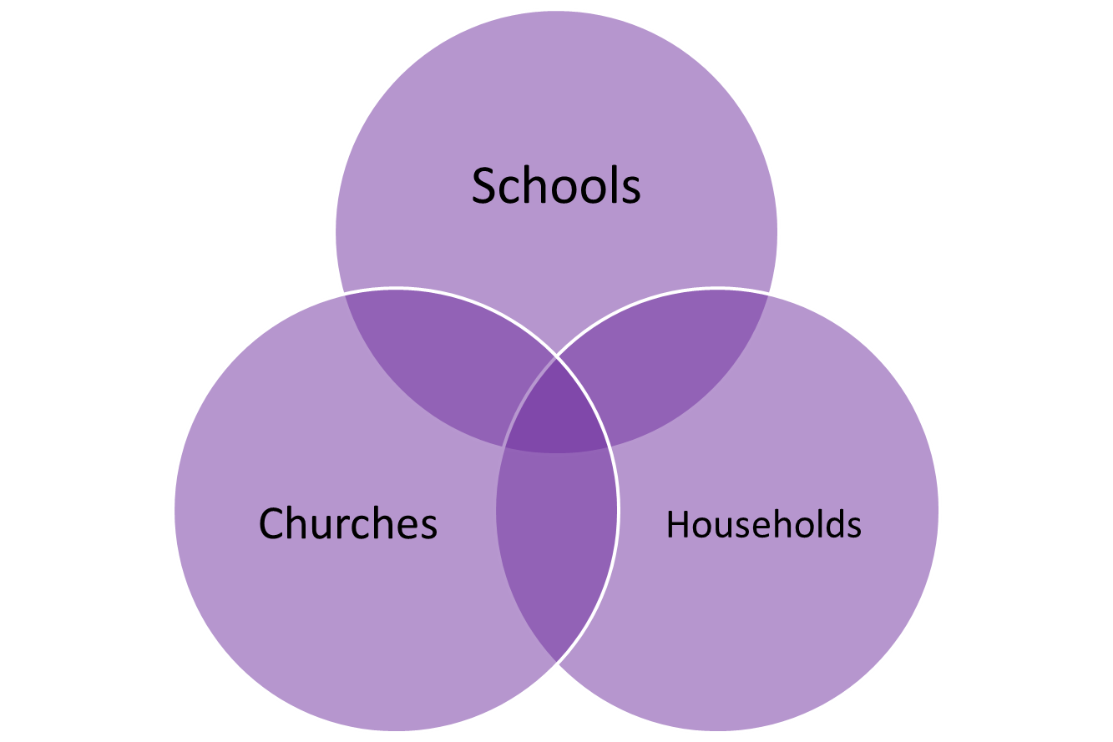
In which spheres are we providing opportunities for ‘John 10’ flourishing?
Identity
Empowering
Authenticity
Commitment
Inclusion

Slide 22
Spiritual Encounters

Slide 24

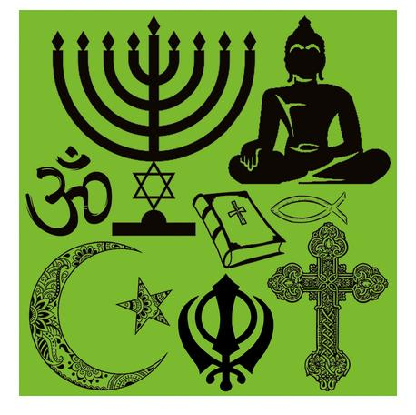
Faith formation is a process – a journey that starts with spirituality and may be expressed through faith.
There is a crucial difference between creating an ethos of spiritual/faith formation and the provision of religious education.

Slide 25
What is the difference between spirituality and faith?
Spirituality:
  an innate sense of awe and wonder; there’s something or someone more than just me
Faith:
  our response to God;
  making a difference to the life that we live

Slide 26
UNCRC 1989
Religion is identified as a matter of mind, belief and practise, part of cultural expression associated with minority rights and human equality.
Spirituality is identified as an aspect of human development and overall human health.
Notes:
In 1989 the UNCRC recognised both religion and spirituality, made provision for both within the convention, and saw both as a right
RELIGION – a matter of mind, choice
SPIRITUALITY – important for healthy development
Articles 14, 29 & 30 are concerned with religious rights
Articles 17, 27 & 32 are concerned with spirituality
Article 14 States Parties shall respect the right of the child to freedom of thought, conscience and religion
Article 17 States Parties recognize the important function performed by the mass media and shall ensure that the child has access to information and material from a diversity of national and international sources, especially those aimed at the promotion of his or her social, spiritual and moral well-being and physical and mental health.
Article 27 1. States Parties recognize the right of every child to a standard of living adequate for the child’s physical, mental, spiritual, moral and social development.
Article 29 (d) The preparation of the child for responsible life in a free society, in the spirit of understanding, peace, tolerance, equality of sexes, and friendship among all peoples, ethnic, national and religious groups and persons of indigenous origin;
Article 30 In those States in which ethnic, religious or linguistic minorities or persons of indigenous origin exist, a child belonging to such a minority or who is indigenous shall not be denied the right, in community with other members of his or her group, to enjoy his or her own culture, to profess and practise his or her own religion, or to use his or her own language.
Article 32 States Parties recognize the right of the child to be protected from economic exploitation and from performing any work that is likely to be hazardous or to interfere with the child’s education, or to be harmful to the child’s health or physical, mental, spiritual, moral or social development.

Slide 27
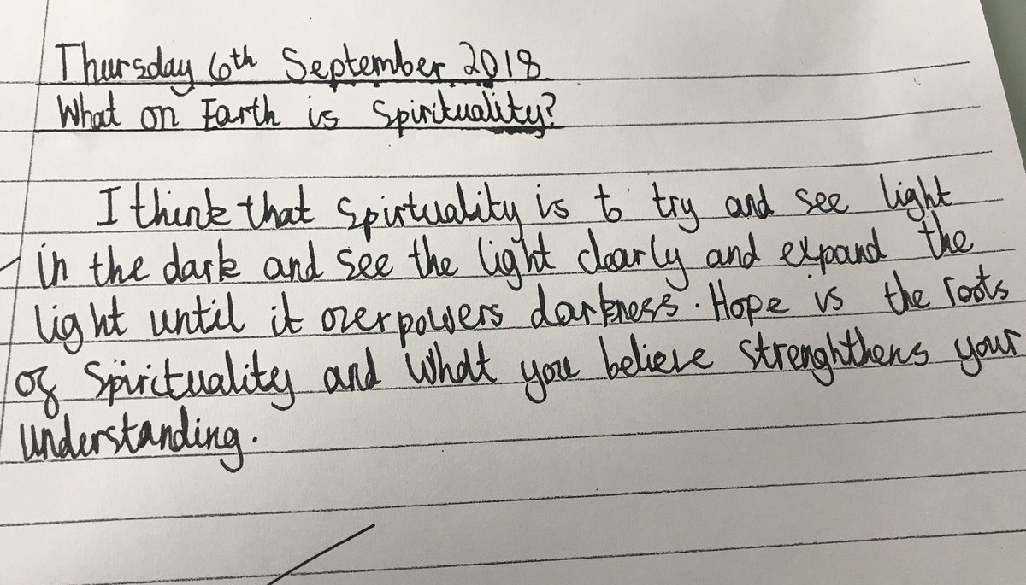
How do we understand Spirituality?
Year 6 pupil

Slide 28
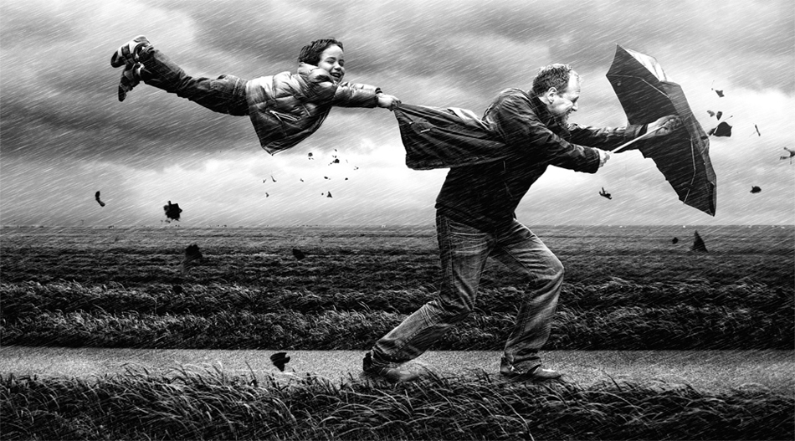
Spirituality is like the wind
Notes:
Very hard to pin down!! And very difficult to define – so much so that most people have their own understanding or working definition.

Slide 30
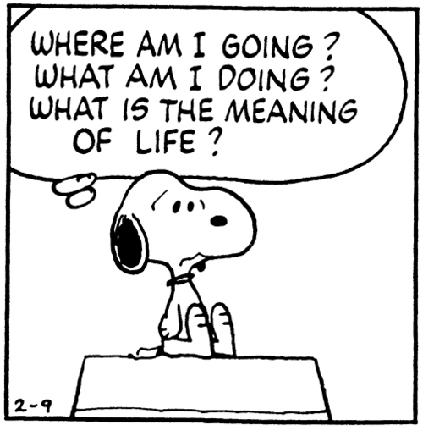
What sort of existential questions might arise for children and young people?
What might trigger these questions?

Slide 31
Left to their own devices (children) will likely become religious in some sense but probably in a sense more like what you would call superstition than a thoughtful, sophisticated belief and behaviour system.
Failure to provide….a system of beliefs and practices refined and honed through generations of theological debate, philosophical scrutiny and collective experience, may leave them open to religious extremism, catchy anecdotes from charismatic spiritualists, or buffet-style ……from various available traditions, whether or not they actually make sense together.
Justin L. Barrett – Born Believers, 2012

Slide 33

What gets in the way of spiritual flourishing?

Slide 34
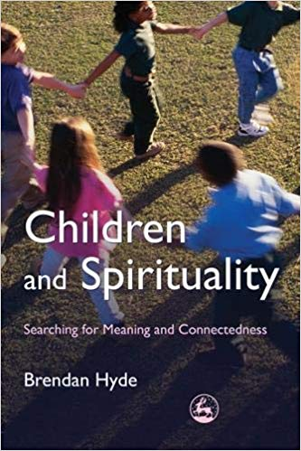
Getting in the way of spiritual flourishing
Material pursuit
  Disconnection with Other
  Affirmation in material excess
Trivialising
  Masking of inner feelings and values
Lack of time
  Busyness of adults
  Lack of space for stillness and listening
Notes:
Brendan Hyde in Children and Spirituality

Slide 35

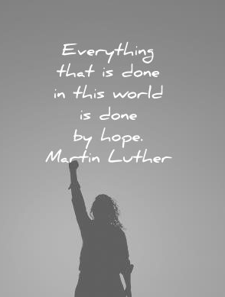
What can break through these barriers?

Slide 36

To flourish spiritually, children need:
Time be listened to
Respectful adults
Space to explore
Opportunities to wonder
To know there is another way

Slide 37
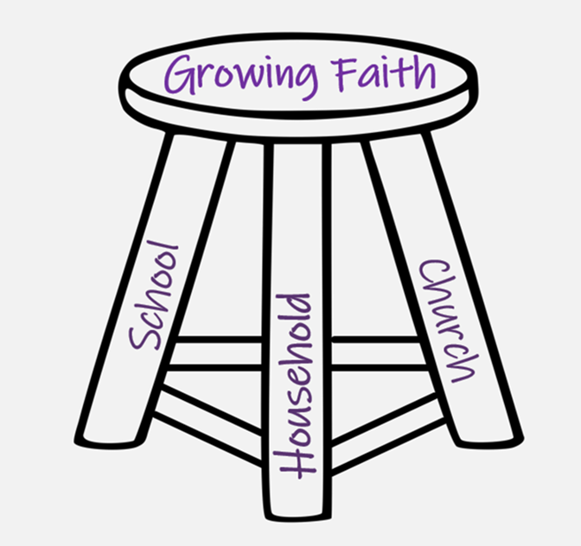
Where is this already happening…
in school?
at church?
within households?
Where are the opportunities to develop this further?

Slide 38
Imaginative Practices

Slide 40

‘Creation is only possible in the liminal space between order and chaos.’
John Polkinghorne
Notes:
What does this mean for your context? Are there opportunities for creation of new ideas? How comfortable are you with the idea of ‘chaos’? What sort of ‘order’ is required for faith to grow?

Slide 41

“…to nurture, nourish and evoke a consciousness and perception alternative to the consciousness and perception of the dominant culture around us.”

Slide 42
“The imagination must come before the implementation.
Our culture is competent to implement almost anything and imagine almost nothing.
It is our vocation to keep alive the ministry of imagination”

Slide 43
Leading Courageously, Inspiring Hope
CRITICISE
ENERGISE

Slide 44

Making a new box
“… Growing Faith requires ‘thinking in a new box’, not merely innovating within the existing box…
It requires an intentional choice to look for the new ideas together rather than accept the same old ideas repackaged as new resources and products.”

Slide 45

Called, Connected, Committed:
24 Leadership Practices for Educational Leaders (2020)

Slide 46
 | Called | Connected | Committed
Educating for Wisdom, Knowledge and Skills | Leading Learning - Refining Judgement | Creating Confidence - Embracing Interdependence | Deepening Understanding - Driving Improvement
Educating for Hope and Aspiration | Developing Imagination - Nurturing Ambition | Healing Relationships - Pursuing Renewal | Sustaining Vision - Building Resilience
Educating for Community and Living Well Together | Removing Disadvantage - Seeking Reconciliation | Accepting Vulnerability - Demonstrating Generosity | Inspiring Faithfulness -Embodying Integrity
Educating for Dignity and Respect | Celebrating Diversity - Enabling Flourishing | Offering Encouragement - Encouraging Service | Practising Humility - Learning Love

Slide 47
Which leadership practices might we need to develop in order to grow faith in our community?
Choose 1 to explore in detail

Slide 48

How will we begin to develop this with...?
Parents
School staff
Children & young people
Church members

Slide 49

Formulating research questions
What would you like to explore around ‘becoming a community of faith where children and young people are INCLUDED and VALUED as EQUAL MEMBERS – fellow pilgrims’?
How will you go about finding this out?
Who will you need to involve?

Slide 50
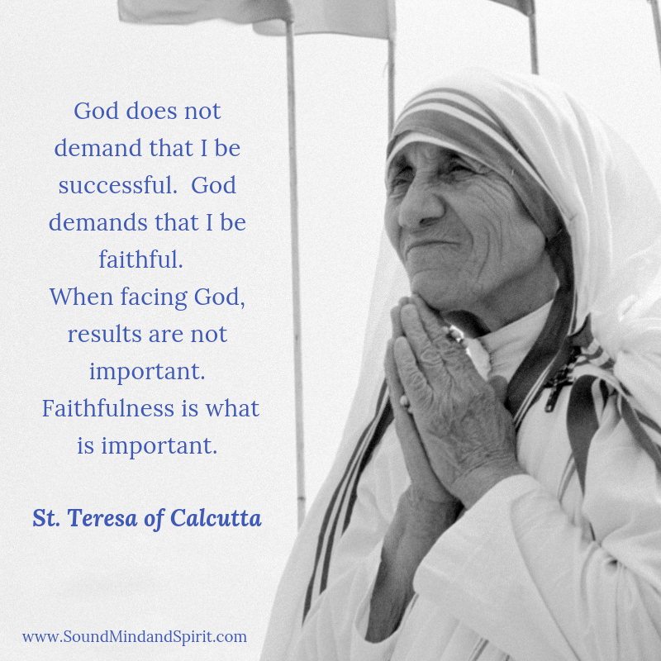
Inspiring Faithfulness

Slide 51


