Slide 1
Chester Diocese Peer Support Network: Visionary Curriculum Leadership – 30.1.20

Slide 2
Reflection

Slide 3

Developing Imagination

Slide 4
‘The imagination must come before the implementation. Our culture is competent to implement almost anything and imagine almost nothing. It is our vocation to keep alive the ministry of imagination.’
Walter Brueggemann The Prophetic Imagination
Notes:
This is a provocative statement from the reflection – do you agree with this?

Slide 5
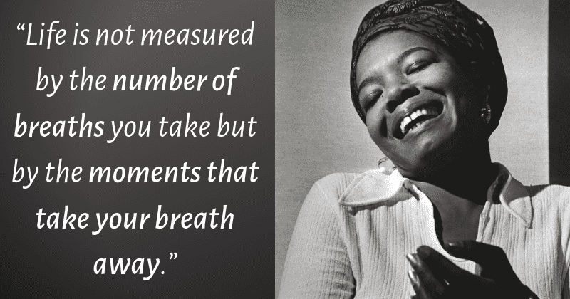
Notes:
Maya Angelou

Slide 6
Defining our Current Reality

Slide 7
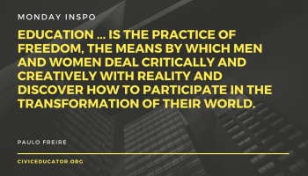

Slide 8
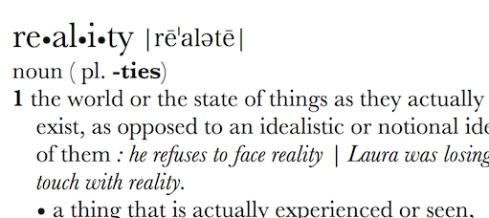
Can Vision be too idealistic? Rose-tinted? Inspirational? Transformational?
What is your actual lived experience? Is the first step of great leadership defining reality accurately?

Slide 9
How can we evaluate the prevailing educational narratives?
The importance of teaching (2010)
Schools that work for everyone (2016)
Every Child Matters (2003)
Educational Excellence Everywhere (2016)
Your child, your schools, our future (2009)

Slide 10
How can we evaluate the prevailing educational narratives?
‘A building with 4 walls and tomorrow inside’
‘Building a better world, one student at a time’
Learners Today. Leaders Tomorrow.
Imagine greatness. Knowledge is Power
‘Be safe. Be Kind. Be smart’

Slide 11
How can we evaluate the prevailing educational narratives?
Narrowing the horizons of learning – keeping it tight until May in Year 6
Every percentage point counts
Your child? Our unit of economic capital
Their results? My job.
Most children matter, some matter more than others

Slide 12
Thin Narratives | Thick Narratives
Utilitarian/ Instrumentalist | Wisdom, Knowledge and Skills (for living well)
Competitive | Hope and Aspiration (through forgiveness and grace)
Individualistic | Community and Living Well Together (created for life together)
Reductionist | Dignity and Respect (of every person)

Slide 13
Children
‘Life in all its fullness’
Adults
Teams

Slide 14
What do we mean by ‘human flourishing’?

Slide 15
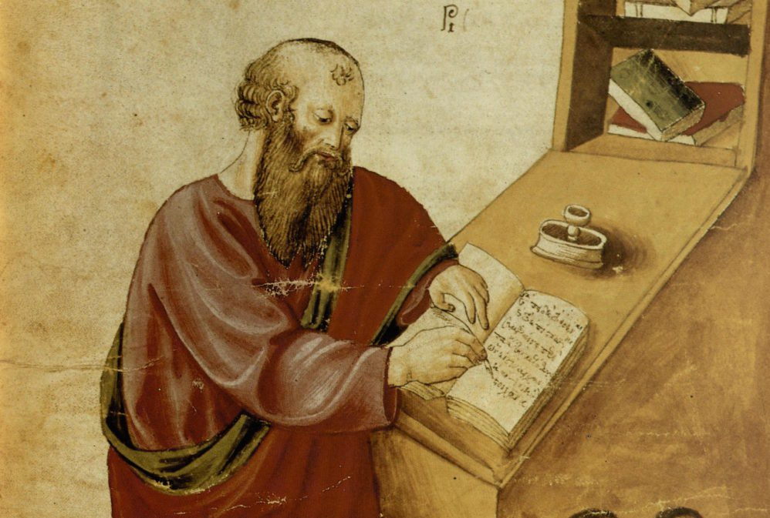
‘The notion of human flourishing set out in our thinking draws significantly on Aristotle, and especially on his conception of eudaimonia. The meaning of eudaimonia can be traced etymologically from its roots of ‘eu’ (good) and ‘daimon’ (spirit), refers to the notion of human flourishing and can…[refer to] physical flourishing, emotional flourishing, societal flourishing and fourthly, flourishing in terms of personal creativity, self-expression and knowledge seeking.’
Leadership of Character Education, 18

Slide 16

Genesis provides a picture of how things were meant to be – what it would mean to truly flourish…
Which, if any, of these words feel like ‘flourishing’ to you?

Slide 17
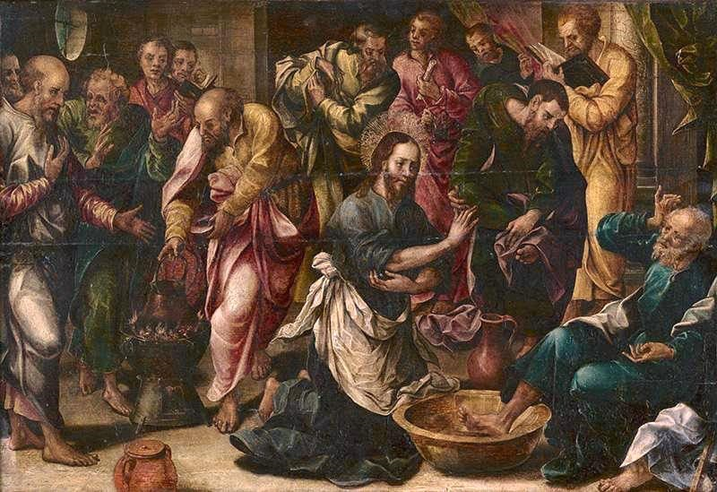
‘Love one another. As I have loved you, so you must love one another. By this, everyone will know that you are my disciples.’
John 13:34-5

Slide 18

‘[It is] not simply the task of the individual to become better by human effort alone, but rather improvement and development is the work of the Spirit in each individual.
The implications for school leadership are releasing, recognising that virtues can be prayed for and infused, rather than simply exhorting one another to work harder at developing them.’
Leadership of Character Education, 19

Slide 19
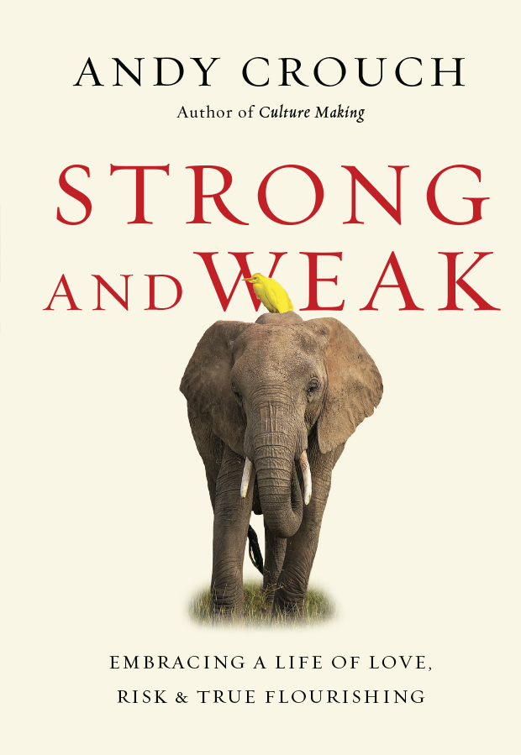
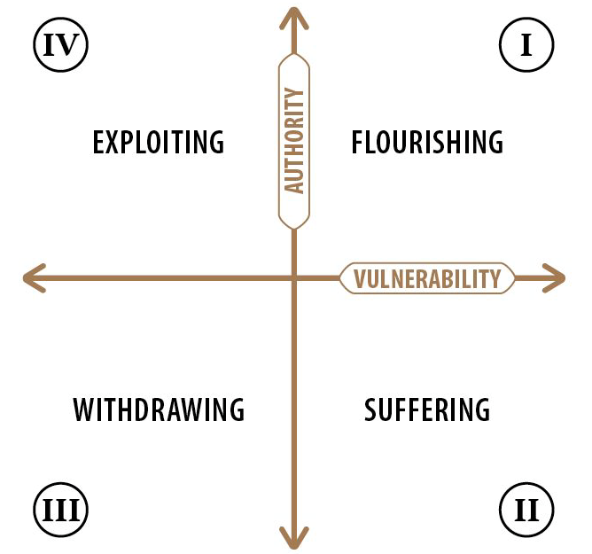
https://www.youtube.com/watch?v=GJ8ry2MyyVA
Notes:
Andy Crouch talks about flourishing as being found in the paradox of being both strong and weak at the same time, having both authority and vulnerability… He explains it well in the youtube clip!

Slide 20

How can we enable flourishing of pupils (and adults!) through our curriculum?
Where are the opportunities for risk?
Where are the opportunities to take the lead?
Where might children withdraw – is this more likely in some subjects than others? What could we do to mitigate this?
Notes:
Use Crouch’s model of flourishing to look at the curriculum and how far children are enabled to flourish through different subjects/ approaches.

Slide 21
Children
‘Life in all its fullness’
Adults
Teams
Notes:
Vision for education puts ‘life in all its fullness’ ie flourishing for all humans at its centre. Not just for children but for adults and communities too. We will return later to what we mean by human flourishing.

Slide 22
We flourish because of our diversity and relationships
We flourish at different times and different speeds
Flourishing Teams
Flourishing Adults
We flourish so we can look outwards and give
Flourishing Children
We flourish when we stop doing things
Notes:
How far does our curriculum give out to others? Where are the opportunities for social action. You could look at the work of #iwill here to think about youth social action opportunities.

Slide 23
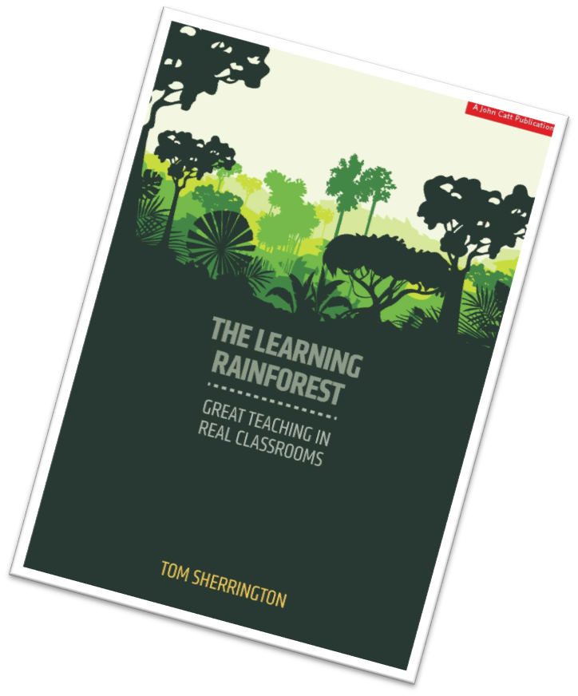
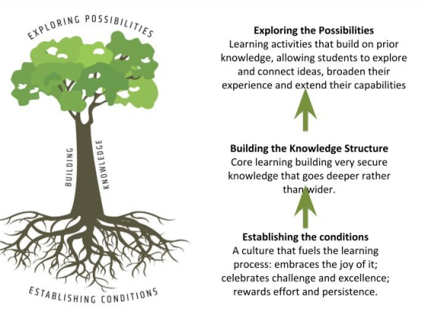
Notes:
Tom Sherrington talks about children as trees, unique and diverse. They need an environment in which they can develop strong roots (foundations), the trunk grows strong through the acquisition of knowledge and the foliage grows through exploration and discovery.

Slide 24
Learning Plantation | Learning Rainforest
‘A right way to do things’ – set routines – e.g. L.O. on the board every lesson | Nourishing individual talents - high trust/high challenge
Leaders driven by compliance to external voices | Great variety in pedagogy and OK to try new things all the time
T+L focused on what can be examined | If creative approaches deliver, there is high level of autonomy
Data has very high status | Data is part of the picture of learning
Interventions heavily focused on short-term gains | T+L structures are dynamic/organic, aligning T+L to stated school values
Creativity becomes rules – e.g. standardised homework format etc. | Highly personalised CPD
Notes:
Sherrington compares a plantation (all trees the same and in orderly rows) and a rainforest (wild and creative). Are we providing plantation environments for children or rainforests? We need to realise that it isn’t necessarily that plantation is bad and rainforest good, but that children actually need a bit of both. Think eg of ASD children. Sherrington suggests a ‘managed rainforest’ as the thing to aim for.
How much of our curriculum is plantation and how much is curriculum?

Slide 25
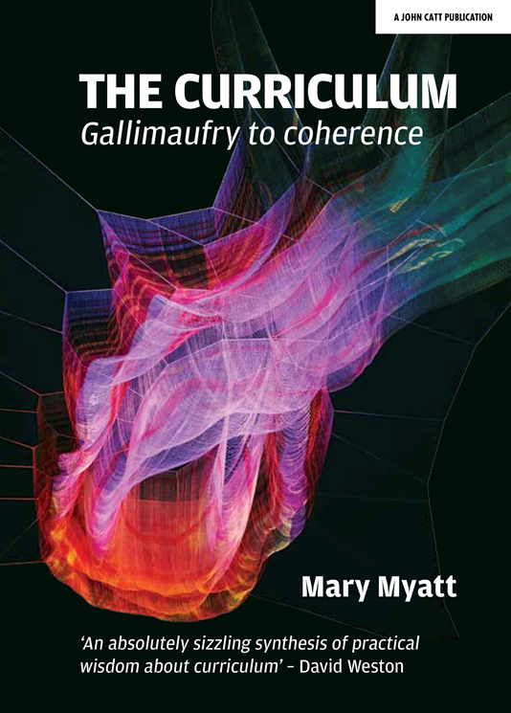
‘The job of a good curriculum is to inspire teachers, not instruct them’
Russell Hobby
‘Knowledge is power. Information is liberating’
Kofi Annan
‘It is not the beauty of a building you should look at; it’s the construction of the foundation that will stand the test of time.’
David Allen Coe
‘Question everything. Learn something’
Euripides
Notes:
Introduce Mary Myatt’s book. Here are some people she quotes in her book. What do you make of these comments? Do you agree, disagree? What are the implications for your own curriculum?

Slide 26

Read ‘Curriculum Purpose’
What stands out to you?
Is there anything here you might not have considered?
How far would children in your classes be able to say ‘we are learning this so that…’

Slide 27
Designing a Curriculum for Wisdom

Slide 28
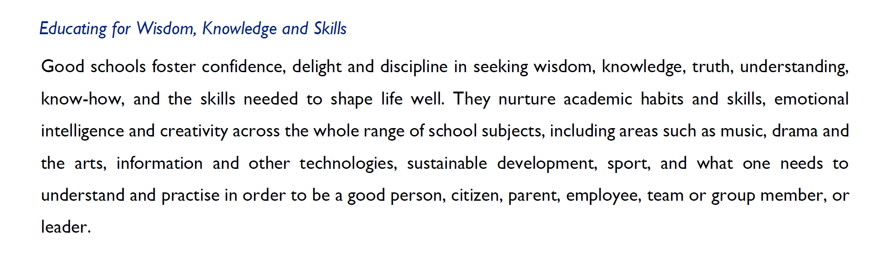
Notes:
There is much debate about knowledge and skills, but what about wisdom? This element of the vision brings an extra dimension. You can look here at the pages in the vision document (attached) with highlighters, looking at key words and phrases which define WISDOM.

Slide 29
Wisdom is…
Wisdom is a shared conversation not a one-way transaction
Wisdom is reliant on one expert, but seeks other views
Wisdom is reading slowly and widely
Wisdom is connecting and synthesising, re-using and rejecting
Wisdom loves detail, not just superficiality
Wisdom unleashes imagination
Wisdom needs diversity, not just because it’s right but because it’s inherently better
Wisdom is making choices, sometimes between two seemingly good things
Wisdom is inherited from those in community & family around us
Wisdom always permits good questions, but has the confidence to articulate clear answers
Wisdom views mistakes with perspective
Can you replace ‘wisdom’ with ‘learning’ in these phrases?
Notes:
From Andy Wolfe – what if we replace ‘wisdom’ with ‘learning’?

Slide 30
Notes:
Give out handouts with this slide and the next one on – get participants to think of how this relates to their curriculum. This one relates to a type of bridge which is made safe by being in tension. In this case, tension is a good thing! Where might the tensions between knowledge and wisdom be in our curricula?

Slide 31
Notes:
Use the handout to think through one subject – the knowledge content goes in the centre, surrounded by the wisdom needed within that subject. Wisdom will be things like wise decision making, holding a breadth of views and understanding, considering the relational aspects of a subject etc…

Slide 32
Ethos Enhancing Outcomes

Slide 33

“If the Vision for Education fails to make and sustain meaningful connections between a school’s ethos and its outcomes, it will become nothing more than a deeply eloquent and well-meaning piece of writing…”

Slide 34
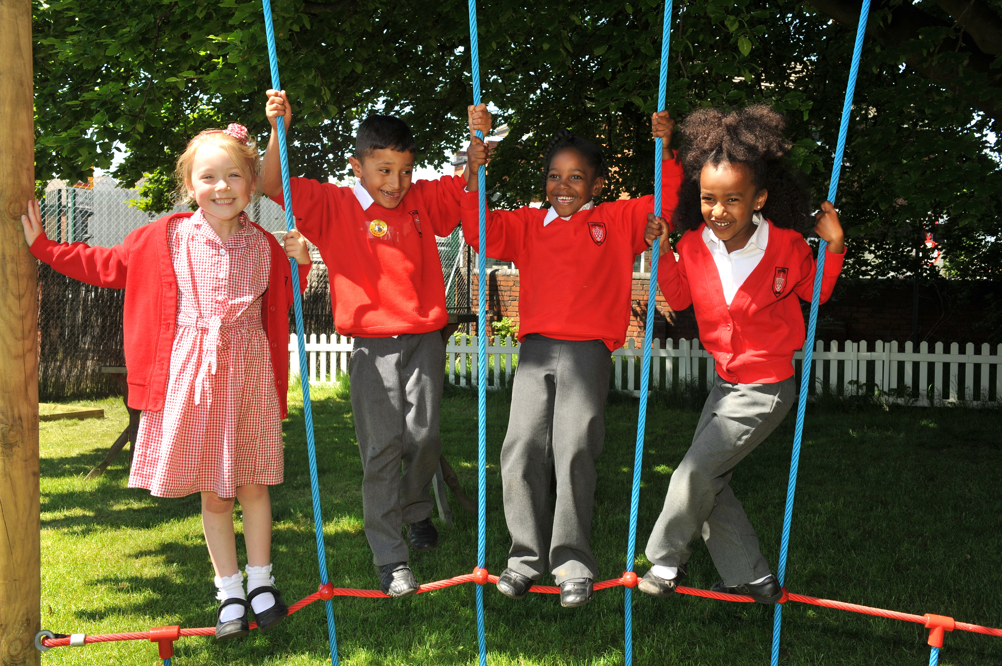
“..It must come off the shelf and be brought to life through leaders evaluating its potential impact on every area of day-to-day school life…”

Slide 35
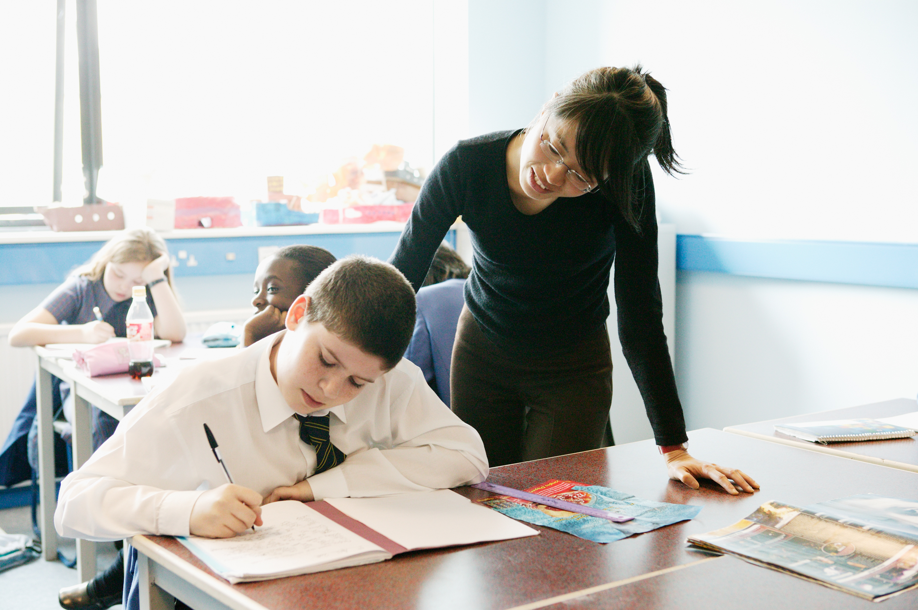
“…This dynamic and enhancing connection between ethos and outcomes is what we mean by ‘Bringing the Vision Alive.’”

Slide 37
What outcomes are you trying to improve?
What are the pressures and challenges?
Who defines this journey?
What help could the Vision offer you?
ethos
enhancing
outcomes
How do you define this for your school?
(in a sentence…)
Where does your ethos come from?
What are the commonalities and differences between us?
What difference does it make to your lived reality?

Slide 38
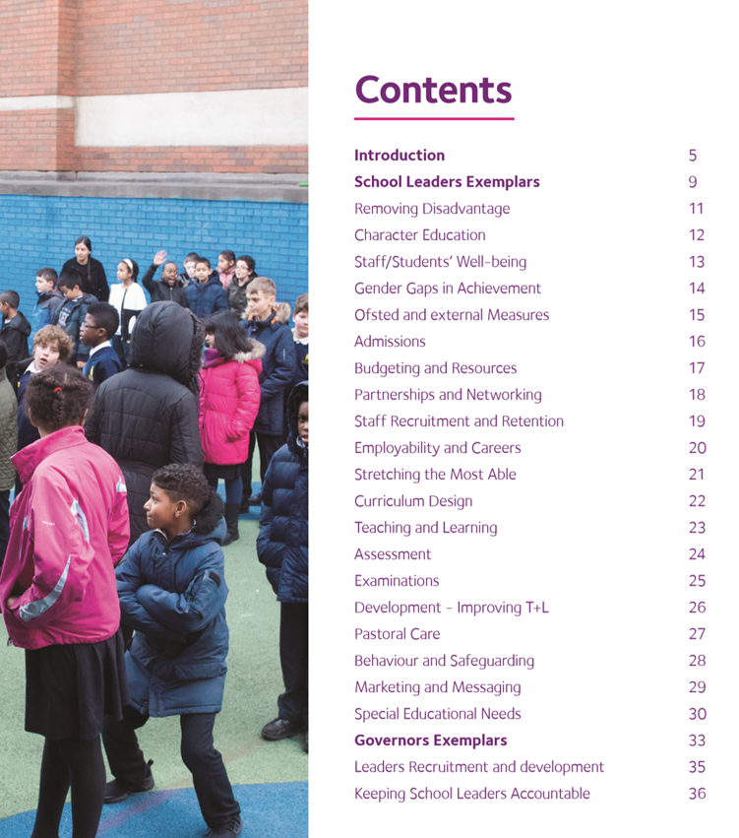


Slide 39

Formulating research questions
What would you like to explore around how visionary curriculum leadership in your school can enable the flourishing of pupils, adults and teams?
How will you go about finding this out?
Who will you need to involve?

Slide 40


