Slide 1
Peer Support Network: Curriculum – Blackburn 19th November

Slide 2
Reflection

Slide 3

Developing Imagination

Slide 4
‘The imagination must come before the implementation. Our culture is competent to implement almost anything and imagine almost nothing. It is our vocation to keep alive the ministry of imagination.’
Walter Brueggemann The Prophetic Imagination

Slide 5
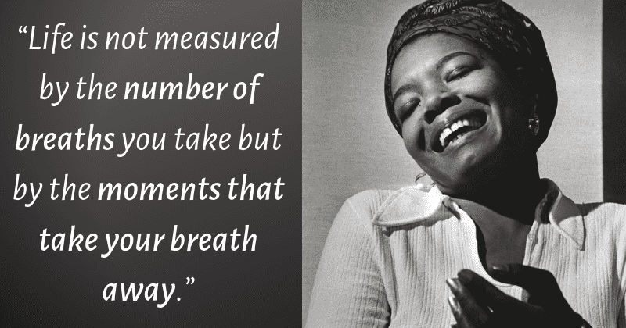

Slide 6
What is the Curriculum for?

Slide 7
Children
‘Life in all its fullness’
Adults
Teams

Slide 8

‘The job of a good curriculum is to inspire teachers, not instruct them’
Russell Hobby
‘Knowledge is power. Information is liberating’
Kofi Annan
‘It is not the beauty of a building you should look at; it’s the construction of the foundation that will stand the test of time.’
David Allen Coe
‘Question everything. Learn something’
Euripides

Slide 9

Read ‘Curriculum Purpose’
What stands out to you?
Is there anything here you might not have considered?
How far would children in your classes be able to say ‘we are learning this so that…’

Slide 10
Wisdom in the Curriculum

Slide 11
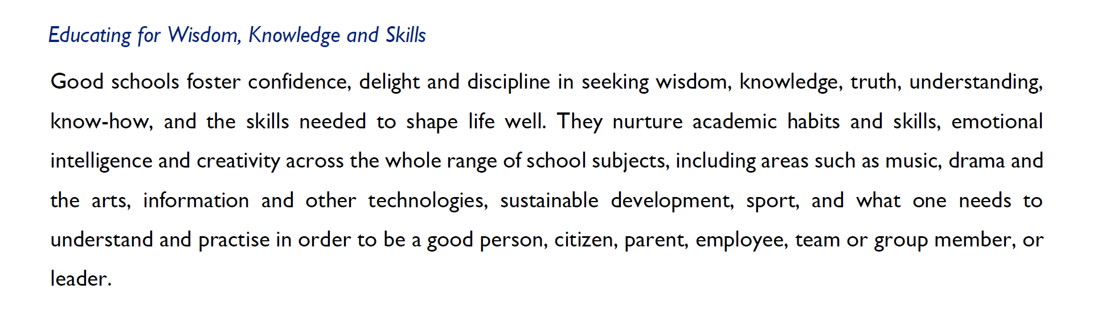

Slide 12
Wisdom is a shared conversation not a one-way transaction
Wisdom is reliant on one expert, but seeks other views
Wisdom is reading slowly and widely
Wisdom is connecting and synthesising, re-using and rejecting
Wisdom loves detail, not just superficiality
Wisdom unleashes imagination
Wisdom needs diversity, not just because it’s right but because it’s inherently better
Wisdom is making choices, sometimes between two seemingly good things
Wisdom is inherited from those in community & family around us
Wisdom always permits good questions, but has the confidence to articulate clear answers
Wisdom views mistakes with perspective

Slide 15
What do we mean by ‘human flourishing’?

Slide 16
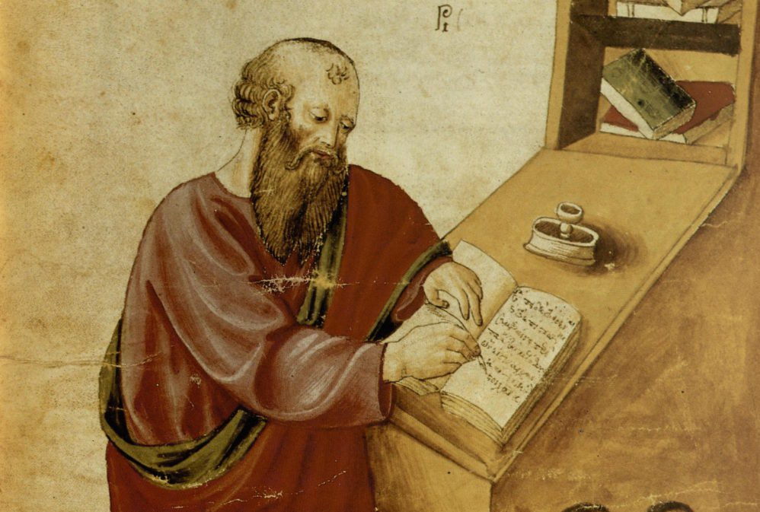
‘The notion of human flourishing set out in our thinking draws significantly on Aristotle, and especially on his conception of eudaimonia. The meaning of eudaimonia can be traced etymologically from its roots of ‘eu’ (good) and ‘daimon’ (spirit), refers to the notion of human flourishing and can…[refer to] physical flourishing, emotional flourishing, societal flourishing and fourthly, flourishing in terms of personal creativity, self-expression and knowledge seeking.’
Leadership of Character Education, 18

Slide 17
‘In the New Testament, the notion of ‘life in all its fullness’ cannot be understood without explicit reference to the Christian’s response to God. Jesus says clearly what he was specifically looking for in his followers, and the kind of defining love-in-action that he hoped would mark them out:
‘Love one another. As I have loved you, so you must love one another.
By this, everyone will know that you are my disciples.’ (John 13:34-5).
Jesus models this frequently, for example, showing his closest followers what the virtues of service and humility meant, not merely talking about them, but by washing their feet shortly before his own arrest, trial and crucifixion. [It] was not simply the task of the individual to become better by human effort alone, but rather improvement and development is the work of the Spirit in each individual.
The implications for school leadership are releasing, recognising that virtues can be prayed for and infused, rather than simply exhorting one another to work harder at developing them.’
Leadership of Character Education, 19

Slide 18
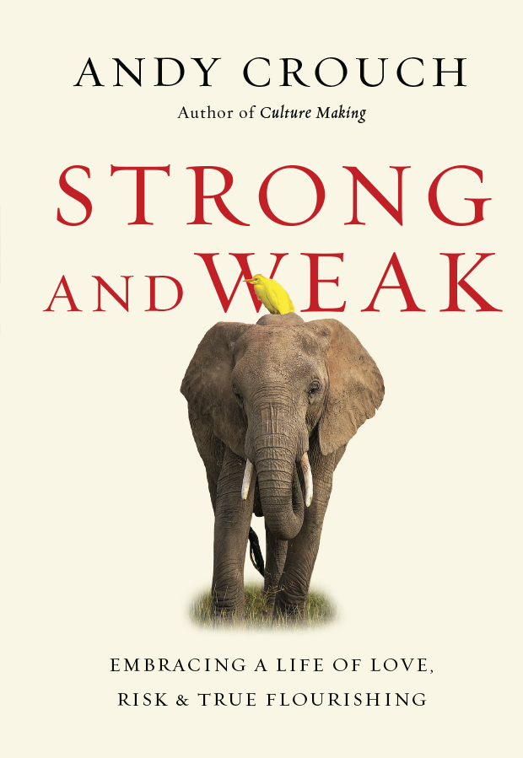
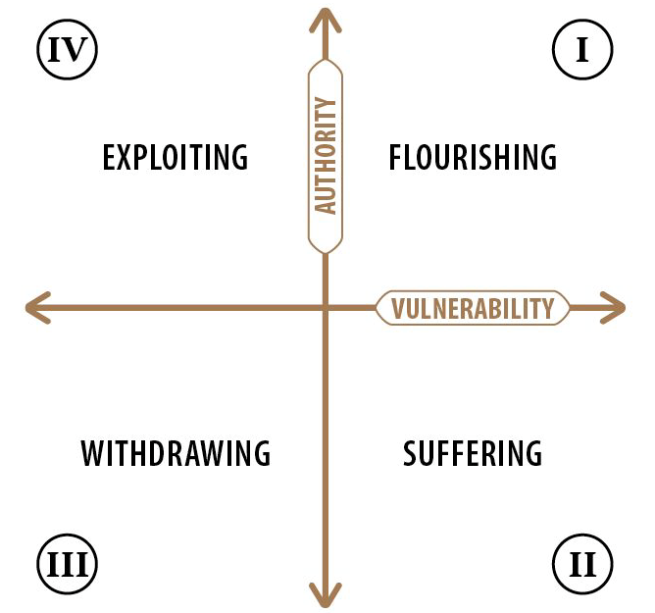
https://www.youtube.com/watch?v=GJ8ry2MyyVA

Slide 19

How can we enable flourishing of pupils (and adults!) through our curriculum?
Where are the opportunities for risk?
Where are the opportunities to take the lead?
Where might children withdraw – is this more likely in some subjects than others? What could we do to mitigate this?

Slide 20
We flourish because of our diversity and relationships
Flourishing Teams
Flourishing Adults
Flourishing Children

Slide 21

What does this mean for the Curriculum?

Slide 22
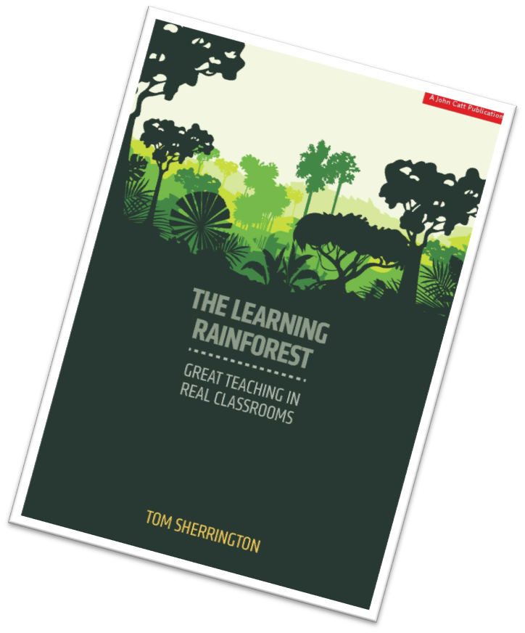
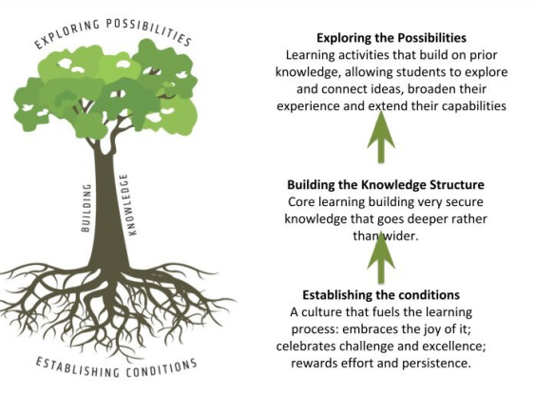

Slide 23
Learning Plantation | Learning Rainforest
‘A right way to do things’ – set routines – e.g. L.O. on the board every lesson | Nourishing individual talents - high trust/high challenge
Leaders driven by compliance to external voices | Great variety in pedagogy and OK to try new things all the time
T+L focused on what can be examined | If creative approaches deliver, there is high level of autonomy
Data has very high status | Data is part of the picture of learning
Interventions heavily focused on short-term gains | T+L structures are dynamic/organic, aligning T+L to stated school values
Creativity becomes rules – e.g. standardised homework format etc. | Highly personalised CPD

Slide 24
We flourish because of our diversity and relationships
We flourish at different times and different speeds
Flourishing Teams
Flourishing Adults
Flourishing Children

Slide 25
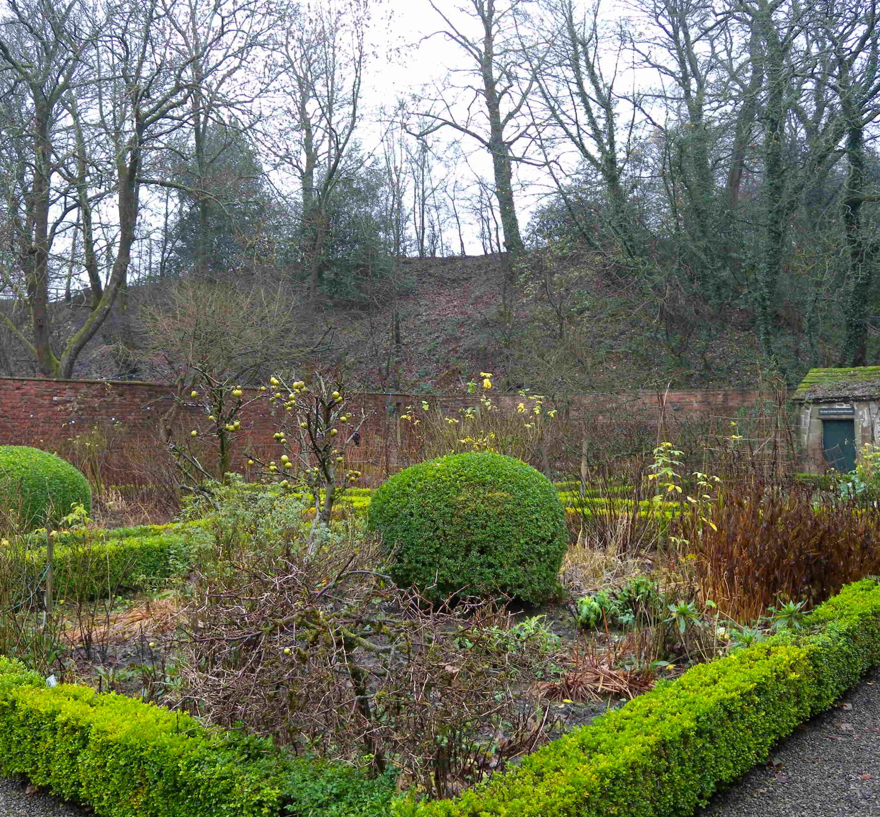

A garden that’s bursting into life…?

Slide 26
We flourish because of our diversity and relationships
We flourish at different times and different speeds
Flourishing Teams
Flourishing Adults
Flourishing Children
We flourish when we stop doing things

Slide 27
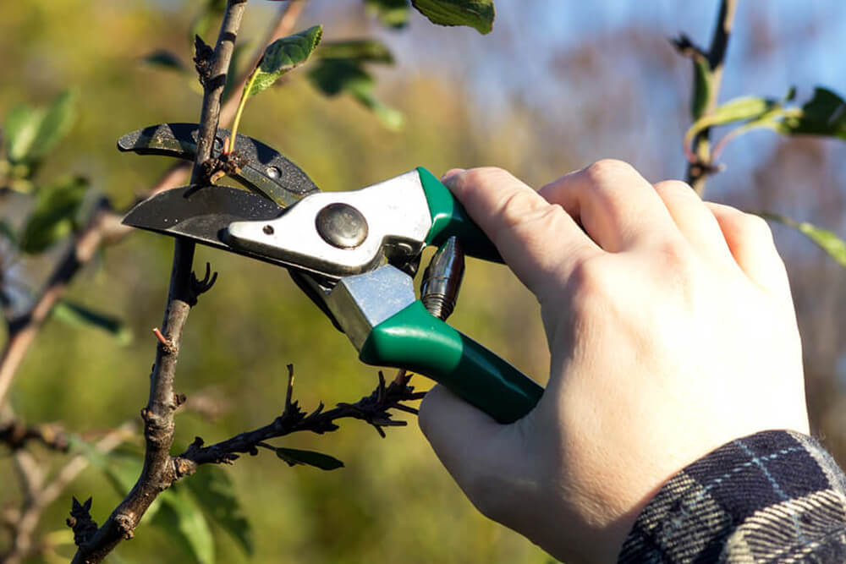
What should we stop doing?

Slide 28
We flourish because of our diversity and relationships
We flourish at different times and different speeds
Flourishing Teams
Flourishing Adults
We flourish so we can look outwards and give
Flourishing Children
We flourish when we stop doing things

Slide 29
“But since you excel in everything – in faith, in speech, in knowledge, in complete earnestness and in the love we have kindled in you – see that you also excel in this grace of giving.”
(2 Corinthians 8.7)

Slide 30
We flourish because of our diversity and relationships
We flourish at different times and different speeds
Flourishing Teams
Flourishing Adults
We flourish so we can look outwards and give
Flourishing Children
We flourish when we stop doing things

Slide 31

Theology
Leadership
Pedagogy

Slide 32
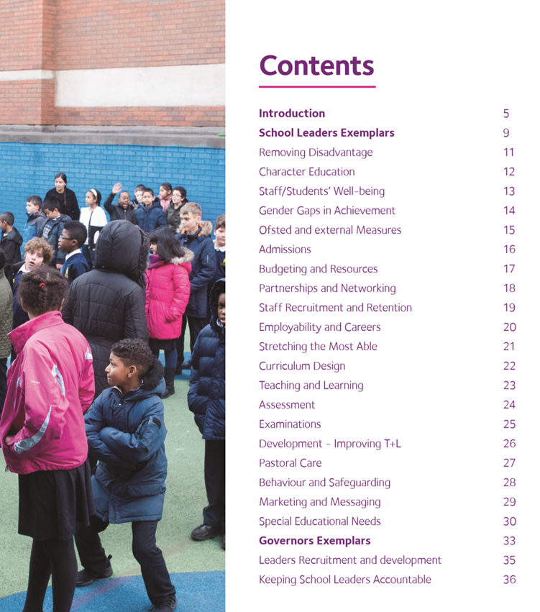


Slide 33

Formulating research questions
What would you like to explore around how the Curriculum in your school enables the flourishing of pupils, adults and teams?
How will you go about finding this out?
Who will you need to involve?

Slide 34
Which leadership practices do we need to pay particular attention to with regards to the curriculum?
 | Called | Connected | Committed
Educating for Wisdom, Knowledge and Skills | Leading Learning - Refining Judgement | Creating Confidence - Embracing Interdependence | Deepening Understanding - Driving Improvement
Educating for Hope and Aspiration | Developing Imagination - Nurturing Ambition | Healing Relationships - Pursuing Renewal | Sustaining Vision - Building Resilience
Educating for Community and Living Well Together | Removing Disadvantage - Seeking Reconciliation | Accepting Vulnerability - Demonstrating Generosity | Inspiring Faithfulness -Embodying Integrity
Educating for Dignity and Respect | Celebrating Diversity - Enabling Flourishing | Offering Encouragement - Encouraging Service | Practising Humility - Learning Love

Slide 38


