Slide 1
Weekly Resources for Schools
PHASE: PRIMARY
THEME: Family and Culture
Gypsy, Roma and Traveller History Month
Session 2

Slide 2
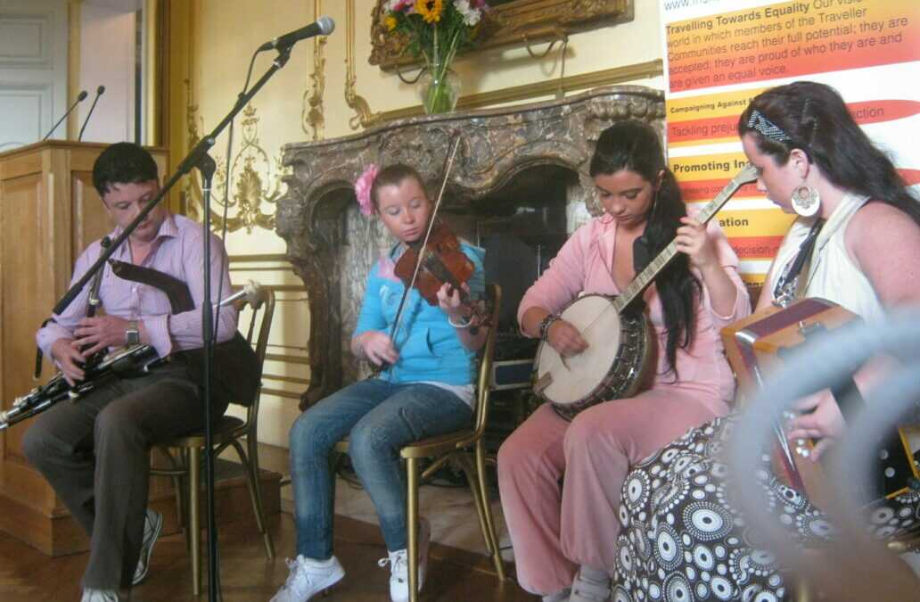
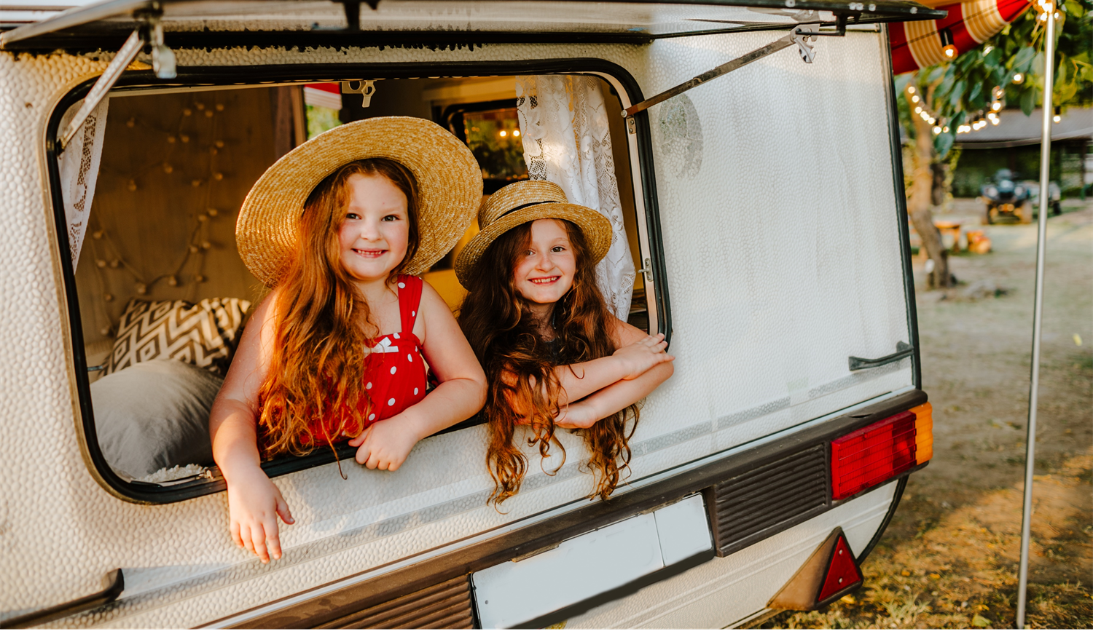
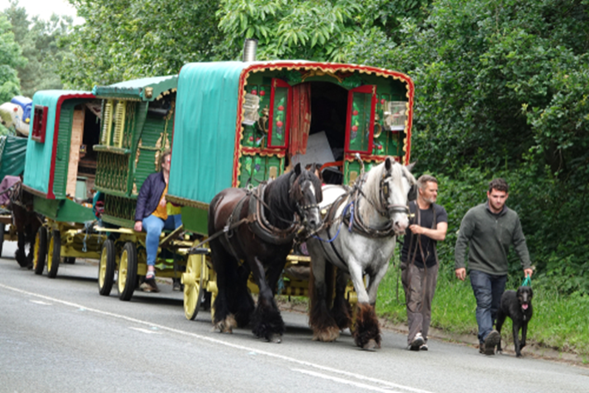
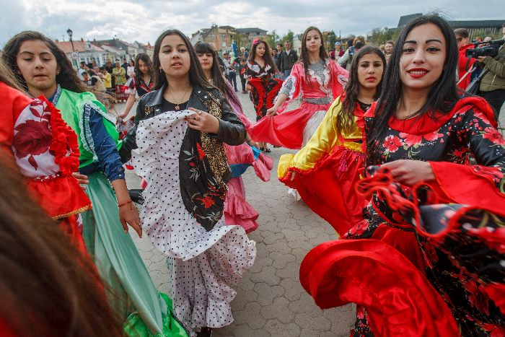
Family and culture: Freedom in your identity
What have we learnt so far about Gypsy, Roma and Traveller heritage families?

Slide 3
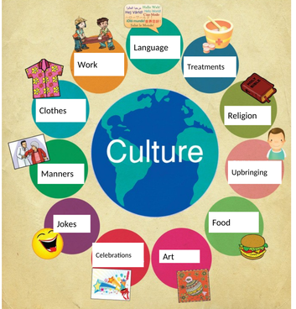
What is Culture?
Culture is how we live our lives. It includes the food we eat, the clothes we wear, the language we speak, and the traditions we have. It includes special things we do with our family, like holidays, songs, and dances.
Globally, groups have various elements to their culture, which makes them unique and special.

Slide 4
What Does Family and Culture Mean to You?
What cultural things do you do with your family?
Why is it important to celebrate your culture freely?

Slide 5
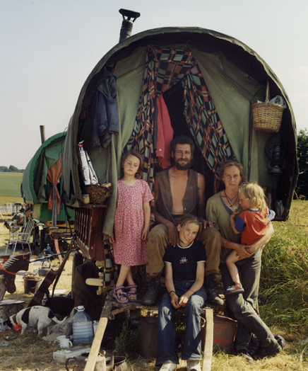
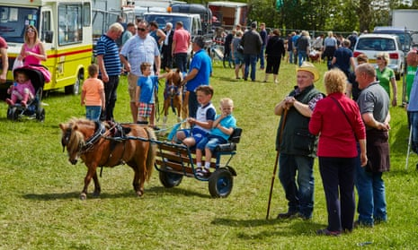
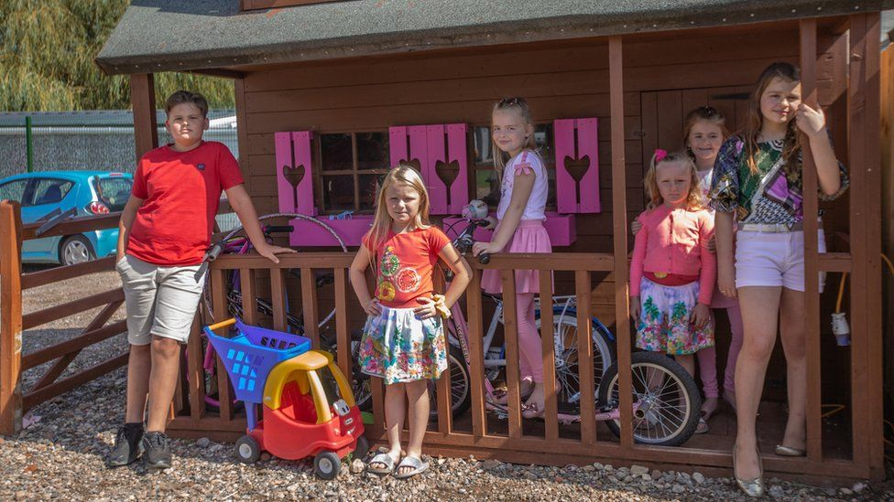
Examples of Gypsy, Roma and Traveller people in the UK
These families live in different parts of the UK and have different traditions.
But they all value family and culture. Every family is unique and special!

Slide 6
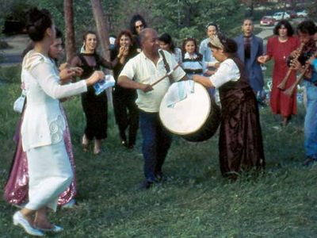
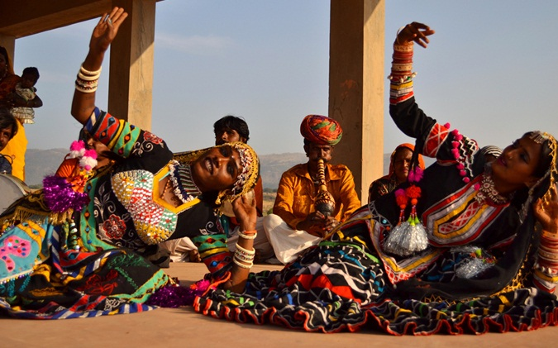
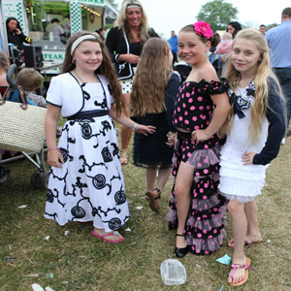
Examples of Gypsy, Roma and Traveller people worldwide
Roma people in Macedonia
Bopa & Kalbeliya gypsy tribe of India
Irish travellers in the USA
These families live in different countries and have different traditions.
But they all value family and culture. Every family is unique and special!

Slide 7
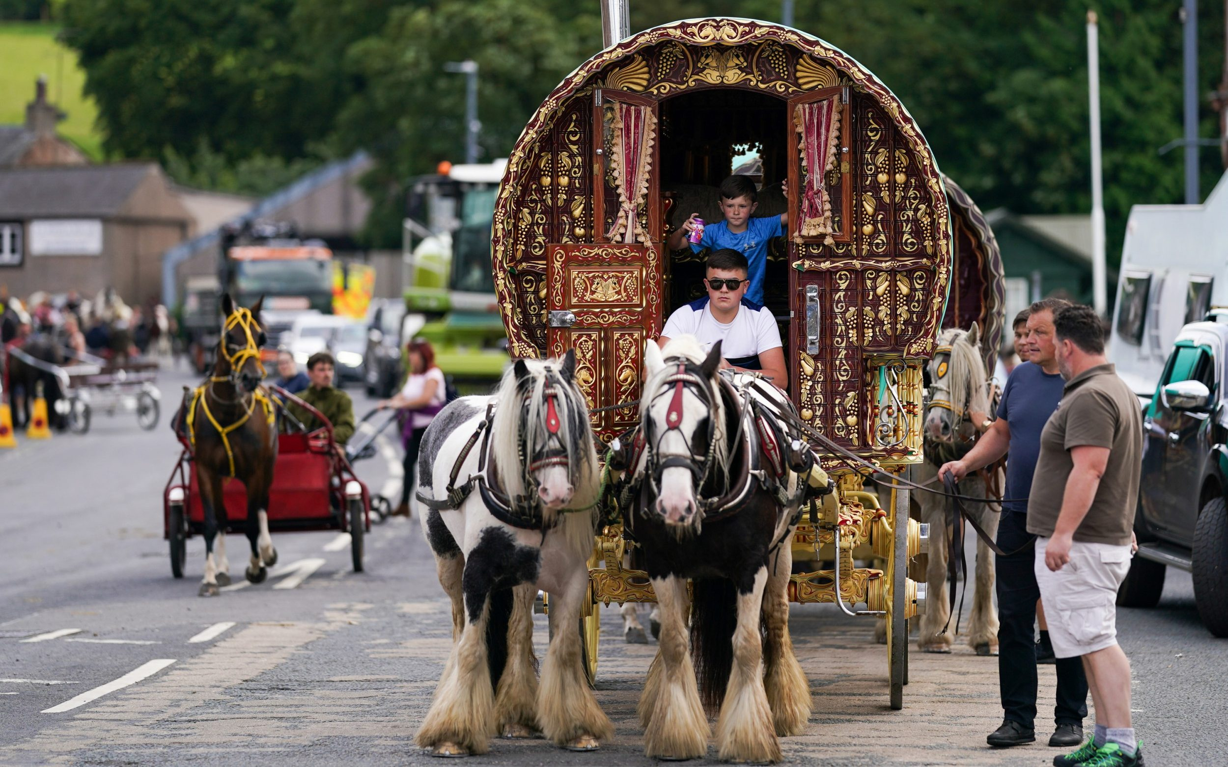
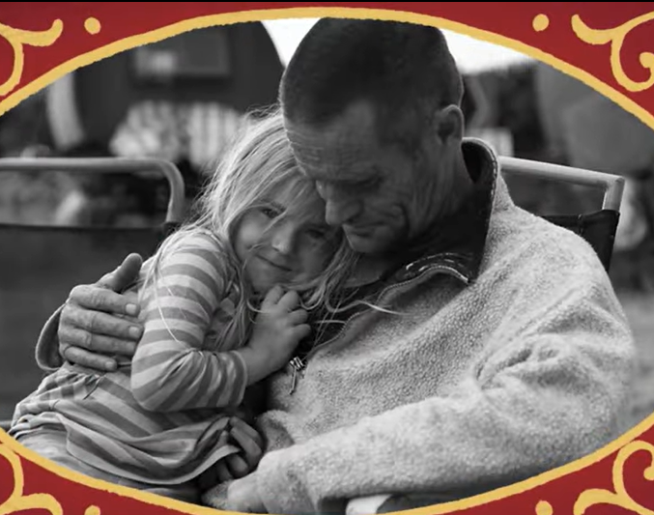
We are more than one identity, and show love to all.
Even so the body is not made up of one part but of many.
1 Corinthians 12:14
Love one another. As I have loved you, so you must love one another.
John 13:34

Slide 8
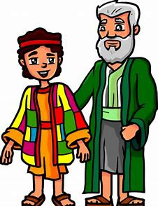
Bible Story of the Week - Joseph and His Colourful Coat
Joseph was Jacob’s favourite son. To show his love, Jacob gives Joseph a special coat in many colours. This colourful coat made Joseph’s brothers jealous. One day, they did something unkind to Joseph and sent him far away. Even though Joseph was far from home, he always remembered his family and stayed true to himself. Joseph's story teaches us to stay true to who we are and always to value our families.

Slide 9
Reflection - What We Can Learn from Joseph
Joseph’s colourful coat made him feel special and reminded him of his father’s love. What special clothes, traditions or customs make us and our families feel special?

Slide 10
How should we treat Gypsy, Roma and Traveller culture with respect?
Be kind and friendly to everyone, just as we want them to be to us.
Listen to their stories and learn about their traditions.
Celebrate their special days and enjoy their music and dances.
Never make fun of them or say mean things about their culture. Remember that everyone is special in their own way, and we should always show respect.

Slide 11
Gathering
Dear God,
Thank you for the things that make us special and unique!
We thank you for the special and unique culture of Gypsy, Roma and Traveller families, both in this country and around the world.
Help us to grow in understanding, remembering that all families are different and all families are special to you.
Amen

Slide 12
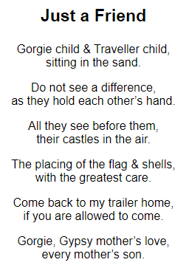
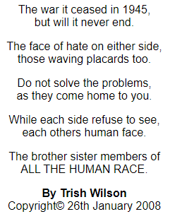
Further Learning (KS2)

Slide 13
Further learning
Alternative activity: For a mature Year 6 group discussions can be held around the modernisation of GRT culture.
Stimulus:
The erosion of Nomadism (Youtube) by London Gypsies & Travellers
How persecuted travellers survive the modern world (Youtube) by Story Seeker

Slide 14
SPIRITUAL DEVELOPMENT (practical ways to help us explore faith and develop spiritually at home together)
Experiences that can help us encounter:
Watch the short film by the London Gypsy and Travellers Unit celebrating 25 years as an independent charity.
Visit the Gypsy Traveller Moment website to learn more about Gypsy Roma and Traveller's history and culture.
Visit the Gordan Boswell Romany Museum in Spalding.
Visit the Streetlife Museum in Hull.
Notes:
Transitioning from reflection to action, let's explore how we can channel our insights and empathy into tangible steps to support nomadic communities and promote inclusion.

Slide 15
References & Further Reading
Denied a future? The rights to education Roma/Gypsy & Traveller children in Europe (Save the Children, 2001).
The Education of Gypsy and Traveller Children towards inclusion and educational achievement (Christine O'Hanlon and Pat Holmes, 2004).
Romani Culture and Gypsy Identity (Edited by Thomas Acton and Gary Mundy, 1997)
The Gypsy and The State: The Ethnic Cleansing of British Society (Derek Hawes and Barbara Perez, 1996)
Friends, Families & Travellers – Getting a fair deal for Gypsies, Roma and Travellers

