Slide 1
Weekly Resources for Schools
PHASE: PRIMARY
THEME: What does family mean to you?
Gypsy, Roma, Traveller History Month
Session 1

Slide 2
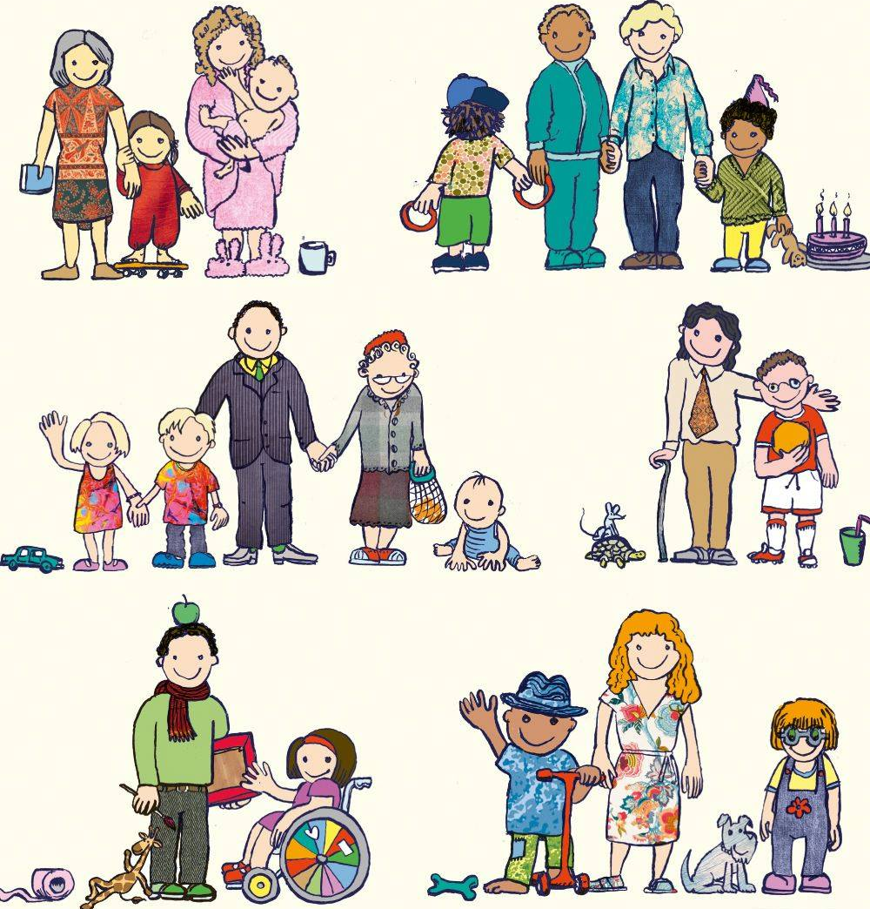
What makes a group of people a family?

Slide 3
What binds a family together?
Families join together through sharing.
This is normally positive sharing of love, experiences, homes, culture and history.
Families can also bond (come together) through tragedy and sadness.
Gypsy, Roma and Traveller communities are large families of people bonded in many ways.

Slide 4
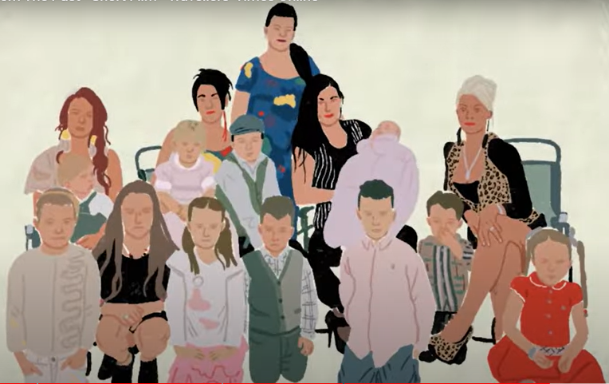
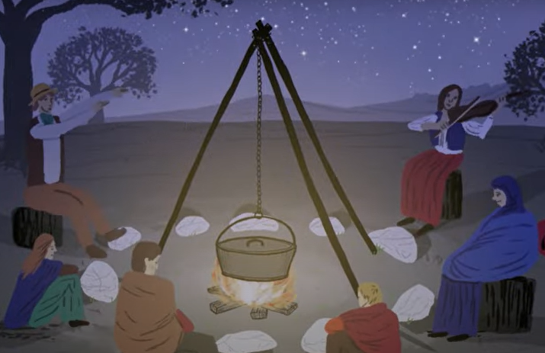
Gypsy, Roma, Traveller heritage families
Heritage is what is inherited from ancestors like culture, appearance or traditions.
People who are within the same heritage group will share some traditions.
Gypsy, Roma and Traveller heritages share some historic customs,
e.g. nomadic lifestyles,
but have very different characteristics from each other.

Slide 5
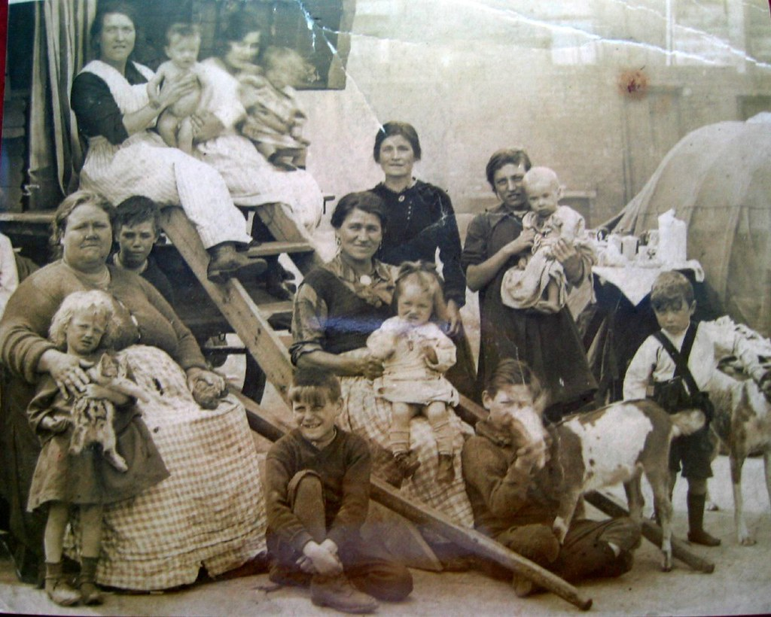
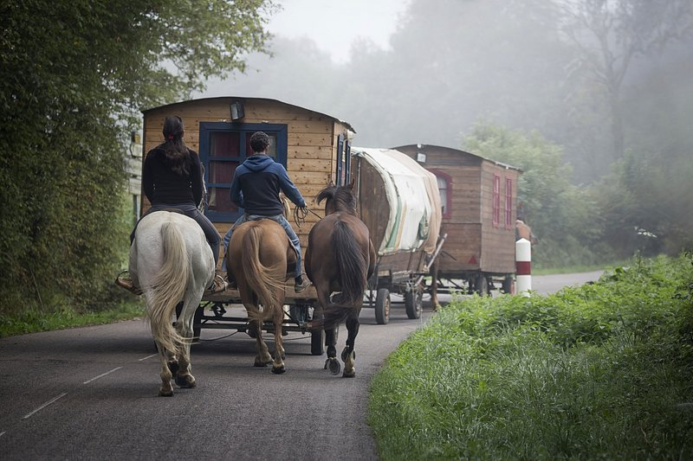
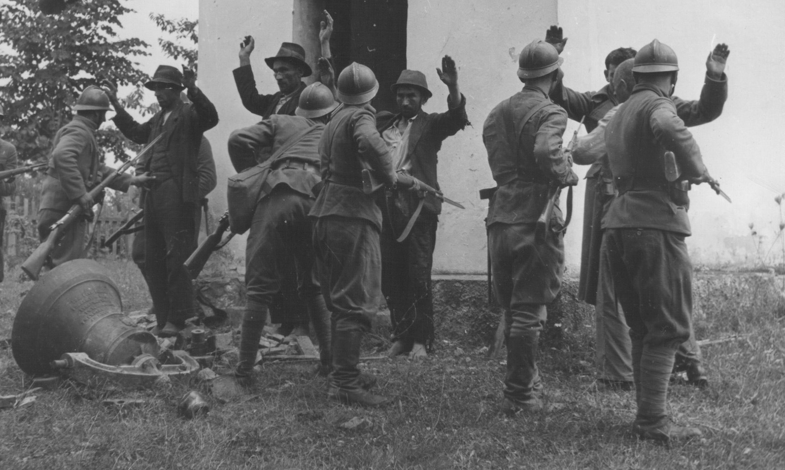
Gypsy, Roma and Traveller Heritage Families
Often GRT families can be very extended – with aunts, uncles, grandparents and other family living together.
Some GRT families can be nomadic – they travel from place to place to live for short periods.
Many times, GRT families have faced discrimination both in the past and still now, in the present.

Slide 6
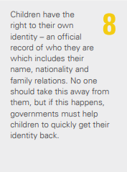
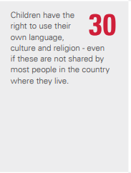
Gypsy, Roma and Traveller families deserve respect.
Think about these two human rights... What should they mean for Gypsy, Roma and Traveller families?

Slide 7
Gypsy, Roma and Traveller families are all welcome in God's family
'Now, therefore, you are no longer strangers and foreigners, but fellow citizens with the saints and members of the household of God.'
Ephesians 2:19
"Your people will be my people, and your God my God."
Ruth 1: 16
God calls us to accept that though there are differences in how we live, we are all a part of one unified family

Slide 8
BIBLE STORY OF THE WEEK
I wonder what we can learn from how Ruth responded to her mother-in-law?
Start 0.37 and stop 1:30
Notes:
Now, we will watch a clip of the bible story from the Book of Ruth. During the video, think about what we can learn from Ruth's example and how her actions challenge acceptance and inclusion.
Click on the slide title to access the Book of Ruth video clip.
https://youtube.com/clip/Ugkx36CqPt5eXHUmvPnvNmCD8FsySB4dOWqM?feature=shared

Slide 9
Gathering
Father Almighty,
We thank you for our families – for the love we share and the care we show to one another.
We thank you for families that are different to ours – with different histories, traditions and ways of living. Today we ask a special blessing as we celebrate Gypsy, Roma and Traveller families. May they be given respect for their culture.
Help us to live as one great, big family where God’s children are loved and valued for their differences.
Amen
Notes:
When introducing the gathering prayer for reading aloud, you might want to consider something like the following:
Let's take a moment to read our gathering prayer together. As we join in this prayer, let's reflect on its words and the sentiments it conveys. Please follow along as we read aloud, allowing the words to guide our thoughts and intentions as we come together in this moment of reflection and unity.

Slide 10
Response
How did Ruth show respect for her husband’s family?
How can we show respect to all families, especially Gypsy, Roma and Traveller families?
Notes:
Let us take a moment to consider, as an individual and a school community, how we can deepen our understanding of the history, culture and traditions of nomadic communities after watching both videos?
How can we foster greater understanding and inclusivity?
Take a few ideas from a diverse range of students.
-----
Reflection Questions:
1. How can we deepen our understanding of the history, culture, and traditions of nomadic communities?
- Potential Response: We can deepen our understanding by engaging with nomadic communities directly, listening to their stories and experiences, and seeking out resources such as books, documentaries, and cultural events that provide insights into their history and traditions.
2. How might our perceptions and interactions with nomadic communities?
- Potential Response: Our cultural background can shape our perceptions and interactions with nomadic communities, influencing how we interpret their customs, behaviours, and identities. By recognizing and examining our own cultural biases, we can approach interactions with empathy, openness, and respect.
These reflection questions serve as starting points for critical thinking and discussion, inviting students to consider the complexities of intercultural understanding and the importance of self-awareness in engaging with diverse communities.

Slide 11
Sending/From Lament to Action
God calls us to accept that though there are differences in how we live, we are all a part of one unified family.
We can make everyone feel welcome and included in our school.
We can help others feel happy and included in both our work and our play.
'Now, therefore, you are no longer strangers and foreigners, but fellow citizens with the saints and members of the household of God.'
Ephesians 2:19
"Your people will be my people, and your God my God."
Ruth 1: 16
Notes:
Now, as we prepare to conclude our session, let us carry forward the insights gained and the commitments made. Reflecting on our time together, consider these questions:
- What can we do?
- What should we do?
Take a moment to gather your thoughts in response to these questions. Your reflections are valuable and can guide our actions moving forward.
This prompts participants to consider actionable steps and provides an opportunity for them to commit to taking positive actions after the session.

Slide 12
Further Learning (KS2)
Notes:
As you know, we are spending the month of June raising our awareness of Gypsy, Roma, and Traveller history, culture, and traditions. In the engagement section of our collective worship, we will watch a weekly video that will give us an insight into their heritage, practices, and customs. Our video today will provide us with a brief history of nomadic migration and insight into the different cultures and traditions associated with the community. Let's have a watch.
https://youtu.be/1bhBbMrF8Z0?feature=shared

Slide 13
Proposed programme of study Structure(Optional)
Day and Date | Activity
Monday | CW using PPT
Tuesday | Class Worship KS1: Watch the bible story again and discuss the questions below: What are some ways we can celebrate the special stories and parties of all our friends? KS2: watch the video clip and discuss the question below. https://youtu.be/1bhBbMrF8Z0?feature=shared How can we learn more about the lives and traditions of people who move from place to place?
Wednesday | Class Worship KS1: class reading/circle time on any of the books below: “Yokki and the Parno Gry” by Richard O’Neill and Katharine Quarmby: Age Group: 4-8 years. A beautiful story about a Traveller boy and his magical white horse, celebrating the rich storytelling traditions of the Roma community. OR/AND “Ossiri and the Bala Mengro” by Richard O’Neill and Katharine Quarmby: This tale follows a Traveller girl named Ossiri who makes a musical instrument from a willow branch and the magical journey that ensues. KS2: Visit the Gypsy Traveller Moment website to learn more about Gypsy Roma and Traveller's history and culture.
Thursday | Class Worship: Kindness Rocks: KS1 and KS2 Give each child a smooth rock and provide paints and markers. Ask the children to paint their rocks with messages or images of kindness. Once dry, place the rocks around the school or playground as reminders to be kind to everyone, including people from GRT communities. Discuss why kindness is important and how it makes everyone feel included and valued.
Friday 21st | Class Worship: Craft and Art worship: KS1 and KS2 Read a story from a GRT-themed book, such as "Yokki and the Parno Gry" or "Ossiri and the Bala Mengro.“. Then discuss the story with the children. Ask questions like: What did you like about the story? What did you learn about the characters’ lives? How are their celebrations and traditions special? Encourage children to draw or write their favourite part of the story.
Saturday 22nd | Faith at Home act of worship: you can visit the Gordan Boswell Romany Museum in Spalding or the you can visit the Streetlife Museum in Hull.
Sunday 23rd | Faith at Home act of worship: Pray for all families that they should feel loved and included if you go to church.

Slide 14
SPIRITUAL DEVELOPMENT (practical ways to help us explore faith and develop spiritually at home together)
Experiences that can help us encounter:
Watch the short film by the London Gypsy and Travellers Unit celebrating 25 years as an independent charity.
Visit the Gypsy Traveller Moment website to learn more about Gypsy Roma and Traveller's history and culture.
Visit the Gordan Boswell Romany Museum in Spalding.
Visit the Streetlife Museum in Hull.
Notes:
Transitioning from reflection to action, let's explore how we can channel our insights and empathy into tangible steps to support nomadic communities and promote inclusion.

Slide 15
References & Further Reading
Denied a future? The rights to education Roma/Gypsy & Traveller children in Europe (Save the Children, 2001).
The Education of Gypsy and Traveller Children towards inclusion and educational achievement (Christine O'Hanlon and Pat Holmes, 2004).
Romani Culture and Gypsy Identity (Edited by Thomas Acton and Gary Mundy, 1997)
The Gypsy and The State: The Ethnic Cleansing of British Society (Derek Hawes and Barbara Perez, 1996)
Friends, Families & Travellers – Getting a fair deal for Gypsies, Roma and Travellers

